Slide 1
UZ Leuven & UCLH Fetal spina bifida repair program Referral Slides for Professionals

Slide 2
Introduction
Thank you for considering whether your patient is suitable for in-utero repair of open spina bifida.
To find out more about our service please see the following:
Leaflet: UCLH Fetal MMC Repair – Information for Physicians
If you believe your patient may be suitable, please add/ amend to the following slides as requested and return to fmumidwife@uclh.nhs.uk.
Thank you.

Slide 3
Background Information
Demographics | Patient Information (please complete) | Comments
Patient initials
Date of birth
Maternal age
Date of evaluation in FMU
Gravidity + Parity |  | Specify gestation at pregnancy loss
EDD
Genetic testing result |  | Conventional or microarray
Previous abdominal surgery
Previous Caesarean section
Risks for preterm birth |  | Previous preterm birth, non-lower segment uterine surgery, cervical surgery/incompetence
Maternal medical history |  | Including blood-borne viruses and psychiatric conditions

Slide 4
Confirmation the Patient Fulfils Criteria
Criteria | Please untick and comment if false | Comments
Singleton pregnancy | ✓
No previous history of preterm birth | ✓
No previous uterine surgery | ✓
BMI <35 | ✓
Gestational age <26+0 | ✓
Isolated MMC | ✓
Fetal kyphosis <30° | ✓
No placenta praevia | ✓ | This will be reassessed on referral
Cervix >20mm | ✓ | This will be reassessed on referral
Normal genetic testing | ✓ | This is a mandatory criteria of fetal MMC repair yet may deferred until assessment at fetal surgery centre.

Slide 5
Images – please upload on left
BPD with measurement
Lemon sign yes/no
BPD example (normal)

Slide 6
Images – please upload on left
Lateral ventricles with measurement
Lateral ventricles example (normal)

Slide 7
Images – please upload on left
Cerebellum with measurement
Banana sign yes/no
Cerebellum example (normal)

Slide 8
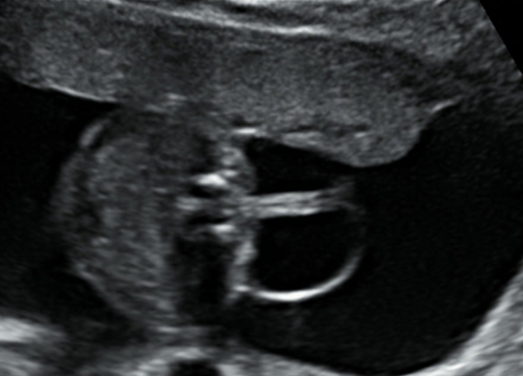
Images – please upload on left
Spinal defect in two planes
Level:
Spinal defect examples (MMC)

Slide 9
Images – please paste in if available
Spinal defect
Tethered cord yes/no

Slide 10
Images – please paste in if available
Spinal defect
Angulation of vertebral column yes/no

Slide 11
Images – please paste in if available
Spine 3D if done

Slide 12
Images – please paste in
Lower limbs in two planes
Talipes yes/no
Lower limbs examples

Slide 13
Images – please paste in
Placental location
Anterior/ Posterior/ Fundal
Placental location example

Slide 14
Summary of US findings
Feature | Yes/No
Isolated MMC?
Lemon sign?
Banana sign?
Arnold Chiari II?
Angulation of spine?
Level? (upper and lower)

Slide 15
MRI
If a fetal MRI has been performed, please provide us with images.
The minimum we need is as follows:
Brain: sagittal and transverse views
Spine: sagittal and transverse views
Please add the written report characterizing the lesion and the brain, with special attention to:
Posterior fossa, skull, corpus callosum, fourth ventricle, parenchymal signal, subependymal heterotopia
Confirmation that MMC sac is present if possible

Slide 16
Referrers details
Fetal Medicine Unit
Hospital for future obstetric care if different from FMU
FMU consultant:
Hospital:
Email:
Contact phone:
Neonatal/paediatric consultant:
Consultation was done on (date):
Neurosurgical consultant:
Consultation was done on (date):
Lead obstetrician:
Hospital:
Email:
Contact phone:

