Slide 1
UCL Drug discovery group application note.
Author: Dr. Ben Allsop
DDG Screening capacity & Automation:
Automated Biochemical and Cellular Analysis
*Data in this presentation are owned by the UCL DDG and are not for unauthorised reproduction*
School of Pharmacy
29-39 Brunswick square
WC1N 1AX
Translational Research office

Slide 2
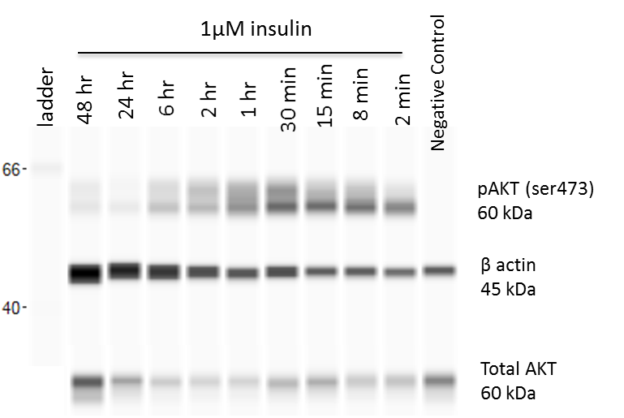
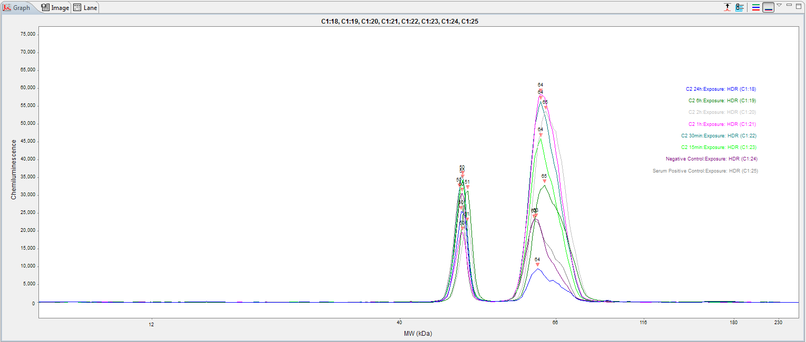
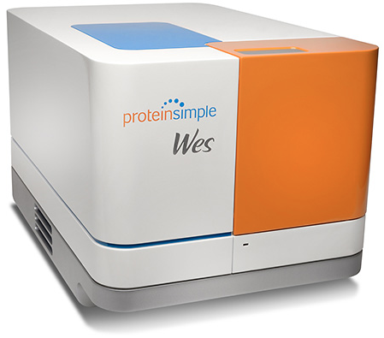
Automated western blotting
Wes (ProteinSimple) is an automated capillary based western blotting system that only uses 4µL sample – and below 0.2µg protein.
Wes removes the need for manual electrophoresis, transferring, blocking, overnight antibody incubations and imaging by automating the whole Western process to 3h.
Each of the 25 capillaries acts as an independent gel. Fluorescent standards of a known molecular weight are used to align the ECL detected proteins of interest.
a)
b)
This method is fully quantitative, and produces classic Wetern blot images (Fig. 5A) and Chemiluminescence spectra (Fig. 5B).
Analysis software is free to download.
Fig 5: Example Wes results. (a) Timecourse of insulin effect on phospho-Akt and total Akt in lung adrenocarcinoma cells. β-actin is used as loading control. Approximately 0.5µg protein / well. (b) Quantified luminescence from the pAkt / β-actin blot in (a). Wes automatically detects peaks, determines their molecular weight and peak area.

Slide 3
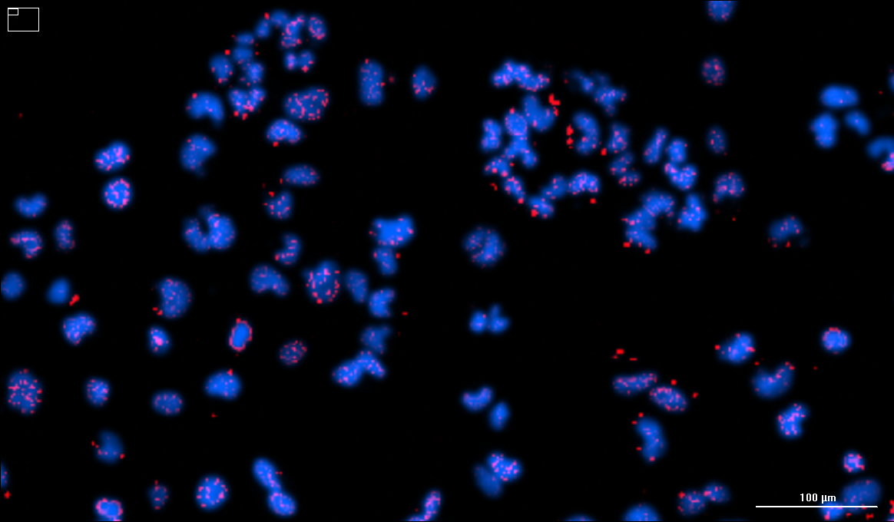
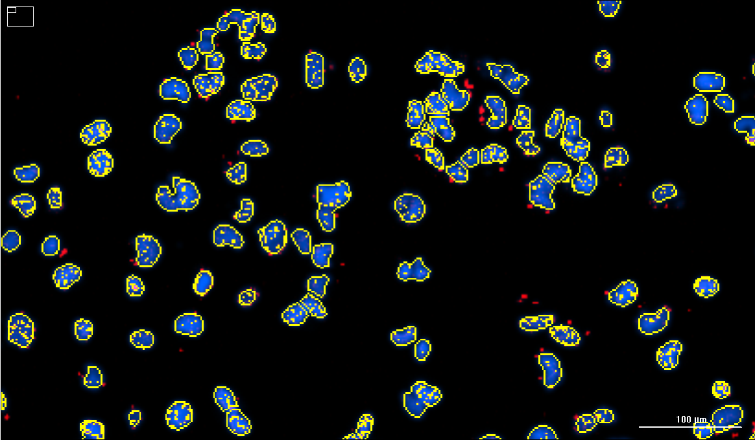
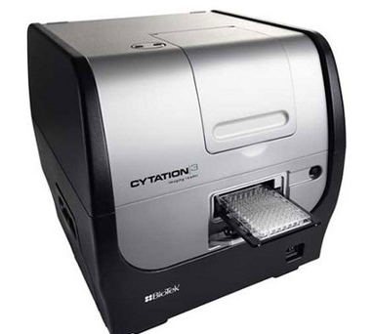
Automated fluorescence microscopy
Cytation 3 (Biotek)
Takes 9 overlapping images (2x or 10x objective) per well of a 96-well plate.
Focal height is automatically determined. Cell line specific exposure times can be performed automatically against reference control wells if necessary.
Define analyses
Overlapping images are stitched together, deconvolved, and predetermined analyses applied.
Count cells and objects of interest
Create rules to determine subpopulations and threshold based counting.
Statistical outputs automatically calculated
Subpopulation analysis
Cell count
Signal intensity
Changes to statistical outputs can be retrospectively made
a)
b)
Fig 4: Lung mesothelioma cells treated with ionising radiation. γH2AX foci (Red) and Hoechst 33342 (Blue).
Automated capture (a) and analysis (b) that identifies γH2AX foci within nuclei.

Slide 4
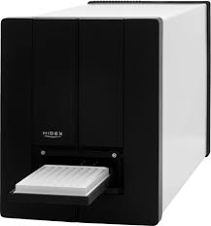
Automated plate reading of Biochemical assays
S-Lab (PAA) / Sense (Hidex) combination
Combination of the S-lab robotic arm and the Sense plate reader allows for assay plates to be stacked up and automatically read.
Up to 60 x 96 – 1536 well plates can be stacked, read and data saved in excel format automatically using S-lab automation of the Sense plate reader.
Incorporated Barcode reader can insert barcode into filenames and exported data for ease of data analysis.
S-lab can handle stacks of lidded or unlidded plates
S-lab can perform also de-/re-lidding steps if desired.
Fig 3:Video of S-lab automated plate reading. Plates are moved from the ‘up-stack’ to the barcode reader before being placed in the Sense plate reader. A fluorescence read is automatically performed – then plates are deposited in the ‘down-stack’. Video at 10x normal speed.

Slide 5
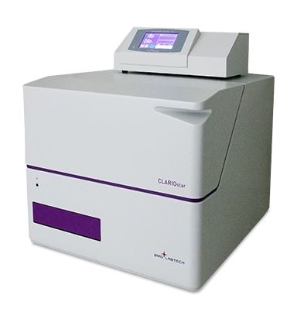
DDG plate readers
Cytation 3 (Biotek)
Clariostar (BMG Labtech)
Sense (Hidex)
Automated fluorescence microscope
6-384 well plates and microscope slides
Monochromator fluorescence
Gen 5 Analysis software
Atmospheric control of CO₂, O₂ and temperature.
96- to 1536-well plates
Monochromator fluorescence
Custom multiplex assay scripts.
Reagent injectors
Mars Analysis software
Intuitive, simple software
Luminescence / fluorescence / adsorbance / FRET.
96- to 1536-well plates
Connected to S-Lab robotic arm for automated plate reading.

Slide 6
For questions and further information please contact:
Richard Angell – Drug discovery group lead; (r.angell@ucl.ac.uk)
Trevor Askwith – Senior biologist; (t.askwith@ucl.ac.uk).
Ben Allsop – Biologist (Author); (b.allsop@ucl.ac.uk).

