Slide 1
UCL Drug discovery group application note.
Author: Dr. Ben Allsop
Automated detection of γH2AX to measure DNA damage
*Data in this presentation are owned by the UCL DDG and are not for unauthorised reproduction*
School of Pharmacy
29-39 Brunswick square
WC1N 1AX
Translational Research office

Slide 2
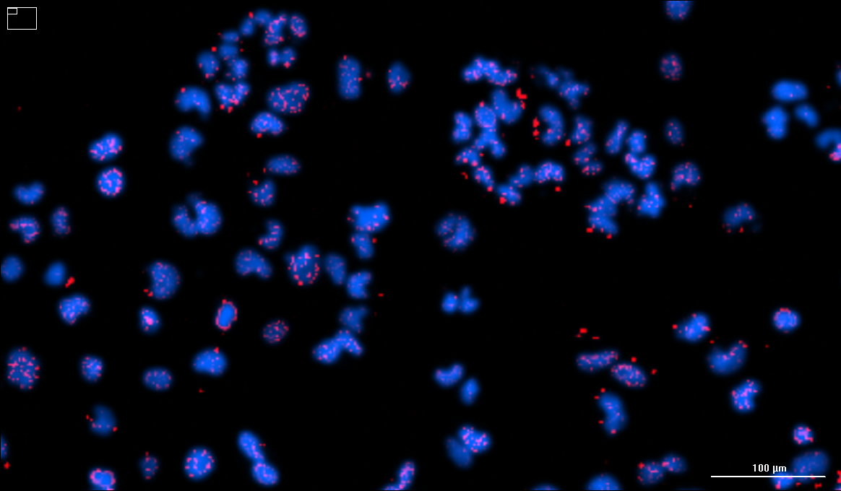
γH2AX is a biomarker of DNA damage
DNA damage often takes the form of double stranded breaks (DSBs). DSBs are always followed by phosphorylation of H2AX¹ – a histone component of the nucleosome – at the site of the break.
Phosphorylated H2AX, termed γH2AX, is the focal site of DNA repair protein recruitment. Each γH2AX foci represents a single DSB¹.
DSBs are caused by ionising radiation and cytotoxic agents and are repaired by various methods of genetic recombination – such as homologous recombination. Inhibitors of homologous recombination have become important therapeutics in oncology.
Fig 1: Lung mesothelioma cells treated with ionising radiation. γH2AX foci (Red) appear at sites of DSBs. Nuclei (Blue) are stained with Hoechst 33342.
1 – Kuo & Lang; In Vivo; May-June; 2008; vol. 22 (3) 305-309

Slide 3
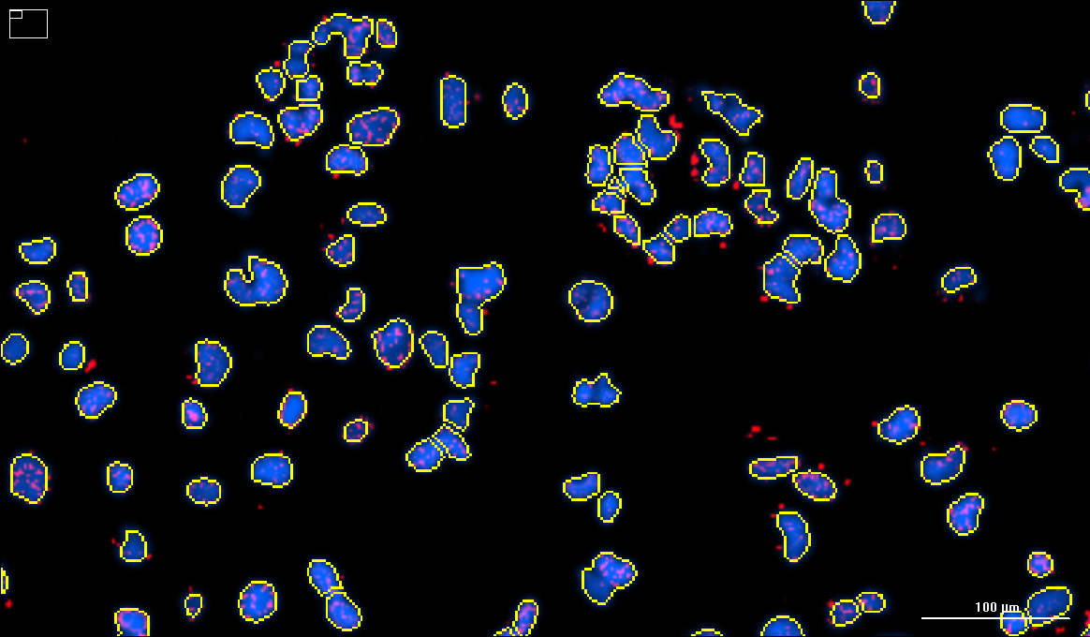
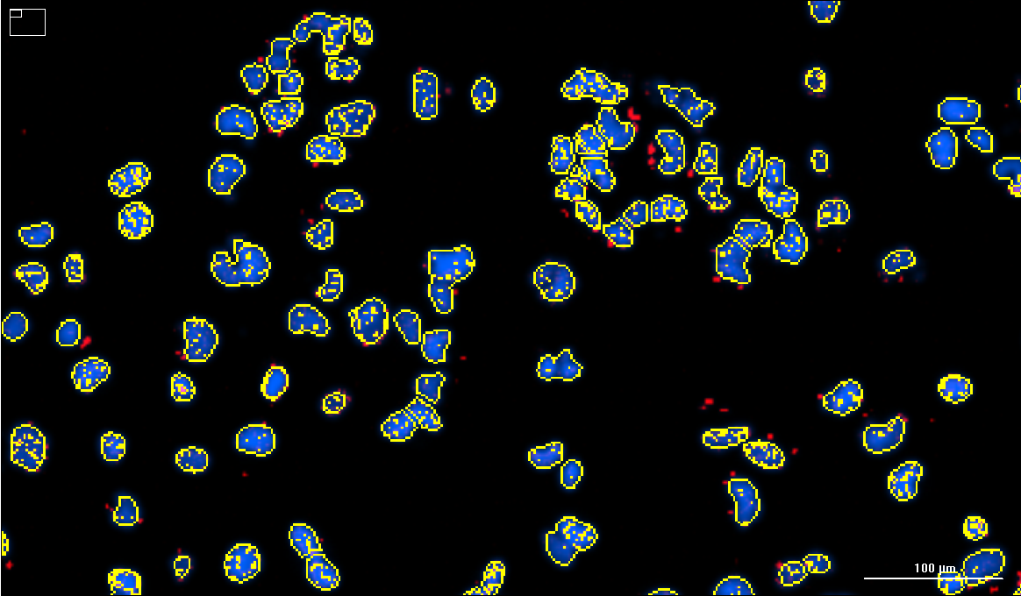
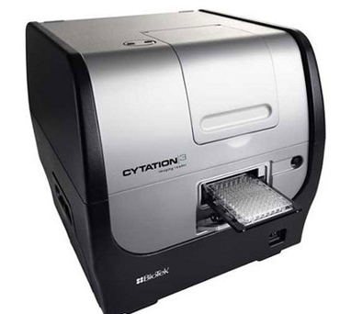
Automated γH2AX detection and quantification
Biotek Cytation 3 - an automated fluorescence microscope
Takes 9 overlapping images (10x objective) per well of a 96-well plate.
Focal height is automatically determine. Cell line specific exposure times can be performed automatically against reference control wells if necessary.
Analysis
The overlapping images are stitched together, deconvolved, and a cell line specific γH2AX analysis applied.
Nuclei are identified and counted (Fig. 2a): ~1300 nuclei / well
Only H2AX foci that are within the nuclei are identified (Fig. 2b). Counts ~20,000 foci per well.
Statistical outputs automatically calculated
Average number of foci per nuclei
Cell count
Signal intensity
Changes to statistical outputs can be retrospectively made
a)
b)
Fig 2: γH2AX analysis identifies individual nuclei (a) and identifies γH2AX foci within nuclei (b).

Slide 4
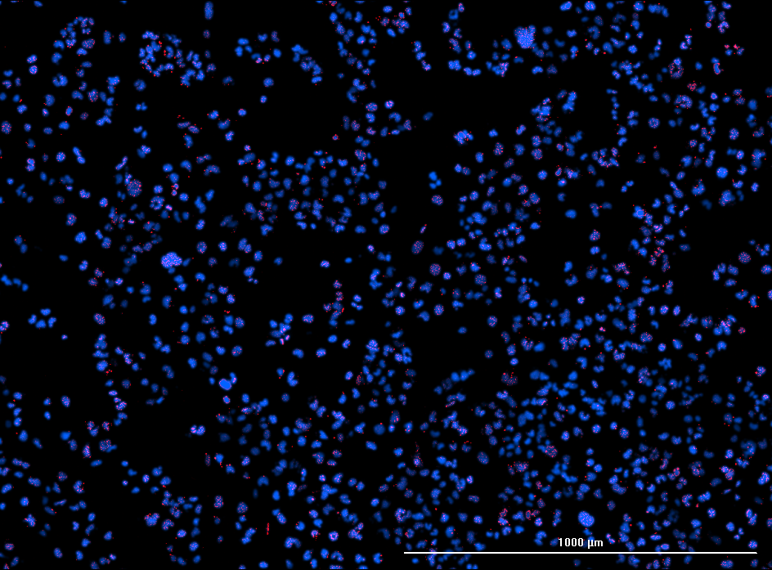
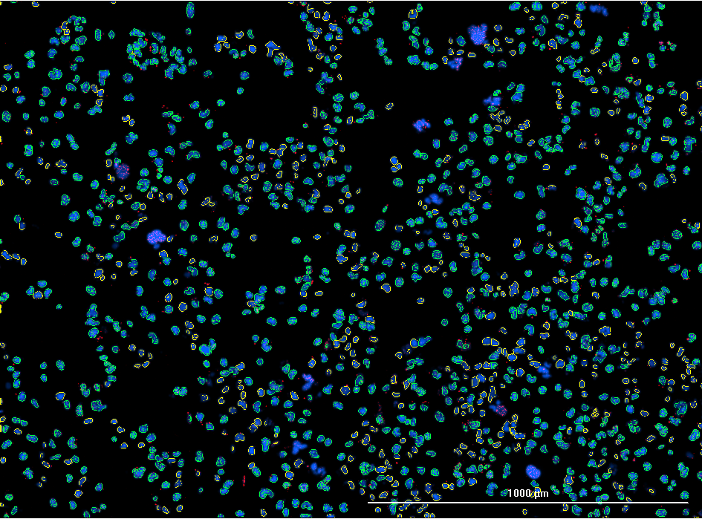
Sub-population analysis
a)
b)
Fig 3: Identifying γH2AX positive cells.
a) Example processed image from 1 well of a 96-well plate. b) γH2AX positive cells are identified as a subpopulation within the analysis. Quantification can be performed on all cells and only within the subpopulation. γH2AX foci (Red); Hoechst 33342 (Blue).
= γH2AX negative
= γH2AX positive

Slide 5
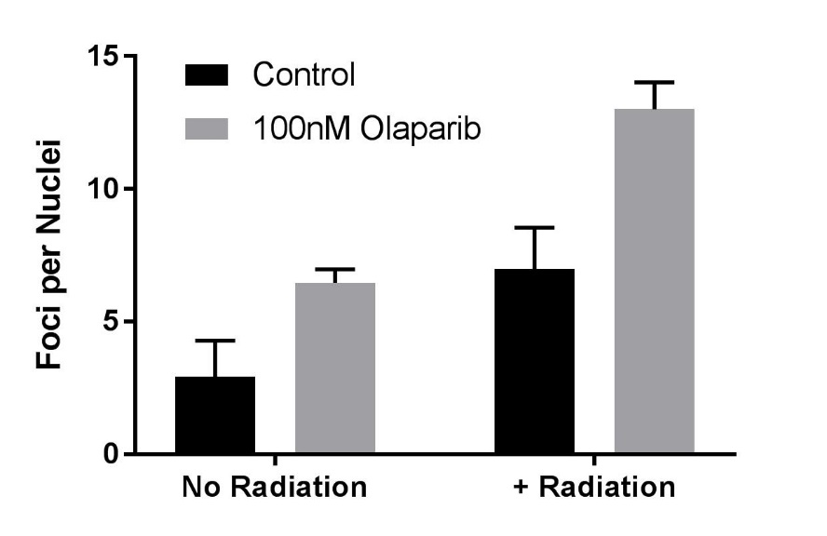
Tailored data output
Cell death
Hoechst Stain
Foci per nuclei
All cells data
Sub-population specific data
Data are exported into excel and images can be batch-saved as jpegs.
Variations on our standard data output can be retrospectively made to suit user requirements

Slide 6
For questions and further information please contact:
Richard Angell – Drug discovery group lead; (r.angell@ucl.ac.uk)
Trevor Askwith – Senior biologist; (t.askwith@ucl.ac.uk).
Ben Allsop – Biologist (Author); (b.allsop@ucl.ac.uk).

