Slide 1
UCL Drug discovery group application note.
Author: Dr. Ben Allsop
Cell toxicity assays
*Data in this presentation are owned by the UCL DDG and are not for unauthorised reproduction*
School of Pharmacy
29-39 Brunswick square
WC1N 1AX
Translational Research office

Slide 2
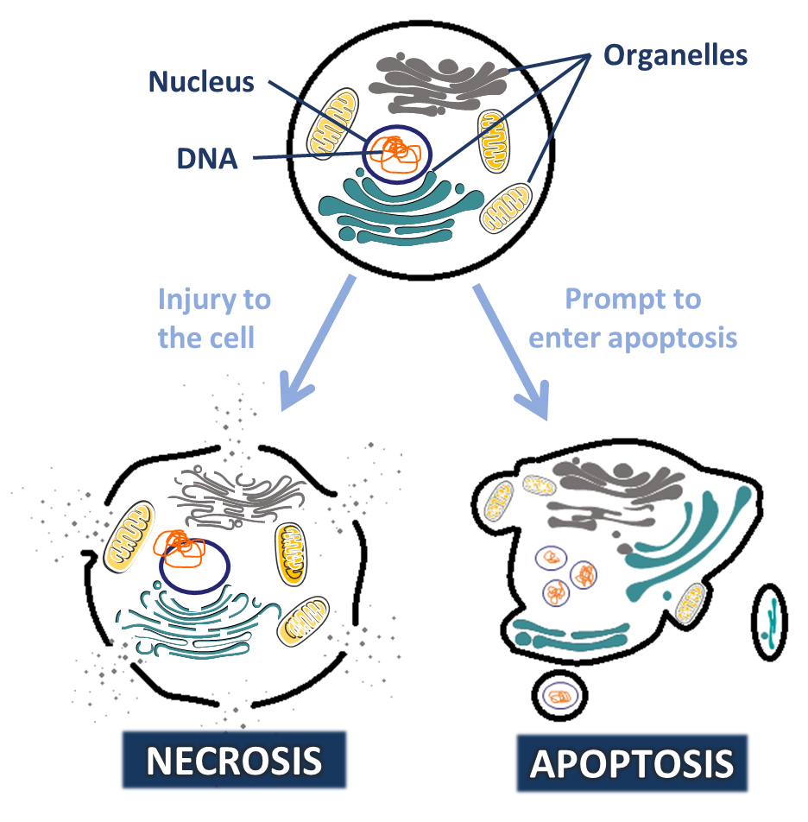
Types of cell death
Cell death is a major feature of disease and an important part of developmental biology. Death may occur in response to external injury, internal cues or programmed redundancy.
Necrosis (extrinsic injury induced cell death)
Cytoplasmic swelling followed by rupture of the plasma membrane.
Death receptor activation (Fas, TRAIL-Receptor etc.)
Release of DNA from the nucleus.
Mitochondrial swelling and decreased ATP production.
Apoptosis (cell suicide)
Membrane blebbing and organelle compartmentalisation
Cytochrome C binds and activates procaspase-9 (Apoptosome)
Eventually followed by necrotic cell death.

Slide 3
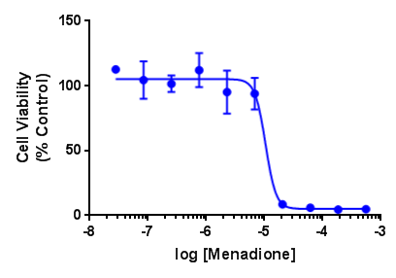
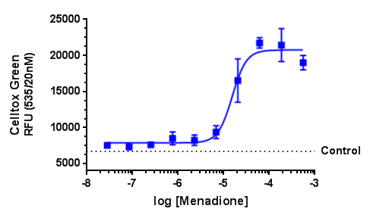
Measuring cell toxicity
Cell Viability
Cell death
CellTiter-glo (Promega) is an endpoint luminescence assay used to determine cell viability. This assay results in cell lysis and a signal proportional to the amount of ATP present in the well. The amount of ATP is directly proportional to the number of cells present. CellTiter-glo is a simple 1-step addition at a fixed timepoint. NB: Luminescence readouts are often O₂ dependent and may have a reduced signal in hypoxia.
CellTox-Green (Promega) is green channel fluorescent assay able to directly measure cell death. This assay uses a non-cell permeable DNA binding flurophore, meaning it can directly measure the free-DNA of burst cells (Necrotic death). CellTox-Green is well tolerated and non-toxic, it can be used kinetically to measure cell death over hours or days.

Slide 4
Kinetic measurement of cell death
Measuring cell death throughout Ischaemia-reperfusion injury in vitro
Understanding the kinetics of cell death following an insult can be very important to inform therapeutic interventions, as well as the underlying biology.
CellTox-Green enables kinetic measurement of cell death in cycles as short as 5min intervals (Fig. 1), or staggered over hours or days.
This may be multiplexed with other kinetic dyes to maximise data output. For example - ROS, MPTP and Intracellular O₂ dyes.
Reading every 5 min for 24h causes little-to-no bleaching of the fluorophore. Cell tox green has been used at timepoints up to 72h in our lab.
Fig 1: Rat myoblast cell death in response to 1h simulated ischaemia-reperfusion injury.
Kinetic measurement of chamber O₂ (%) (Red) and cell death (blue) measured by CellTox-Green every 5min over a short ischaemia-reperfusion protocol. Atmospheric gases were manipulated using Clariostar plate reader fitted with atmospheric control unit.

Slide 5
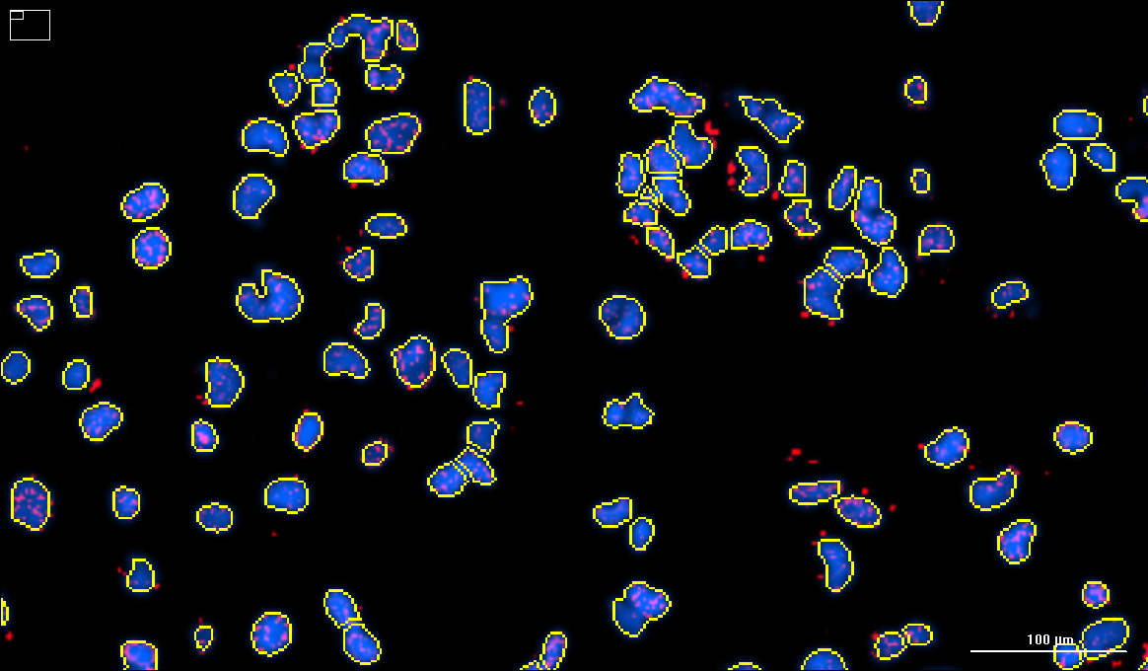
Cell counting by automated immunofluorescence
a)
b)
Measuring cell death and DNA damage in response to olaparib treatment.
Automated fluorescence microscopy with the Cytation (Biotek) of Hoechst 33342 staining allows for assaying nuclei following treatment.
Multiples images per well of 96-well and 384-well plates can be stitched together to give whole-well data (Fig. 2a). Automated nuclei identification can be used as a measure of cell death (Fig. 2b).
Multiplex with antibody staining (for example γH2AX to identify double stranded DNA breaks (Fig. 2c)) or endpoint mechanistic dyes (such as the MTMP dye Mitotraker Red) to investigate mechanisms of toxicity.
c)
Fig 2: Effect of Olaparib treatment in mesothelioma cells.
Cancer cells were fixed with 4% PFA and stained with Hoechst 33324. 9 overlapping images per well were stitched together and deconvolved to form each image in (a). Automatic analysis counts cells and reports mean + standard deviation per sample (b). Representation of automated nuclei identification (c).
Notes:
Cytation DAPI staining with DR olaporib

Slide 6
All assays can be performed in 96-well and 384-well format to increase throughput.
All assays are suitable for both adherent and non-adherent cell culture.
The DDG have several plate readers available for use.
Easily perform synergy experiments between compound treatments (for example: test compound + [Menadione])
Compound hit picking, serial dilution and cell treatments are automated to increase throughput and data reproducibility using the BRAVO (Agilent) liquid handling system.
We are happy to discuss other assays not mentioned in this App note (for example the Annexin 5 Apoptosis/ Necrosis multiplex assay (Promega)).

Slide 7
For questions and further information please contact:
Richard Angell – Drug discovery group lead; (r.angell@ucl.ac.uk)
Trevor Askwith – Senior biologist; (t.askwith@ucl.ac.uk).
Ben Allsop – Biologist (Author); (b.allsop@ucl.ac.uk).

