Slide 1
Food & SUSTAINABILITY AT UCL Q1 2021 – what we’re doing
Compiled April 2021 by Rosie Rayner-Law, Sustainability Manager

Slide 2
Who are we?
We’re Gather & Gather and we deliver the catering across UCL, including Bloomsbury campus, Institute of Education, Institute of Child Health, School of Pharmacy and catered residencies
Our parent company is CH&Co, a large contract caterer who work across a range of places including education and workplaces
We took over the contract at the beginning of the year

Slide 3
Carbon Labelling
We’ve partnered with Foodsteps to do the number crunching for us on the carbon cost of our dishes
I’ll allow us to create labels for dishes, allowing you to know the carbon cost of the food you’re choosing
It gives us good data to track the carbon of our dishes, allowing us to work out our emissions

Slide 4
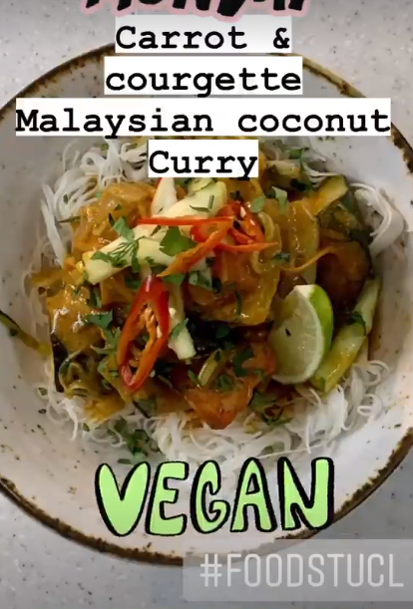
Plant-based Eating
We’re offering plant-based options across our range – there’ll always be plenty of choice
We’re making sure our plant-based options are competitively priced against meat-based dishes, to encourage higher uptake of plant-based dishes
We’re offering both healthy and treat options so you can always have what you fancy

Slide 5
Powered by Plants
We’ll be broadening the #PoweredByPlants initiative spearheaded by departments within the university
This means our standard hospitality offer will be 100% veggie and vegan (veg-led)
It doesn’t mean that you won’t be able to order hospitality that contains meat and fish, but it will be a special request

Slide 6
Waste Management
Winnow allows us to track our food waste both in the kitchen and from unserved food
We’ll understand how to reduce it by 10% by the end of the year
We’re working to get Too Good To Go set up again, which will allow us to redistribute unserved meals

Slide 7
Single-Use Plastic Reduction
Launched as low-plastic as we could during Covid
No plastic bottles
No plastic cutlery
Working with suppliers to reduce plastic coming in; buying in bulk for coffee
Using alternative packaging to plastic; bagasse boxes & wooden cutlery
Working to target our 5 worst offenders by the end of the year

Slide 8
Reducing Disposables Retail
Looking to reinstate crockery as soon as safe to do so
We’re implementing Club Zero
This is a cup deposit scheme which allows you to use a reusable cup like a disposable cup, for free
You’ll need to register on the app, scan the cup when you’re at the coffee counter and then return the cup to one of the specialist crates found around campus, and the wider King’s Cross area

Slide 9
Reducing Disposables - Hospitality
We’ll be continuing the good work started before Covid-19 to reduce and remove disposables in hospitality
We will not be transporting hospitality wrapped in any clingfilm
As soon as possible with Covid, we’ll be launching a disposable-free hospitality offer, and reducing all we can until then

Slide 10
Fairtrade
We include Fairtrade products (or better) across chocolate, tea, coffee, sugar and bananas
We took part in Fairtrade Fortnight by offering promotions on Fairtrade products and running engagement competitions on our social media

Slide 11
Training Our Staff
All our staff are undergoing return-to-work training which includes sustainability training
They’ll be trained on basic environmental issues like climate change & plant-based eating
Our aim is to have a team that is passionate about UCL’s sustainability aims and who are armed with knowledge to take into their own lives at home

Slide 12
How to find out more & contact us
Rosie Rayner-Law – Sustainability Manager
Rosie.RaynerLaw@gatherandgather.com
Instagram: @RosieUCLFood
Our Instagram: @FoodatUCL
Our website: www.foodatucl.com
Our email: foodatUCL@gatherandgather.com

