Slide 1
SUSTAINABILITY
AT UCL
Notes:
Link to our YouTube video: https://www.youtube.com/watch?v=7r8Yru6STuI&t=1s
Hi, my name is XYZ. I’m the Green Champion from XYZ department. I’m here to give you a brief presentation on sustainability.
Before I start, it would be great to hear from you! Would anybody be happy to share, what the best example of sustainability is, that they have seen? This could have been in your school or your home town, for example. → Feel free to adapt that question to your audience.
Here is a message from the Sustainable UCL team, the team that works with researchers, students, and staff to drive UCL’s sustainability goals forward, and UCL students and staff from around the world. They are sharing examples of sustainability activities that are happening at UCL.
Play video

Slide 2
THE SUSTAINABILITY
STORY
SO FAR …
18th most sustainable university out of 254
Top climate scientists in the world
Reduced 15% carbon emissions in the last 10 years despite significant growth in students and buildings
None of our waste goes to landfill
Student Centre achieved outstanding sustainability rating
Notes:
UCL is a community of 50,000 staff and students. Essentially we are the size of a small town and so we have a large impact on society and the environment.
Here are some of our best achievements in recent years.
Our academics are researching topics from bacteria eating plastics, to hydrogen cars and liveable cities. Insert an example from your department, if you like!

Slide 3
DEPARTMENTAL
ACTION
Please insert any sustainability work happening at the department:
Academic Research
Student initiatives
Green Impact Teams
See the following slides for examples
Notes:
At our department, we are also doing our best to work towards UCL’s sustainability goals.
Please insert any sustainability work happening at the department:
Academic Research
Student initiatives
Green Impact Teams
See the following slides for examples. You don’t want to crowd the presentation so have one example per slide.

Slide 4
SOME
SOME
EXAMPLES
Notes:
In January PALS took the decision to go vegetarian. They inspired a number of other departments to do the same.
Another example is around air travel and our carbon impact more broadly. We’re working with global partners all around the world. At the same time, we have become more and more interested in the carbon impact we are having as a university. So how do we stay connected while reducing our carbon impact? There are different UCL wide recommendations for reducing our carbon impact that are going to the academic board for discussion, but some departments are setting their own policies e.g. around only using the train for domestic travel. UCL has also just launched Carbon Accountability Pilot Scheme. The scheme brings together elements of carbon pricing and behavioural support to reduce carbon emissions from buildings and operations. Fifteen departments are taking part in the pilot in the academic year 2019/20, to determine how this might be implemented across UCL. → mention if your department is one of the department’s involved in the pilot.

Slide 5
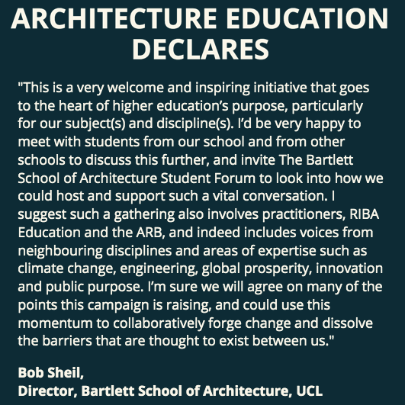
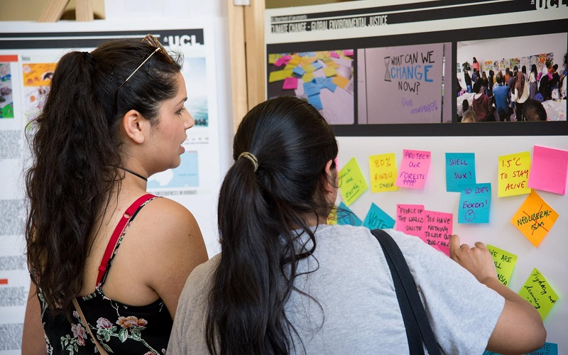
SOME
EXAMPLES
Notes:
The impetus to change can also come from the student body. Last year, an architecture student at the Bartlett started a national campaign to increase sustainability in architecture education. Bartlett are now putting together a citizen’s assembly to look at their teaching practice.

Slide 6
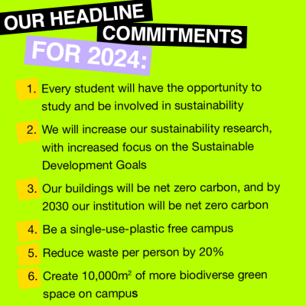
BUT WE NEED
TO DO MORE
Notes:
We’re very proud of the work we’ve done so far, but we know there’s so much more to do.
In 2018 Sustainable UCL spent an entire year listening to the UCL community of students and staff and together we came up to create UCL’s new Sustainability Manifesto “Change Possible”. This was launched in October 2019. Here are our 6 key pledges.

Slide 7
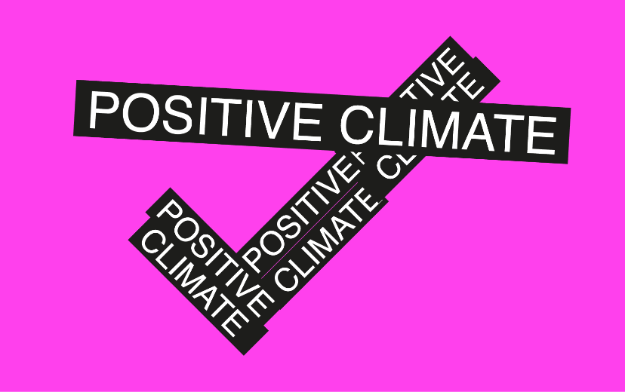
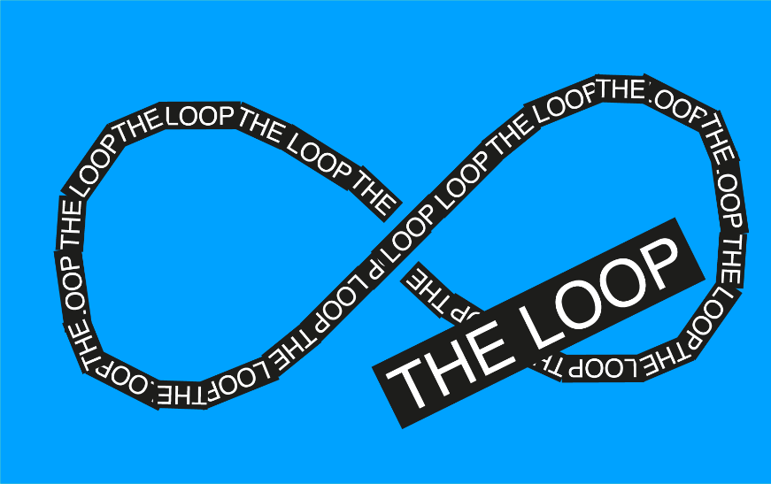
SUSTAINABLE UCL:
A STRATEGY, 2019-2024
Notes:
We’re very proud of the work we’ve done so far, but we know there’s so much more to do.
In 2018 Sustainable UCL spent an entire year listening to the UCL community of students and staff and together we came up to create UCL’s new Sustainability Manifesto “Change Possible”. This was launched in October 2019. Here are our 6 key pledges.

Slide 8
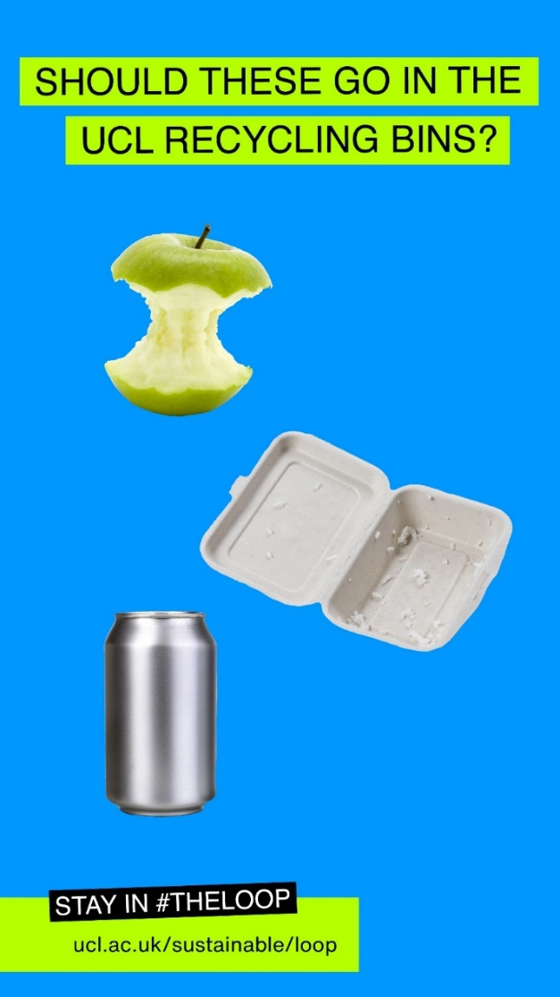
STAY IN
#THE LOOP
Notes:
Firstly to wake you all up, a quick quiz on how to recycle at UCL *remember this might be different to your home recycling. Grab a piece of paper and a pen and write down the following items and put yes or no for whether it can go in the recycling bin. Give yourself 1 point for each item you get right.
Apple
Food packaging (Styrofoam box)
Clean and empty can

Slide 9
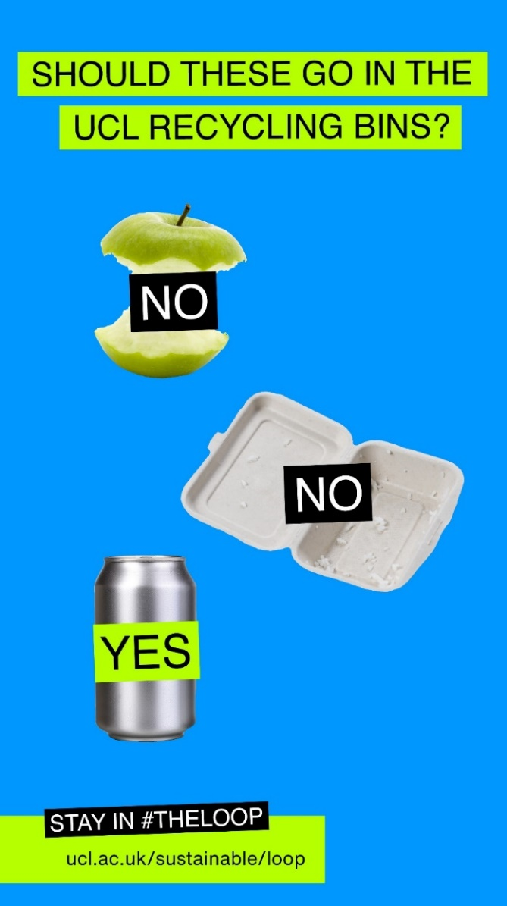
STAY IN
#THE LOOP

Slide 10
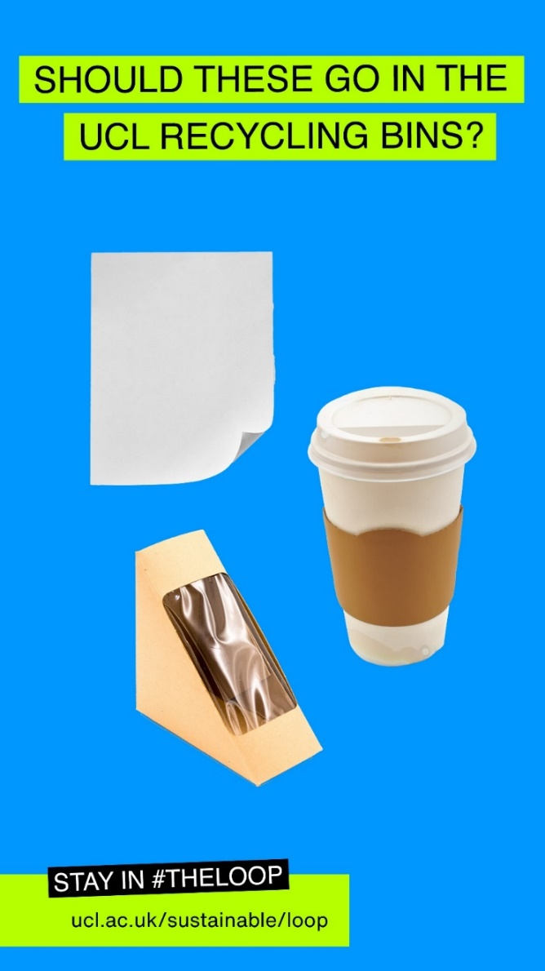
STAY IN
#THE LOOP
Notes:
Next up we have the following:
Paper
Coffee cup
Sandwich Packaging

Slide 11
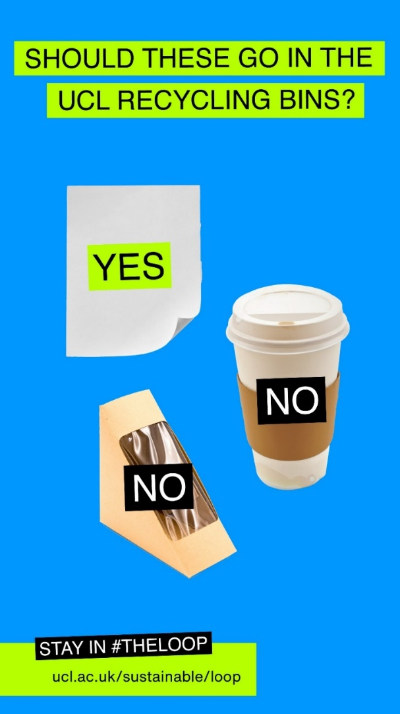
STAY IN
#THE LOOP
Notes:
Paper
Coffee cup
Sandwich Packaging

Slide 12
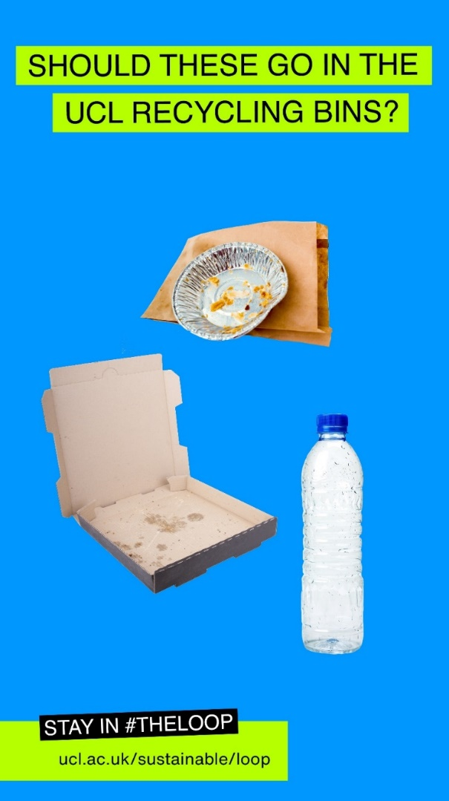
STAY IN
#THE LOOP
Notes:
And finally:
Takeaway packaging
Pizza boxes
Clean and Empty plastic bottle

Slide 13
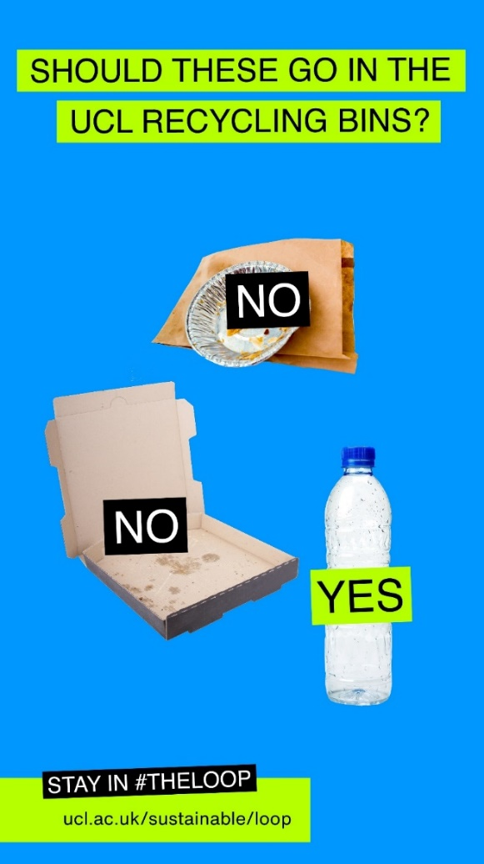
STAY IN
#THE LOOP
Notes:
Takeaway packaging
Pizza boxes
Clean and Empty plastic bottle

Slide 14
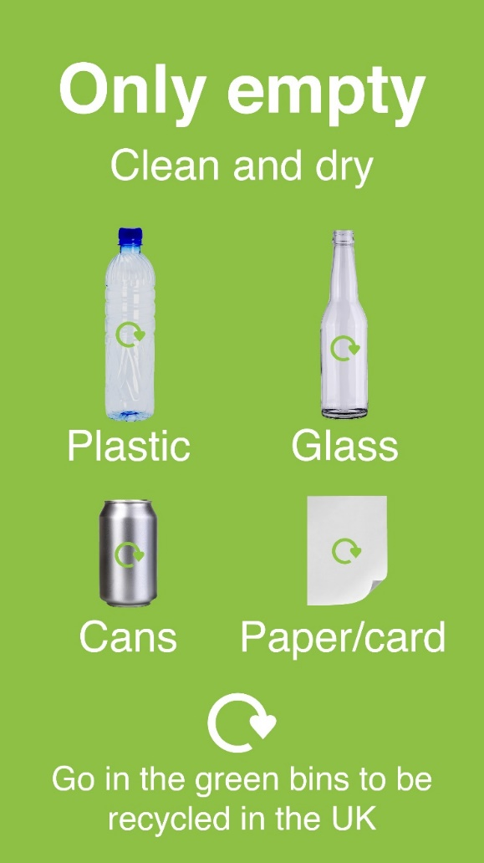
STAY IN
#THE LOOP
Notes:
Why all these answers? Have you noticed a pattern? Only these items - when empty, clean, and dry - can go into the recycling

Slide 15
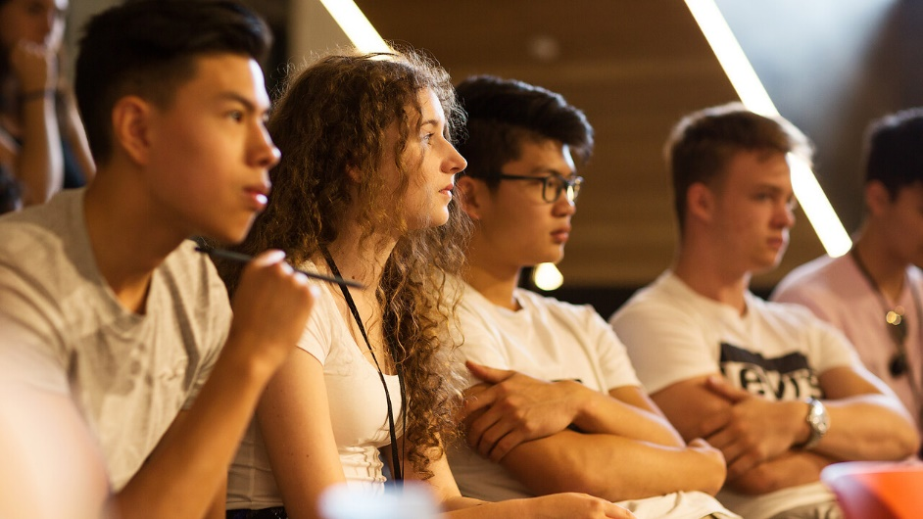
GET
INVOLVED
As students, you make up the largest proportion of the UCL community. There are 41,000 of you, and we need your help.
Notes:
As you might tell from activities like recycling, we need your help to reach our sustainability goals. We want to give you the tools to be sustainability literate and give you a platform to integrate sustainability into your research, personal, or professional life, if you like.
There are lots of ways you can get involved on campus from putting your trash into the recycling bins to joining a society …
I’m about to give you some examples of the kind of work students have done previously…

Slide 16
ACADEMIC
LIFE
Notes:
Over 80% of students now want to study sustainability.
At UCL we have a programme called Living Labs which means you can undertake your dissertation or research whilst solving some of UCL’s sustainability challenges on campus.
Here is one example of a student’s Living Lab Project.

Slide 17
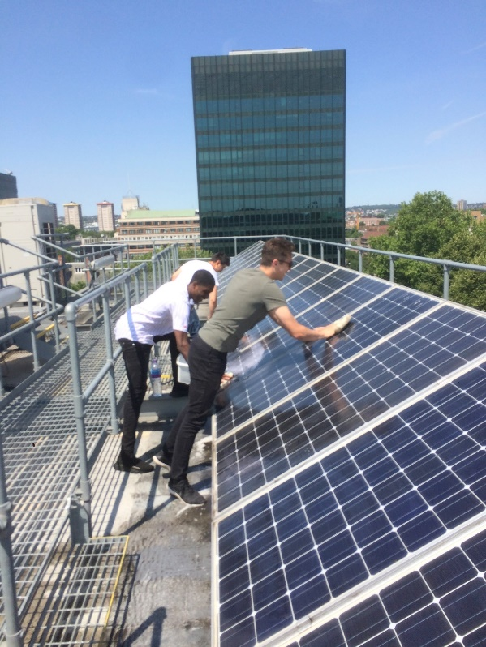
ACADEMIC
LIFE
MSc Environmental Design and Engineering student, Isa Ibrahim, cleaned panels on the roof of Central House to assess the effect of dust on the panels’ efficiency.
This increased the electricity generation by 25%. Consequently UCL now regularly cleans its panels to reduce carbon emissions.
Notes:
MSc Environmental Design and Engineering student, Isa Ibrahim, monitored a small array of panels on the roof of Central House and carried out cleaning tests to assess the effect of dust on the panels’ efficiency.
On average, the electricity generated by the panels increased by around 25% after two rounds of cleaning, thereby showing the importance of regular panel cleaning in reducing carbon emissions.
We’ve also had engineering students make UCL’s urinals more water efficient!
But you don’t have to be an engineering or geography student to participate in the Living Lab programme. We’ve had students in the SLADE art school do artwork showcasing sustainability challenges and we’ve had behavioural change students looking at how to make recycling easier at UCL! So no matter what you are studying, you can link it to sustainability, if you like.

Slide 18
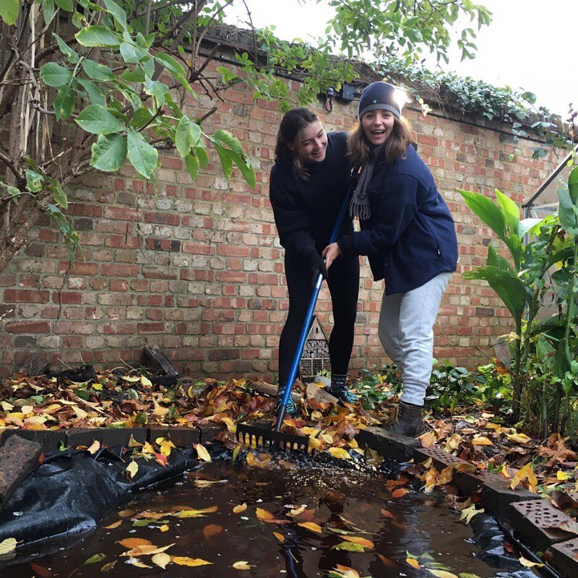
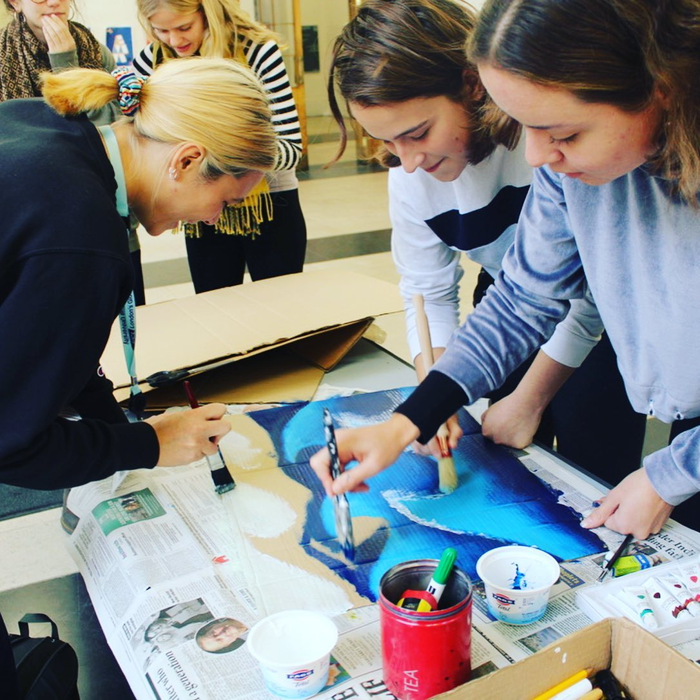
EXTRACURRICULAR
LIFE
Notes:
However, engaging with sustainability is not limited to your studies. Here are some extracurricular activities you can do.
Whether you want to develop your leadership and sustainability skills as a Sustainability Ambassador, working with the Students Union and Sustainable UCL to embed sustainability into the heart of UCL or become a member of UCL’s Student Sustainability Council, to help direct UCL’s sustainability vision, there are many ways in which you can make your voice heard.
Many of UCL’s clubs and societies also have an environmental and social focus. From re-distributing food waste to homeless shelters with the Zero Waste Society, to engaging students in justice activism with the Environmental Justice Project, there are many to choose from. Make sure to take a look at the overview of sustainability-themed inductions events we shared as part of the induction pack.

Slide 19
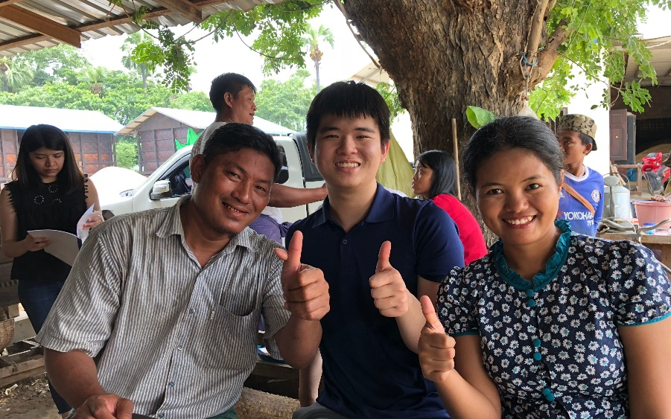
PROFESSIONAL
LIFE
Rice Inc – a social enterprise founded by UCL students - aims to alleviate food poverty in South East Asia, by installing rice drying facilities that will boost rice crop yields by 30-40%. They won the Hult Prize to fund their project and are now planning on selling rice commercially.
Notes:
Sustainability is a hot topic and increasingly more employers, are looking for students with sustainability skills and literacy. And not just in environmentally focused jobs, but in engineering, retail, urban planning and many more!
There are lots of opportunities for students at UCL to gain these skills. In February Sustainable UCL is organising a Sustainability Careers Fortnight to show the breadth of opportunities in this rapidly growing sector and introduce you to leading organisations.
UCL Innovation and Enterprise also provides funding and support for students with enterprising ideas. The students and founders of Rice Ing developed the idea to install rice drying facilities in remote villages in Myanmar, Vietnam, Malaysia and the Philippines to help boost their yields by 30-40%, thus alleviating food poverty in South East Asia. They won the Hult Prize to fund their social enterprise and now they are planning to sell rice commercially, having delivered on their vision to install rice drying facilities.

Slide 20
Find out more!
www.ucl.ac.uk/sustainable/student-opportunities
@Sustainable UCL
@SustainableUCL
@SustainableUCL
@sustainableucl
Or join our department’s Green Team!
Notes:
To end with, maybe we could see a show of hands who is interested in engaging with sustainability either as part of their studies, free time, or professional career.
Show of hands for studies
Show of hands for free time
Show of hands for professional context/work experience
Well, in whatever capacity you are interested in sustainability, make sure to check out the Sustainable UCL website or social media channels for more information about sustainability at UCL or join our very own Green Team.

