Slide 1
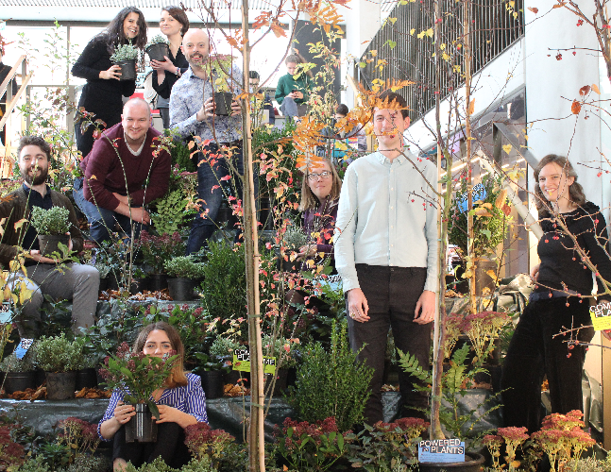
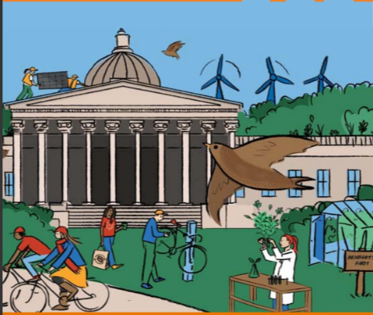
WELCOME
Notes:
First start of with an introduction.
Hi, my name is XYZ. I’m the Green Champion from XYZ department. I’m here to give you a brief presentation on sustainability at UCL and within the department.

Slide 2
AGENDA
Sustainability at UCL
Departmental Actions
Recycling Quiz
How to get involved
Academic Life
Extracurricular Life
Professional Life
Notes:
Agenda:
Today, we’ll start with an explanation of UCL’s sustainability work. UCL has a sector leading sustainability strategy, set out by the central sustainability team. We’ll then present some of the sustainability work we do at the departmental level. Many departments also have a green champion, such as myself, to make the department more sustainable. This will be followed by a recycling quiz and we’ll conclude with an overview of all the ways in which you can get involved in sustainability either as part of your studies or during your extracurricular activities.

Slide 3
QUESTION
What is the best example of sustainability that you have seen?
Notes:
Before I start, it would be great to hear from you! Would anybody be happy to share, what the best example of sustainability is, that they have seen? This could have been in your school or your home town, for example. → Feel free to adapt that question to your audience. – Consider using an interactive platform such as menti for this: https://www.mentimeter.com/

Slide 4
Sustainability at UCL
Notes:
Here is a message from the Sustainable UCL team, the team that works with researchers, students, and staff to drive UCL’s sustainability goals forward, and UCL students and staff from around the world. They are sharing examples of sustainability activities that are happening at UCL.
Link to our YouTube video: https://www.youtube.com/watch?v=7r8Yru6STuI&t=1s
Play video

Slide 5
STORY SO FAR
UCL has the highest score in the University Carbon League Table out of 519 institutions.
UCL has risen from 89th – 18th in the University Green League (4th in Russel Group)
1st University to issue a Sustainability Bond
Notes:
UCL is a leading university in the sustainability and HE sector
It is a university that you can be proud of working and studying at - both for its environmental and social sustainability credentials
We have the highest score in the Carbon League – as we have the most ambitious carbon targets in the sector – this was a ranking designed after students across the declared a climate emergency
We have risen in the Green League too – this league covers everything from workers rights, to climate education and engagement, procurement and food
And more recently we are the first university to issue a sustainability bond : https://www.ucl.ac.uk/sustainable/bond
We’ve also Reduced 15% carbon emissions in the last 10 years despite significant growth in students and buildings
None of our waste goes to landfill
Student Centre achieved outstanding sustainability rating

Slide 6
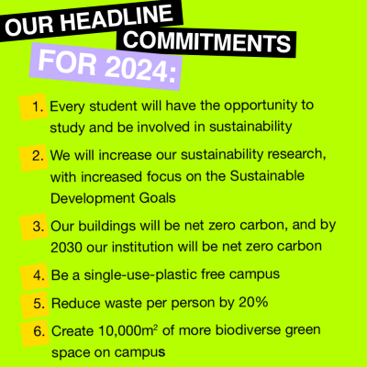
OUR HEADLINE
Notes:
So what’s our vision?
In October 2019 we launched UCL’s second Sustainability Strategy. Our vision is to show that a Sustainable Future IS POSSIBLE. And to demonstrate this we need to make Change Possible Now.
We worked with our researchers and academics to create the strategy and it focuses on the 6 headline commitments that you can see on the slide.

Slide 7
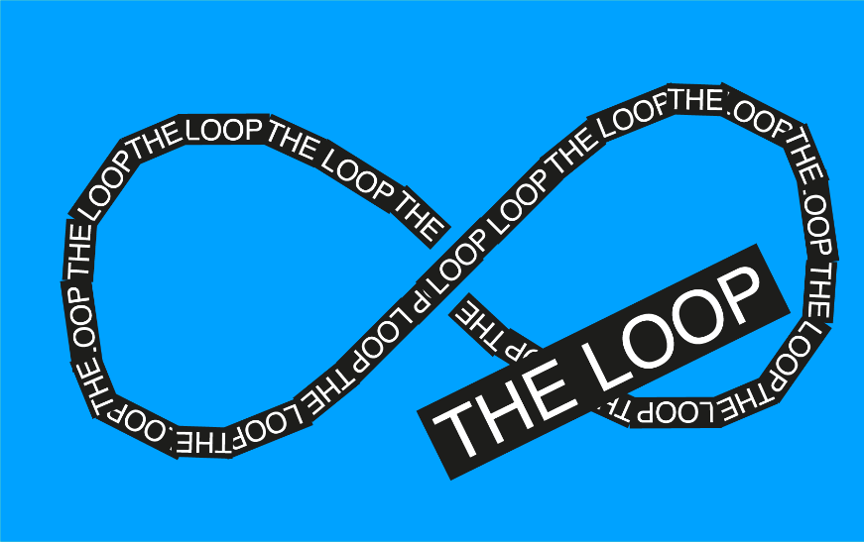
SUSTAINABLE UCL
A STRATEGY, 2019-2024
Notes:
We structure our work towards these commitments via three campaigns:
Positive Climate uses UCL's wealth of climate change expertise and research to reduce carbon emissions.
The Loop tackles unsustainable consumption by redesigning the way we use materials and specifying the best products for people and planet.
With Wild Bloomsbury, we are introducing nature-based solutions to Bloomsbury.

Slide 8
DEPARTMENTAL ACTION
Please insert any sustainability work happening at the department:
Academic Research
Student initiatives
Green Impact Teams
See the following slides for examples
Notes:
At our department, we are also doing our best to work towards UCL’s sustainability goals.
Please insert any sustainability work happening at the department:
Academic Research
Student initiatives
Green Impact Teams
See the following slides for examples. You don’t want to crowd the presentation so have one example per slide.

Slide 9
SOME EXAMPLES
SOME
Notes:
In January 2019 UCL’s Psychology and Language Science Department (PALS) took the decision to be 100% vegetarian. This means all catering provided at PALS meeting or events is vegetarian. This pledge grew into the UCL-wide “Powered by Plants” campaign that many other departments and UCL’s senior management have signed up to. The initiative also spread to other Psychology departments around the world, including the University of Auckland, Bath and Royal Holloway.

Slide 10
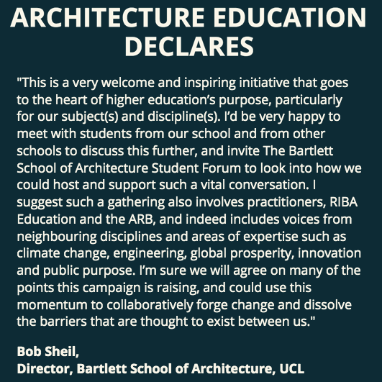
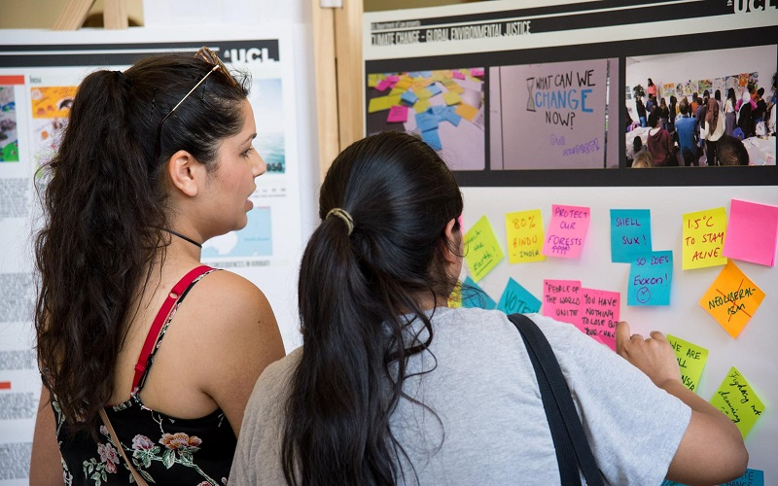
MORE EXAMPLES
Notes:
The impetus to change can also come from the student body. In 2019, an architecture student at the Bartlett started a national campaign to increase sustainability in architecture education. As a result, the Bartlett declared a climate emergency and held an open Student forum to hear from students about what the Bartlett should be doing at a programme, school, faculty and institutional level to help reduce our negative impact on the world. Bartlett students are also co-leading an inter-architecture school call for change – ‘Architectural Education Declares’, that invites other schools to pledge to incorporate climate considerations into their curriculums – So far the call has received 2517 signatures

Slide 11
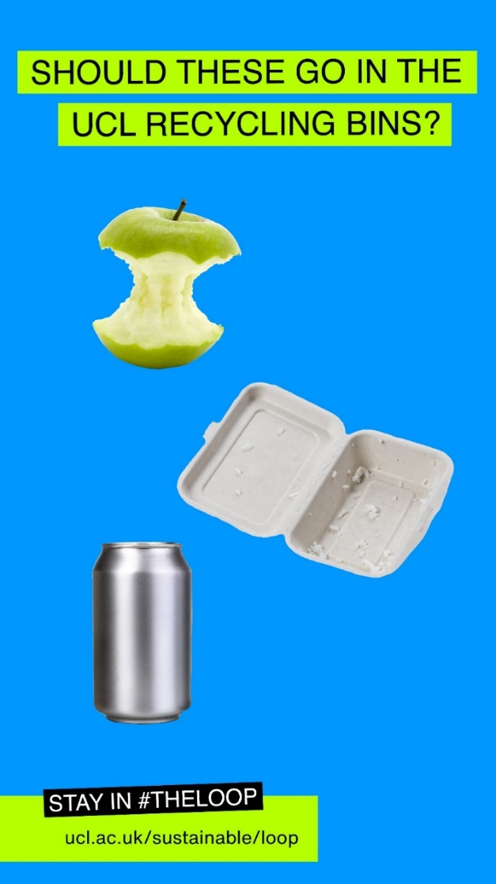
STAY IN #THE LOOP
Notes:
It’s a lot to take in, so we thought we could to a quick quiz on how to recycle at UCL as a break. *Remember this might be different to your home recycling. Grab a piece of paper and a pen and write down the following items and put yes or no for whether it can go in the recycling bin. Give yourself 1 point for each item you get right.
Apple
Food packaging (Styrofoam box)
Clean and empty can

Slide 12
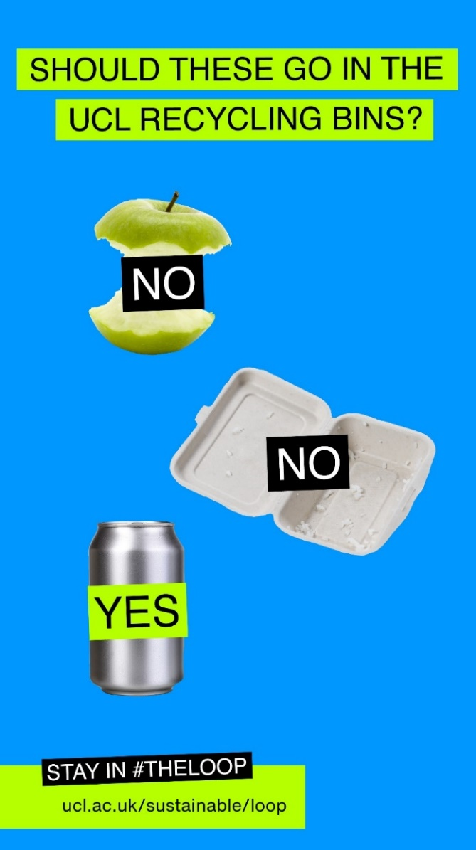
STAY IN #THE LOOP

Slide 13
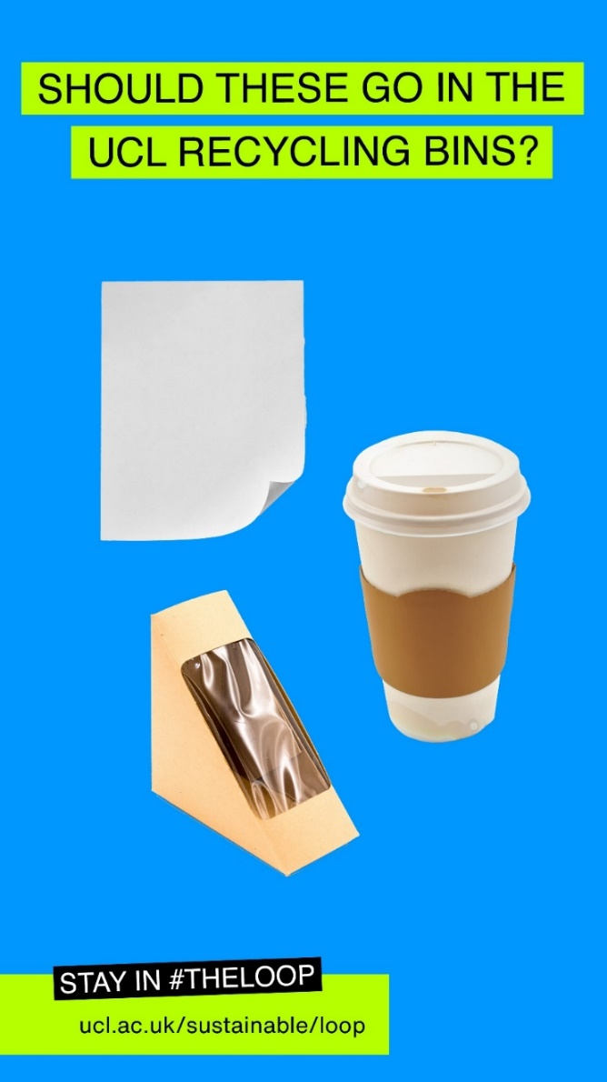
STAY IN #THE LOOP
Notes:
Next up we have the following:
Paper
Coffee cup
Sandwich Packaging

Slide 14
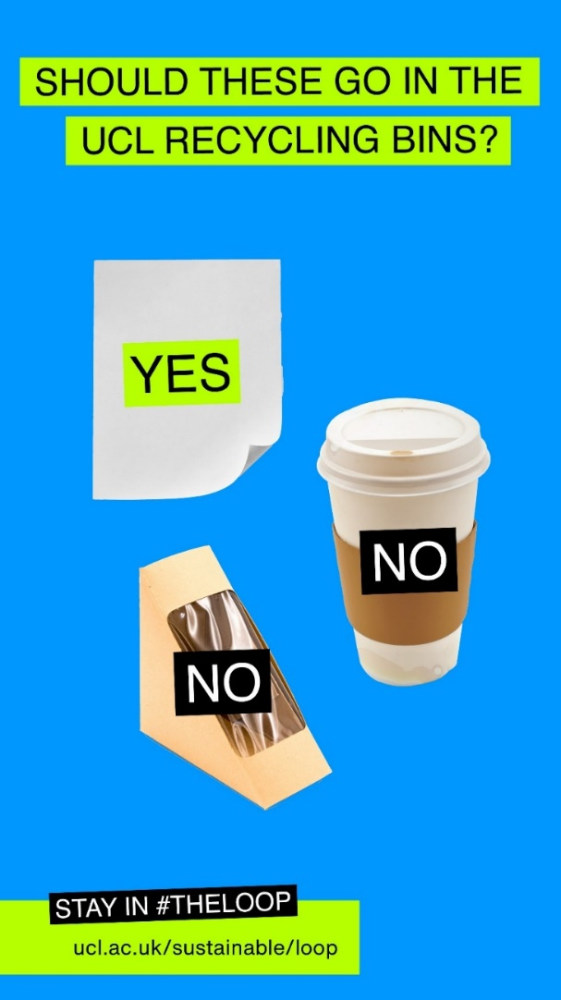
STAY IN #THE LOOP
Notes:
Paper
Coffee cup
Sandwich Packaging

Slide 15
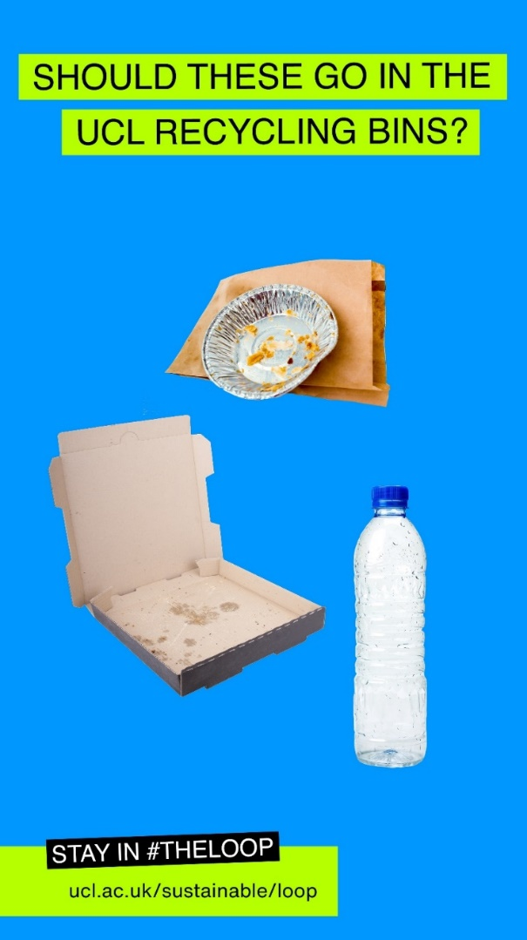
STAY IN #THE LOOP
Notes:
And finally:
Takeaway packaging
Pizza boxes
Clean and Empty plastic bottle

Slide 16
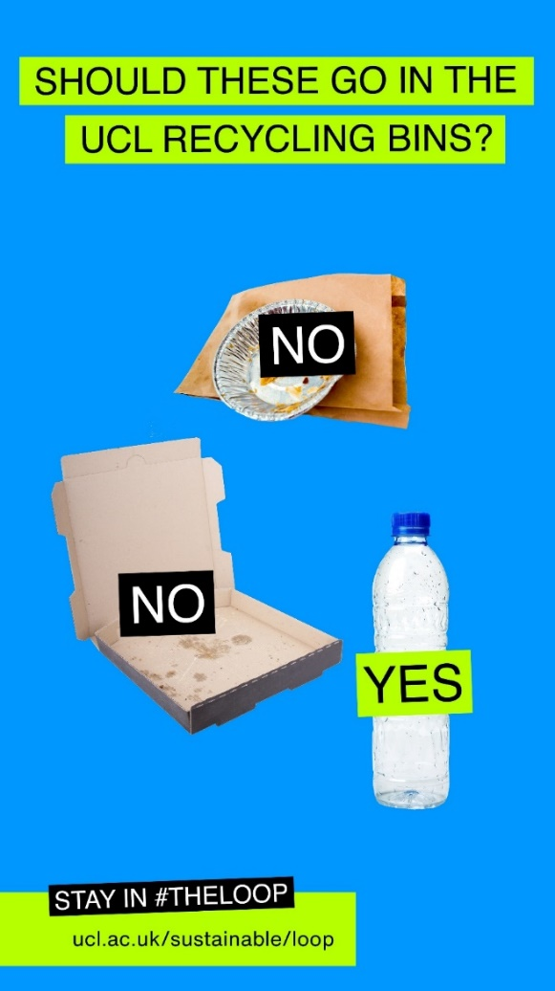
STAY IN #THE LOOP
Notes:
Takeaway packaging
Pizza boxes
Clean and Empty plastic bottle

Slide 17
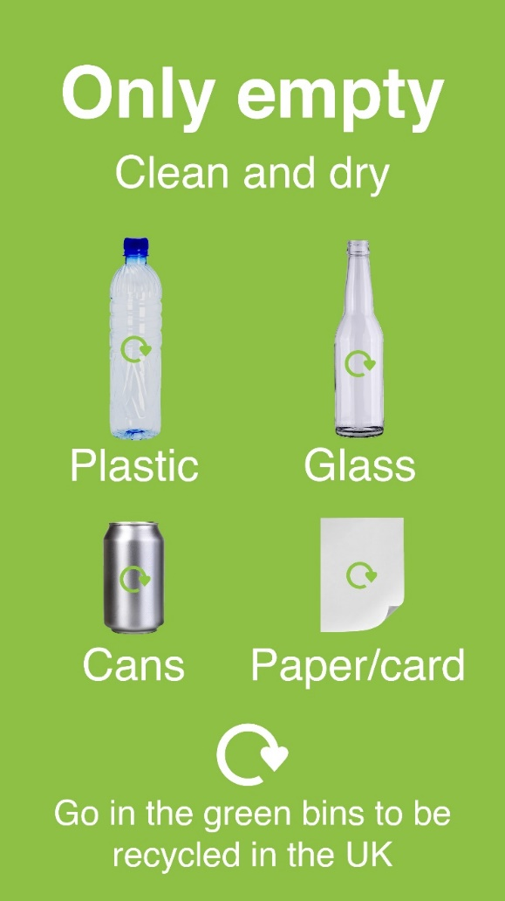
STAY IN #THE LOOP
Notes:
Why all these answers? Have you noticed a pattern? Only these items - when empty, clean, and dry - can go into the recycling at UCL

Slide 18
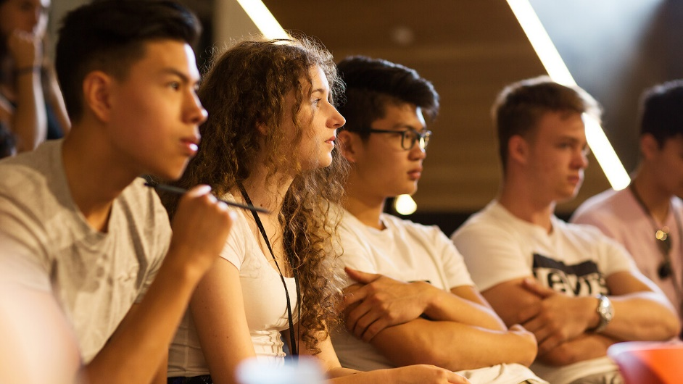
GET INVOLVED
As students, you make up the largest proportion of the UCL community. There are 41,000 of you, and we need your help.
Notes:
As you might tell from activities like recycling, we need your help to reach our sustainability goals. We want to give you the tools to be sustainability literate and give you a platform to integrate sustainability into your research, personal, or professional life, if you like.
There are lots of ways you can get involved on campus from putting your trash into the recycling bins to joining a society …
I’m about to give you some examples of the kind of work students have done previously…

Slide 19
ACADEMIC LIFE
Notes:
Over 80% of students now want to study sustainability.
At UCL we have a programme called Living Labs which means you can undertake your dissertation or research whilst solving some of UCL’s sustainability challenges on campus. After choosing a topic (we have a sustainability topic list for your inspiration) and speaking to your supervisor, get in touch with the Sustainable UCL team, who can provide feedback on your idea and share relevant data. All details can be found here: https://www.ucl.ac.uk/sustainable/education/living-lab
On the next slide, you can see an example of a student’s Living Lab Project.

Slide 20
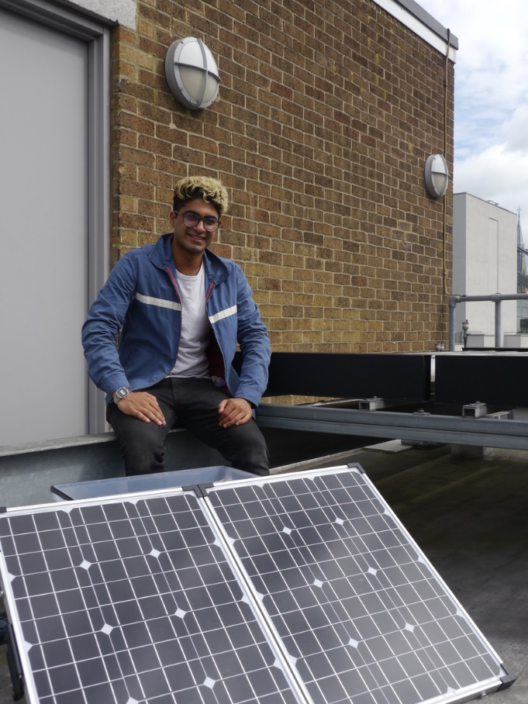
ACADEMIC LIFE
MSc student, Isa Ibrahim, cleaned UCL’s solar panels to assess the effect of dust on the panels’ efficiency.
Cleaning the panels increased the electricity generation by 25%.
Notes:
MSc Environmental Design and Engineering student, Isa Ibrahim, monitored a small array of panels on the roof of Central House and carried out cleaning tests to assess the effect of dust on the panels’ efficiency.
On average, the electricity generated by the panels increased by around 25% after two rounds of cleaning, thereby showing the importance of regular panel cleaning in reducing carbon emissions.
We’ve also had engineering students make UCL’s urinals more water efficient!
But you don’t have to be an engineering or geography student to participate in the Living Lab programme. We’ve had students in the SLADE art school do artwork showcasing sustainability challenges and we’ve had behavioural change students looking at how to make recycling easier at UCL! So no matter what you are studying, you can link it to sustainability, if you like.

Slide 21
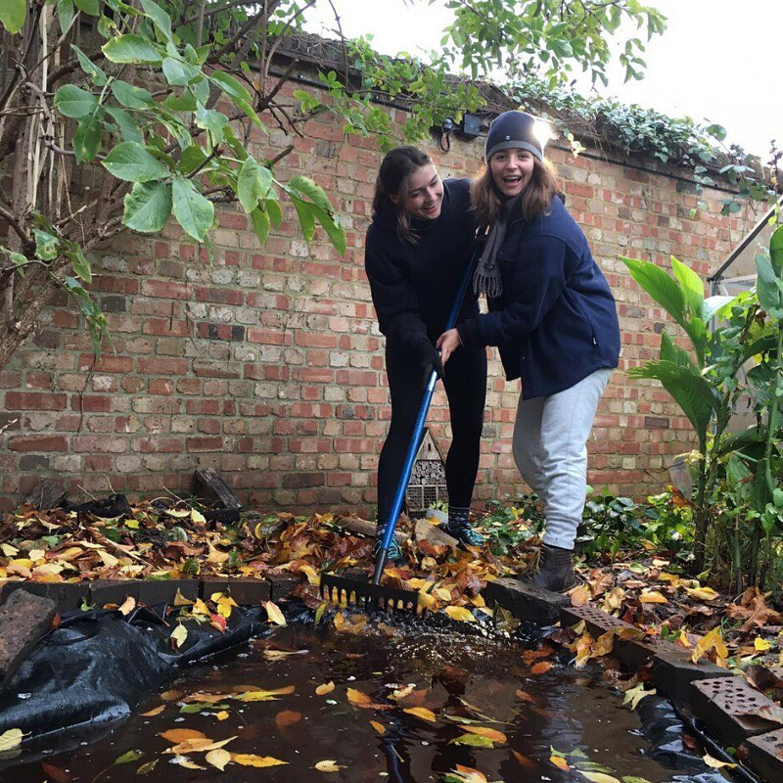
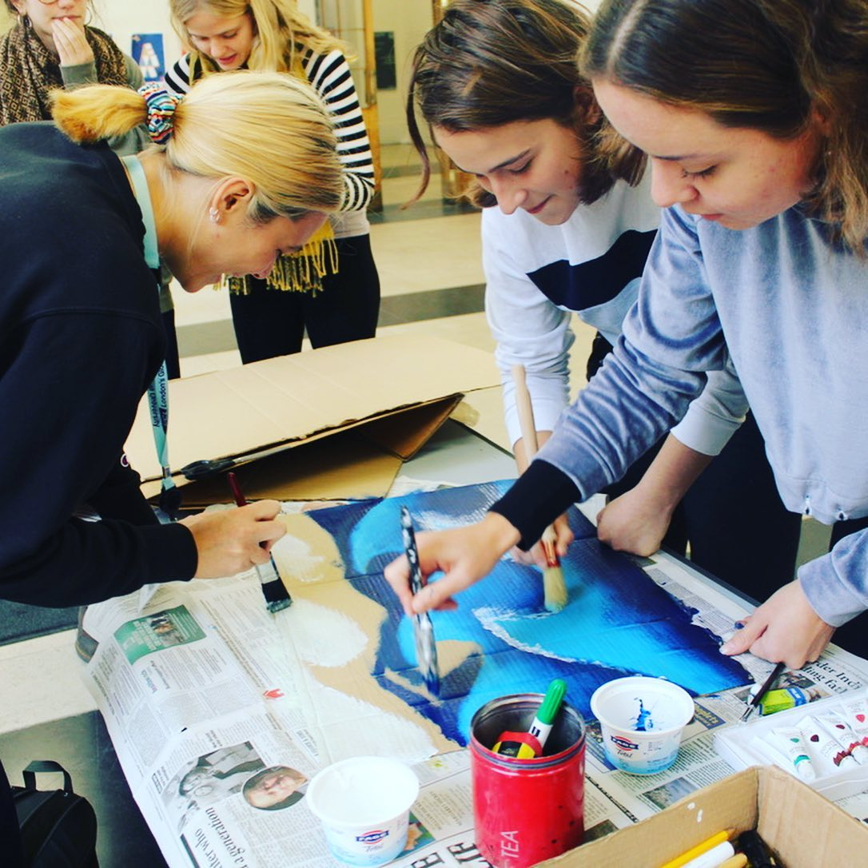
EXTRACURRICULAR
LIFE
Notes:
However, engaging with sustainability is not limited to your studies. Here are some extracurricular activities you can do:
Join the Sustainability Ambassador Programme: At the beginning of the academic year, Sustainable UCL recruit passionate students, both undergraduate and postgraduate, who work on projects related to UCL’s sustainability commitments and want to develop their skills in project management, sustainability, team work, communications and leadership. The application deadline is 15th October: https://www.ucl.ac.uk/sustainable/students/sustainability-ambassadors
Join the Student Sustainability Council: The student sustainability council is the chance for students to shape UCL and the Students Union’s Sustainability Visions. Council members meet two times per term and provide feedback and input on the SU’s and UCL’s sustainability work: https://studentsunionucl.org/sustainability-council
Many of UCL’s clubs and societies also have an environmental and social focus. From re-distributing food waste to homeless shelters with the Zero Waste Society, to engaging students in justice activism with the Environmental Justice Project, there are many to choose from, you can meet them all during the Sustainability Welcome Fair on 27th September!
Events: Throughout the year, Sustainable UCL also run bike sales and repair events, clothes swaps and planting events. Check out the Sustainable UCL website or Instagram pages to find out more about the dates for these events.

Slide 22
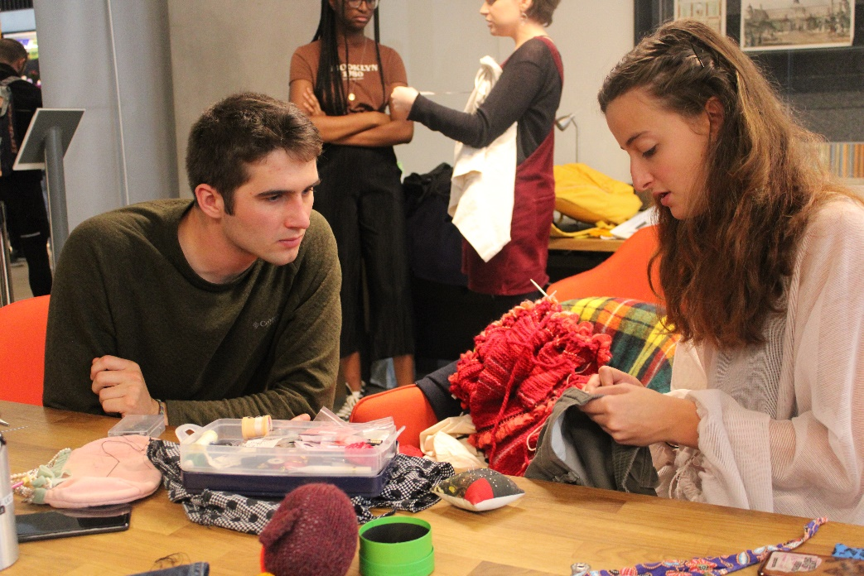
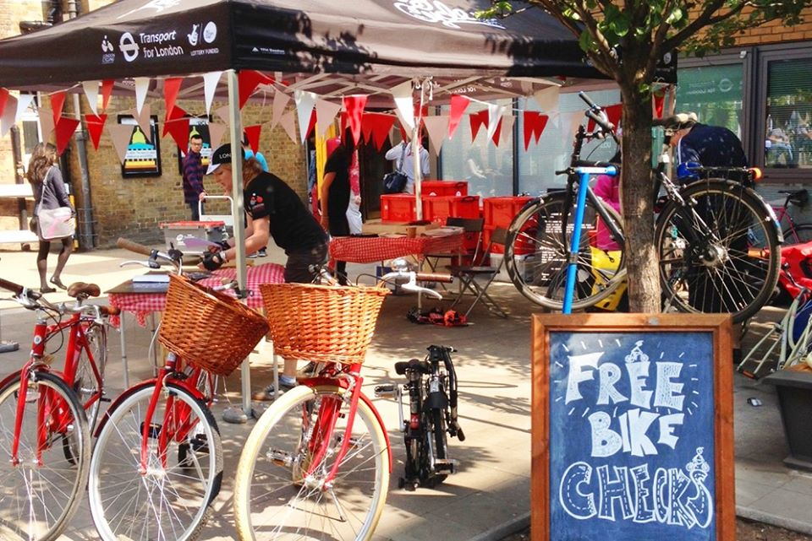
SUSTAINABILITY
EVENTS
Notes:
If you prefer to join one-off activities, check out UCL’s sustainability events. Throughout the year, Sustainable UCL run bike sales and repair events, clothes swaps and planting events. Check out the Sustainable UCL website or Instagram pages to find out more about the dates for these events.
You can also search for Sustainable UCL’s “Small Steps, Big Change” article, for things you can do straight away: https://www.ucl.ac.uk/sustainable/small-steps-big-change

Slide 23
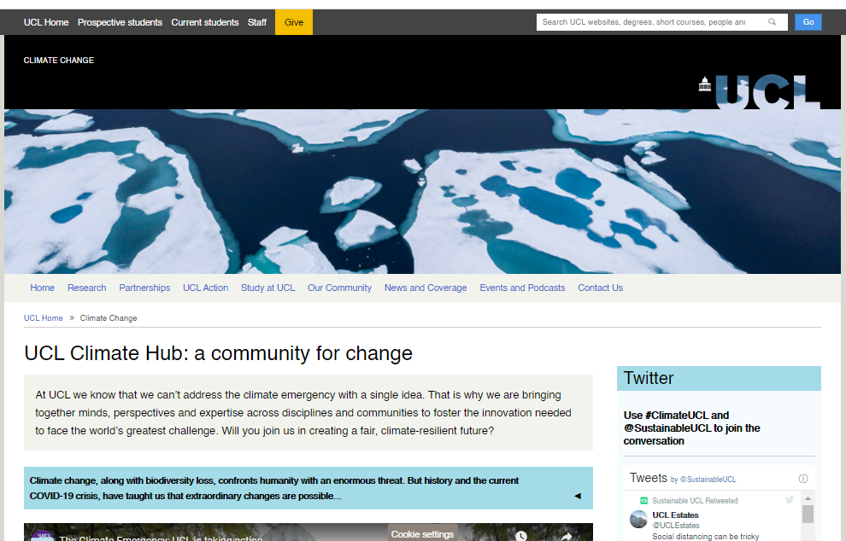
CLIMATE ACTION
AT UCL
Notes:
Last year we launched the UCL Climate Hub, a website to demonstrate the breadth of climate change research and action happening at UCL. Visit ucl.ac.uk/climate-change to find out what climate action and research UCL is doing and get inspired for your own studies or climate action.

Slide 24
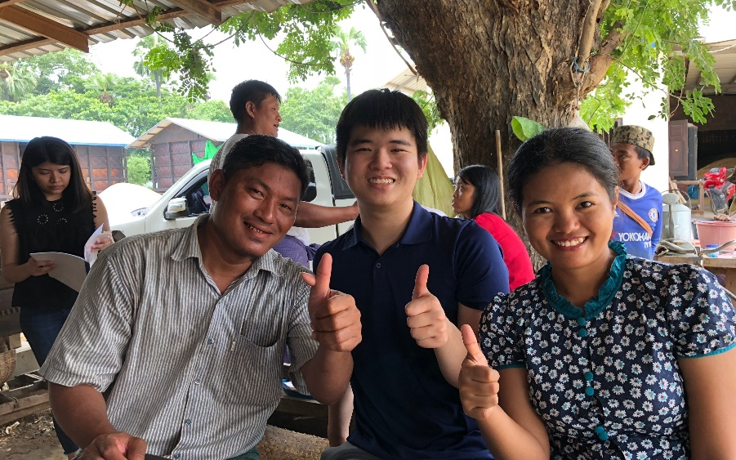
PROFESSIONAL
LIFE
Rice Inc – a social enterprise founded by UCL students - aims to alleviate food poverty in South East Asia.
They won the Hult Prize to fund their project.
Notes:
Sustainability is a hot topic and increasingly more employers, are looking for students with sustainability skills and literacy. And not just in environmentally focused jobs, but in engineering, retail, urban planning and many more!
There are lots of opportunities for students at UCL to gain these skills. In February Sustainable UCL is organising a Sustainability Careers Fortnight to show the breadth of opportunities in this rapidly growing sector and introduce you to leading organisations. Check out the Sustainable UCL website nearer the time to find out more.
UCL Innovation and Enterprise also provides funding and support for students with enterprising ideas. The students and founders of Rice Ing developed the idea to install rice drying facilities in remote villages in Myanmar, Vietnam, Malaysia and the Philippines to help boost their yields by 30-40%, thus alleviating food poverty in South East Asia. They won the Hult Prize to fund their social enterprise and now they are planning to sell rice commercially, having delivered on their vision to install rice drying facilities.

Slide 25
FIND OUT MORE!
www.ucl.ac.uk/sustainable/student-opportunities
@Sustainable UCL
@SustainableUCL
@SustainableUCL
@sustainableucl
Or join our department’s Green Team!
Notes:
To end with, maybe we could see a show of hands who is interested in engaging with sustainability either as part of their studies, free time, or professional career.
Show of hands for studies
Show of hands for free time
Show of hands for professional context/work experience
Well, in whatever capacity you are interested in sustainability, make sure to check out the Sustainable UCL website or social media channels for more information about sustainability at UCL or join our very own Green Team.

