Slide 1
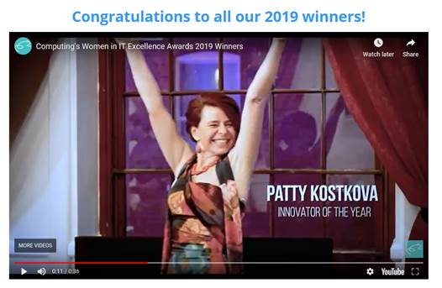
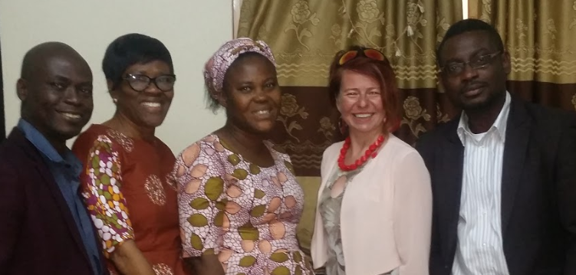
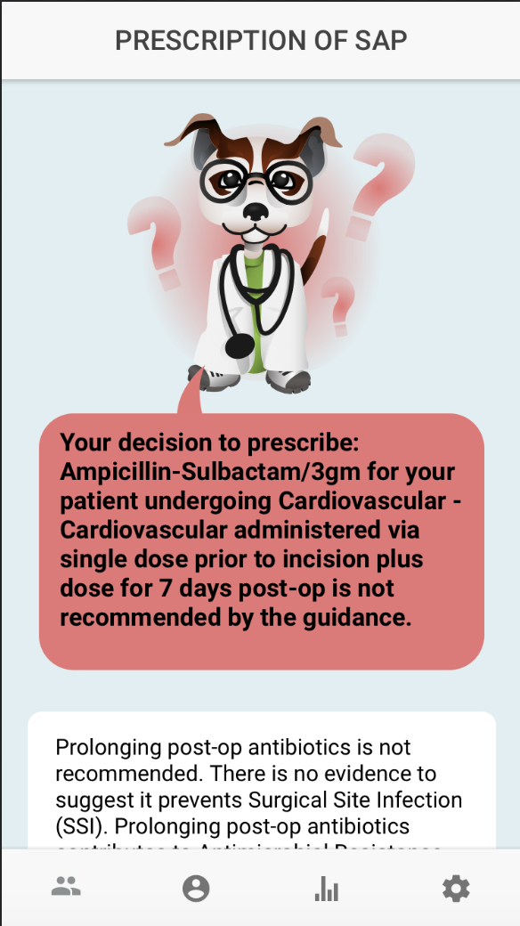
UCL IRDR CENTRE FOR DIGITAL PUBLIC HEALTH IN EMERGENCIES
Prof Patty Kostkova
Professor of Digital Health
Director, UCL Centre for Digital Public Health in Emergencies
GADSA: Gamified Antimicrobial Stewardship Decision
Support App in Nigeria
MANTRA: Increasing maternal and child health resilience before
during and after disasters using mobile technology in Nepal
MEWAR / ZIKA: Mosquito population modelling for early warning system
and rapid health authority response in Brazil
DR-TB Genie App: gamified decision support prescribing app for DR-TB management
in rural South Africa
iNRIC: iNternational Resource for Infection Control – one stop shop for IP&C evidence
in the UK and Africa
COVID-19: My Events Journal App, authorities discourse on Twitter, Zoom or not to Zoom

