Slide 1
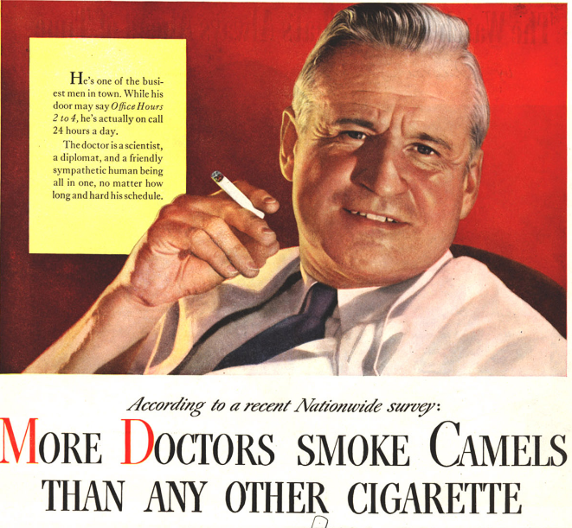
When study design and inference collide
The curious case of smoking and covid-19

Slide 2
This study found a “markedly decreased risk of both COVID-19 disease and ICU admission in smokers”.

Slide 3
OK, weird things can happen in research. This was just one study…?

Slide 4
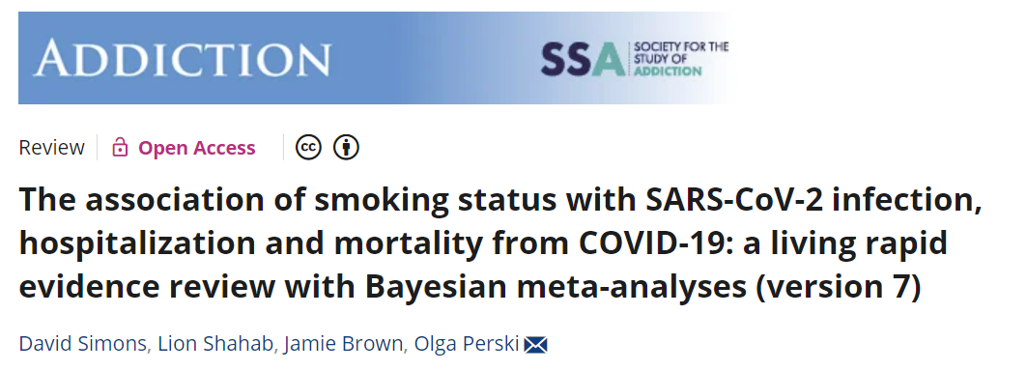
A review of 33 studies judged of at least “fair” quality found “Current compared with never smokers were at reduced risk of SARS-CoV-2 infection [relative risk (RR) = 0.74, 95% credible interval (CrI) = 0.58–0.93].”

Slide 5
Consider this hypothetical research study
A “covid symptom tracker” app was distributed widely (App Store, Google Play Store) to the general public.
Users were asked to log their symptoms daily and to record the outcome of any covid tests they had taken.
The results showed a lower likelihood of a positive covid test in current smokers vs ex- and never-smokers.
The researchers could not rule out that smoking may be protective of covid infection.

Slide 6
Your task
Divide yourselves into groups of 4 – 5 people each.
In your groups, critically discuss the study design just shown:
What might be the effect of measurement error?
What might be the effect of important but unmeasured variables?
What other sources of bias might there be?
How could such factors account for the specific finding of apparent protective effect of smoking on covid infection?
Go to menti.com. Use code 8442 8993. Tell us your suggestions for 1-4.

Slide 7
Summary of your task
The study design
Consider the likely effects of:
A “covid symptom tracker” is distributed to the general public.
Users log their covid symptoms and tests.
Results: Probability of a positive covid test lower in current smokers.
Measurement error
Unmeasured variables
Other biases
Could these design issues explain the results? (if the result is in fact a type I error)
Go to menti.com. Use code 8442 8993

Slide 8
Let’s look at what you said

Slide 10
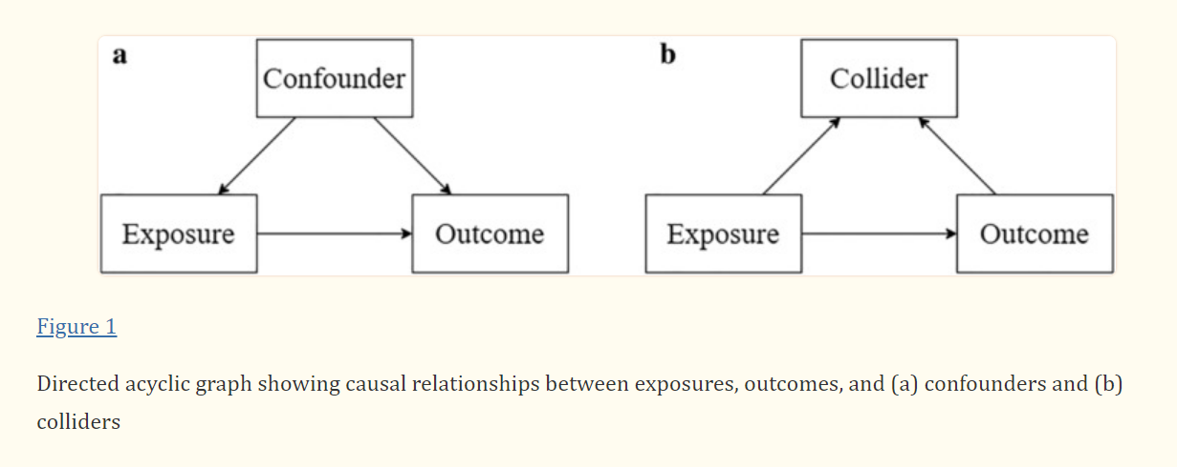
What is a collider?
Source: Tattan-Birch, H. et al. (2021). http://doi.org/10.1111/add.15348

Slide 11
Collider bias – an example
Full card deck N (proportion)
 | Red | Not Red
Face Card | 6 | 6 | (0.23)
Not Face | 20 | 20 | (0.77)
 | (0.50) | (0.50) | 52
Phi correlation = 0
Face cards (Jack, Queen, King): 12 cards
Red cards (Hearts, Diamonds): 26 cards
Phi correlation, Face with Red = 0

Slide 12
Collider bias – an example
Pick a card
You are selected if:
You have a face card (Jack, Queen, or King) OR
Your card is red (diamond or heart)
In the full deck (unselected sample), the correlation between face and red is zero
Full card deck N (proportion)
 | Red | Not Red
Face Card | 6 | 6 | (0.23)
Not Face | 20 | 20 | (0.77)
 | (0.50) | (0.50) | 52
Phi correlation = 0

Slide 13
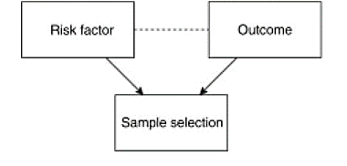
An example of collider bias on selection:
Face card
Red
Sample selection is a “collider”: the outcome of multiple, (potentially) sufficient causes.
Selection depends on having EITHER one or the
other “cause” of selection. If you have one, having the other as well is conditionally less likely.

Slide 14
Collider bias – an example
In the full deck, the correlation between face and red is zero
Pick a card
You are selected if:
You have a face card (Jack, Queen, or King) OR
Your card is red (diamond or heart)
Full card deck N (proportion)
 | Red | Not Red
Face Card | 6 | 6 | (0.23)
Not Face | 20 | 20 | (0.77)
 | (0.50) | (0.50) | 52
Phi correlation = 0
In those selected, what will be the sign and size of the phi correlation?

Slide 15
Our data

Slide 16
Collider bias – an example
The expected distribution of the selected cards is this →
If you have one “cause” of selection, having the other one too is relatively less likely than not having it.
62% of cards on average will be selected.
The expectation distribution for selected cards is:
 | Red | Not Red
Face Card | 0.19 | 0.19 | 0.37
Not Face | 0.63 | 0.00 | 0.63
 | 0.82 | 0.19 | 1
Phi correlation = -0.62

Slide 17
Collider bias causes an association between the causes of the selection
Corr = 0
Corr = -0.62
Face card
Red
Face card
Red
Expected association in the population
Expected association in the selected sample

Slide 18
What if the “causes” of selection are predictor and outcome?
Face card
Red
Sample selection is a “collider”: the outcome of multiple, (potentially) sufficient causes.
There will be a spurious association between
predictor and outcome in the sample

Slide 19
Collider bias for smoking and covid
Smoker
Covid test
Even if the risk and outcome are uncorrelated in the population…
…selection is more likely for those with symptoms of covid, one of which is having a cough (which is also a “symptom” of smoking).

Slide 20
In summary
People are not equally likely to be selected into a study (or to agree to participate, if randomly selected)
If sample selection is related to predictors and outcomes (or the outcomes of outcomes) this will introduce collider bias
In the example, both smokers and those with covid symptoms are more likely to download the app (i.e. to be selected into the study)
If all this is true, smoking will be negatively related to having covid in the sample, even though in the population they may be independent (or positively related)

Slide 21
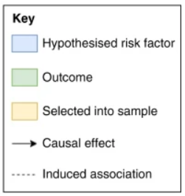
Another collider bias example: covid and age
Data from covid-tracking apps found an association between age and infection risk. (The association between covid disease severity is well-established, but this was infection risk, not severity when infected).
This was in part because people who used the app were likely to be younger, and people who had been infected were more likely to use the app.
Figure 2, from: Griffith, G.J., Morris, T.T., Tudball, M.J. et al. Collider bias undermines our understanding of COVID-19 disease risk and severity. Nature Communications, 11, 5749 (2020). https://doi-org.manchester.idm.oclc.org/10.1038/s41467-020-19478-2

Slide 22
A final note….

Slide 23
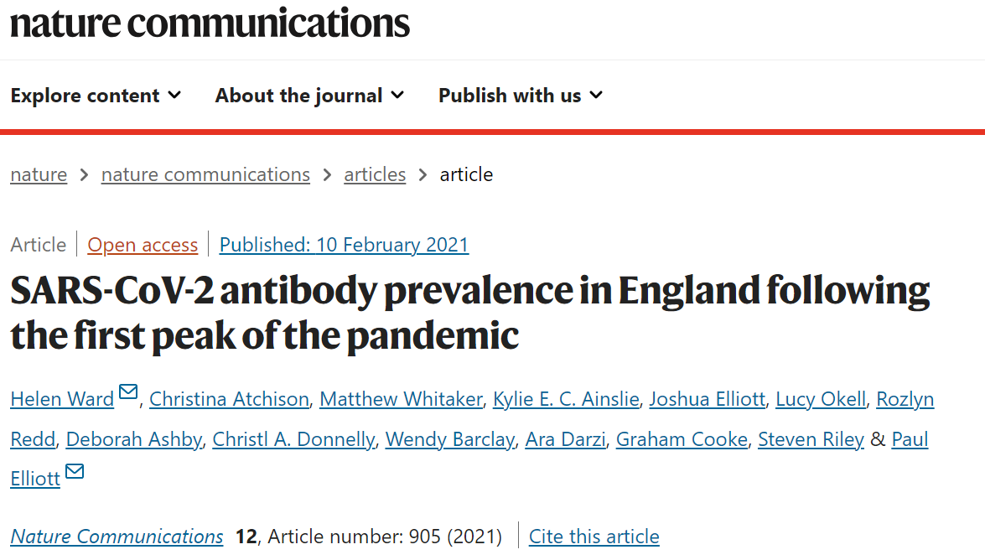
The sample in this study (REACT) was a random population sample, not selected on covid-testing status.
“Our finding that current smokers have a lower prevalence of SARS-CoV-2 infection than non-smokers may reflect unmeasured confounding, differential adoption of preventive behaviours (given the known associations of COVID-19 severity with smoking-related co-morbidities), or there may be some biological basis.”

Slide 24
References
Griffith et al. (2020). Collider bias undermines our understanding of COVID-19 disease risk and severity. Nature Communications,
Hippisley-Cox et al. (2020). Risk of severe COVID-19 disease with ACE inhibitors and angiotensin receptor blockers: cohort study including 8.3 million people. Heart. 2020; 106: 1503-1511.
Simons D, et al. (2021). The association of smoking status with SARS‐CoV‐2 infection, hospitalisation and mortality from COVID‐19: a living rapid evidence review with Bayesian meta‐analyses (version 7). Addiction. https://doi.org/10.1111/add.15276
Tattan-Birch, H. et al. (2021). http://doi.org/10.1111/add.15348

