Slide 1
Open Evening
Martin Lo
PhD Student
UCL

Slide 2
First year PhD student
Route A – MRes + PhD
Forensic Anthropology
Forensic Age Estimation using CT Scans of the Pelvis

Slide 3
The Journey
University of Edinburgh
MSc Human Anatomy
UCL
| MPhil/PhD (Present)
University of St Andrews
Medicine MBBS
2014
2018
2013
2017
2019
University of Sheffield
BSc Biomedical Science
UCL
| MRes Security Science

Slide 4
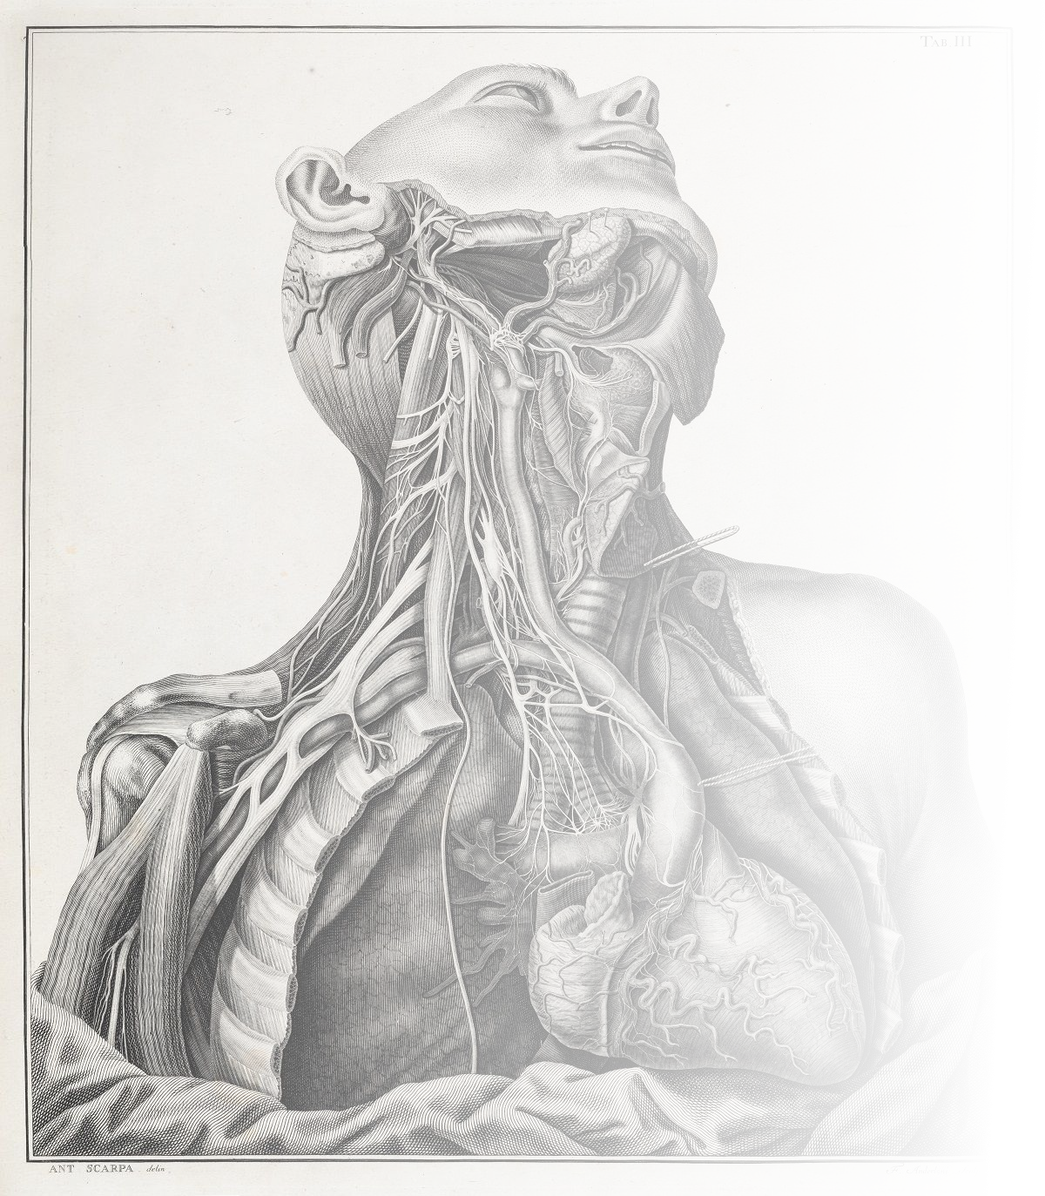
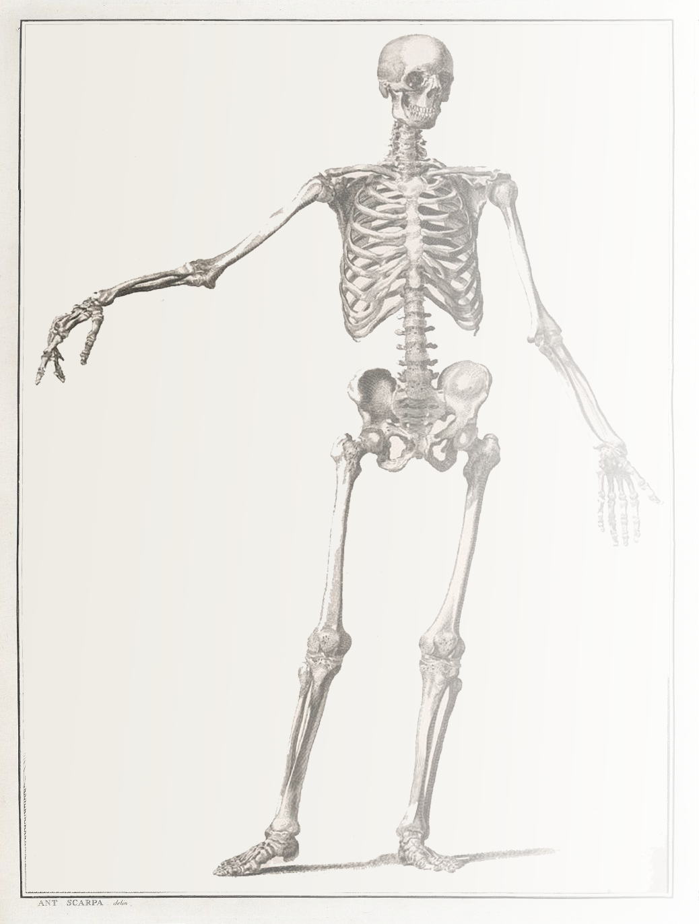
Why did I decide to do the PhD
Curiosity
Passion
Application of my knowledge
Synthesis of new knowledge
Keen to publish

Slide 5
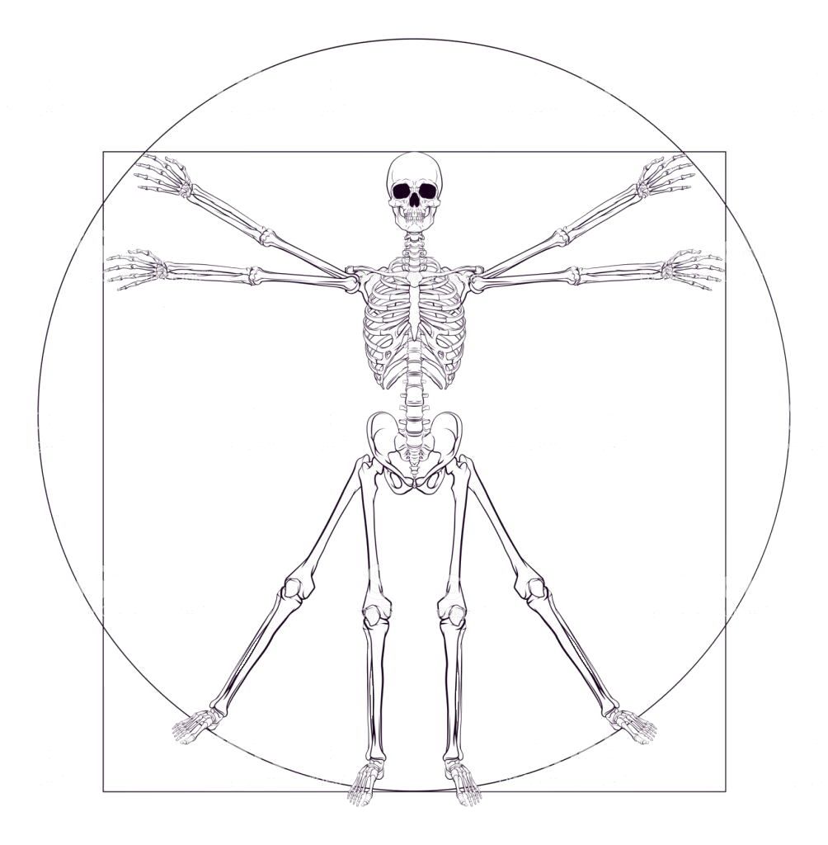
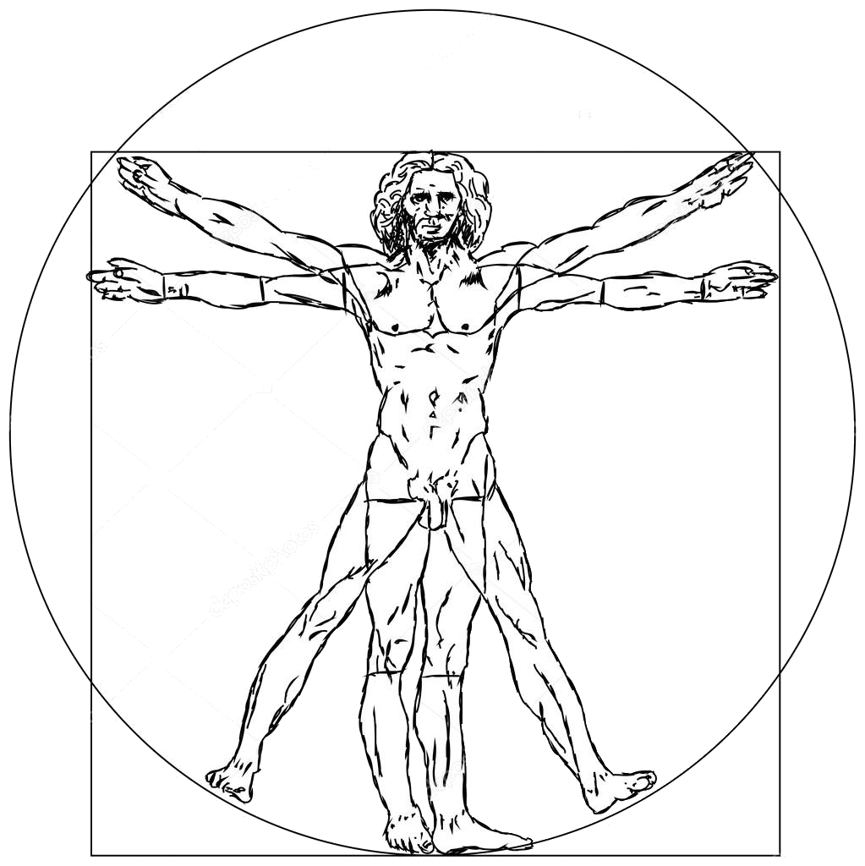
How did I arrive at my topic
Anatomy
Forensic Anthropology

Slide 6
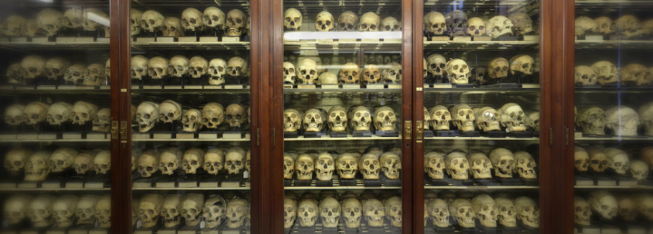
How did I arrive at my topic

Slide 7
What is it like to be a PhD student
BUT WHAT I ACTUALLY DO IS….

Slide 8
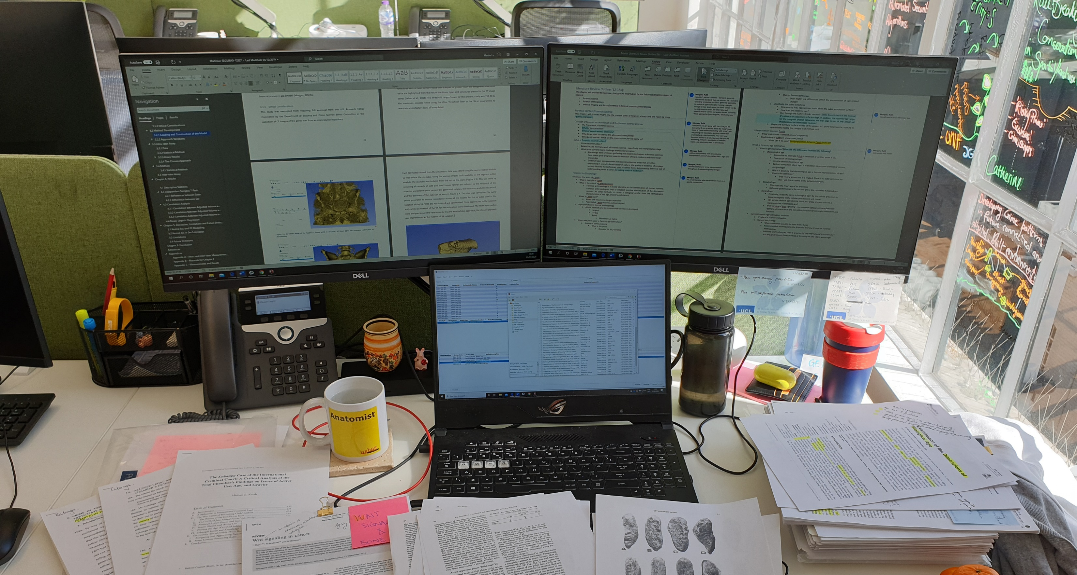
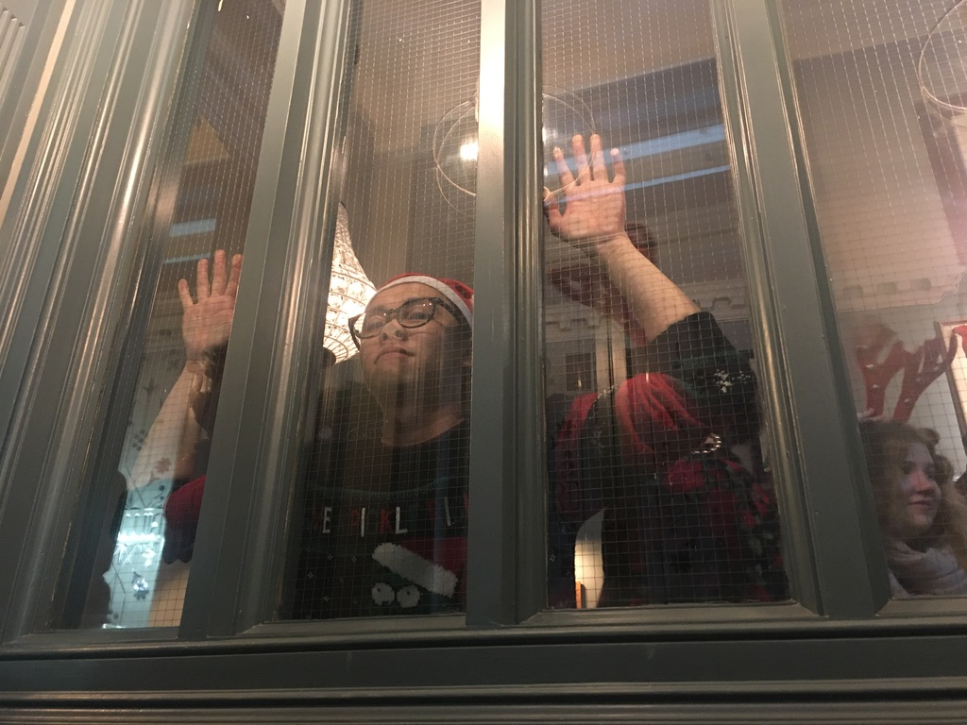
Ahmed, A.A., Mohammed, H.A., Hassan, M.A., 2011. Sex determination from cranial measurements in recent northern Sudanese. Khartoum Medical Journal 4, 539–547.
Akansel, G., Inan, N., Kurtas, O., Sarisoy, H.T., Arslan, A., Demirci, A., 2008. Gender and the lateral angle of the internal acoustic canal meatus as measured on computerized tomography of the temporal bone. Forensic Science International 178, 93–95. https://doi.org/10.1016/j.forsciint.2008.02.006
Albert, A.M., Greene, D.L., 1999. Bilateral asymmetry in skeletal growth and maturation as an indicator of environmental stress. Am. J. Phys. Anthropol. 110, 341–349. https://doi.org/10.1002/(SICI)1096-8644(199911)110:3<341::AID-AJPA6>3.0.CO;2-8
Anderson, B.E., 1990. Ventral arc of the os pubis: Anatomical and developmental considerations. American Journal of Physical Anthropology 83, 449–458. https://doi.org/10.1002/ajpa.1330830406
Apostolakos, J., Durant, T.J., Dwyer, C.R., Russell, R.P., Weinreb, J.H., Alaee, F., Beitzel, K., McCarthy, M.B., Cote, M.P., Mazzocca, A.D., 2014. The enthesis: a review of the tendon-to-bone insertion. Muscles Ligaments Tendons J 4, 333–342.
Asala, S.A., 2001. Sex determination from the head of the femur of South African whites and blacks. Forensic Sci. Int. 117, 15–22. https://doi.org/10.1016/S0379-0738(00)00444-8
Bainbridge, D., Tarazaga, S.G., 1956. A Study of Sex Differences in the Scapula. The Journal of the Royal Anthropological Institute of Great Britain and Ireland 86, 109–134. https://doi.org/10.2307/2843994
Barnard, M.M., 1935. The Secular Variations of Skull Characters in Four Series of Egyptian Skulls. Annals of Eugenics 6, 352–371. https://doi.org/10.1111/j.1469-1809.1935.tb02117.x
Beare, R., 2011. Histogram-based thresholding - some missing methods. The Insight Journal, 2011 January-June 811.
Behrensmeyer, A.K., Kidwell, S.M., Gastaldo, R.A., 2000. Taphonomy and Paleobiology. Paleobiology 26, 103–147.
Benjamin, M., Ralphs, J.R., 2001. Entheses--the bony attachments of tendons and ligaments. Ital J Anat Embryol 106, 151–157.
Biwasaka, H., Aoki, Y., Sato, K., Tanijiri, T., Fujita, S., Dewa, K., Yoshioka, K., Tomabechi, M., 2012a. Analyses of sexual dimorphism of reconstructed pelvic computed tomography images of contemporary Japanese using curvature of the greater sciatic notch, pubic arch and greater pelvis. Forensic Science International 219, 288.e1-288.e8. https://doi.org/10.1016/j.forsciint.2011.11.032
Biwasaka, H., Aoki, Y., Sato, K., Tanijiri, T., Fujita, S., Dewa, K., Yoshioka, K., Tomabechi, M., 2012b. Analyses of sexual dimorphism of reconstructed pelvic computed tomography images of contemporary Japanese using curvature of the greater sciatic notch, pubic arch and greater pelvis. Forensic Science International 219, 288.e1-288.e8. https://doi.org/10.1016/j.forsciint.2011.11.032
Blau, S., Ubelaker, D.H. (Eds.), 2016. Handbook of Forensic Anthropology and Archaeology, 2 edition. ed. Routledge, Walnut Creek, California.
Brough, A.L., Bennett, J., Morgan, B., Black, S., Rutty, G.N., 2013. Anthropological Measurement of the Juvenile Clavicle Using Multi‐Detector Computed Tomography—Affirming Reliability. Journal of Forensic Sciences 58, 946–951. https://doi.org/10.1111/1556-4029.12126
Brough, A.L., Morgan, B., Robinson, C., Black, S., Cunningham, C., Adams, C., Rutty, G.N., 2014. A minimum data set approach to post-mortem computed tomography reporting for anthropological biological profiling. Forensic Sci Med Pathol 10, 504–512. https://doi.org/10.1007/s12024-014-9581-4
Bruzek, J., 2002. A method for visual determination of sex, using the human hip bone. American Journal of Physical Anthropology 117, 157–168. https://doi.org/10.1002/ajpa.10012
Budinoff, L.C., Tague, R.G., 1990. Anatomical and developmental bases for the ventral arc of the human pubis. American Journal of Physical Anthropology 82, 73–79. https://doi.org/10.1002/ajpa.1330820109
Buikstra, J.E., Ubelaker, D.H., 1994. Standards for Data Collection from Human Skeletal Remains. Arkansas Archaeological Survey Research Series No. 44, Fayetteville. Idque sacrum vas iis erat, quo solennibus libarent 1.
Busey, T.A., Dror, I.E., 2011. Special Abilities and Vulnerabilities in Forensic Expertise 23.
Byers, S.N., 2016. Introduction to Forensic Anthropology. Taylor & Francis.
Caddy, B., Cobb, P., 2004. Forensic Science, in: White, P.C. (Ed.), Crime Scene to Court: The Essentials of Forensic Science. Royal Society of Chemistry, Cambridge, UK.
Caldwell, W.E., Moloy, H.C., 1938. Anatomical Variations in the Female Pelvis: Their Classification and Obstetrical Significance. Proc R Soc Med 32, 1–30.
Carew, R.M., Morgan, R.M., Rando, C., 2019. A Preliminary Investigation into the Accuracy of 3D Modeling and 3D Printing in Forensic Anthropology Evidence Reconstruction,. Journal of Forensic Sciences 64, 342–352. https://doi.org/10.1111/1556-4029.13917
Cattaneo, C., 2007. Forensic anthropology: developments of a classical discipline in the new millennium. Forensic Science International, Research in Forensic Medicine and Forensic Sciences: Basic Principles and Application in Practice 165, 185–193. https://doi.org/10.1016/j.forsciint.2006.05.018
Chen, P.Y., Popovich, P.M., 2002. Correlation: Parametric and nonparametric measures. Sage.
Christensen, A.M., 2004. The Impact of Daubert: Implications for Testimony and Research in Forensic Anthropology (and the Use of Frontal Sinuses in Personal Identification). Journal of Forensic Sciences 49, 1–4. https://doi.org/10.1520/JFS2003185
Christensen, A.M., Crowder, C.M., 2009. Evidentiary Standards for Forensic Anthropology*. Journal of Forensic Sciences 54, 1211–1216. https://doi.org/10.1111/j.1556-4029.2009.01176.x
Christensen, A.M., Passalacqua, N.V., Bartelink, E.J., 2014. , in: Forensic Anthropology: Current Methods and Practice. Academic Press, Oxford ; San Diego, California, pp. 414–424.
Cignoni, P., Callieri, M., Corsini, M., Dellepiane, M., Ganovelli, F., Ranzuglia, G., 2008. Meshlab: an open-source mesh processing tool., in: Eurographics Italian Chapter Conference 2008. Presented at the Eurographics 2008, Eurographics, Salerno, Italy, pp. 129–136.
Clark, K., Vendt, B., Smith, K., Freymann, J., Kirby, J., Koppel, P., Moore, S., Phillips, S., Maffitt, D., Pringle, M., Tarbox, L., Prior, F., 2013. The Cancer Imaging Archive (TCIA): Maintaining and Operating a Public Information Repository. J Digit Imaging 26, 1045–1057. https://doi.org/10.1007/s10278-013-9622-7
Clark, M.A., Guatelli‐Steinberg, D., Hubbe, M., Stout, S., 2016. Quantification of Maxillary Dental Arcade Curvature and the Estimation of Biological Ancestry in Forensic Anthropology. Journal of Forensic Sciences 61, 141–146. https://doi.org/10.1111/1556-4029.12910
Colman, K.L., Dobbe, J.G.G., Stull, K.E., Ruijter, J.M., Oostra, R.-J., van Rijn, R.R., van der Merwe, A.E., de Boer, H.H., Streekstra, G.J., 2017. The geometrical precision of virtual bone models derived from clinical computed tomography data for forensic anthropology. Int J Legal Med 131, 1155–1163. https://doi.org/10.1007/s00414-017-1548-z
Colman, K.L., van der Merwe, A.E., Stull, K.E., Dobbe, J.G.G., Streekstra, G.J., van Rijn, R.R., Oostra, R.-J., de Boer, H.H., 2019a. The accuracy of 3D virtual bone models of the pelvis for morphological sex estimation. Int J Legal Med. https://doi.org/10.1007/s00414-019-02002-7
Colman, K.L., van der Merwe, A.E., Stull, K.E., Dobbe, J.G.G., Streekstra, G.J., van Rijn, R.R., Oostra, R.-J., de Boer, H.H., 2019b. The accuracy of 3D virtual bone models of the pelvis for morphological sex estimation. Int J Legal Med. https://doi.org/10.1007/s00414-019-02002-7
Cöloğlu, A.S., Işcan, M.Y., Yavuz, M.F., Sari, H., 1998. Sex determination from the ribs of contemporary Turks. J. Forensic Sci. 43, 273–276.
Committee on Identfiying the Needs of the Forensic Sciences Community, National Research Council, 2009. Strengthening forensic science in the United States: a path forward, 1st ed. The National Academies Press, Washington, D.C.
Cooke, E., Hertzell, D., Ormerod, D., Patterson, F., Lorimer, E., 2012. The Law Commission Annual Report 2011-12.
Cox, M., Mays, S., 2000. Human Osteology: In Archaeology and Forensic Science. Cambridge University Press.
Cumming, G., Finch, S., 2005. Inference by eye: confidence intervals and how to read pictures of data. Am Psychol 60, 170–180. https://doi.org/10.1037/0003-066X.60.2.170
Cunningham, C., Scheuer, L., Black, S., 2016. Developmental Juvenile Osteology. Academic Press.
Dabbs, G.R., Moore-Jansen, P.H., 2010. A Method for Estimating Sex Using Metric Analysis of the Scapula. Journal of Forensic Sciences 55, 149–152. https://doi.org/10.1111/j.1556-4029.2009.01232.x
Daubert v. Merrell Dow Pharmaceuticals, Inc., 1993. , US.
Decker, S.J., Davy‐Jow, S.L., Ford, J.M., Hilbelink, D.R., 2011a. Virtual Determination of Sex: Metric and Nonmetric Traits of the Adult Pelvis from 3D Computed Tomography Models*,†. Journal of Forensic Sciences 56, 1107–1114. https://doi.org/10.1111/j.1556-4029.2011.01803.x
Decker, S.J., Davy‐Jow, S.L., Ford, J.M., Hilbelink, D.R., 2011b. Virtual Determination of Sex: Metric and Nonmetric Traits of the Adult Pelvis from 3D Computed Tomography Models*,†. Journal of Forensic Sciences 56, 1107–1114. https://doi.org/10.1111/j.1556-4029.2011.01803.x
DeSilva, R., Flavel, A., Franklin, D., 2014. Estimation of sex from the metric assessment of digital hand radiographs in a Western Australian population. Forensic Science International 244, 314.e1-314.e7. https://doi.org/10.1016/j.forsciint.2014.08.019
Di Vella, G., Campobasso, C.P., Dragone, M., Introna, F., 1994. Skeletal sex determination by scapular measurements. Boll. Soc. Ital. Biol. Sper. 70, 299–305.
Dirkmaat, D.C., Cabo, L.L., Ousley, S.D., Symes, S.A., 2008. New perspectives in forensic anthropology. American Journal of Physical Anthropology 137, 33–52. https://doi.org/10.1002/ajpa.20948
Djorojevic, M., Roldán, C., García-Parra, P., Alemán, I., Botella, M., 2014. Morphometric sex estimation from 3D computed tomography os coxae model and its validation in skeletal remains. International Journal of Legal Medicine 128, 879–888. https://doi.org/10.1007/s00414-014-1033-x
Dror, I.E., Cole, S.A., 2010. The vision in “blind” justice: Expert perception, judgment, and visual cognition in forensic pattern recognition. Psychonomic Bulletin & Review 17, 161–167. https://doi.org/10.3758/PBR.17.2.161
Đurić, M., Rakočević, Z., Đonić, D., 2005. The reliability of sex determination of skeletons from forensic context in the Balkans. Forensic Science International 147, 159–164. https://doi.org/10.1016/j.forsciint.2004.09.111
Erickson, B.J., Mutch, D., Lippmann, L., Jarosz, R., 2016. Radiology Data from The Cancer Genome Atlas Uterine Corpus Endometrial Carcinoma (TCGA-UCEC) collection. https://doi.org/10.7937/K9/TCIA.2016.GKJ0ZWAC
Fedorov, A., Beichel, R., Kalpathy-Cramer, J., Finet, J., Fillion-Robin, J.-C., Pujol, S., Bauer, C., Jennings, D., Fennessy, F., Sonka, M., Buatti, J., Aylward, S., Miller, J.V., Pieper, S., Kikinis, R., 2012. 3D Slicer as an Image Computing Platform for the Quantitative Imaging Network. Magn Reson Imaging 30, 1323–1341. https://doi.org/10.1016/j.mri.2012.05.001
Franklin, D., O’Higgins, P., Oxnard, C.E., Dadour, I., 2008. Discriminant function sexing of the mandible of Indigenous South Africans. Forensic Science International 179, 84.e1-84.e5. https://doi.org/10.1016/j.forsciint.2008.03.014
Garcia de Leon, J., Toon, C., 2014. A Comparison of the Klales et al. (2012) and Phenice (1969) Methods of Sex Estimation on a Modern Colombian Sample, in: Proceedings of the 64th Annual Scientific Meeting of the American Academy of Forensic Sciences. Presented at the 66th Annual Scientific Meeting of the American Academy of Forensic Sciences, American Academy of Forensic Sciences, 2014, Seattle, WA. Colorado Springs, p. 465.
Garvin, H.M., 2012. Adult Sex Determination: Methods and Application, in: A Companion to Forensic Anthropology. John Wiley & Sons, Ltd, pp. 239–247. https://doi.org/10.1002/9781118255377.ch12
Garvin, H.M., Sholts, S.B., Mosca, L.A., 2014. Sexual dimorphism in human cranial trait scores: effects of population, age, and body size. Am. J. Phys. Anthropol. 154, 259–269. https://doi.org/10.1002/ajpa.22502
General Electric Co. v. Joiner, 1997. , US.
Giles, E., Elliot, O., 1963. Sex determination by discriminant function analysis of crania. American Journal of Physical Anthropology 21, 53–68. https://doi.org/10.1002/ajpa.1330210108
Goldstein, H., Healy, M.J.R., 1995. The Graphical Presentation of a Collection of Means. Journal of the Royal Statistical Society. Series A (Statistics in Society) 158, 175–177. https://doi.org/10.2307/2983411
Gray, H., 2008. , in: Standring, S. (Ed.), Gray’s Anatomy: The Anatomical Basis of Clinical Practice. Churchill Livingstone/Elsevier, Edinburgh, pp. 1355, 1359–1360, 1374.
Greulic, W.W., Thoms, H., 1938. The dimensions of the pelvic inlet of 789 white females. The Anatomical Record 72, 45–51. https://doi.org/10.1002/ar.1090720105
Grigson, S.G., n.d. LORD JUSTICE THOMAS MR JUSTICE COULSON 11.
Grigson, S.G., n.d. LORD JUSTICE THOMAS MR JUSTICE COULSON 11.
Grivas, C.R., Komar, D.A., 2008. Kumho, Daubert, and the Nature of Scientific Inquiry: Implications for Forensic Anthropology*. Journal of Forensic Sciences 53, 771–776. https://doi.org/10.1111/j.1556-4029.2008.00771.x
Guyomarc’h, P., Bruzek, J., 2011. Accuracy and reliability in sex determination from skulls: A comparison of Fordisc® 3.0 and the discriminant function analysis. Forensic Science International 208, 180.e1-180.e6. https://doi.org/10.1016/j.forsciint.2011.03.011
Haglund, W.D., Sorg, M.H., 2001. Advances in Forensic Taphonomy: Method, Theory, and Archaeological Perspectives. CRC Press.
Hamer, D., 2012. Discussion paper: The R v T controversy: forensic evidence, law and logic. Law, Probability and Risk 11, 331–345. https://doi.org/10.1093/lpr/mgs021
Harnad, S., 2012. Lateralization in the Nervous system. Elsevier.
Hayashizaki, Y., Usui, A., Hosokai, Y., Sakai, J., Funayama, M., 2015. Sex determination of the pelvis using Fourier analysis of postmortem CT images. Forensic Science International 246, 122.e1-122.e9. https://doi.org/10.1016/j.forsciint.2014.10.008
Hiss, J., Freund, M., Kahana, T., 2007. The forensic expert witness—An issue of competency. Forensic Sci Int 168, 89–94. https://doi.org/10.1016/j.forsciint.2006.06.004
Holobinko, A., 2012. Forensic human identification in the United States and Canada: A review of the law, admissible techniques, and the legal implications of their application in forensic cases. Forensic Science International 222, 394.e1-394.e13. https://doi.org/10.1016/j.forsciint.2012.06.001
House of Lords, 2019. Forensic science and the criminal justice system: a blueprint for change (No. HL Paper 333), Science and Technology Select Committee. House of Lords.
Hunt, D.R., Albanese, J., 2005. History and demographic composition of the Robert J. Terry anatomical collection. Am. J. Phys. Anthropol. 127, 406–417. https://doi.org/10.1002/ajpa.20135
Inman, K., Rudin, N., 2002. The origin of evidence. Forensic Science International 126, 11–16. https://doi.org/10.1016/S0379-0738(02)00031-2
Introna, F., Di Vella, G., Campobasso, C.P., 1998. Sex determination by discriminant analysis of patella measurements. Forensic Sci. Int. 95, 39–45.
Işcan, M.Y., 1988. Rise of forensic anthropology. Am. J. Phys. Anthropol. 31, 203–229. https://doi.org/10.1002/ajpa.1330310510
İşcan, M.Y., Steyn, M., 1999. Craniometric determination of population affinity in South Africans. Int J Leg Med 112, 91–97. https://doi.org/10.1007/s004140050208
Iscan, M.Y., Steyn, M., Krogman, W.M., 2014. The Human Skeleton in Forensic Medicine, 3rd edition. ed. Charles C Thomas Publisher Ltd, Springfield, Illinois, U.S.A.
Kanchan, T., Gupta, A., Krishan, K., 2013. Estimation of sex from mastoid triangle - a craniometric analysis. J Forensic Leg Med 20, 855–860. https://doi.org/10.1016/j.jflm.2013.06.016
Kanchan, T., Kumar, T.S.M., Kumar, G.P., Yoganarasimha, K., n.d. Handedness in Skeletal Remains 2.
Kenyhercz, M.K., 2012. Sex estimation using pubic bone morphology in a modern South African sample: a test of the Klales et al. method, in: Proceedings of the Eightiy-First Meeting of the American Association for Physical Anthropology at Portland, OR. Presented at the 81st Meeting of the American Association for Physical Anthropology, WILEY-BLACKWELL 111 RIVER ST, HOBOKEN 07030-5774, NJ USA, Portland, Oregon, pp. 179–80.
Kenyhercz, M.W., Klales, A.R., Fredette, S.M., Dirkmaat, D.C., 2012. Metric and non-metric assessments of sex: accuracy, correlation and corroboration, in: Proceedings of the 64th Annual Meeting of the American Academy of Forensic Sciences Atlanta, GA. Presented at the 64th Annual Meeting of the American Academy of Forensic Sciences, American Academy of Forensic Sciences, 2012, Atlanta, GA, pp. 406–407.
Kenyhercz, M.W., Klales, A.R., Stull, K.E., McCormick, K.A., Cole, S.J., 2017. Worldwide population variation in pelvic sexual dimorphism: A validation and recalibration of the Klales et al. method. Forensic Sci. Int. 277, 259.e1-259.e8. https://doi.org/10.1016/j.forsciint.2017.05.001
Kimmerle, E.H., Ross, A., Slice, D., 2008. Sexual Dimorphism in America: Geometric Morphometric Analysis of the Craniofacial Region*. Journal of Forensic Sciences 53, 54–57. https://doi.org/10.1111/j.1556-4029.2007.00627.x
Kirk, S., Lee, Y., Lucchesi, F.R., Aredes, N.D., Gruszauskas, N., Catto, J., Garcia, K., Jarosz, R., Duddalwar, V., Varghese, B., Rieger-Christ, K., Lemmerman, J., 2016. Radiology Data from The Cancer Genome Atlas Urothelial Bladder Carcinoma [TCGA-BLCA] collection. https://doi.org/10.7937/K9/TCIA.2016.8LNG8XDR
Klales, A.R., 2013. Current practices in physical anthropology for sex estimation in unidentified, adult individuals, in: Proceedings of the Eighty-Second Annual Meeting of the American Association of Physical Anthropologists. Presented at the 82nd Annual Meeting of the American Association of Physical Anthropologists, WILEY-BLACKWELL 111 RIVER ST, HOBOKEN 07030-5774, NJ USA, Knoxville, Tennessee, p. 168.
Klales, A.R., Kenyhercz, M.W., 2015. Morphological Assessment of Ancestry using Cranial Macromorphoscopics,. Journal of Forensic Sciences 60, 13–20. https://doi.org/10.1111/1556-4029.12563
Klales, A.R., Ousley, S.D., Vollner, J.M., 2012. A revised method of sexing the human innominate using Phenice’s nonmetric traits and statistical methods. American Journal of Physical Anthropology 149, 104–114. https://doi.org/10.1002/ajpa.22102
Koo, T.K., Li, M.Y., 2016. A Guideline of Selecting and Reporting Intraclass Correlation Coefficients for Reliability Research. J Chiropr Med 15, 155–163. https://doi.org/10.1016/j.jcm.2016.02.012
Krakowka, K., 2017. Violence-Related Trauma from the Cistercian Abbey of St Mary Graces and a Late Black Death Cemetery. International Journal of Osteoarchaeology 27, 56–66. https://doi.org/10.1002/oa.2462
Krishan, K., Chatterjee, P.M., Kanchan, T., Kaur, S., Baryah, N., Singh, R.K., 2016. A review of sex estimation techniques during examination of skeletal remains in forensic anthropology casework. Forensic Science International 261, 165.e1-165.e8. https://doi.org/10.1016/j.forsciint.2016.02.007
Kumho Tire Co. v. Carmichael, 1999. , US.
L’Abbé, E.N., Loots, M., Meiring, J.H., 2005. The Pretoria Bone Collection: a modern South African skeletal sample. Homo 56, 197–205.
Langley, N.R., Dudzik, B., Cloutier, A., 2018. A Decision Tree for Nonmetric Sex Assessment from the Skull. J Forensic Sci 63, 31–37. https://doi.org/10.1111/1556-4029.13534
LaVelle, M., 1995. Natural selection and developmental sexual variation in the human pelvis. American Journal of Physical Anthropology 98, 59–72. https://doi.org/10.1002/ajpa.1330980106
Law Commission, G.B.L., 2011. Expert evidence in criminal proceedings in England and Wales (No. HC 829), LAW COM No 325. The Stationery Office, London.
Lesciotto, K.M., Doershuk, L.J., 2018. Accuracy and Reliability of the Klales et al. (2012) Morphoscopic Pelvic Sexing Method. Journal of Forensic Sciences 63, 214–220. https://doi.org/10.1111/1556-4029.13501
Lewis, C.J., Garvin, H.M., 2016. Reliability of the Walker Cranial Nonmetric Method and Implications for Sex Estimation. Journal of Forensic Sciences 61, 743–751. https://doi.org/10.1111/1556-4029.13013
Listi, G.A., Elizabeth Bassett, H., 2006. Test of an Alternative Method for Determining Sex from the Os Coxae: Applications for Modern Americans*. Journal of Forensic Sciences 51, 248–252. https://doi.org/10.1111/j.1556-4029.2006.00080.x
Lottering, N., MacGregor, D.M., Meredith, M., Alston, C.L., Gregory, L.S., 2013. Evaluation of the suchey–brooks method of age estimation in an Australian subpopulation using computed tomography of the pubic symphyseal surface. American Journal of Physical Anthropology 150, 386–399. https://doi.org/10.1002/ajpa.22213
Lovell, N.C., 1989. Test of Phenice’s technique for determining sex from the os pubis. American Journal of Physical Anthropology 79, 117–120. https://doi.org/10.1002/ajpa.1330790112
Luo, Y.-C., 1995. Sex determination from the pubis by discriminant function analysis. Forensic Science International 74, 89–98. https://doi.org/10.1016/0379-0738(95)01739-6
MacLaughlin, S. M., Bruce, M.F., 1990. Population variation in sexual dimorphism in the human innominate. Hum. Evol. 1, 221–231. https://doi.org/10.1007/BF02436580
MacLaughlin, Sue M., Bruce, M.F., 1990a. The Accuracy of Sex Identification in European Skeletal Remains Using the Phenice Characters. J. Forensic Sci. 35, 12974J. https://doi.org/10.1520/JFS12974J
MacLaughlin, Sue M., Bruce, M.F., 1990b. The Accuracy of Sex Identification in European Skeletal Remains Using the Phenice Characters. J. Forensic Sci. 35, 12974J. https://doi.org/10.1520/JFS12974J
MacLaughlin, S.M., Oldale, K.N.M., 1992. Vertebral body diameters and sex prediction. Annals of Human Biology 19, 285–292. https://doi.org/10.1080/03014469200002152
Mahakkanukrauh, P., Sinthubua, A., Prasitwattanaseree, S., Ruengdit, S., Singsuwan, P., Praneatpolgrang, S., Duangto, P., 2015. Craniometric study for sex determination in a Thai population. Anat Cell Biol 48, 275–283. https://doi.org/10.5115/acb.2015.48.4.275
Maples, W.R., Browning, M., 2010. Dead men do tell tales: the strange and fascinating cases of a forensic anthropologist. Broadway Books.
Maples, W.R., Browning, M., 1995. Dead Men Do Tell Tales: The Strange and Fascinating Cases of a Forensic Anthropologist. Broadway Books.
Marks, M.K., 1995. William M. Bass and the Development of Forensic Anthropology in Tennessee. J. Forensic Sci. 40, 15376J. https://doi.org/10.1520/JFS15376J
Martin, C.M., Roach, V.A., Nguyen, N., Rice, C.L., Wilson, T.D., 2013. Comparison of 3D reconstructive technologies used for morphometric research and the translation of knowledge using a decision matrix. Anat Sci Educ 6, 393–403. https://doi.org/10.1002/ase.1367
McDonald, J.H., 2009. Handbook of biological statistics. Sparky House Publishing, Baltimore, MD.
McFadden, C., Oxenham, M.F., 2016a. Revisiting the Phenice technique sex classification results reported by MacLaughlin and Bruce (1990). American Journal of Physical Anthropology 159, 182–183. https://doi.org/10.1002/ajpa.22839
McFadden, C., Oxenham, M.F., 2016b. Revisiting the Phenice technique sex classification results reported by MacLaughlin and Bruce (1990): Revisiting Phenice Technique Sex Classification Results. American Journal of Physical Anthropology 159, 182–183. https://doi.org/10.1002/ajpa.22839
Meindl, R.S., Lovejoy, C.O., Mensforth, R.P., Don Carlos, L., 1985. Accuracy and direction of error in the sexing of the skeleton: implications for paleodemography. Am. J. Phys. Anthropol. 68, 79–85. https://doi.org/10.1002/ajpa.1330680108
Mennell, J., Shaw, I., 2006. The Future of Forensic and Crime Scene Science: Part I. A UK forensic science user and provider perspective. Forensic Science International 157, S7–S12. https://doi.org/10.1016/j.forsciint.2005.12.022
Mnookin, J.L., Cole, S.A., Dror, I.E., Fisher, B.A.J., Houck, M.M., Inman, K., Kaye, D.H., Koehler, J.J., Langenburg, G., Risinger, D.M., Rudin, N., Siegel, J., Stoney, D.A., 2011. The Need for a Research Culture in the Forensic Sciences. UCLA LAW REV. 58, 725–780.
Morgan, R., 2017a. Conceptualising forensic science and forensic reconstruction. Part I: A conceptual model. Science & Justice 57, 455–459. https://doi.org/10.1016/j.scijus.2017.06.002
Morgan, R., 2017b. Conceptualising forensic science and forensic reconstruction. Part II: The critical interaction between research, policy/law and practice. Science & Justice 57, 460–467. https://doi.org/10.1016/j.scijus.2017.06.003
Morgan, R.M., Allen, E., Lightowler, Z.L., Freudiger-Bonzon, J., Bull, P.A., 2008. A Forensic Geoscience Framework and Practice. Policing 2, 185–195. https://doi.org/10.1093/police/pan021
Morgan, R.M., Bull, P.A., 2007a. Forensic geoscience and crime detection. MINERVA MEDICOLEGALE 127, 17.
Morgan, R.M., Bull, P.A., 2007b. The philosophy, nature and practice of forensic sediment analysis. Progress in Physical Geography: Earth and Environment 31, 43–58. https://doi.org/10.1177/0309133307073881
Morgan, R.M., Cohen, J., McGookin, I., Murly-Gotto, J., O’Connor, R., Muress, S., Freudiger-Bonzon, J., Bull, P.A., 2009. The relevance of the evolution of experimental studies for the interpretation and evaluation of some trace physical evidence. Science & Justice 49, 277–285. https://doi.org/10.1016/j.scijus.2009.02.004
Murail, P., Bruzek, J., Houët, F., Cunha, E., 2005. DSP: A tool for probabilistic sex diagnosis using worldwide variability in hip-bone measurements. Bulletins et mémoires de la Société d’Anthropologie de Paris 167–176.
Nakhaeizadeh, S., Dror, I.E., Morgan, R.M., 2014. Cognitive bias in forensic anthropology: Visual assessment of skeletal remains is susceptible to confirmation bias. Science & Justice 54, 208–214. https://doi.org/10.1016/j.scijus.2013.11.003
Nakhaeizadeh, S., Morgan, R.M., 2015. Forensic Anthropology and Cognitive Bias, in: Jamieson, A., Moenssens, A. (Eds.), Wiley Encyclopedia of Forensic Science. John Wiley & Sons, Ltd, Chichester, UK, pp. 1–8. https://doi.org/10.1002/9780470061589.fsa1118
Neuroscience, 2nd ed, 2001. . Sinauer Associates.
O’Brien, É., Nic Daeid, N., Black, S., 2015. Science in the court: pitfalls, challenges and solutions. Philos Trans R Soc Lond B Biol Sci 370. https://doi.org/10.1098/rstb.2015.0062
O’Donnell, C, Rotman, A., Collett, S., Woodford, N., 2007. Current status of routine post-mortem CT in Melbourne, Australia. Forensic science, medicine, and pathology 3, 226–232. https://doi.org/10.1007/s12024-007-9006-8
O’Donnell, C., Rotman, A., Collett, S., Woodford, N., 2007. Current status of routine post-mortem CT in Melbourne, Australia. Forensic Sci Med Pathol 3, 226–232. https://doi.org/10.1007/s12024-007-9006-8
Palmer, A.R., 1996. Waltzing with Asymmetry. BioScience 46, 518–532. https://doi.org/10.2307/1312930
Park, H.A., 2013. An introduction to logistic regression: from basic concepts to interpretation with particular attention to nursing domain. Journal of Korean Academy of Nursing 43, 154–164. https://doi.org/10.4040/jkan.2013.43.2.154
Phenice, T.W., 1969. A newly developed visual method of sexing the os pubis. American Journal of Physical Anthropology 30, 297–301. https://doi.org/10.1002/ajpa.1330300214
President’s Council of Advisors on Science and Technology, 2016. Report To The President - Forensic Science in Criminal Courts: Ensuring Scientific Validity of Feature-Comparison Methods. Executive Office of the President.
Pretorius, E., Steyn, M., Scholtz, Y., 2006a. Investigation into the usability of geometric morphometric analysis in assessment of sexual dimorphism. Am. J. Phys. Anthropol. 129, 64–70. https://doi.org/10.1002/ajpa.20251
Pretorius, E., Steyn, M., Scholtz, Y., 2006b. Investigation into the usability of geometric morphometric analysis in assessment of sexual dimorphism. Am. J. Phys. Anthropol. 129, 64–70. https://doi.org/10.1002/ajpa.20251
Purves, D., Augustine, G.J., Fitzpatrick, D., Katz, L.C., LaMantia, A.-S., McNamara, J.O., Williams, S.M., 2001. What Is Sex?, in: Neuroscience. Sinauer Associates Inc.
R. v Weller [2010] EWCA Crim 1085, 2010.
Ramsthaler, F., Kettner, M., Gehl, A., Verhoff, M.A., 2010a. Digital forensic osteology: Morphological sexing of skeletal remains using volume-rendered cranial CT scans. Forensic Science International 195, 148–152. https://doi.org/10.1016/j.forsciint.2009.12.010
Ramsthaler, F., Kettner, M., Gehl, A., Verhoff, M.A., 2010b. Digital forensic osteology: Morphological sexing of skeletal remains using volume-rendered cranial CT scans. Forensic Science International 195, 148–152. https://doi.org/10.1016/j.forsciint.2009.12.010
Robinson, C., Eisma, R., Morgan, B., Jeffery, A., Graham, E.A.M., Black, S., Rutty, G.N., 2008. Anthropological Measurement of Lower Limb and Foot Bones Using Multi‐Detector Computed Tomography. Journal of Forensic Sciences 53, 1289–1295. https://doi.org/10.1111/j.1556-4029.2008.00875.x
Robinson, T.E., 2007. Computed Tomography Scanning Techniques for the Evaluation of Cystic Fibrosis Lung Disease. Proc Am Thorac Soc 4, 310–315. https://doi.org/10.1513/pats.200612-184HT
Roche, A.F., 1992. Growth, Maturation and Body Composition: The Fels Longitudinal Study 1929-1991.
Rogers, T., Saunders, S., 1994. Accuracy of sex determination using morphological traits of the human pelvis. J. Forensic Sci. 39, 1047–1056.
Rogers, T.L., 2005. Determining the sex of human remains through cranial morphology. J. Forensic Sci. 50, 493–500.
Sahoo, P.K., Soltani, S., Wong, A.K.C., 1988. A survey of thresholding techniques. Computer Vision, Graphics, and Image Processing 41, 233–260. https://doi.org/10.1016/0734-189X(88)90022-9
Saul, F., Saul, J., 1989. Osteobiography: a Maya example, in: Reconstruction of Life from the Skeleton. Wiley, pp. 287–302.
Scheuer, L., 2002. Application of osteology to forensic medicine. Clinical Anatomy 15, 297–312. https://doi.org/10.1002/ca.10028
Schmeling, A., Dettmeyer, R., Rudolf, E., Vieth, V., Geserick, G., 2016. Forensic Age Estimation. Dtsch Arztebl Int 113, 44–50. https://doi.org/10.3238/arztebl.2016.0044
Schultz, A.H., 1930. The Skeleton of the Trunk and Limbs of Higher Primates. Human Biology 2, 303–438.
Science and Technology Select Committee, 2019. Forensic science and the criminal justice system: a blueprint for change (Session Report No. 333). House of Lords, London, United Kingdon.
Shirley, N.R., Ramirez Montes, P.A., 2015. Age estimation in forensic anthropology: quantification of observer error in phase versus component-based methods. J. Forensic Sci. 60, 107–111. https://doi.org/10.1111/1556-4029.12617
Silverman, B.W., 2011. Research and development in forensic science: a review. Home Office London (UK).
Smith, D.R., Limbird, K.G., Hoffman, J.M., 2002. Identification of human skeletal remains by comparison of bony details of the cranium using computerized tomographic (CT) scans. J. Forensic Sci. 47, 937–939.
Soni, G., Dhall, U., Chhabra, S., 2010. Determination of Sex From Femur: Discriminant Analysis. Journal of Anatomical Society of India 59, 216–221. https://doi.org/10.1016/S0003-2778(10)80029-2
Spradley, M.K., Jantz, R.L., 2016. Ancestry Estimation in Forensic Anthropology: Geometric Morphometric versus Standard and Nonstandard Interlandmark Distances. Journal of Forensic Sciences 61, 892–897. https://doi.org/10.1111/1556-4029.13081
Spradley, M.K., Jantz, R.L., 2011. Sex Estimation in Forensic Anthropology: Skull Versus Postcranial Elements. Journal of Forensic Sciences 56, 289–296. https://doi.org/10.1111/j.1556-4029.2010.01635.x
Steadman, D.W., 2009. Hard Evidence: Case Studies in Forensic Anthropology, 2 edition. ed. Routledge, Upper Saddle River, N.J.
Steele, D.G., 1976. The estimation of sex on the basis of the talus and calcaneus. Am. J. Phys. Anthropol. 45, 581–588. https://doi.org/10.1002/ajpa.1330450323
Stewart, T.D., 1979. , in: Essentials of Forensic Anthropology: Especially as Developed in the United States. Charles C. Thomas Springfield, IL, United States of America, pp. 104–257.
Steyn, M., İşcan, M.Y., 2008. Metric sex determination from the pelvis in modern Greeks. Forensic Science International 179, 86.e1-86.e6. https://doi.org/10.1016/j.forsciint.2008.04.022
Stull, K.E., Kenyhercz, M.W., L’Abbe, E.N., 2013. Non-metric cranial and pelvic traits as a measure of sexual dimorphism in a modern South African population, in: Proceedings of the Eighty‐Second Meeting of the American Association of Physical Anthropologists, Knoxville Convention Center, Knoxville, Tennessee,. Presented at the 82nd Annual Meeting of the American Association of Physical Anthropologists, WILEY-BLACKWELL 111 RIVER ST, HOBOKEN 07030-5774, NJ USA, Knoxville, Tennessee, p. 266.
Stull, K.E., Tise, M.L., Ali, Z., Fowler, D.R., 2014. Accuracy and reliability of measurements obtained from computed tomography 3D volume rendered images. Forensic Science International 238, 133–140. https://doi.org/10.1016/j.forsciint.2014.03.005
Sutherland, L.D., Suchey, J.M., 1991. Use of the Ventral Arc in Pubic Sex Determination. Journal of Forensic Sciences 36, 13051J. https://doi.org/10.1520/JFS13051J
Tague, R.G., 1992. Sexual dimorphism in the human bony pelvis, with a consideration of the Neandertal pelvis from Kebara cave, Israel. American Journal of Physical Anthropology 88, 1–21. https://doi.org/10.1002/ajpa.1330880102
Telmon, N., Gaston, A., Chemla, P., Blanc, A., Joffre, F., Rougé, D., 2005. Application of the Suchey-Brooks method to three-dimensional imaging of the pubic symphysis. J. Forensic Sci. 50, 507–512.
Thali, M.J., Yen, K., Schweitzer, W., Vock, P., Boesch, C., Ozdoba, C., Schroth, G., Ith, M., Sonnenschein, M., Doernhoefer, T., Scheurer, E., Plattner, T., Dirnhofer, R., 2003. Virtopsy, a new imaging horizon in forensic pathology: virtual autopsy by postmortem multislice computed tomography (MSCT) and magnetic resonance imaging (MRI)--a feasibility study. J. Forensic Sci. 48, 386–403.
Thompson, W.C., 2011. What role should investigative facts play in the evaluation of scientific evidence? Australian Journal of Forensic Sciences 43, 123–134. https://doi.org/10.1080/00450618.2010.541499
Torimitsu, S., Makino, Y., Saitoh, H., Sakuma, A., Ishii, N., Yajima, D., Inokuchi, G., Motomura, A., Chiba, F., Yamaguchi, R., Hashimoto, M., Hoshioka, Y., Iwase, H., 2015a. Morphometric analysis of sex differences in contemporary Japanese pelves using multidetector computed tomography. Forensic Science International 257, 530.e1-530.e7. https://doi.org/10.1016/j.forsciint.2015.10.018
Torimitsu, S., Makino, Y., Saitoh, H., Sakuma, A., Ishii, N., Yajima, D., Inokuchi, G., Motomura, A., Chiba, F., Yamaguchi, R., Hashimoto, M., Hoshioka, Y., Iwase, H., 2015b. Morphometric analysis of sex differences in contemporary Japanese pelves using multidetector computed tomography. Forensic Science International 257, 530.e1-530.e7. https://doi.org/10.1016/j.forsciint.2015.10.018
Tully, G., 2018. Forensic Science Regulator Annual Report 2017 (Corporate). Forensic Science Regulator.
Turner, W.D., Brown, R.E.B., Kelliher, T.P., Tu, P.H., Taister, M.A., Miller, K.W.P., 2005. A novel method of automated skull registration for forensic facial approximation. Forensic Science International 154, 149–158. https://doi.org/10.1016/j.forsciint.2004.10.003
Tuttösí, P., Cardoso, H.F.V., 2015. An assessment of sexual dimorphism and sex estimation using cervical dental measurements in a Northwest Coast archeological sample. Journal of Archaeological Science: Reports 3, 306–312. https://doi.org/10.1016/j.jasrep.2015.06.018
Ubelaker, D.H., 2018. Recent advances in forensic anthropology. Forensic Sciences Research 3, 275–277. https://doi.org/10.1080/20961790.2018.1466384
Ubelaker, D.H., Shamlou, A., Kunkle, A., 2019. Contributions of forensic anthropology to positive scientific identification: a critical Review. Forensic Sciences Research 4, 45–50. https://doi.org/10.1080/20961790.2018.1523704
Ubelaker, D.H., Volk, C.G., 2002. A Test of the Phenice Method for the Estimation of Sex. Journal of Forensic Sciences 47, 15200J. https://doi.org/10.1520/JFS15200J
Ubelaker, D.H., Zarenko, K.M., 2012. Can Handedness be Determined from Skeletal Remains? A Chronological Review of the Literature. Journal of Forensic Sciences 57, 1421–1426. https://doi.org/10.1111/j.1556-4029.2012.02173.x
U.S Department of Justice, 2014. Special Abilities and Vulnerabilities in Forensic Expertise, in: The Fingerprint: Sourcebook. National Institute of Justice, pp. 15-1-15–23.
Vance, V.L., Steyn, M., L’Abbé, E.N., 2011. Nonmetric Sex Determination from the Distal and Posterior Humerus in Black and White South Africans. Journal of Forensic Sciences 56, 710–714. https://doi.org/10.1111/j.1556-4029.2011.01724.x
Virtopsy, a New Imaging Horizon in Forensic Pathology: Virtual Autopsy by Postmortem Multislice Computed Tomography (MSCT) and Magnetic Resonance Imaging (MRI)—a Feasibility Study, 2003a. . JFS 48, 1–18. https://doi.org/10.1520/JFS2002166
Virtopsy, a New Imaging Horizon in Forensic Pathology: Virtual Autopsy by Postmortem Multislice Computed Tomography (MSCT) and Magnetic Resonance Imaging (MRI)—a Feasibility Study, 2003b. . JFS 48, 1–18. https://doi.org/10.1520/JFS2002166
Walker, P.L., 2008. Sexing skulls using discriminant function analysis of visually assessed traits. Am. J. Phys. Anthropol. 136, 39–50. https://doi.org/10.1002/ajpa.20776
Walker, P.L., 2005. Greater sciatic notch morphology: Sex, age, and population differences. American Journal of Physical Anthropology 127, 385–391. https://doi.org/10.1002/ajpa.10422
Walport, M., Craig, Claire, Surkovic, E., 2015. Forensic science and beyond: authenticity, provenance and assurance (No. 2), Annual report of the Governement Chief Scientific Advisor. Government Office for Science.
Wankhede, K.P., Bardale, R.V., Chaudhari, G.R., Kamdi, N.Y., 2015a. Determination of sex by discriminant function analysis of mandibles from a Central Indian population. J Forensic Dent Sci 7, 37–43. https://doi.org/10.4103/0975-1475.150304
Wankhede, K.P., Bardale, R.V., Chaudhari, G.R., Kamdi, N.Y., 2015b. Determination of sex by discriminant function analysis of mandibles from a Central Indian population. J Forensic Dent Sci 7, 37–43. https://doi.org/10.4103/0975-1475.150304
Washburn, S.L., 1948. Sex differences in the pubic bone. American Journal of Physical Anthropology 6, 199–208. https://doi.org/10.1002/ajpa.1330060210
Wasinpongwanich, K., Paholpak, P., Tuamsuk, P., Sirichativapee, W., Wisanuyotin, T., Kosuwon, W., Jeeravipoolvarn, P., 2014. Morphological Study of Subaxial Cervical Pedicles by Using Three-Dimensional Computed Tomography Reconstruction Image. Neurologia medico-chirurgica 54. https://doi.org/10.2176/nmc.oa.2013-0287
Weissheimer, A., Menezes, L.M. de, Sameshima, G.T., Enciso, R., Pham, J., Grauer, D., 2012. Imaging software accuracy for 3-dimensional analysis of the upper airway. American Journal of Orthodontics and Dentofacial Orthopedics 142, 801–813. https://doi.org/10.1016/j.ajodo.2012.07.015
Wescott, D.J., 2018a. Recent advances in forensic anthropology: decomposition research. Forensic Sci Res 3, 327–342. https://doi.org/10.1080/20961790.2018.1488571
Wescott, D.J., 2018b. Recent advances in forensic anthropology: decomposition research. Forensic Sciences Research 3, 278–293. https://doi.org/10.1080/20961790.2018.1488571
White, TD., Folkens, PA., 2005. , in: The Human Bone Manual. Academic Press, Amsterdam ; Boston, pp. 362–404.
Wilczak, C.A., 1998. Consideration of sexual dimorphism, age, and asymmetry in quantitative measurements of muscle insertion sites. International Journal of Osteoarchaeology 8, 311–325. https://doi.org/10.1002/(SICI)1099-1212(1998090)8:5<311::AID-OA443>3.0.CO;2-E
Williams, B.A., Rogers, T., 2006. Evaluating the accuracy and precision of cranial morphological traits for sex determination. J. Forensic Sci. 51, 729–735. https://doi.org/10.1111/j.1556-4029.2006.00177.x
Zimmer, W.D., Berquist, T.H., McLeod, R.A., Sim, F.H., Pritchard, D.J., Shives, T.C., Wold, L.E., May, G.R., 1985. Bone tumors: magnetic resonance imaging versus computed tomography. Radiology 155, 709–718. https://doi.org/10.1148/radiology.155.3.4001374
Zuley, M.L., Jarosz, R., Drake, B.F., Rancilio, D., Klim, A., Rieger-Christ, K., Lemmerman, J., 2016. Radiology Data from The Cancer Genome Atlas Prostate Adenocarcinoma [TCGA-PRAD] collection. https://doi.org/10.7937/K9/TCIA.2016.YXOGLM4Y

Slide 9
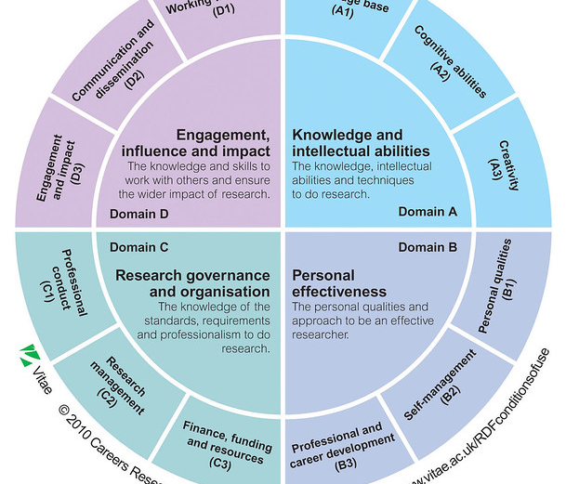
Support tools
Doctoral skills development
Regular Supervision
Research group meetings
Seminars
JDI Open
Internal Seminars
Collective intelligence of the cohort
Wide range of people from varying fields of expertise
All connected by the DSCS | JDI
PhD Society

Slide 10
