Slide 1
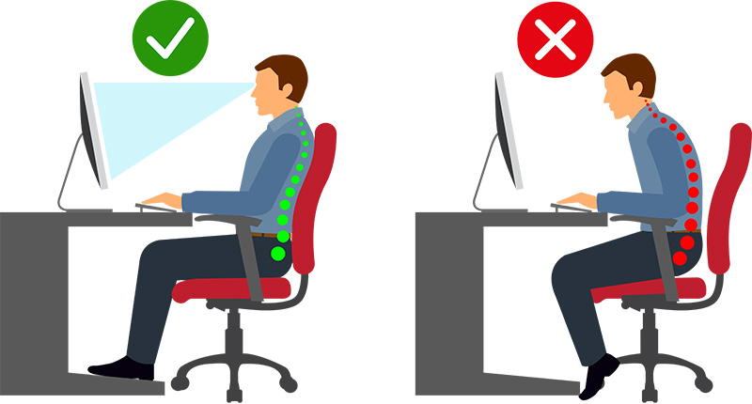
Safety Moment
Setting up your chair for comfort
A Safety Moment to reflect on how you can set up your chair most effectively for your workstation
When carrying out your DSE (Display Screen Equipment) Assessment, you should determine if the chair you use provides you with support for a comfortable working position.
You should know how to adjust your chair and it must be in working order.
If it is worn, damaged or you are unable to adjust it to suit you, you may need to report this or review your DSE Assessment.
Discussion Points
What impact could sitting poorly for prolonged periods have?
Think about how you might set up your car seat before you start driving – is there a benefit for doing something similar with your chair?
Do you know what all the levers on your chair do? Do they all work?
Further Information and Resources
Safety Services – Practical DSE Guidance
Safety Services – DSE Assessments
Workplace Health – Manager Referral to Occupational Health
NHS Resources – Live Well

