Slide 1
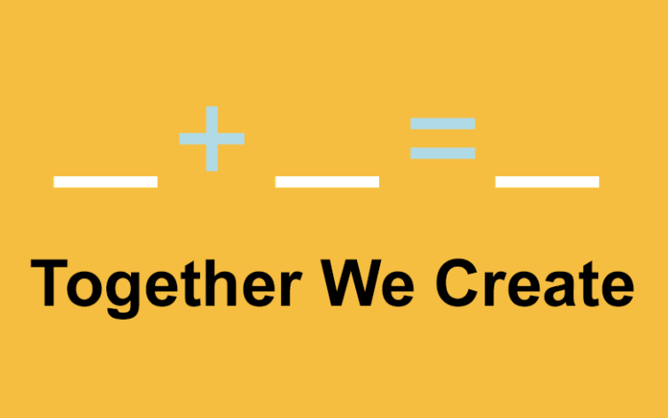
Social Science Plus What Makes a Good Application?

Slide 2
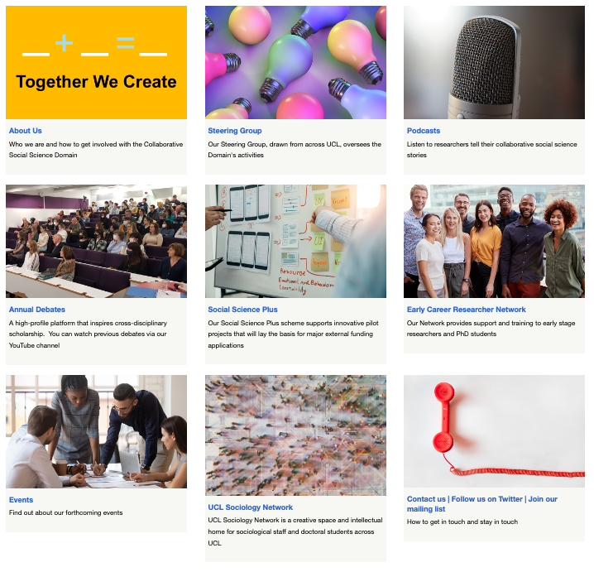
What is the aim of CSSD & what does it do?
Aims to Consolidate UCL’s innovative collaborative social science across the disciplines
Foster interdisciplinary ECR & Mid-Career capacity
Build conversations & partnerships between social science & other UCL disciplines
Innovate & share methods across Collaborative Social Science at UCL
Increase the visibility of UCL collaborative social science (e.g., Podcast series, annual debate)

Slide 3
Social Science Plus funds pilot studies to seed new collaborations between social science and other disciplines across UCL that foster a (medium or large) interdisciplinary collaborative projects with a strong social science component
Social Science Plus has supported:
15 pilot projects
Over 40 collaborators across UCL
Follow-on projects, publications and new networks
Over £1million of research funding being secured by UCL social scientists

Slide 4
Eligibility & process
Idea/focus viable pilot for a medium – large external research funding application
Team
Principal Investigators (PI) must be a UCL social scientist from the IOE or the Faculty of Social & Historical Sciences (our scheme funders)
Co-Investigators / ECRs / Additional Collaborators may be based in any UCL faculty
Min of 1 Co-I must be a non-social scientist from a different department to the PI
PI and Co-investigators must be of post-doctoral standing or above & be employed by UCL during the life of the project
We use the UKRI (ESRC) broad definition of social science disciplines.
Costs
Max 10K
Cost of employing a researcher
Non-staff costs (e.g. travel, equipment)
NOT faculty staff costs/time
Process
A Work-tribe costing is NOT required
Application form is short and straightforward

Slide 5
What makes a successful social science plus application?
A NEW collaboration
Social science led
Genuine inter/cross-disciplinary
Research based
High quality
Innovative
Viable basis for a medium/large external funding application
An ECR development plan
Duration: min 6mths, max 1 yr
The scheme is competitive
13% success rate
Two awards made per call

Slide 6
1. Off-world living analogue pilot projects: determining their value for the far and near future
Three examples of a successful application
Social Science Principal Investigator Aaron Parkhurst Lecturer, Biosocial and Medical Anthropology, Anthropology, Social and Historical Sciences, SLASH. Click on the bottom of the image to hear Aaron talk about his project.
Non-Social Science Co-Investigator Daniel Brayson, Post-doctoral Researcher, Developmental Neurosciences, Population Health Sciences, LMS
Second Co-Investigator Andrew Edkins, Professor of the Management of Complex Projects, Bartlett School of Sustainable Construction, Bartlett, BEAMS
Early Career Researcher Myles Harris PhD student, Institute of Risk and Disaster Reduction, Earth Sciences, Mathematical & Physical Sciences, BEAMS

Slide 7
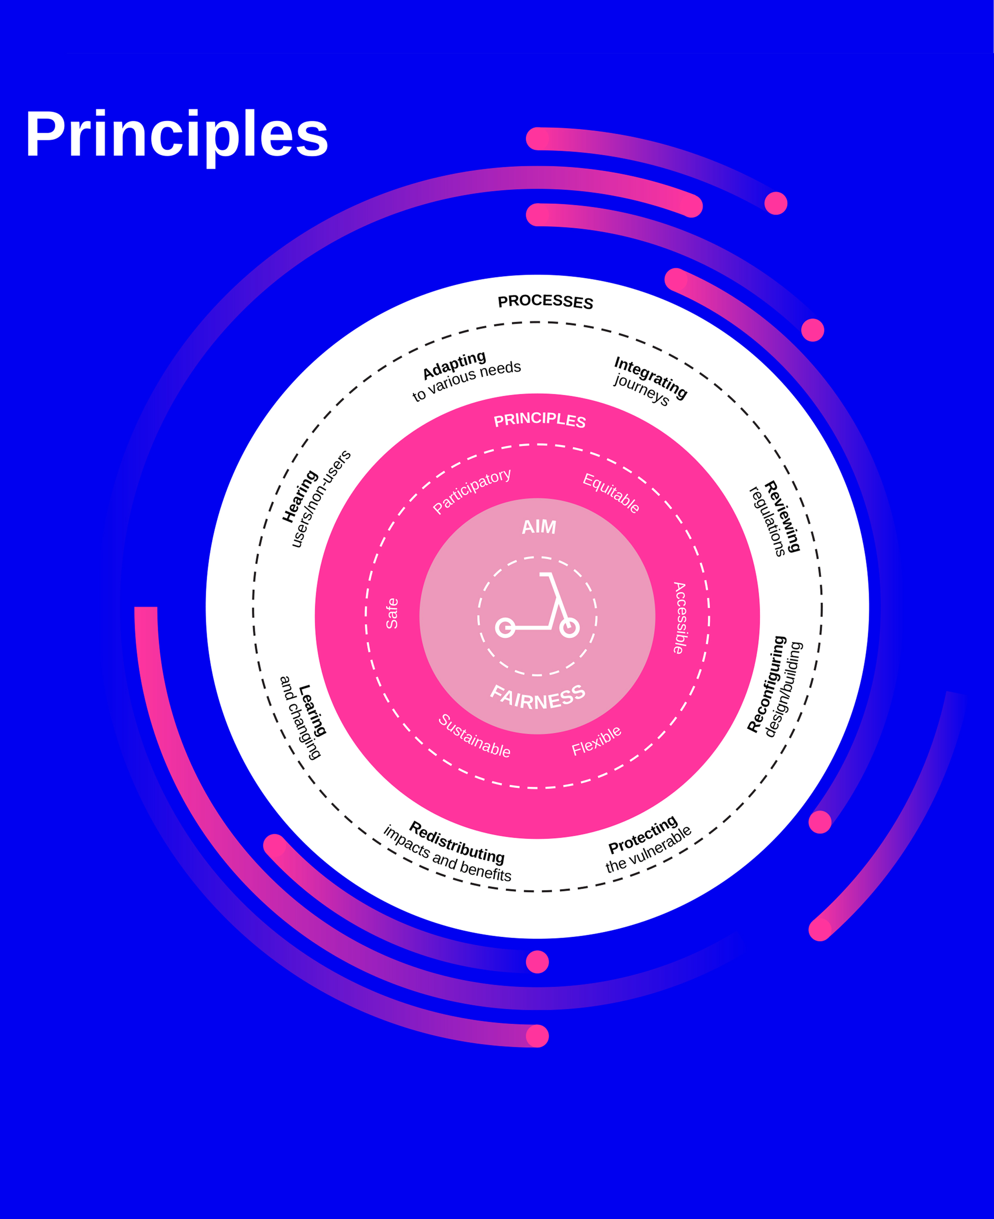
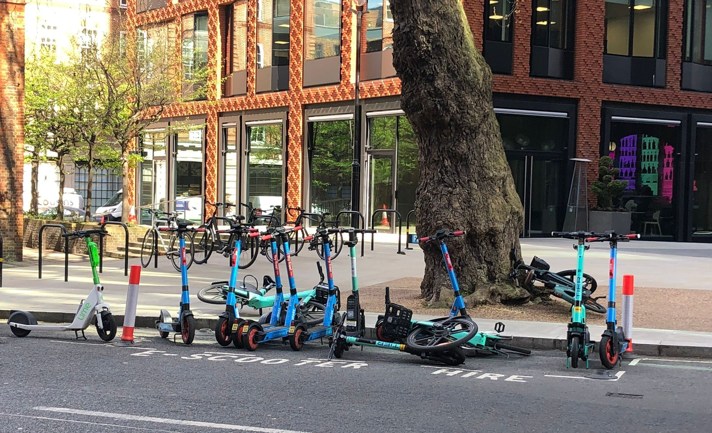
2. Are e-scooters contributing to transport-related social exclusion? Mapping supply practices in London’s micro mobility pilot
Social Science Principal Investigator Daniel Oviedo, Lecturer, Development Planning Unit, Bartlett, BEAMS
Non-Social Science Co-Investigator Helena Tiheridge, Professor of Mobility and Sustainable Transport, Civil, Environmental and Geomatic Engineering, Engineering Sciences, BEAMS
Second Co-Investigator Joanna Hale, Lead Sustainability Consultant, Centre for Behaviour Change, Brain Sciences, LMS
Early Career Researcher Azadeh Mashavehi, Development Planning Unit, Bartlett, BEAMS

Slide 8
3. Children and unsolicited sexual images on social media apps: developing better digital defence and literacy
Social Scientist PI: Jessica Ringrose, Professor Sociology of Gender and Education, Education, Society and Practice, IOE. Click on the bottom of the image to hear Jessica talk about her project. Non-Social Science Co-I: Dr. Enrico Mariconti, Lecturer, Department of Security and Crime Science, Engineering Sciences, BEAMS
Additional collaborator Sexplain sex education charity

Slide 9
Other successful projects
Since 2017 supported 15 pilot projects
over 40 collaborators across UCL
These have led to many follow-on projects, publications and networks
The scheme is competitive, a 13% success rate and two awards made per call.
Medical Anthropology + Psychiatric and Social Epidemiology + Sociology
Embodying the Social: re-thinking inequalities in the era of the ‘exposome’
Architecture and Urban Planning + Transportation Studies + Geography
Walk and Connect: Exploring the built environment’s influence on physical activity and social engagement for lower-income older residents in London through citizen science
Psychology + Dementia Epidemiology + Crime Science
Missing with dementia: Building the evidence base to better understand and reduce missing incidents involving people with dementia
Digital Anthropology + Environmental Modelling What Does Environmental Data Mean? Collaboratively Developing Practices of Environmental Data Justice
Sociology + Computer Science + Neuroscience Digital Touch Emoticons: Development, Effectiveness and Usability

Slide 10
Summary successful social science plus applications have a:
NEW collaboration
Strong social science focused challenge focus
Genuine inter/cross-disciplinary team drawing together different disciplines that make sense to investigate the phenomena
Research-base
High quality outline of the project
Innovative and exciting idea and approach
Clear ECR development plan
Strong and feasible basis for an external funding application (medium/large not an individual fellowship/post doc)
Application form and process outlined on the CSSD website
Closing date: 11am, 4 June 2024

Slide 11
Keep up to date with CSSD
CCSD website
www.ucl.ac.uk/research/domains/collaborative-social-science
Follow us on Twitter/ X:
@UCL_Social_Sci
Sign up for CSSD emails
Join our ECR network

