Slide 1
Space Vehicle Orbit Dynamics Research at UCL: Twenty years of figuring out where things are, and where they’re going
Marek Ziebart
Professor of Space Geodesy
Member NATO SCI-279 task group
Member NASA-CNES Ocean Surface Topography Science Team
Director, Space Geodesy and Navigation Laboratory
University College London
UCL Space Week, 17th May 2019

Slide 2
What’s coming up…....
Flight Dynamics – What is it? Why is it important?
UCL group’s methods, track record
The Orbital Debris Problem
Space Traffic Management

Slide 3
Orbit errors and science
1) Determine orbits and clocks
2) Model range observables
Orbit errors distort Earth and process modelling
3) Compute Earth model

Slide 4
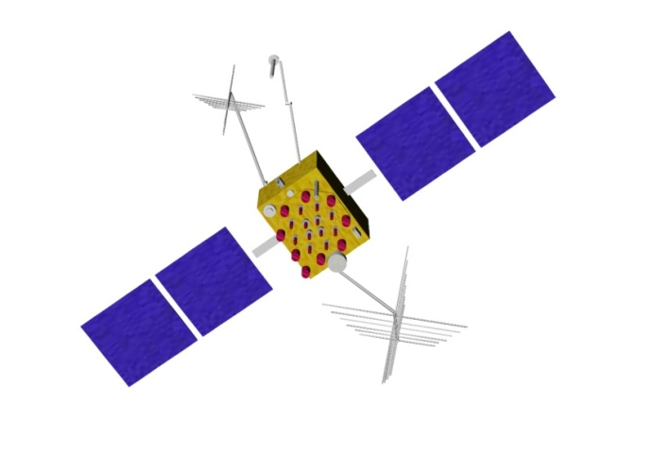
Forces acting on an RSO¹
Antenna thrust
(AT)
Out-gassing
Lorentz forcing
planetary gravity
general relativistic
effects
Thermal forcing
(TRR)
Atmospheric drag
Solar radiation pressure (SRP)
Lunar gravity
Earth gravity
Solar gravity
Tidal effects
PRP
(planetary radiation
pressure)
¹Resident Space Object
Notes:
4
For the GNSS altitude we conventionally assume that the conservative gravitational effects are very well known – particularly since the launch and analysis of dedicated gravity field missions like GRACE and GOCE. The radiation pressure effects are perceived as more problematic and simplified, empirical approaches are adopted.

Slide 5
Main UCL Group Capabilities
Photon pressure modelling of complex space vehicles (solar radiation pressure; earth radiation pressure; thermal re-radiation; antenna thrust)
Radiation torque modelling
Lorentz force and surface charge modelling
Analysis of space debris
GNSS Geodesy, instrument integration, modelling and realisation of height datums, offshore reference surface modelling, novel navigation concepts
14 PDRAs/PhD students, 3 academic staff
Main partners: NASA (JPL & GSFC); ESA (ESOC and ESTEC); DSTL; USAF/AFRL (Air Force Research Lab)

Slide 6
Modelling Philosophy
Use all available physical and engineering data in model computation
Avoid simplifying assumptions, embrace complexity
Avoid any empirical (soak-up) estimation
Output models that capture complexity but are simple to implement and which run fast

Slide 7
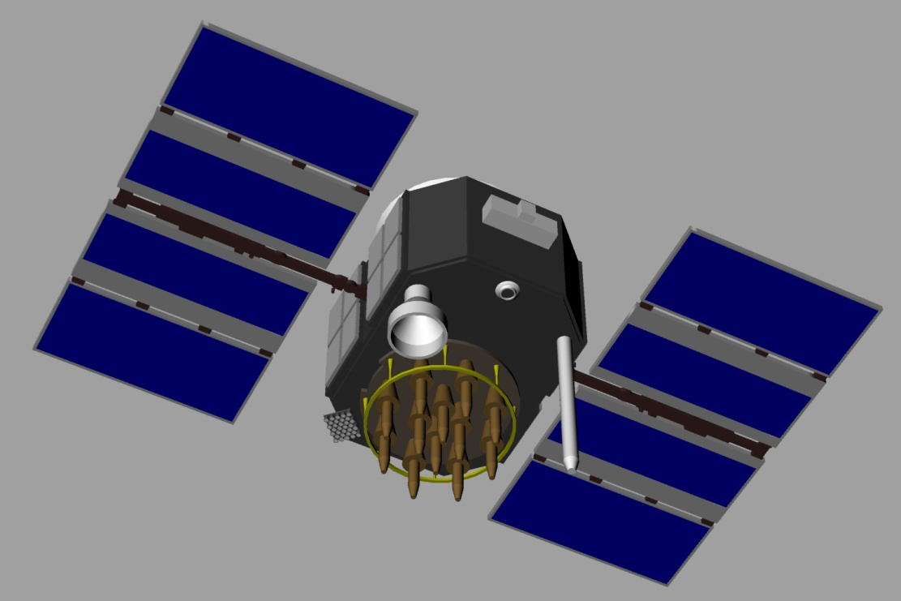
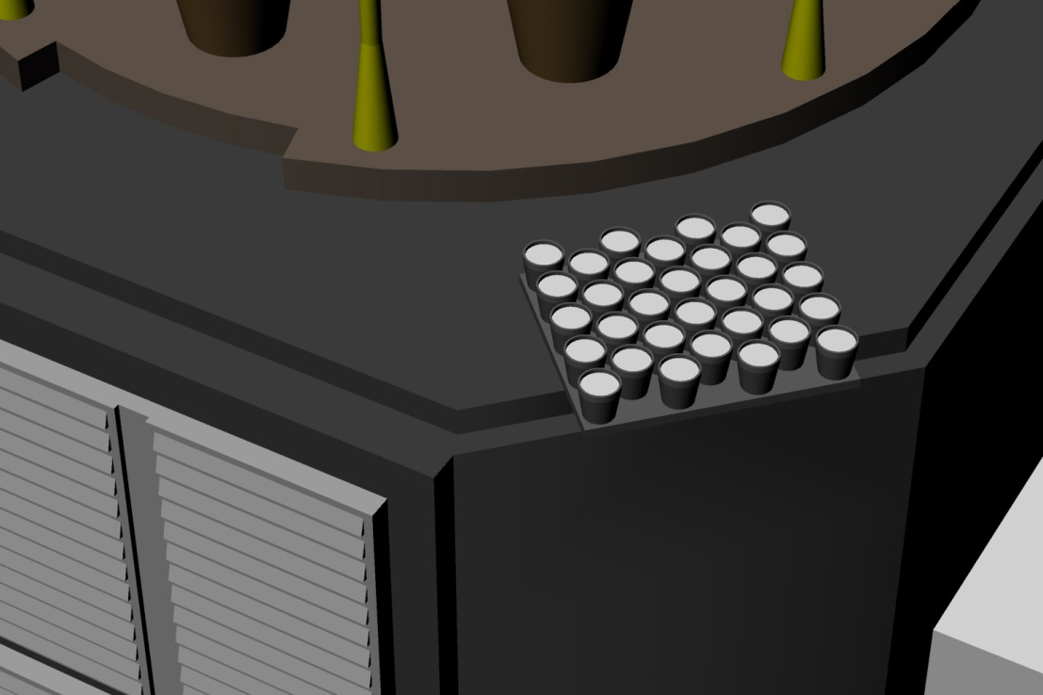
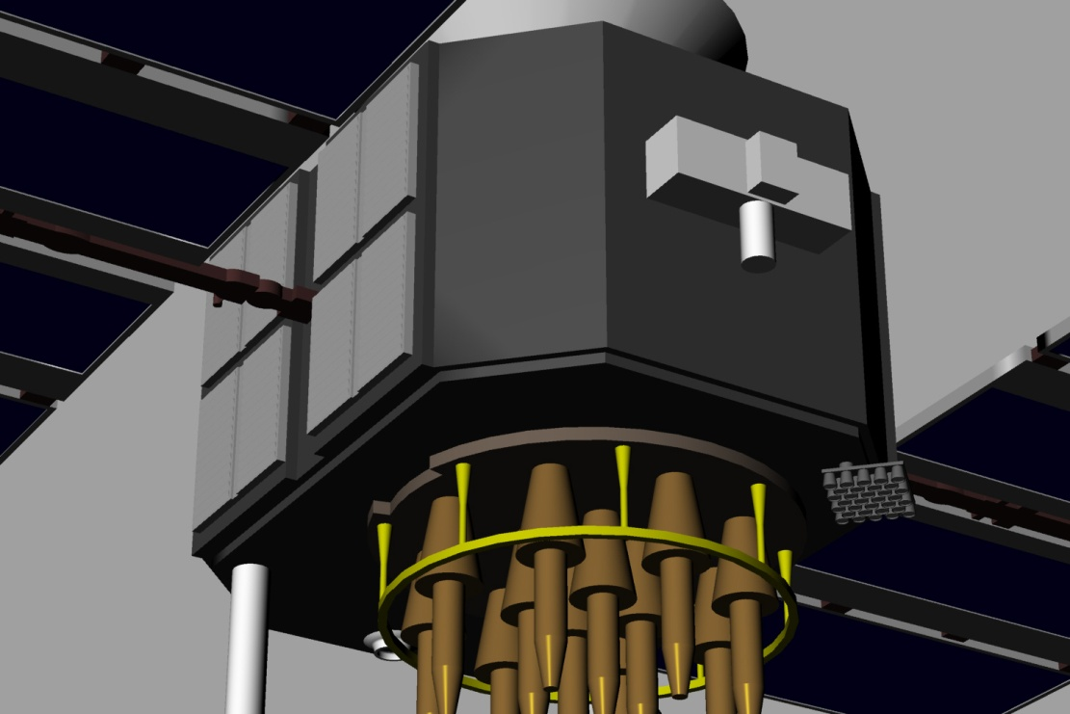
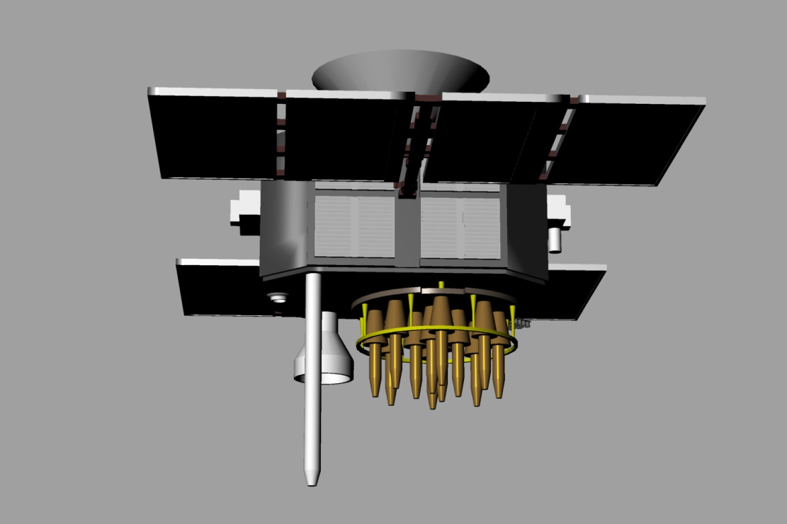
We develop a detailed structural computer model of the spacecraft

Slide 8
Heritage and impact
Jason-1 and ENVISAT models as NASA operational standards
Lead orbit dynamics working group for the IGS (International GNSS Service)
Antenna thrust and earth radiation forcing models are operational standards for the IGS
1cm accuracy orbit for Jason-1 (with JPL & GSFC), 2cm accuracy orbits for GPS (JPL, ESOC)

Slide 9
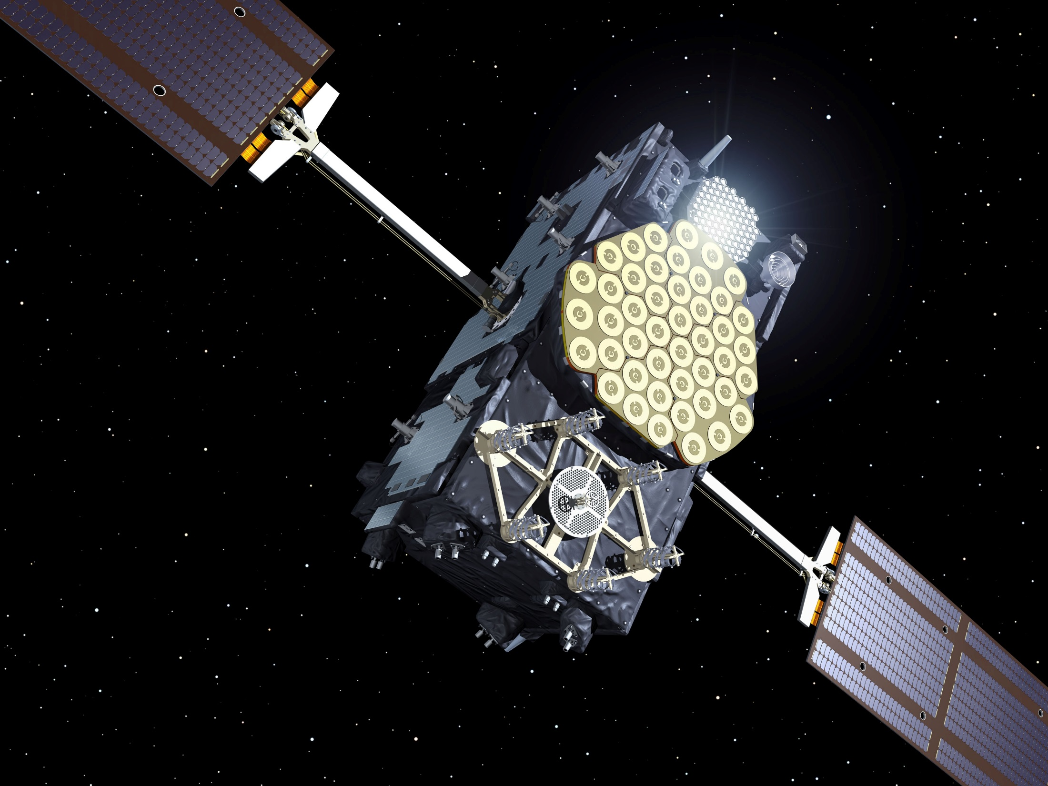
Current work:
Galileo – Europe’s next generation GPS

Slide 10
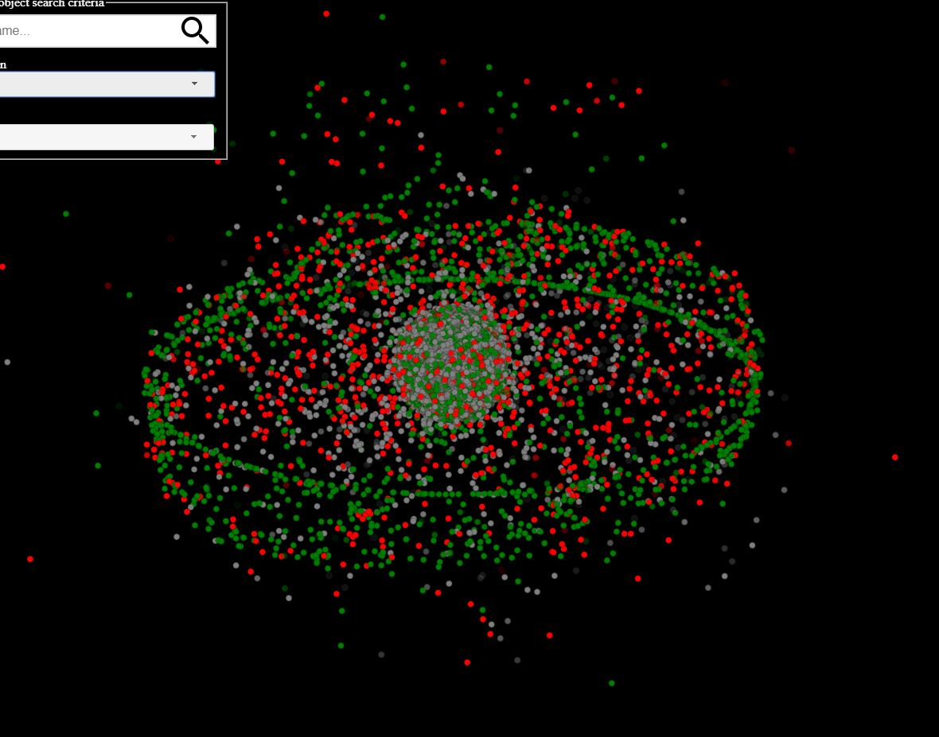
Space Traffic Management and Space Debris
Space Traffic Management and the Orbital Debris Problem

Slide 11
Space Debris: some facts and figures USSTRATCOM catalogue (10cm or larger) n = 33,000 objects Roughly 1,000 correlated at any one time Space Fence Radar comes online (1cm or larger) n > 2,000,000 Problems: Credible conjunction analysis Data management problems Long term evolution of the debris

Slide 12
Overarching trends - debris (from catalogue analysis)
Underlying linear trend
(l >=10cm)
Objects on orbit
Fragmentation or
collision event
time

Slide 13
1-10 cm debris population evolution
Evolution dominated by fragmentation events
Fragmentation: explosive events; collision; break up; battery failure; self-destruct
NASA standard break up model
Analytical/statistical dispersion models
All methods have simplistic assumptions driven by practicality

Slide 14
Fragmentation event file: 242 major events

Slide 15
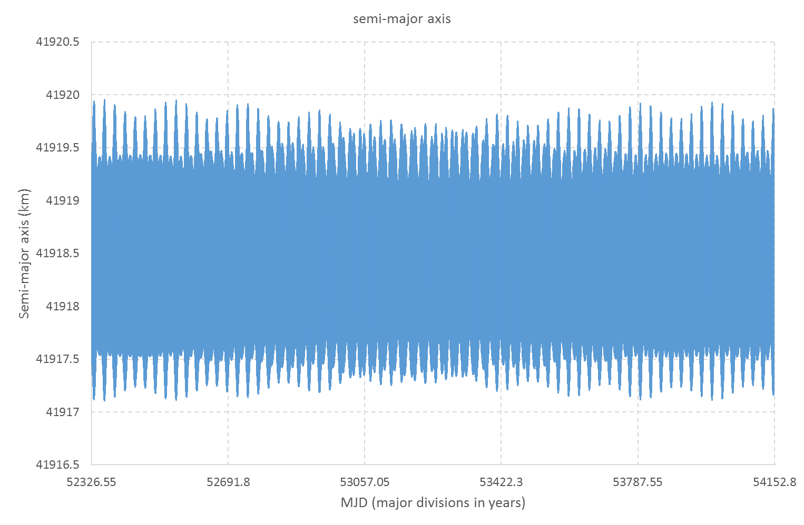
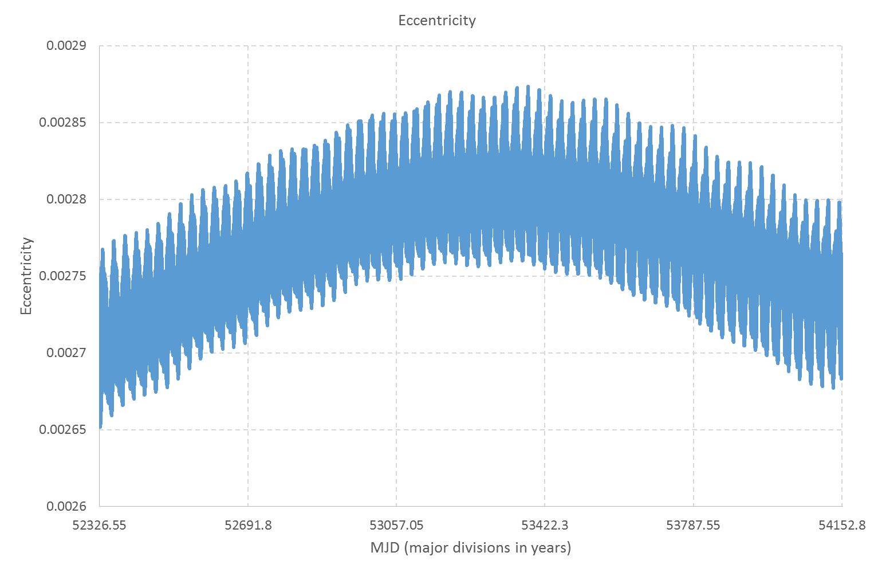
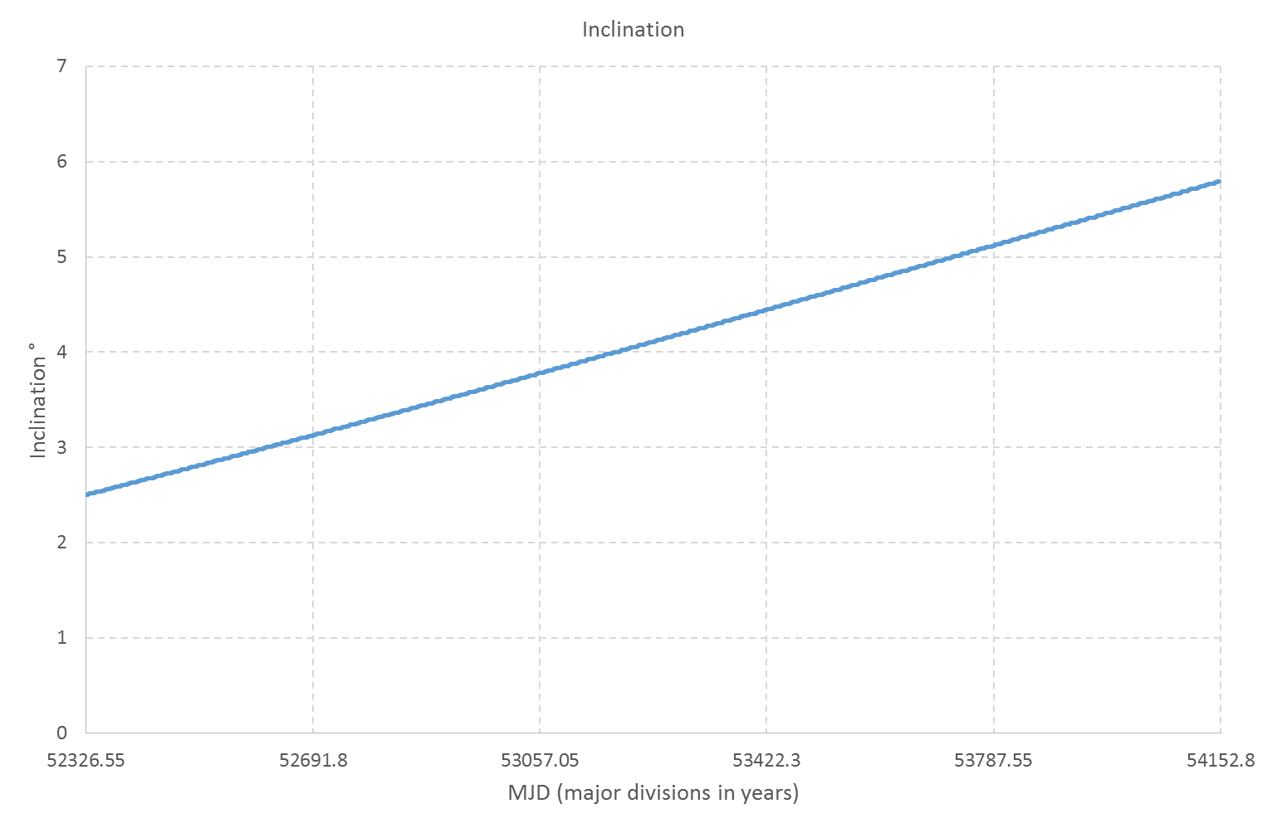
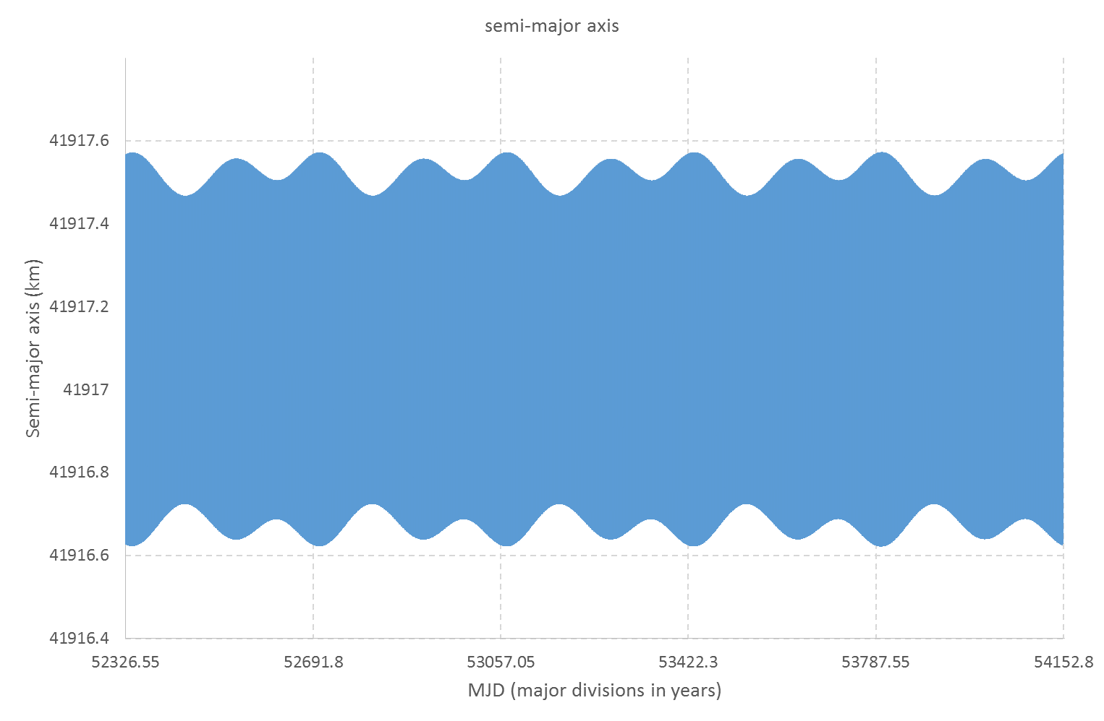
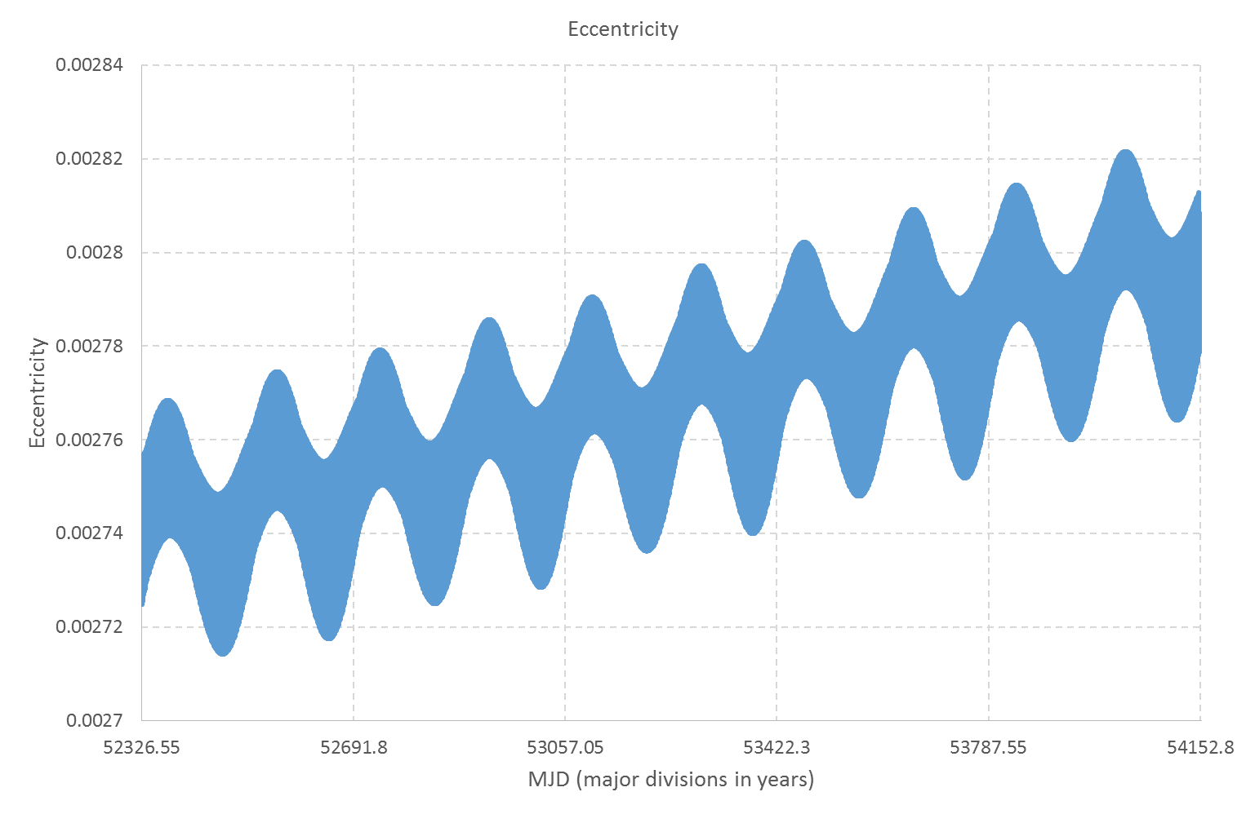
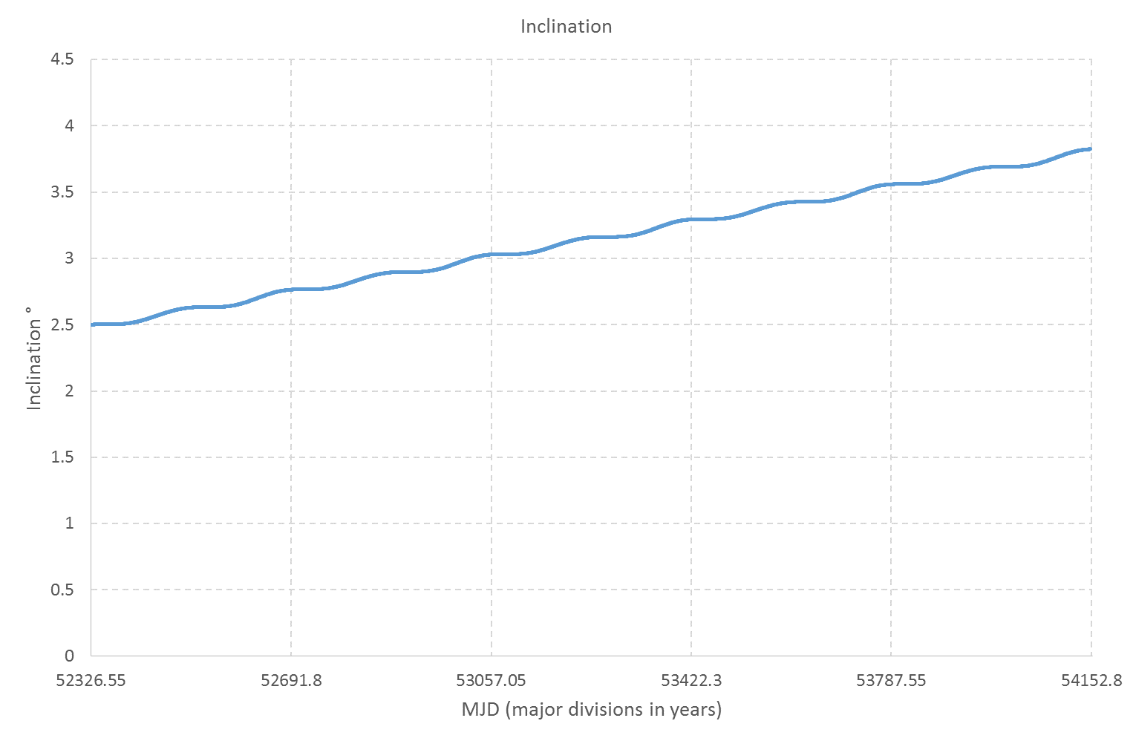
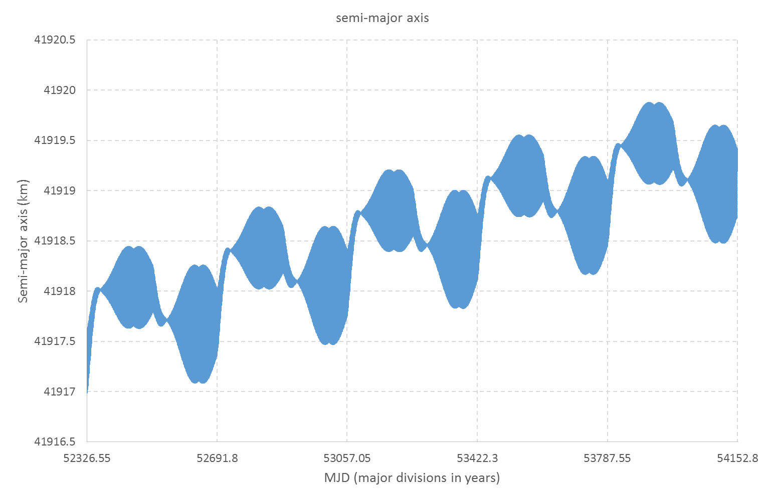
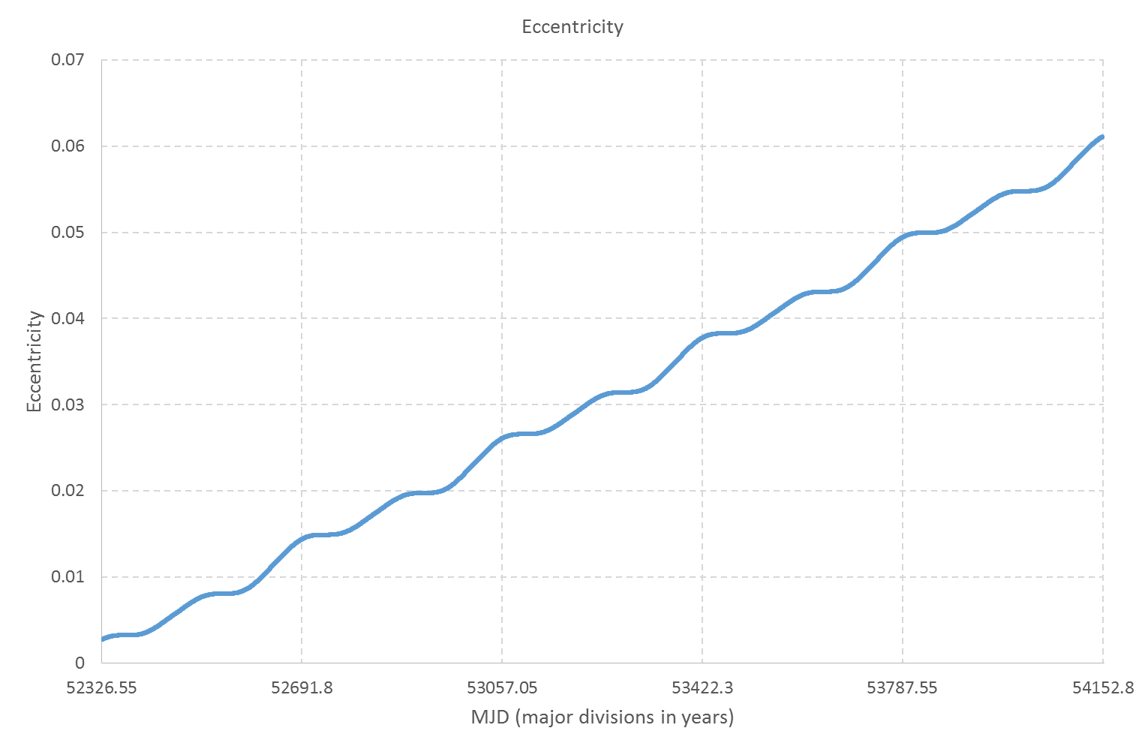
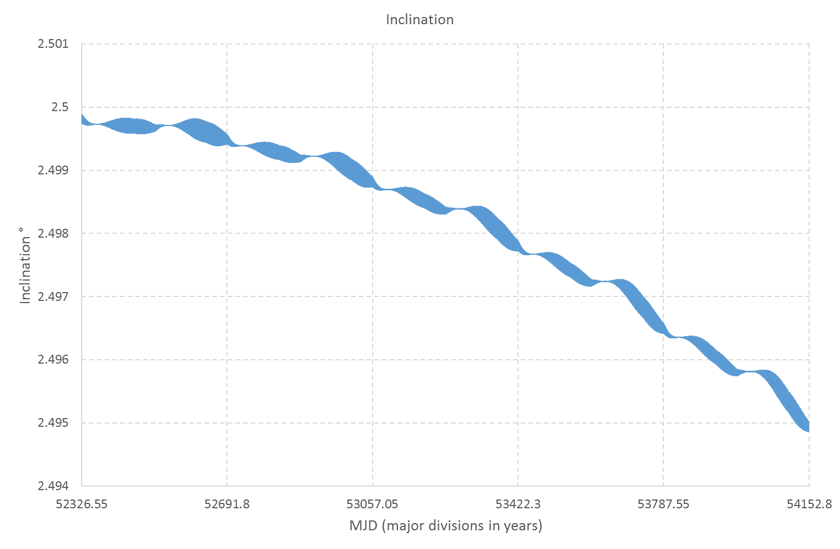
Example: debris orbit variations over 5 years
Semi-major axis
Eccentricity
Inclination
Lunar gravity
Solar gravity
SRP

Slide 16
Launch patterns: A year of launch activity (2018)
Compiled information on every launch in 2018
Catalogues alone insufficient for projections
112 launch events
Even split between single/multiple payload
Multiple payload: 5-20 satellites
471 new satellites on orbit

Slide 17
Launch patterns: Mega Constellations
OneWeb plans circa 696 baseline constellation
Monthly launches through 2019, ~30 satellites per launch
SpaceX licensed for ~4,000 satellite constellation
Bezos constellation ~1,200 satellites
This is a gold rush
The entire environment is changing – behaviours, constellations, sustainability

Slide 18
Space Traffic Management
Huge growth in the number of satellites on orbit
SpaceX alone plans to launch 4,425 satellites for broadband service
Debris collisions can disable satellites (Tiangong-1, Sentinel-1 – recent examples)
Who owns the problem?
Who will solve the problem?
We need to know where satellites and debris are, and where they are going to be…..
The tragedy of the commons…..

Slide 19
Conclusions
UCL has 20 years of experience in space vehicle flight dynamics
Collaborated with NASA, ESA and USAF – generating operational standards for many missions
We have strong challenges coming up – debris evolution and space traffic management

