Slide 1
MERCURY: Robotic Exploration
TITLE
David A Rothery
Professor of Planetary Geosciences The Open University
UCL Space week 16 May 2019

Slide 2
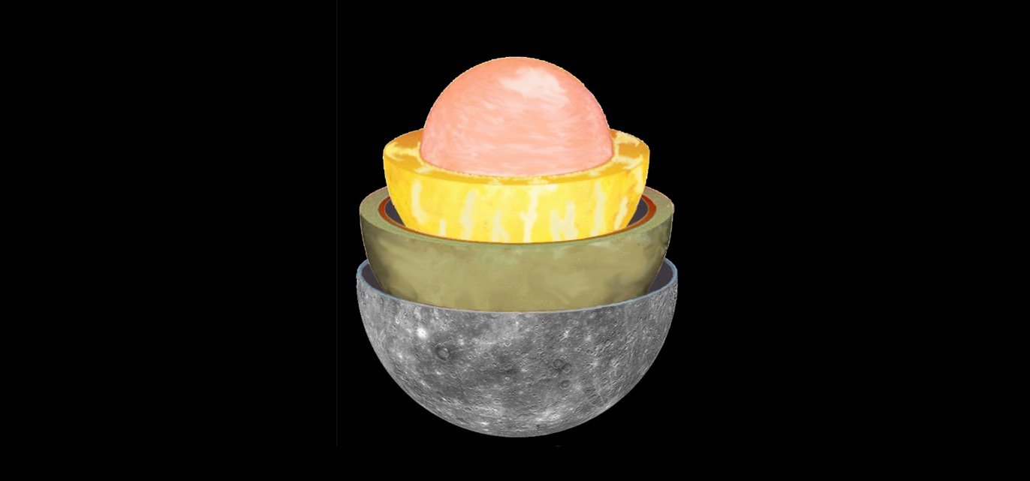
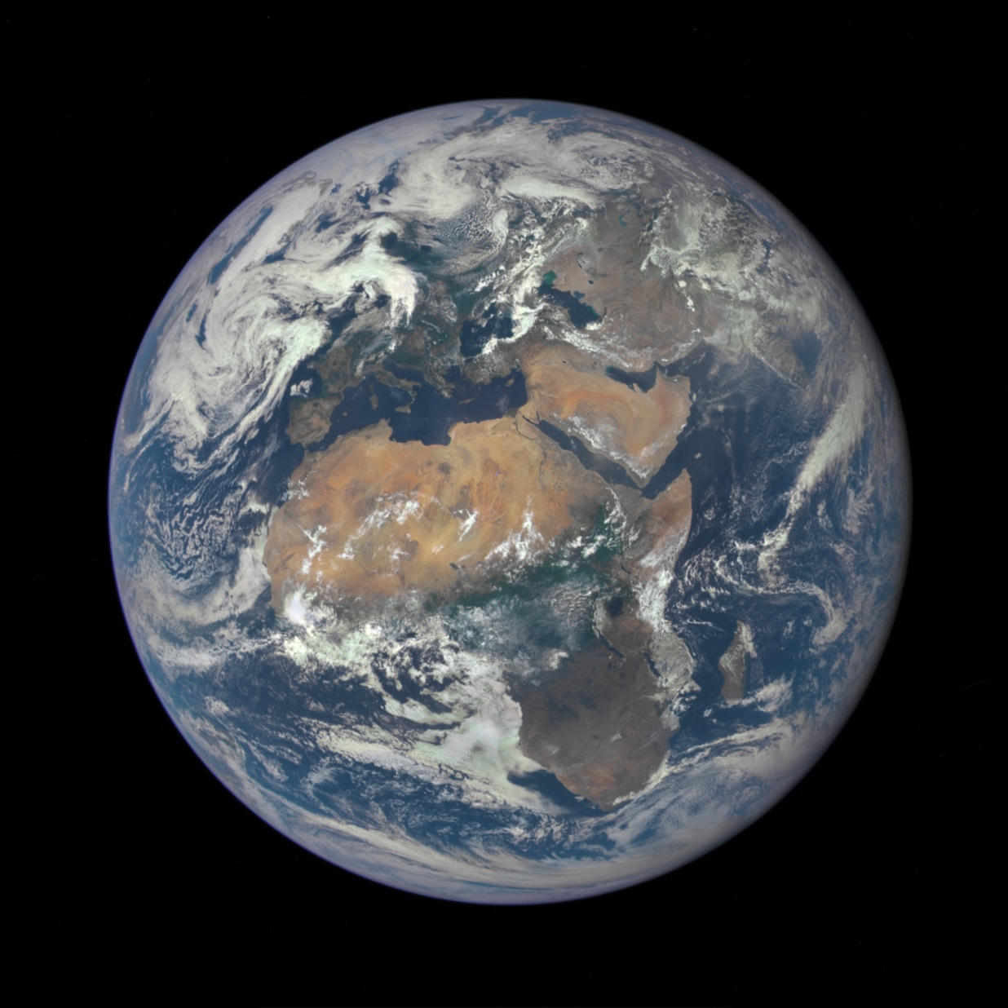

Slide 3
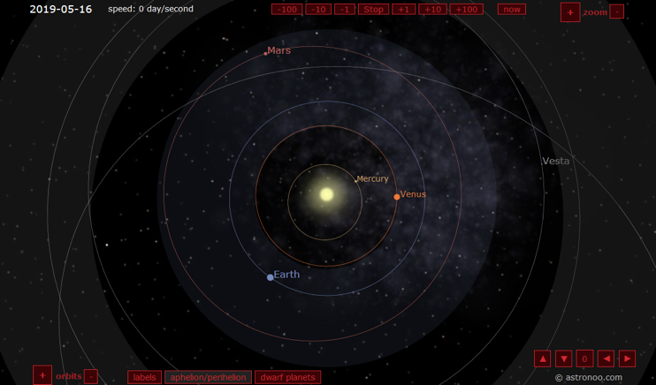
CAMPAIGN ASSETS

Slide 4
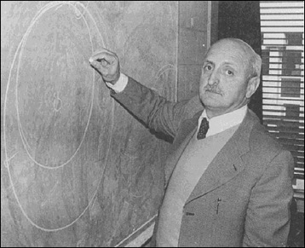
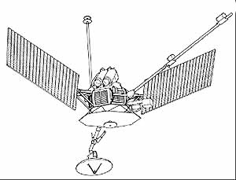
Mariner 10
CAMPAIGN ASSETS
Giuseppe (Bepi) Colombo

Slide 5
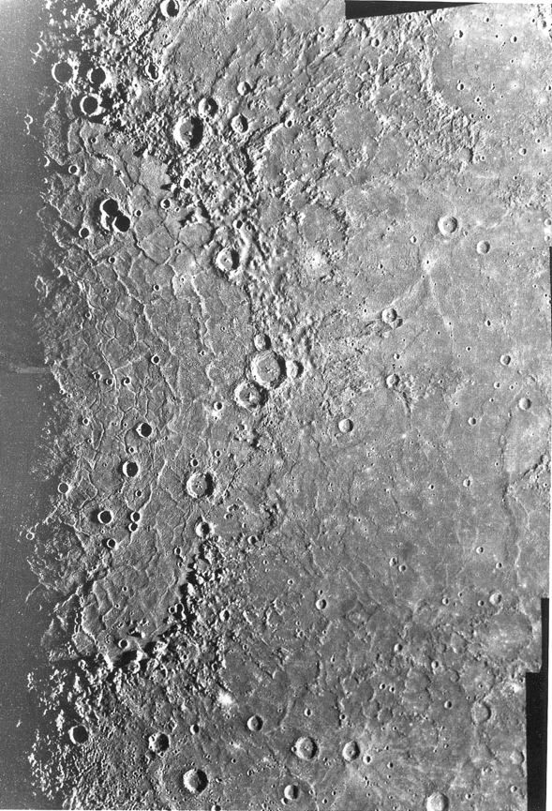
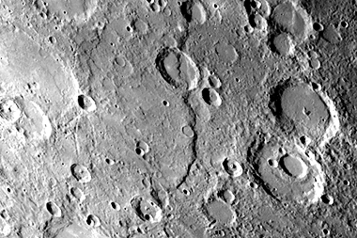
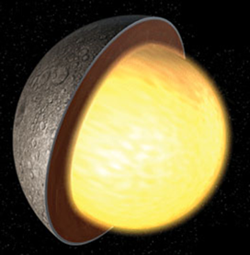
CAMPAIGN ASSETS
Lobate scarps =
Evidence for global
contraction (Discovery Rupes)

Slide 6
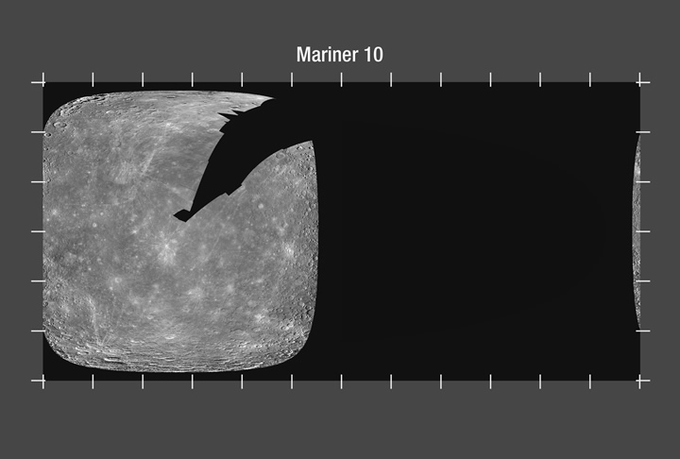
CAMPAIGN ASSETS

Slide 7
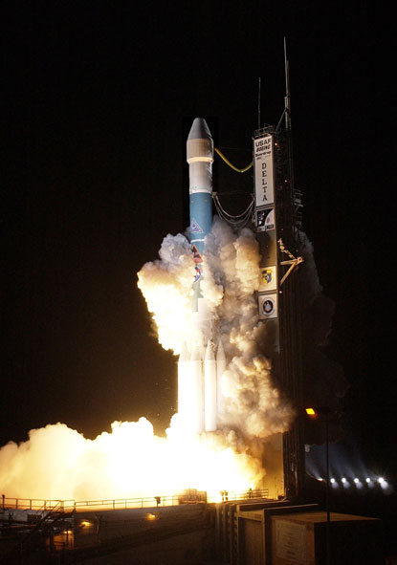
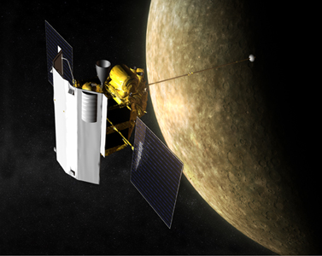
NASA’s MESSENGER mission
Launched August 2004, orbitted Mercury March 2011-April 2015
CAMPAIGN ASSETS

Slide 8
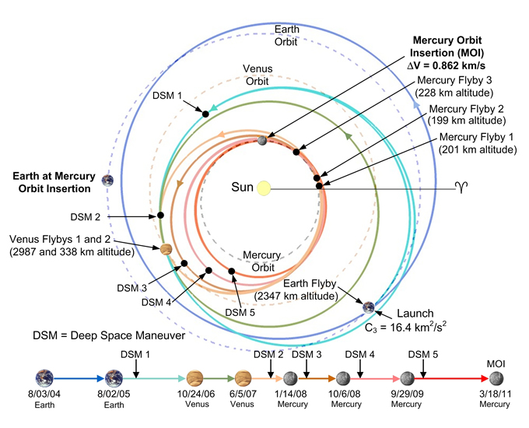
CAMPAIGN ASSETS

Slide 9
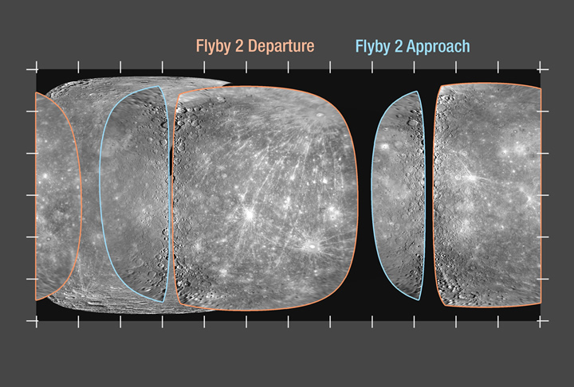
CAMPAIGN ASSETS

Slide 10
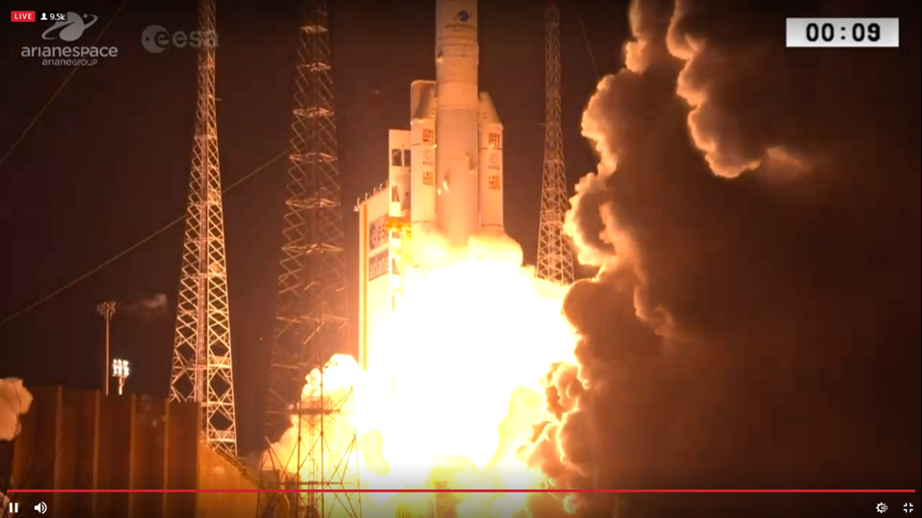
CAMPAIGN ASSETS

Slide 11
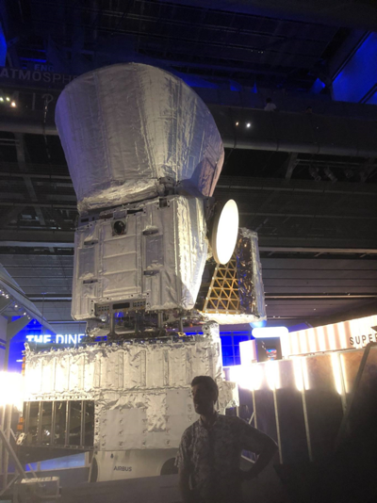
BepiColombo
(ESA + JAXA)
CAMPAIGN ASSETS
Launched 20 Oct 2018,
1 Earth flyby 2 Venus flybys 6 Mercury flybys
Begin orbital science operations May 2026
b

Slide 12
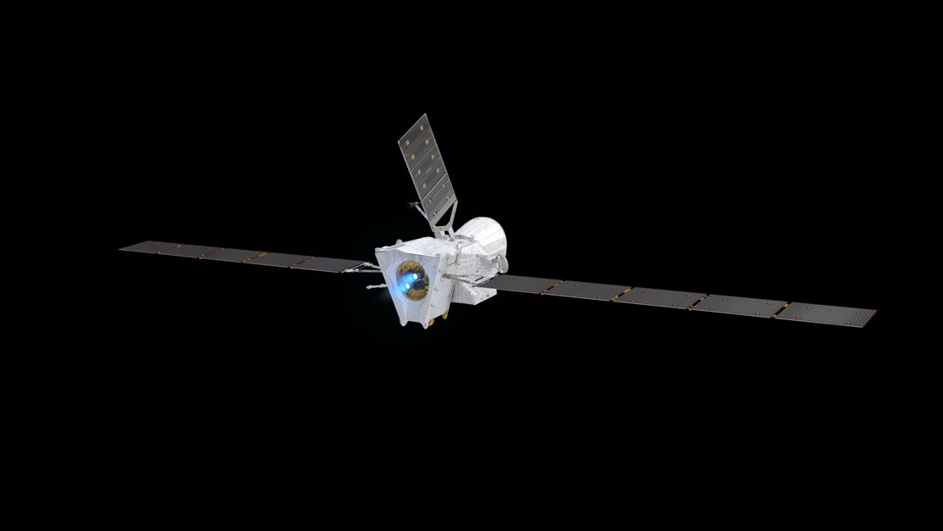
CAMPAIGN ASSETS

Slide 13
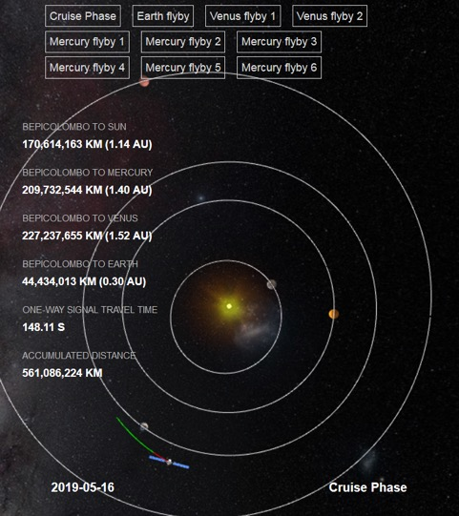
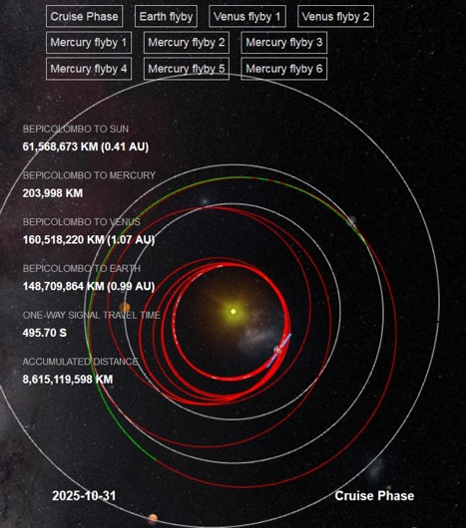
CAMPAIGN ASSETS

Slide 14
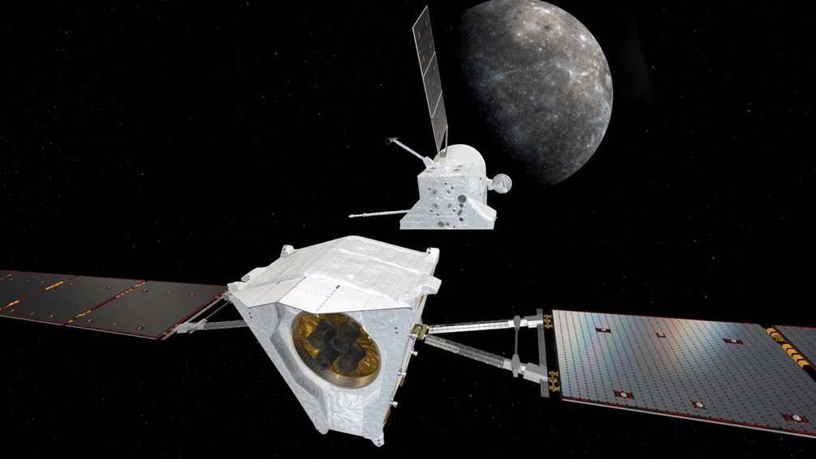
CAMPAIGN ASSETS

Slide 15
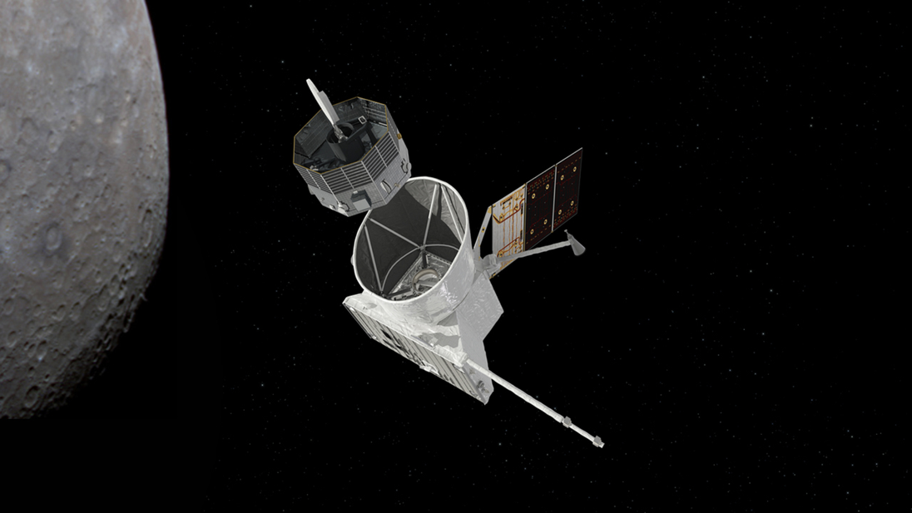
CAMPAIGN ASSETS

Slide 16
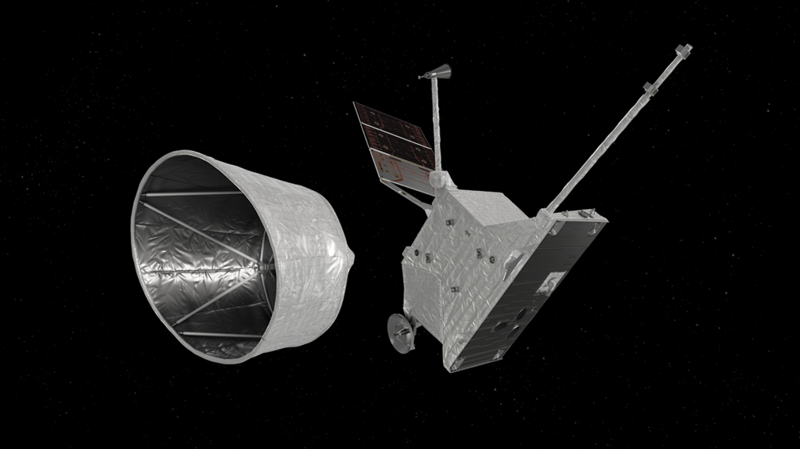
CAMPAIGN ASSETS

Slide 17
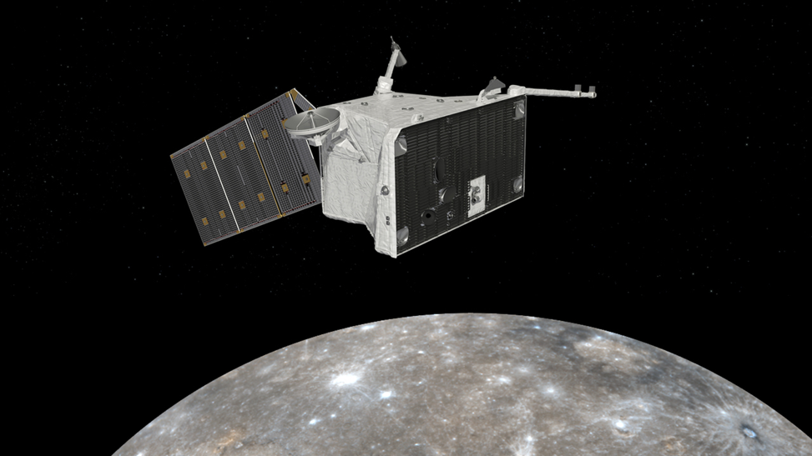
CAMPAIGN ASSETS

Slide 18
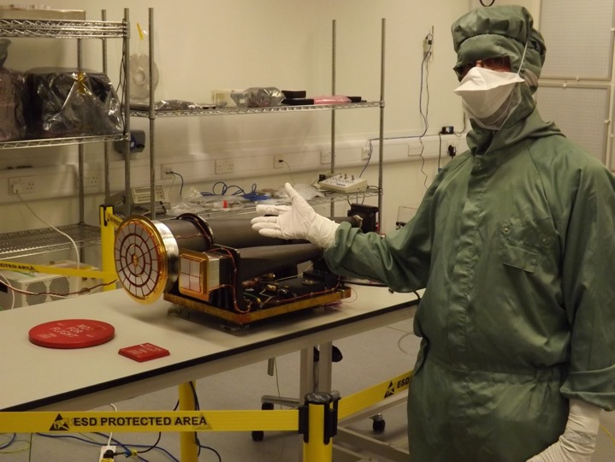
Mercury Imaging X-ray Spectrometer MIXS University of Leicester STFC UKSA
CAMPAIGN ASSETS

Slide 19
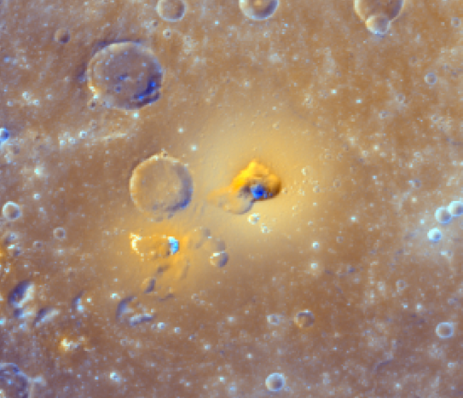
CAMPAIGN ASSETS
MESSENGER images:
NASA/JHUAPL/CIW

Slide 20
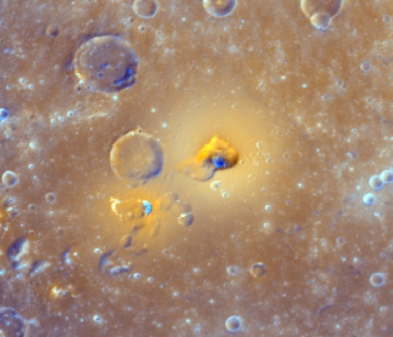
CAMPAIGN ASSETS

Slide 21
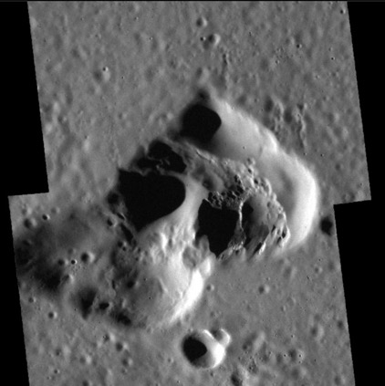

Slide 22
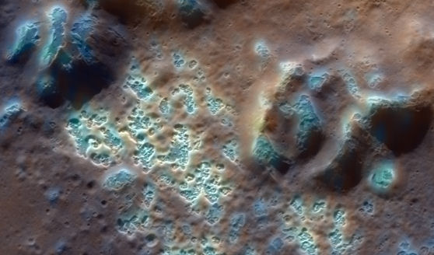

Slide 24
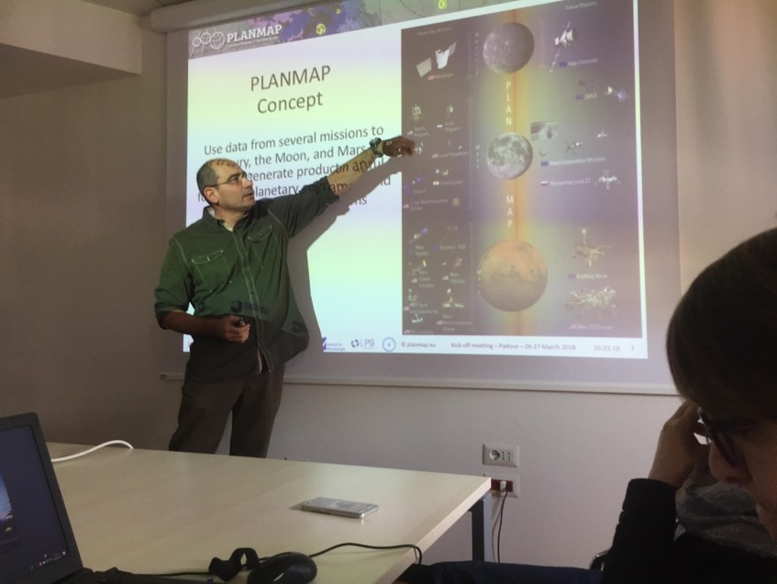
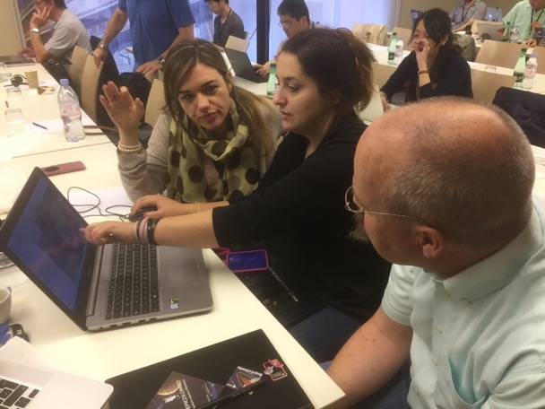

Slide 25
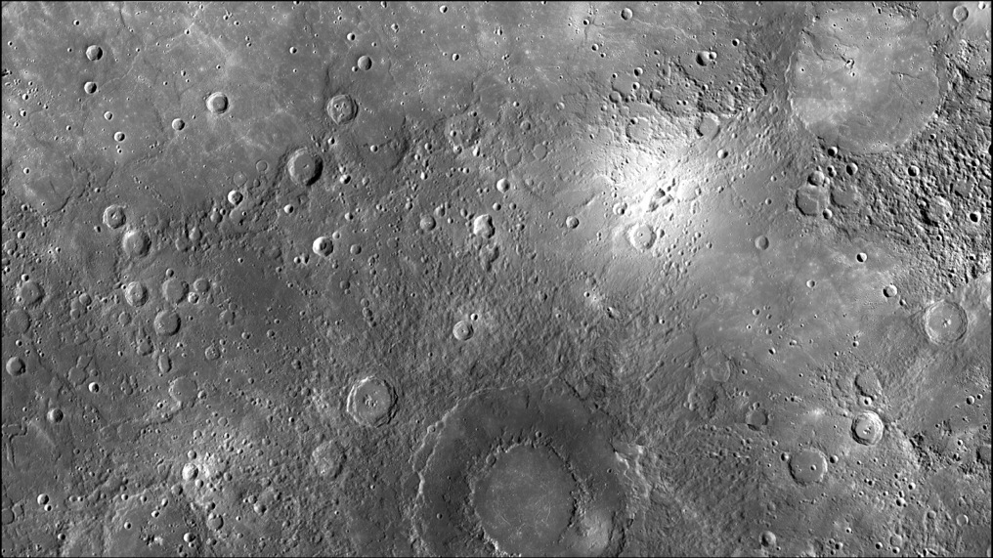
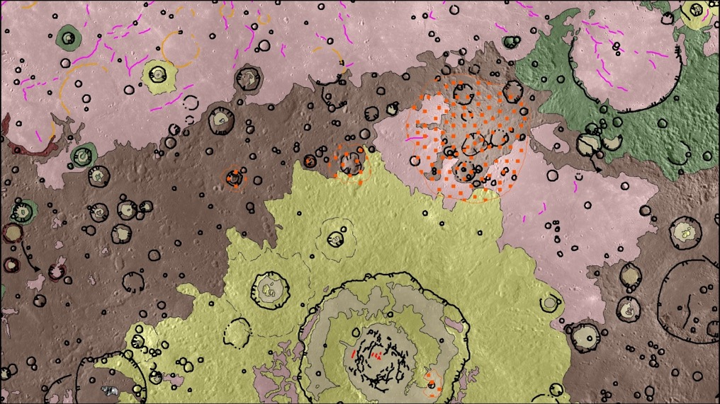

Slide 26
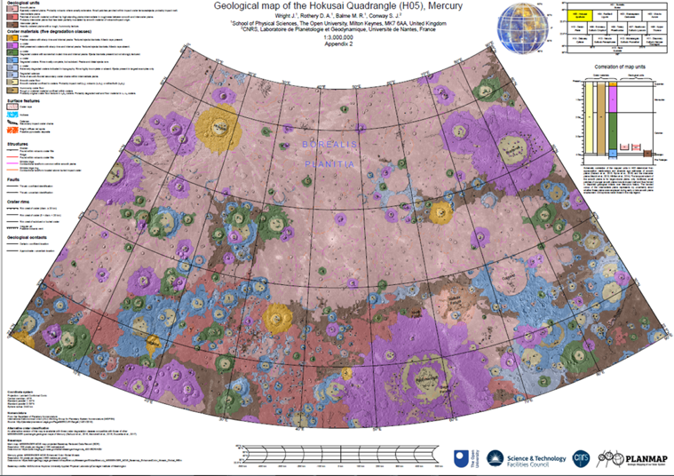

Slide 27
50.open.ac.uk

