Slide 1
Research Data Management Best Practice
Myriam Fellous-Sigrist (Library Services)
& Tom Couch (Research IT Services)
www.ucl.ac.uk/research-it-services
www.ucl.ac.uk/research-data-management

Slide 2
Before you start your project
Relevant policies | Data Management Plans | Desktop@UCL | Collaboration tools
During your project
Personal/sensitive data | Data security | Encryption | Organising your files
Sharing data with collaborators | Data analysis
At the end of your project
Publication | Open Access | Open Data | Data archiving and sharing
Resources and support

Slide 3
Key definitions
Research Data
- original sources or material (digital or not) created or collated to conduct project,
- response to your research question(s) is based on the analysis of these data.
- UCL’s definition (in UCL Research Data Policy): Data “may be raw, abstracted or analysed, experimental or observational.”
E.g..: lab notebooks, questionnaires, films, blood samples, photographs, maps, manuscripts, etc.
Research Data Management
- all of the decisions that you make during your research to handle your data,
- from planning stage of project up to the long-term preservation of your data.
Decisions include how you: organise, store, describe, preserve, re-use data.

Slide 4
Before you start your project
UCL Research Data Policy (see www.ucl.ac.uk/research-data-management)
defines the responsibilities of all UCL staff & students
recognizes research data as first class research objects
research data to be preserved for 10 years
recommends Data Management Plans for all projects
encourages sharing of data, if appropriate
Related UCL policies
Data Protection Policy | Statement on Research Integrity | Intellectual Property Rights | Publication Policy
Research funders' data policies: www.ucl.ac.uk/research-data-management

Slide 5
Summary of EPSRC expectations
Recommended Data Management Plan before/at start of project
Research data
- Securely preserved for 10 years (in any chosen repository)
- Easy to share
Pending publications: must include a Data Access Statement
Check our full guidance for EPSRC-funded projects.
Summary of ESRC expectations
Submit a Data Management Plan as part of application (9 topics; c.3 p.)
Anticipate exceptions to release data (legal, ethical, commercial reasons)
Archiving and giving access to data:
within 3 months of the grant ending (embargo allowed);
by depositing data in a reliable repository (UK Data Service or any other).
Check our full guidance for ESRC grant applicants and grant holders.

Slide 6
Writing your Data Management Plan as part of your grant application
Help to identify the decisions to make regarding data, throughout your project.
Required by AHRC, ESRC, Wellcome Trust... + H2020 and ERC
Helps with costing: usually grant can cover costs of data preparation & preservation (hardware, anonymisation, transcription…)
= mainly activities within the funding period. See our how-to guide on costing.
Content of a Plan
what type of data will be collected;
how data will be stored;
how data could be accessed at the end of the project.
Help to write your Plans
Check our how-to guide (examples of Plans, checklist…)
Ask for review and advice: lib-researchsupport@ucl.ac.uk

Slide 7
Data storage and collaboration options
Filestore@UCL
S: drive departmental storage
200GB + £15 per 100GB (3 years)
Accessible from Desktop@UCL
Can be mapped to standalone PC
Research Data Storage Service
N: drive personal storage
100GB for everyone
Accessible from Desktop@UCL
Can be mapped to standalone PC
For storing large volumes of research data
Free up to a soft limit of 5TB
Larger allocations available on request
Share data with UCL colleagues only
SharePoint Team Site
Data Safe Haven
Available upon request
Supports shared access with external colleagues
UK based servers
ISO27001 compliant for handling personal identifiable data
Shared access for internal and external colleagues

Slide 8
Sharepoint
Team sites
Fully supported, but limited to a single document library (~5GB)
Request via the ISD website
Team site custom
Self-supported, access to additional applications and customisable
Site collection
Self-supported, full SharePoint functionality with ability to include sub sites
Normally taken on by a local SharePoint expert
Notes:
Training is available through ISD Digital Skills Development and Lynda.com: https://www.ucl.ac.uk/isd/services/learning-teaching/digital-skills-development

Slide 9
Access from outside UCL
Desktop @UCL Anywhere
RDS
DSH
Microsoft
Servers
Outlook
SharePoint
OneDrive
VPN
Notes:
On campus: wired and eduroam connections put you on the UCL network inside the firewall
(note other institutions’ Eduroam access points do not put you inside the UCL network)
Off campus: use the VPN or Desktop@UCL Anywhere to access services on the UCL network

Slide 10
vpn.ucl.ac.uk
Allows access to
Filestore@UCL (N-drive, Shared drive)
UCL Services: MyView, MyFinance, ROME
Research Data Storage, Data Safe Haven
Requires
VPN client: Cisco AnyConnect
Antivirus and Firewall:
FSecure (Windows) and Sophos (Mac) are supported by UCL
Available for free from swdb.ucl.ac.uk
See
www.ucl.ac.uk/isd/services/get-connected/remote-working/vpn

Slide 11
Desktop@UCL Anywhere
Allows access to
Applications
Filestore@UCL
UCL Services: MyView, MyFinance, ROME, RPS
Requires
Client: Citrix Receiver
See
www.ucl.ac.uk/isd/services/get-connected/remote-working
my.desktop.ucl.ac.uk

Slide 12
During your project
Define your procedure to deal with personal and/or sensitive data
What is personal data?
Information that relates to living individual who can be identified from that data (via direct or indirect identifiers or a combination of information sources).
What is personal sensitive data = "special category personal data"?
Information about:
racial or ethnic origin | trade union membership | religious beliefs/ philosophical beliefs
political opinions | health | sexual life/orientation
genetic data | biometric data | + about children/minors

Slide 13
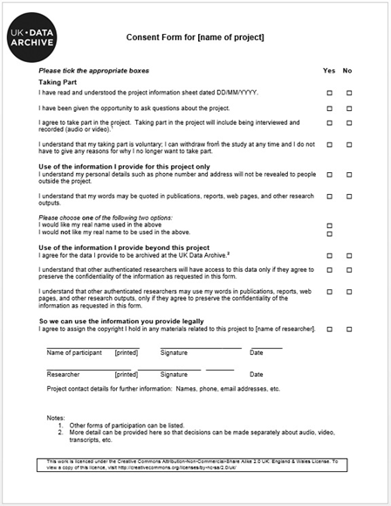
General Data Protection Regulation (GDPR)
3 key changes for researchers
1. Seeking consent
No more implicit; no opt-out
Inform about right to withdraw
Ask for explicit consent, for each distinct use
of the data; e.g. template recommended by UKDS
See UCL templates
2. Children’s consent
If child is below 16: ask parent or guardian’s consent
3. Security of research data you process
Use strong encryption + a data sharing agreement?

Slide 14
understand the legal expectations: Data Protection Act, Freedom of Information Act, Human Rights Act…
See http://libguides.ioe.ac.uk/researchdata
understand the ethical expectations: your discipline, your funder, UCL's
incl. consent procedure: information sheet, consent forms, seeking consent…
Guidance on ethical issues, gaining consent, anonymising, knowing the legal framework and more:
UCL Research Integrity www.ucl.ac.uk/research/integrity
UCL Data Protection Office (incl. GDPR) www.ucl.ac.uk/legal-services/research
data-protection@ucl.ac.uk / foi@ucl.ac.uk
UCL Research Ethics Committee: ethics.grad.ucl.ac.uk
IOE Research Ethics Committee
UK Data Service: www.ukdataservice.ac.uk/manage-data/legal-ethical

Slide 15
Keep your data secure
UCL Central Filestore (“desktop@UCL”)
100Gb available for all staff and students
Also available: UCL Research Data Storage and Data Safe Haven (see above)
Information security advice: check the ISD webpages to
Download an antivirus software for free
Get help if your devices are infected
Tips to secure your computer
Essential tips if using an external hard drive: see our FAQ on hard drives

Slide 16
Backing-up your data
What?
Copying or archiving files and folders for the purpose of being able to restore them in case of data loss.
How?
Use the automatic back-up provided by UCL: store your data in the Central Filestore (“desktop@UCL”)
or, define your own back-up plan:
What data (files and folders) to backup
How often to run your backups (once a week? Once a month? On the 1st of each month?...)
What media on which to store the backups?

Slide 17
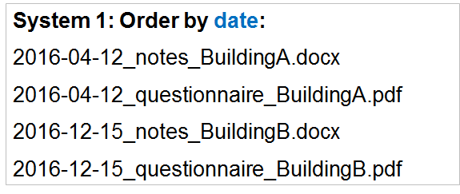
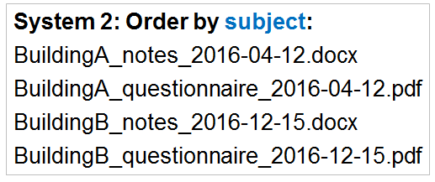
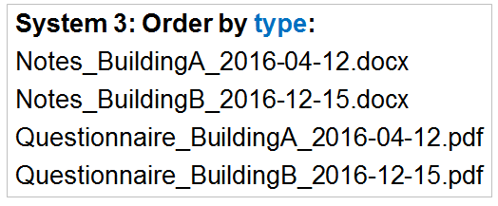
Organise your files
Naming conventions should make data easier to find.
Filename Convention: choose the most relevant system for you and your team.

Slide 18
Good formats: general principles
Open formats
Non-proprietary formats
Well-documented formats
Why?
Data can be read by as many different types of computer/devices as possible; now and in the future.
E.g.: CSV instead of XLSX for a spreadsheet
More information in our file formats guide:
recommended standards for text, audio, video and images;
how to deal with proprietary formats, etc.

Slide 19
Prepare your data for analysis (and archiving/sharing)
Transcription advice: www.ukdataservice.ac.uk/manage-data/format/transcription
Anonymisation advice: www.ukdataservice.ac.uk/manage-data/legal-ethical/anonymisation
Metadata standards:
Follow discipline-specific standards
Or the DataCite standards (any discipline); minimum information include a creator, a title, a publication date, etc.
See more information in our how-to guide on data sharing.
Getting help with data analysis
ISD training courses (for students and staff)
ISD software database: swdb.ucl.ac.uk

Slide 20
Version control
Why?
It’s not just for computer code – any text document
Better collaboration with your future self
Better collaboration with your colleagues
Easily switch between different versions according to your need
Roll back to any previous checkpoint
Keep a record of exactly which version of the code you used for your analysis

Slide 21
Version control
How?
We recommend Git for version control, and GitHub for collaboration and sharing
GitHub repositories can be public or private
Plain text files only
YES: .txt, .csv, .xml, .html, .md …
NO: .docx, .pdf, .xlsx, .mp3 …
We’ll show you how at Software Carpentry
Notes:
Git GUI demo on Windows
https://desktop.github.com/

Slide 22
Encrypting files
On Windows, we recommend using 7-zip to encrypt sensitive data:
- Downloadable from swdb.ucl.ac.uk + ISD guidance
- Pre-installed on Desktop@UCL
For MacOS use FileVault (ISD guidance available)
For Linux use eCryptfs
Another option is VeraCrypt (with Windows, Mac and Linux versions)
To create an encrypted archive:
Highlight files, right-click, and choose: 7-Zip > Add to archive…
Choose a name or accept the default
Choose a password and enter it in both boxes
Make sure the encryption method is AES-256, and click OK

Slide 23
Encrypting files
To access an encrypted archive
Right-click on the zip file and select: 7-Zip > Open Archive
Enter the password
Either double click individual files to open them, or highlight files, click Extract, and choose a folder to extract the files to

Slide 24
Transferring files
UCL Dropbox is the best and safest way to transfer data
More robust and can handle larger files than email
www.ucl.ac.uk/dropbox
When sharing an encrypted archive it is best practice to send the password via another channel; e.g., by text message, phone, or in person.

Slide 25
At the end of your project
Funders & UCL encourage data sharing, if appropriate
Various levels of access: data accessible to all (“Open Data”); restricted to some audience; embargoed; closed
Data sharing should respect copyright; Data Protection Act and other legislation; consent forms; funders’ expectations
E.g. ESRC’s expectations:
Anticipate restrictions to share data in grant application
Share data to enable further scientific use, “within 3 months of the grant ending” BUT embargoes accepted
3 levels of access : “open”, “safeguarded” or “controlled”

Slide 26
Data selection for archiving and future re-use
Considerations: funder’s expectations? UCL’s expectations (UCL Retention Schedule)? Legal requirements? Future use?
2 general selection principles:
1. At a minimum: keep data underlying findings in your publications (i.e. data that allow verifications and reproduction of published results)
2. Also keep datasets which have been processed, cleaned and/or curated and may have value for your future self or future researchers; e.g. of use:
- give access to raw data which other researchers could not produce themselves
- allow different types of analysis to be carried out
What to do with consent documents?
Keep as long as necessary for research project
Keep as long as compliant with Data Protection Act after project
Keep securely (locked cabinet; encrypted folder if digital)
Consider summarising them before you bin them/erase them: who agreed what?

Slide 27
Options to archive & give access to data (project closed)
1. UCL Discovery: for publications & small-scale datasets.
Guidance is available.
An ISD archive service for all research data is in its pilot phase.
2. Funders’ repositories
3. External repositories (re3data.org):
subject-specific repositories, e.g.: UK Data Service
generic repositories such as Zenodo

Slide 28
Data citation standards and Data Access Statements
Each dataset used must have a separate citation.
If your department or publisher recommends a specific reference style, follow the appropriate format for citing data.
Example - the Harvard citation style:
Author names. Year. Title of resource. [medium type]. Host institution name, Physical location. Date of access. Identifier
Institute for Social and Economic Research. 2011. Understanding Society: Wave 1 2009-2010 [data file]. University of Essex, Colchester, Essex. Accessed 29 May 2015. SN: 6614. http://discover.ukdataservice.ac.uk/doi/?sn=6614#
More information in our guide to data discovery & re-use

Slide 29
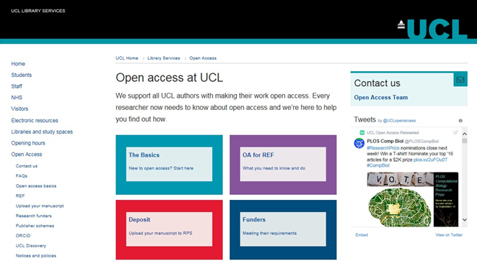
Publication of findings
REF policy basics:
Deposit your publication in UCL Discovery (via RPS)
As soon as it is accepted for publication
Outputs not uploaded within 3 months of first online publication cannot be submitted to the REF.
OA options, policies, funds and help:
www.ucl.ac.uk/library/open-access
open-access@ucl.ac.uk

Slide 30
Resources
We run:
Drop-ins with support for Data Management, Research IT and Sensitive Data
Data Management Plans courses – HR Booking system
Myriam's team is available to:
Answer enquiries about policies, data management, data sharing, etc.
Review Data Management Plans (allow at least 2 weeks before deadline)
Tom's team is available to:
Help find IT solutions for your research workflow
Provide access to IT tools and services supporting research: high performance computing, data storage, software development.

Slide 31
Other resources and contacts
Information security
www.ucl.ac.uk/informationsecurity
IT Security Knowledge Base: advice on encryption, securing your computer, etc.
Ethics
UCL Institute of Education maintains its own Research Ethics Committee
Impact of GDPR on consent procedures (UCL Data Protection Office)
Research integrity
www.ucl.ac.uk/research/integrity
The Research Integrity website answers a lot of questions about best practice relating to ethics and research collaboration.
Open Access
http://www.ucl.ac.uk/library/open-access
Support for all UCL authors with making their work open access.
Research contracts
UCL Research Contracts Office
Review, advice, negotiation of agreements for UCL, including with charities.

Slide 32
Questions & next steps?
rits@ucl.ac.uk
www.ucl.ac.uk/research-it-services
lib-researchsupport@ucl.ac.uk
www.ucl.ac.uk/research-data-management

