Slide 1
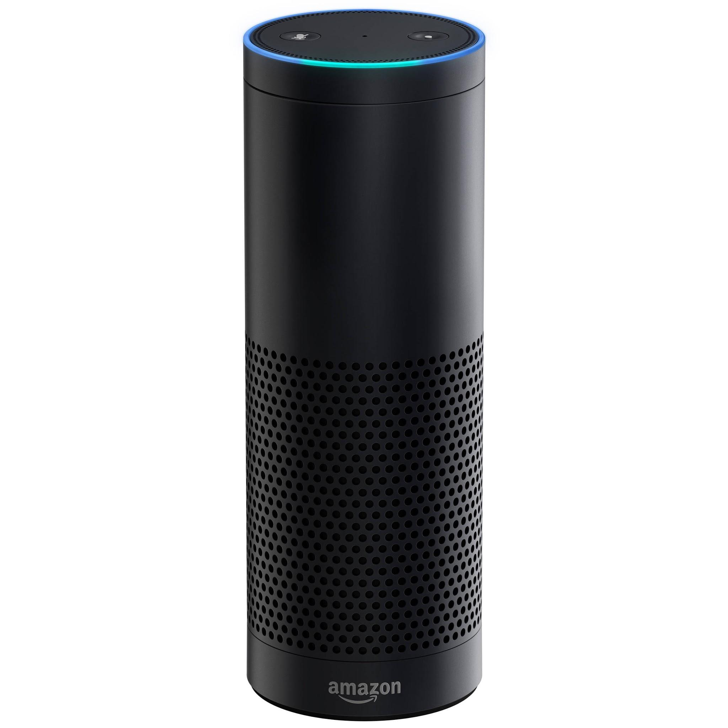
Echoes Around the Home - Can the Amazon Echo be used in the home to help those living with dementia?
Nicholas C. Firth
@piman314
CSSD Launch
12th December 2017

Slide 2
Outline
Echoes Around the Home team
Dementia, Alzheimer’s disease and posterior cortical atrophy
The Amazon Echo
Echoes Around the Home
Methods
Results
Conclusions and future work

Slide 3
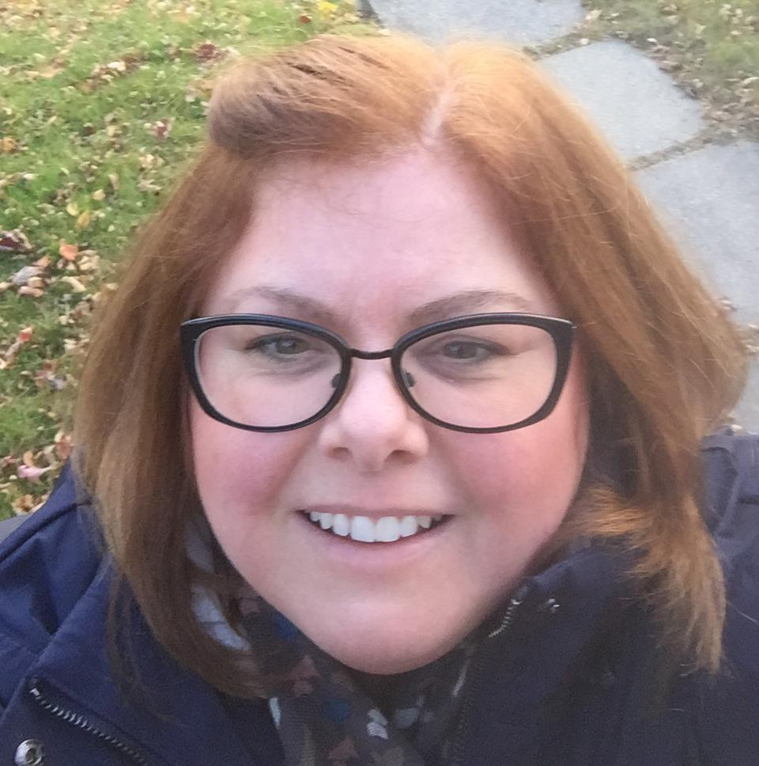
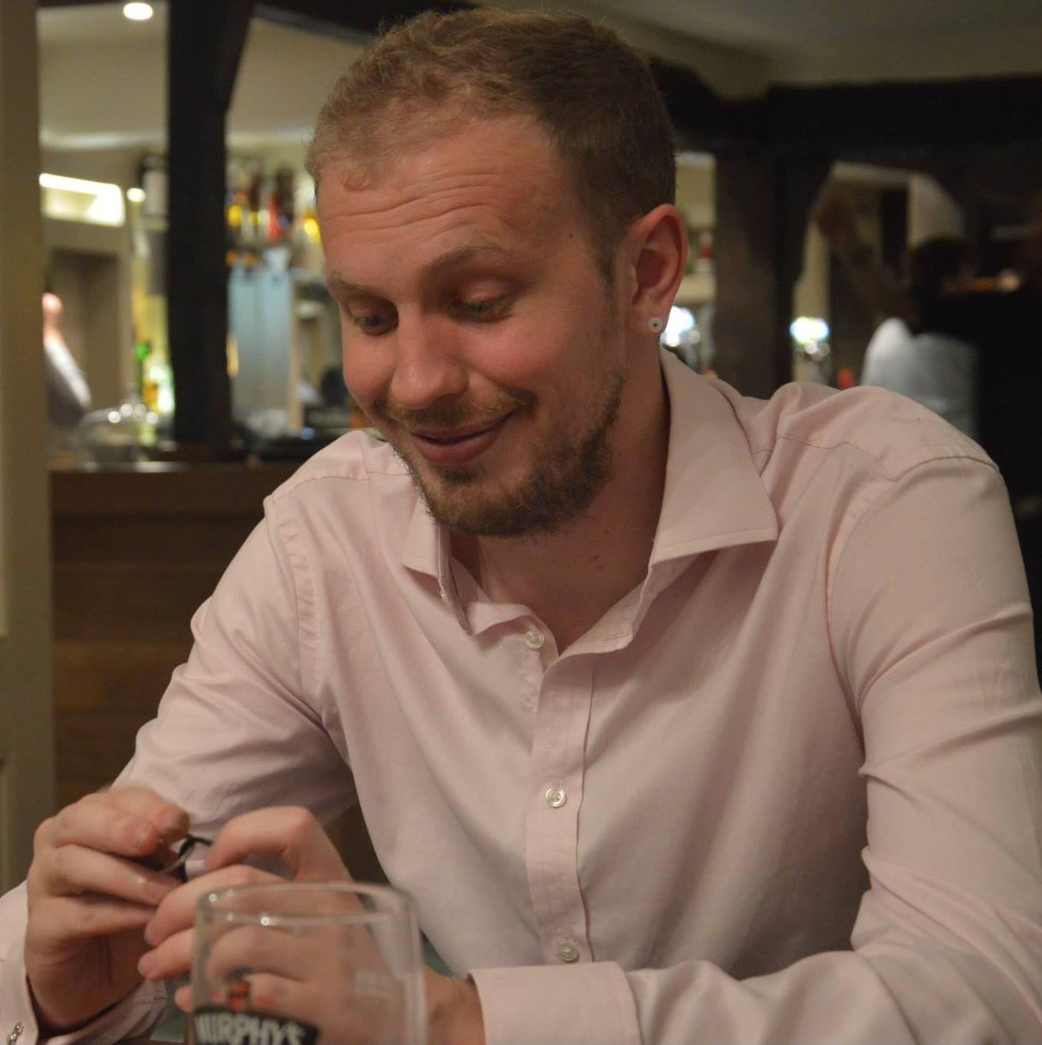
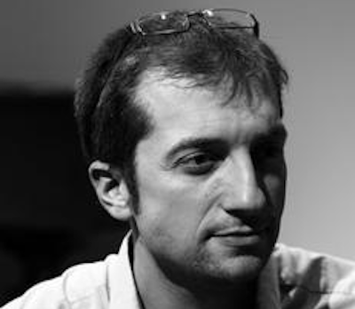
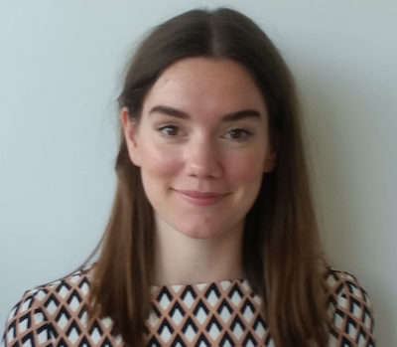
The team
We are a CSSD funded collaboration between the Dementia Research Centre UCL, and UCL Computer Science
Notes:
Mary Pat Sullivan is a registered social worker and social gerontologist, and Director of Social Work at Nipissing University. She is also an Honorary Senior Lecturer at the Dementia Research Centre, University College London, and a social science collaborator at the interdisciplinary ‘Created Out of Mind’ Wellcome Trust Hub, London (2016-18).

Slide 4
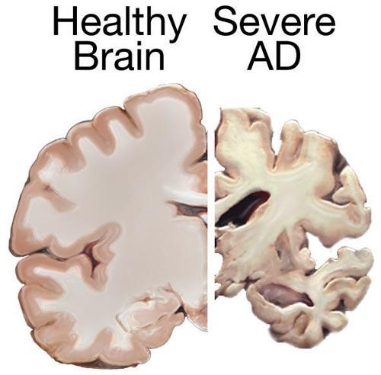
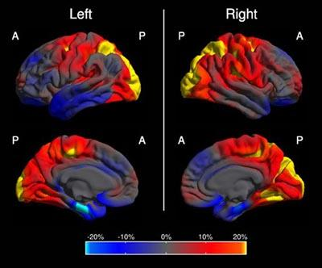
Dementia
Dementia is a syndrome or category of diseases that cause a decline in brain function
Frontotemporal dementia
Parkinson’s
Creutzfeldt–Jakob disease (CJD)
Alzheimer’s disease is the most common cause of dementia
Posterior cortical atrophy is a rare form of dementia that primarily affects people's vision

Slide 5
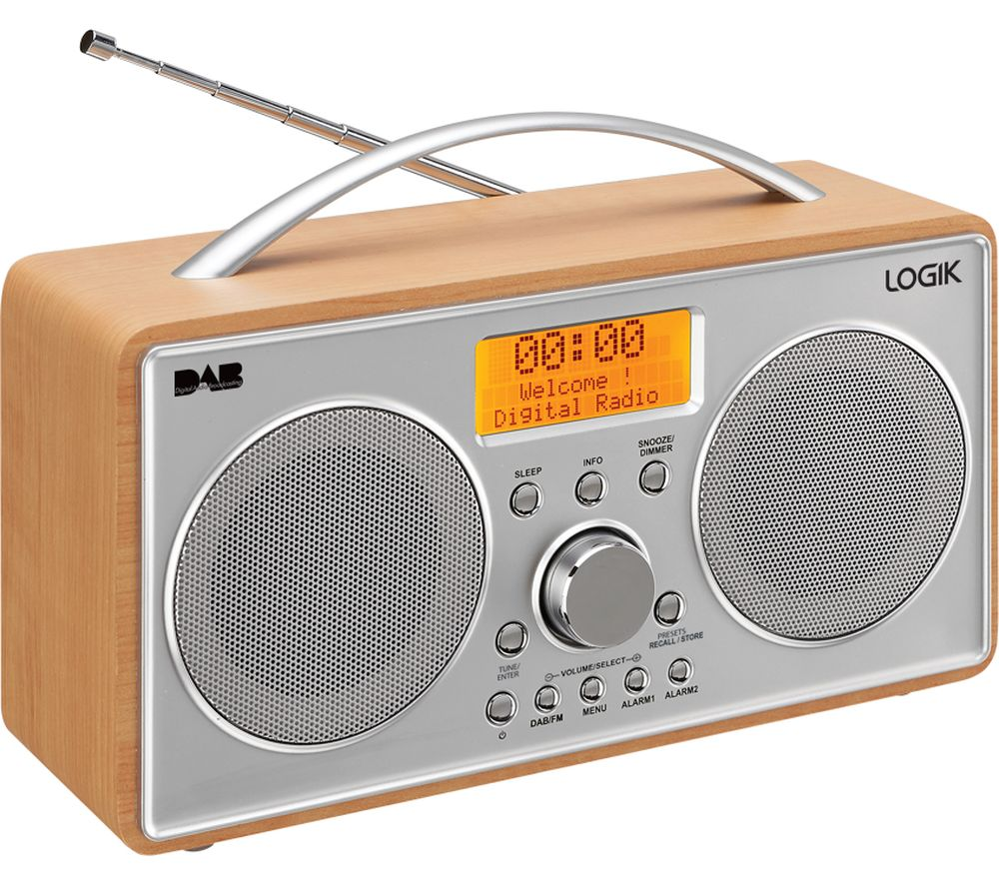
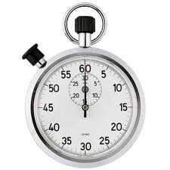
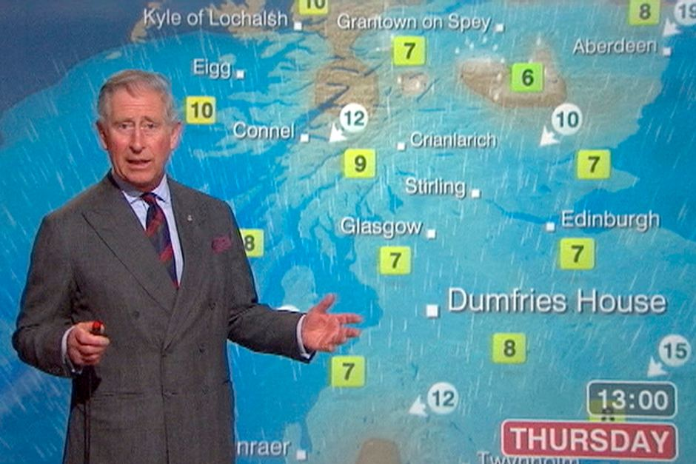
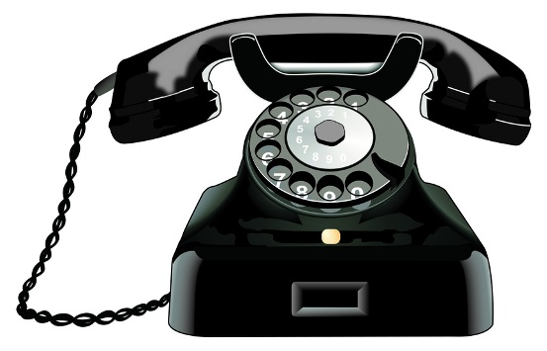
Amazon Echo
Voice activated home assistant
The device itself is essentially a microphone and a speaker
Amazon’s Alexa service is able to predict a user's intent from audio
To ‘improve user experience’ Amazon save all transcribed audio

Slide 6
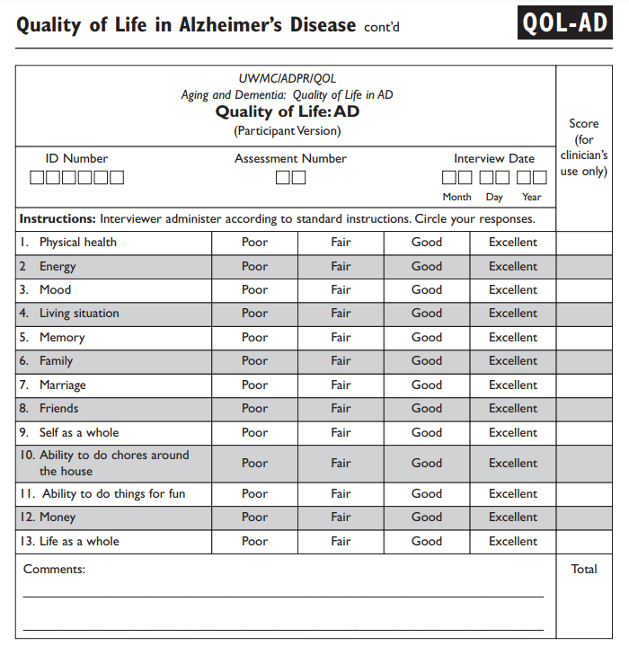
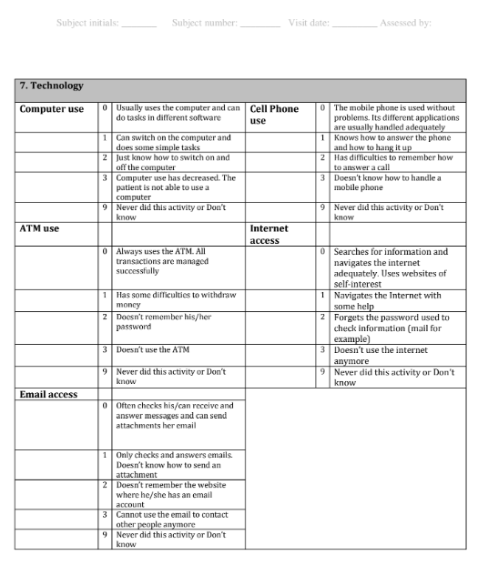
Methods
Social Science
Six people with PCA were recruited + family member (spouse)
Pre and post interviews
Questionnaires: Quality of Life and Activities of Daily Living
Notes:
Pre and post interviews: At time 1 we asked people how they were managing daily activities at the moment, how independent they were feeling and how technology might be supporting them or not and their hopes for the Echo. At time 2 we asked how they had found the Echo, what they had used it for, any difficulties they’d had with it and what had worked well. We interviewed people with dementia and their family members separately to ensure we heard both perspectives and to give each person the opportunity to contribute confidentiality that which they may not have wanted to say in front of their partner (e.g. if they felt micro-managed, if they felt burdened).
Questionnaires: QoL + ADL: we also administered questionnaires to supplement our qualitative data with some quantitative self report data on the person with dementia’s Quality of Life and ability to perform Activities of Daily Living (including a technology subscale) both before and after having the Amazon Echo.

Slide 7
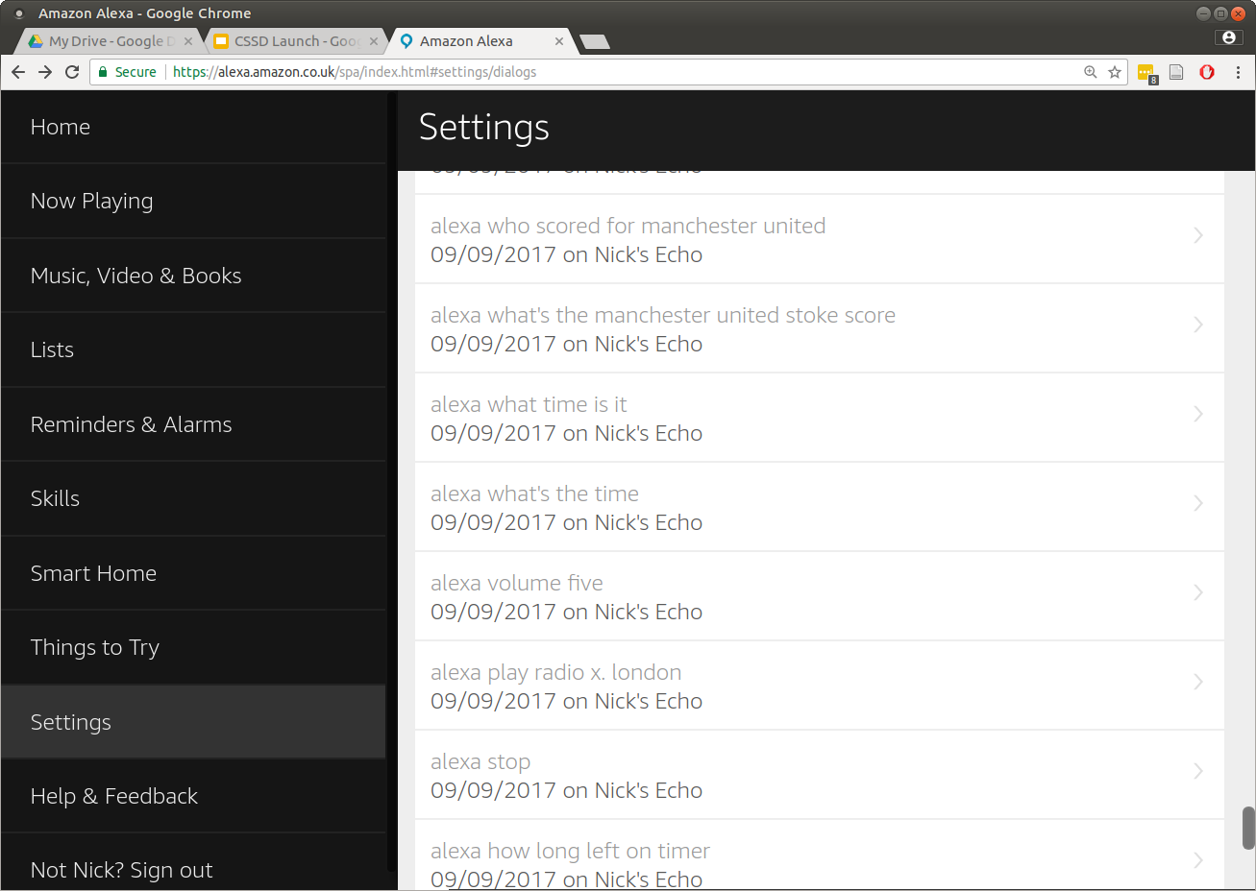
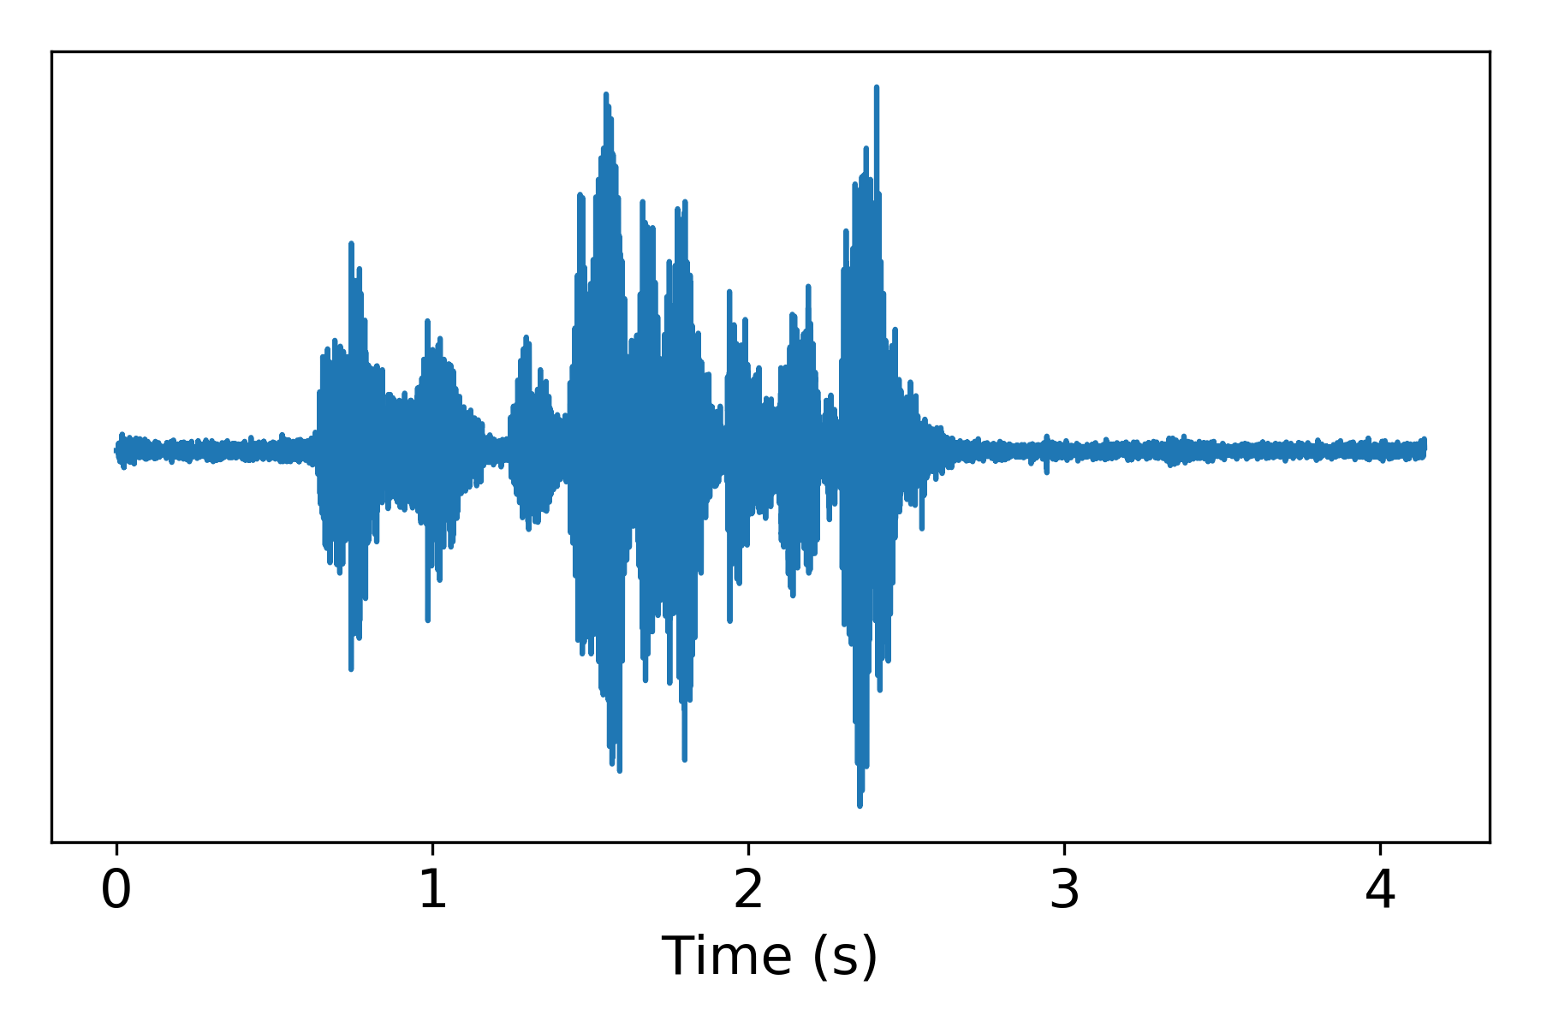
Methods
Computer Science
Data collection
Speaker recognition
Text analysis
Audio analysis
N
N
N
N
J
J
J
J

Slide 8
Results - Interviews
Social Science
Key themes:
Fun over function
“The old me”
Cutting out the middleman
Timing is everything
“Because of the situation I’m in…it really has to be easy…and it is. /// You know…you say something, it is done.
It’s just what is it, you know. It’s not going to change. Well, not get better is it?
/// What I want to do is go along as well as I can for as long as I can”
(male, PCA)
Notes:
Social Science
Key themes:
Fun over function – we saw consistently across the interview data that participants were most enthused about how they had been able to use the Echo to independently initiate enjoyable activities such as listening to music or audio books. For the majority of participants this had been more important for them than using more functional features of the Echo such as checking the time and date as I (Nick) had anticipated, and this difference in ‘hypotheses’ from the Computer Science and Social Science teams perhaps says something about the benefit of interdisciplinary working…!
“The old me” – we saw that a number of background factors affected how people engaged with the Echo. For example, factors such as occupational history, personality factors and previous hobbies and interests relating to technology affected how open, curious and interested participants were in making use of the Echo. It’s important also to say that our sample will also have been self-selecting to an extent in relation to this. A number of participants had worked in the technology industry in some capacity and so felt very comfortable interacting with the device, were keen to get the most out of it and optimistic about it’s potential. A minority of participants were admittedly tech-averse and for one participant this meant it took a while for him to feel comfortable interacting with the device and for another, he found he always preferred to ask a family member any questions and to have a full conversation than to direct any questions to the Echo in the required formulaic way. Several family members described their partner’s previous expertise with technology and the role they had occupied in the household as a result of this, and in these cases the installation and set up of the Echo devices was one of many examples of a change in these roles which some had found difficult to come to terms with. Background factors such as previous interests were also a driver of the Echo usage, in that people were motivated to continue to engage with material such as particular pieces of music or books by certain authors that they had long been interested in and which appeared to be an important demonstration of their sense of self and identity.
Cutting out the middleman – the main way that the Echo facilitated independence for those with PCA was by cutting out the middleman in their initiation of activities, the middleman being either the family member they would usually ask for help when using any sort of technology or the interface of technology itself, e.g. the screens, buttons and menus they would have difficulty navigating because of the dominant visuoperceptual and visuospatial problems which are characteristic of PCA. Having said this, the middleman was only ‘cut out’ to/from a point, as most participants described their reliance on their family member or others to set up the device and to assist them when there were any ‘glitches’ e.g. if they had forgotten the activation word or if they had taken too long to complete a command and the Echo has stopped ‘listening’.
Timing is everything – timing was shown to be an important factor in how effectively the Echo could facilitate independence in a number of ways. Most importantly, in the sense that the disease is always progressing, and there was a general consensus across participants that the earlier in the disease course one could get their hands on an Echo, the better. This was largely because of the increasing secondary memory and language problems that begin to develop further down the line. For example, participants described forgetting the activation word itself or that one was required, struggling to find words or to produce words in the right order when making a command. Participants also described the day to day variation in ‘good and bad days’ and their successes with the Echo as being contingent on that in the short term as well as over the longer term because of the gradual decline that is characteristic of neurodegenerative disease. Lastly timing was important in terms of how their successes in using the Echo to facilitate independence varied over the course of the trial. Some seemed to get consistently more used to the device over time, for others the initial novelty of the device began to wear off and their interactions with it reduced over time to a small selection of preferred features.

Slide 9
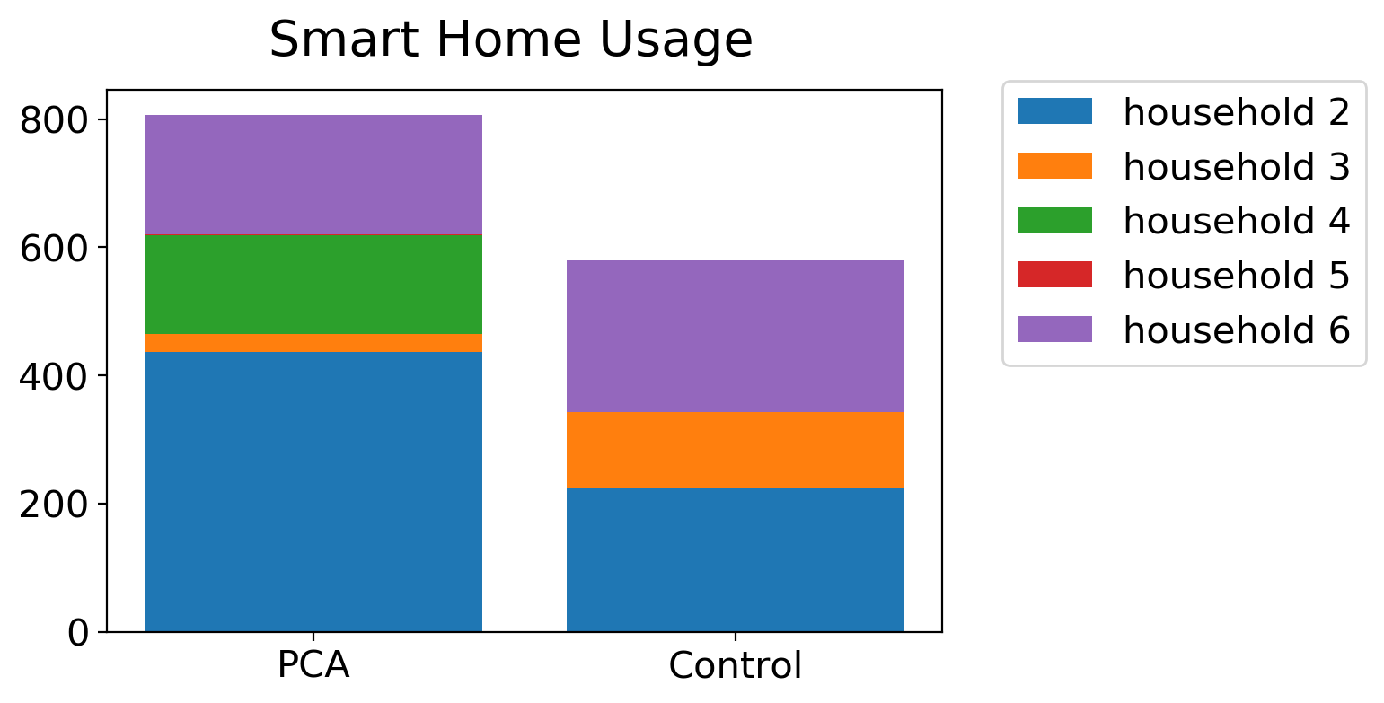
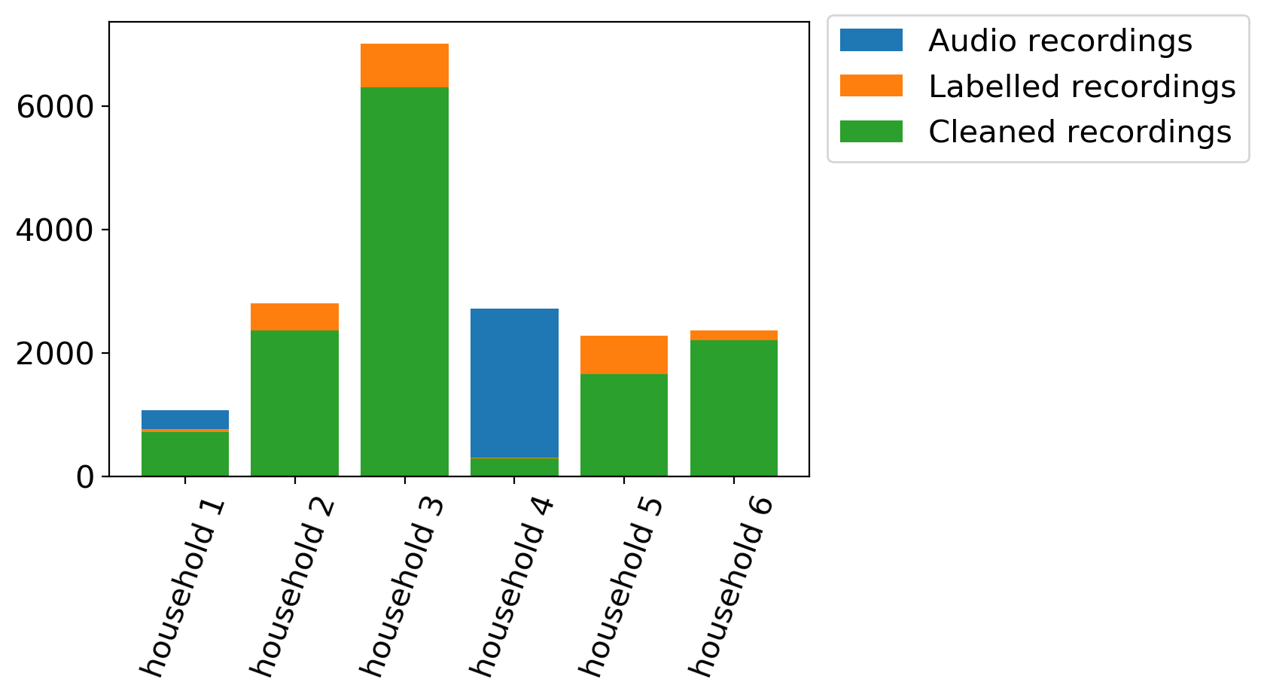
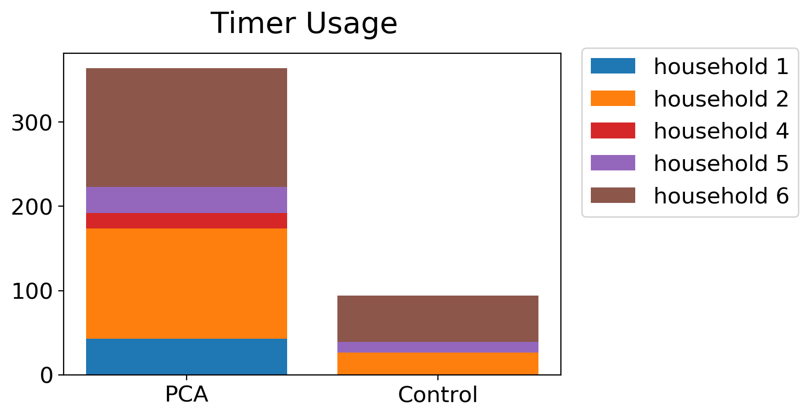
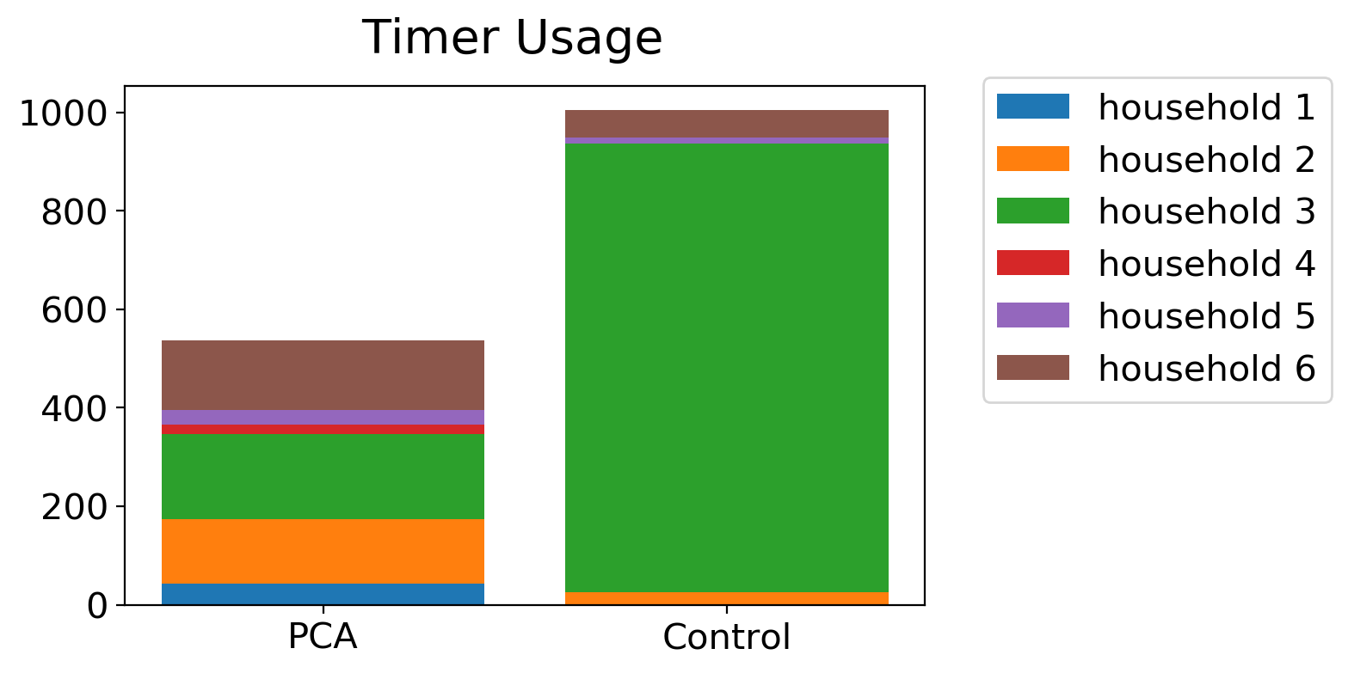
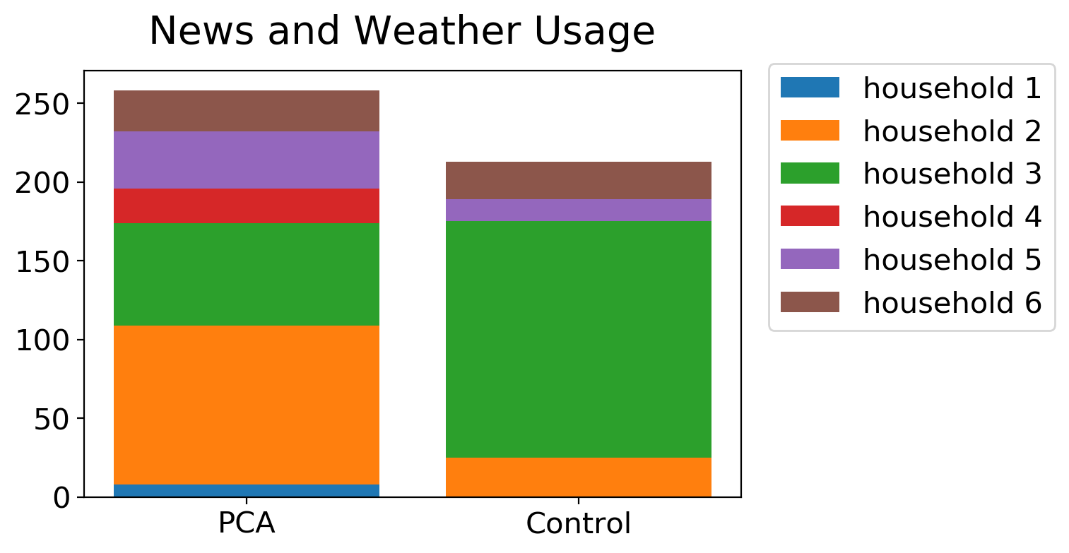
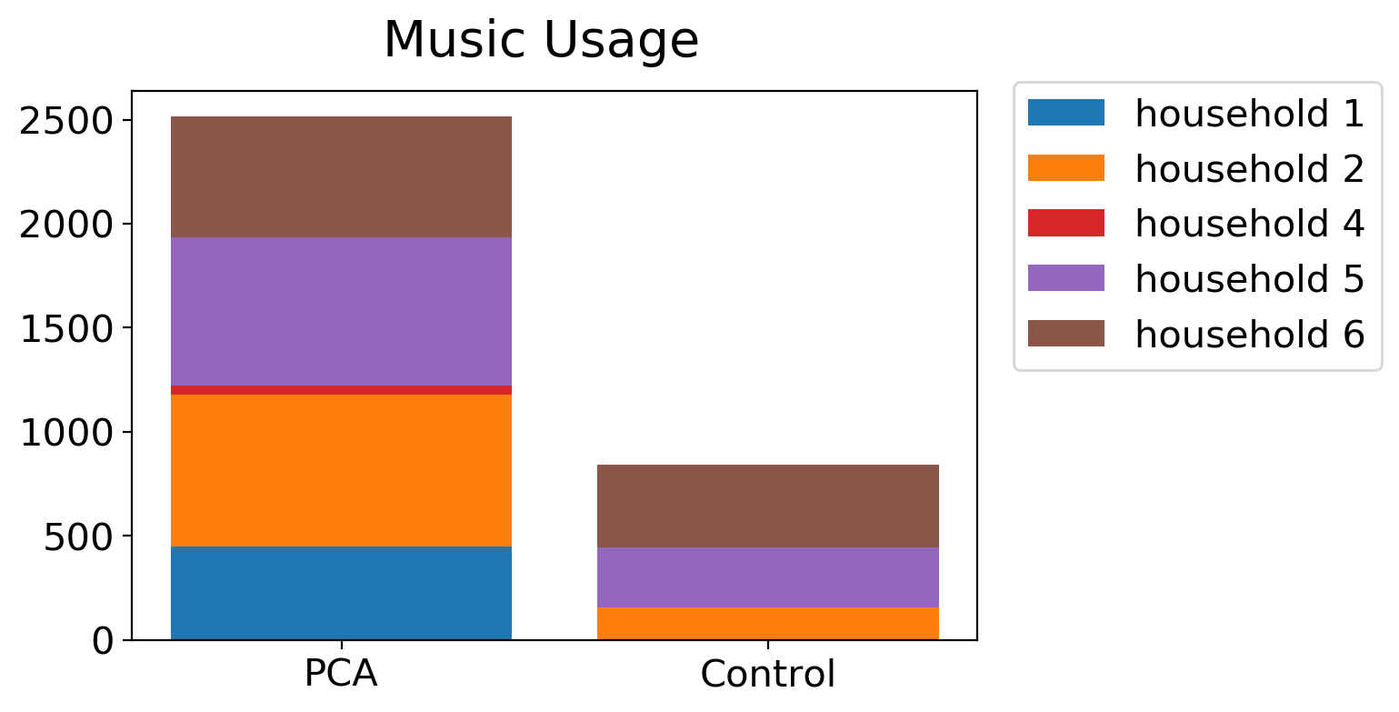
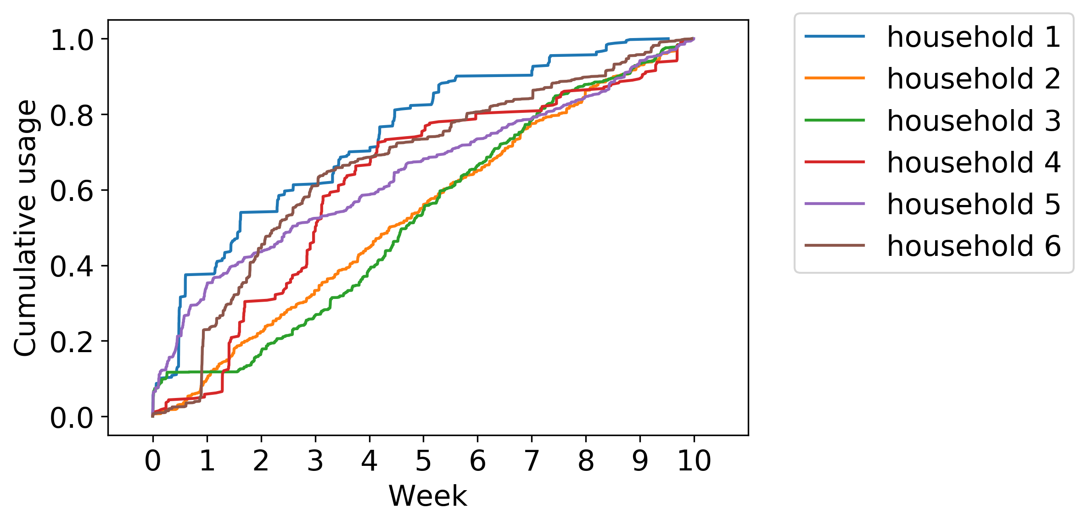
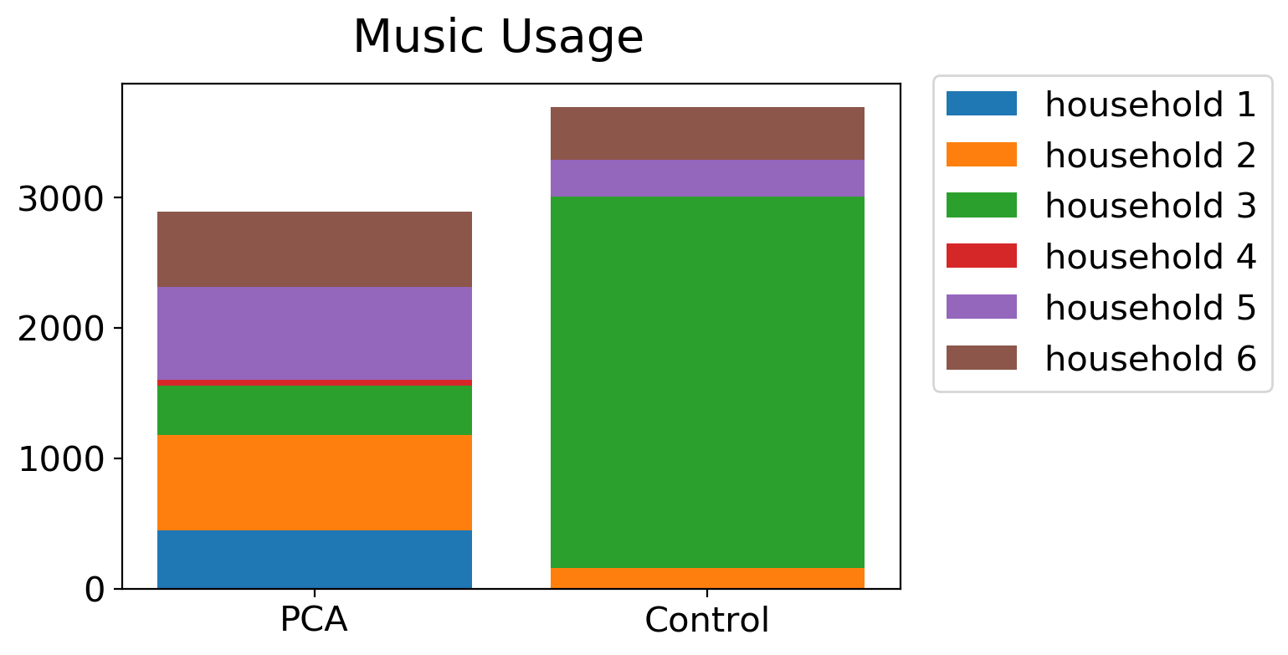
Results – Echoes Data
Notes:
Started off with

Slide 10
Conclusions
The Amazon Echo can facilitate independence in PCA
Fun as well as functional activities
Timing is important
For a successful technology-based intervention in dementia it is absolutely necessary to have qualitative and quantitative researchers working together
Peer supervision in dealing with potentially difficult or sensitive material collected from a naturalistic setting
Data triangulation
Notes:
Something about Echoes
For me, key is that it can help to facilitate independence, with fun as well as functional activities, but that timing is key and that limitations exist both at the device end and owing to the PCA symptom profile (the less prominent memory and language difficulties).
Something about interdisciplinary science
Bringing the qualitative, subjective experience of the person into the quantitative, ‘removed’ computational approach and also exploring ways we can systematically and speedily process data which is considered ‘messy’, ‘rich’ and nuanced and therefore often resource heavy in terms of manual analysis.
Importance of working in close proximity:
Peer supervision in dealing with potentially difficult or sensitive material collected from a naturalistic setting
Data triangulation:
Ability for Emma to let Nick know to look out for any areas of potential discrepancy in PWD and carer accounts and vice versa
Ability for unanticipated qualitative insights to highlight new areas of focus/steer computational analysis e.g. participants comments on leaving too large gaps between words and Echo turning off mid-command

Slide 11
Future work
Continued collaboration
Look at participants’ experiences of other devices which may help us to collect vast amounts of data within a naturalistic setting but using relatively little resource (e.g. FitBit, apps for cognitive testing)
Natural Language Processing of interview data
Discourse analysis of auto-classified data segments from Echo audio transcripts
Expand to other dementias
Do more longitudinal studies
Does usage change over time?
Do vocal patterns change over time?
Could we create some ‘skills’ to improve engagement and usage?

Slide 12
Acknowledgments
Our participants
The PCA community
POND team
PCA research team
Our funders
CSSD
You for listening!
Keir Yong

