Slide 1
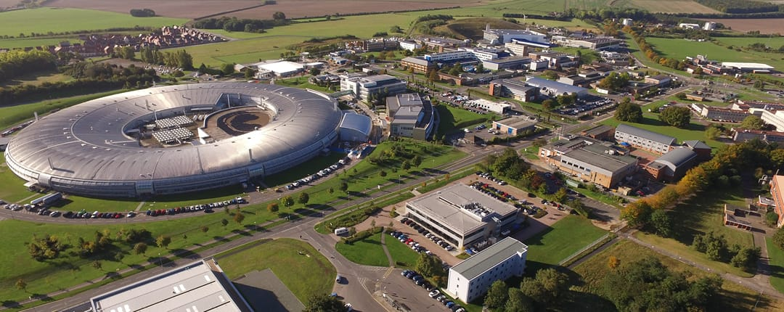
UCL-CSED knowledge exchange
in the space sector
RAL
CSED
Space Catapult
ESA
Harwell Campus

Slide 2
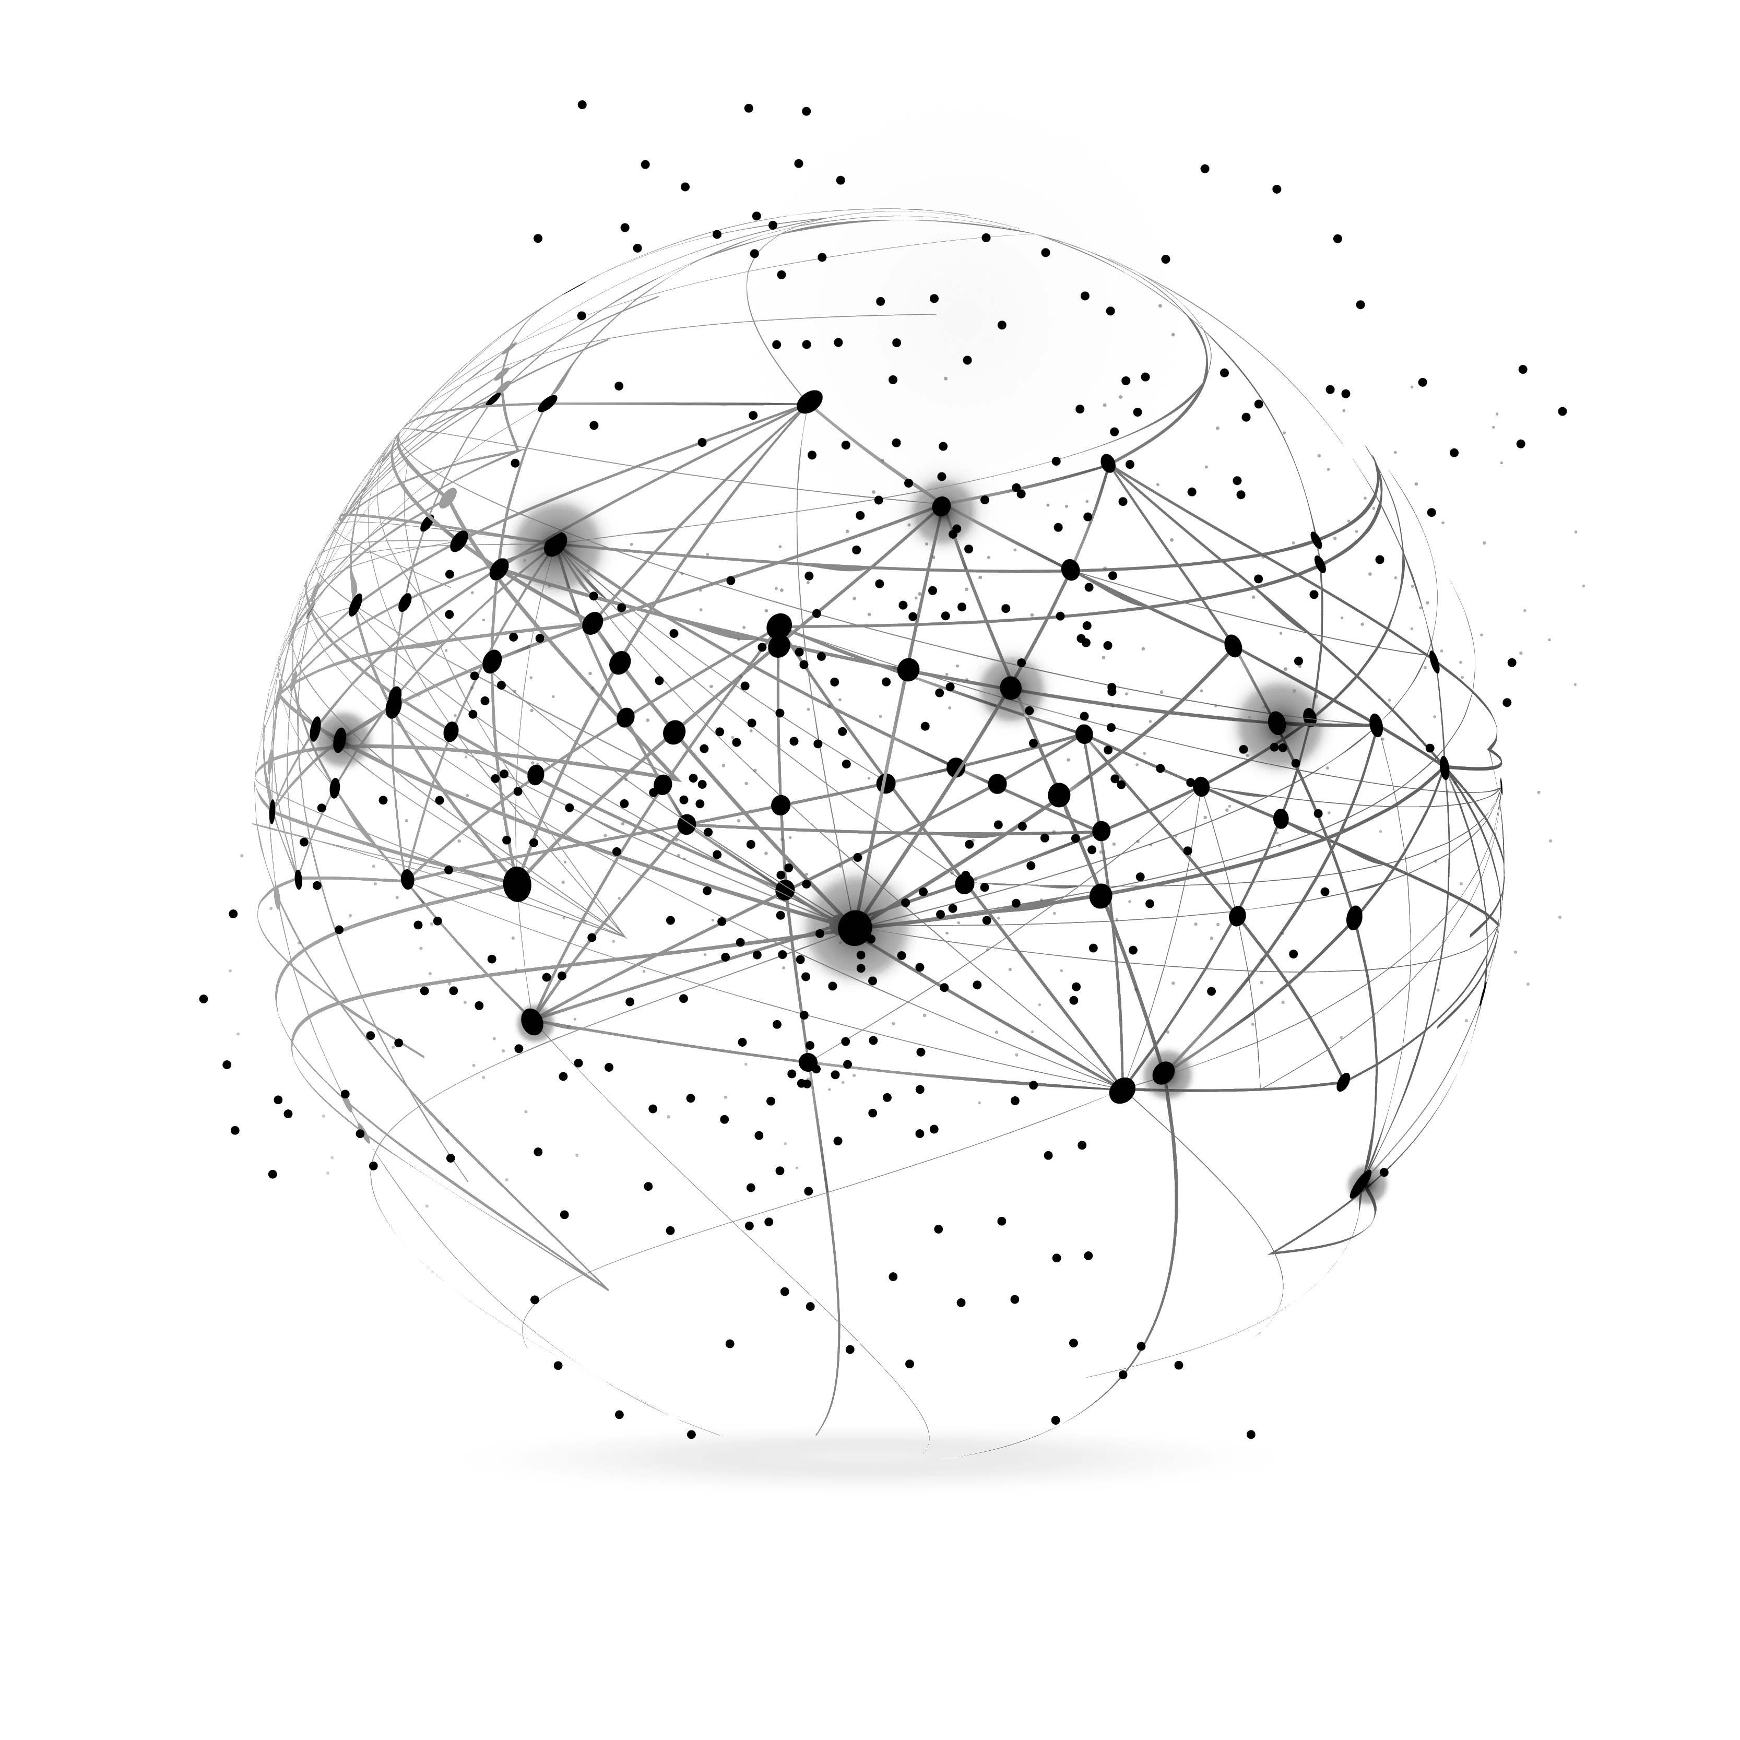
UCL Innovation & Enterprise and
Space Catapult
UCL Centre of Exoplanet Space Data (CSED) based at Harwell Campus (Oxfordshire)
Amongst other activities, CSED will do Knowledge Exchange in the space industry
Started CSED with two PoCs in collaboration with UCL Innovation and Enterprise and Space Catapult (based at Harwell)

Slide 3
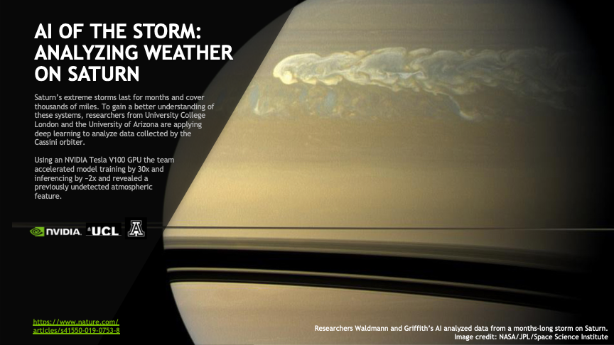
Pattern recognition on solar system and extrasolar planets

Slide 4
Dark vessel detection with OceanMind
CSED to demonstrate that Illegal, Unreported and Unregulated (IUU) can be effectively analysed using space-based image data
Work in collaboration with OceanMind (and Catapult) who provide data and expertise
UCL exoplanets has ample expertise in faint signal detection, i.e. detecting exoplanets around distant stars.
Small scale project (<15K from UCL)

Slide 5
Pirate
UCL
How the project was sold to the students…

Slide 6
Outlier detection in Eutelsat satellites
In collaboration with Eutelsat, Catapult and UCL Electronic and Electric Engineering
Identifying anomalous behaviour in satellites is often done manually to date
We will explore supervised and unsupervised machine learning techniques to detect anomalous behaviour in telemetry and interference detection
Detection of malicious interference by competitors

