Slide 1
The Green Space Conundrum
It’s everywhere – Why can’t we see it?
Dan Osborn
Earth Sciences
Co-Chair UCL Environment Domain

Slide 2
Benefits of locating, measuring and characterising all the green space and not just part.
1. Information on all an area's green space would be to hand. The amount might surprise people.
2. Natural capital assets could be more readily calculated – big gaps at present
3. Planners and land managers in local authorities together with the community would have a common base for discussions and dialogue on green space and how this should be used (including changes of use). Might help with pre-application work with developers as well.
4. A base map could well make it easier to work through the practical implications of emerging policy positions e.g. on biodiversity net gain or help identify where SUDS might be most effective or otherwise help with adaptations needed for climate change risks (e.g. overheating or flooding)
5. It could guide investment and maximise value for money.
6. It could help promote health and wellbeing through better awareness, management and use of green space.
7. Measurement of changes in the extent and character of green space could be determined using a time series of observations and the map could be regularly updated. This would increase the value of the exercise especially when combined with existing mapped information.

Slide 3
Greenhavens Chair
I’m writing primarily in my role as Chair of the Greenhavens Network (now with 80 corporate members and approx. 200 individuals) but also with an interest as an Lewes District Councillor (and Chair).
Greenhavens has a real need to accurately identify the green spaces within its geographic area to better plan to lobby or indeed provide, biodiversity enhancement/protection and promote well being through intelligent use and “joining up” of corridors etc.
We do have maps but the scale gets nowhere near providing what we need. The sort of resolutions you are pondering would transform our activities!
In the meantime I wish the meeting well and hope your efforts will be able to bring such a quantum leap to Greenhavens!

Slide 4
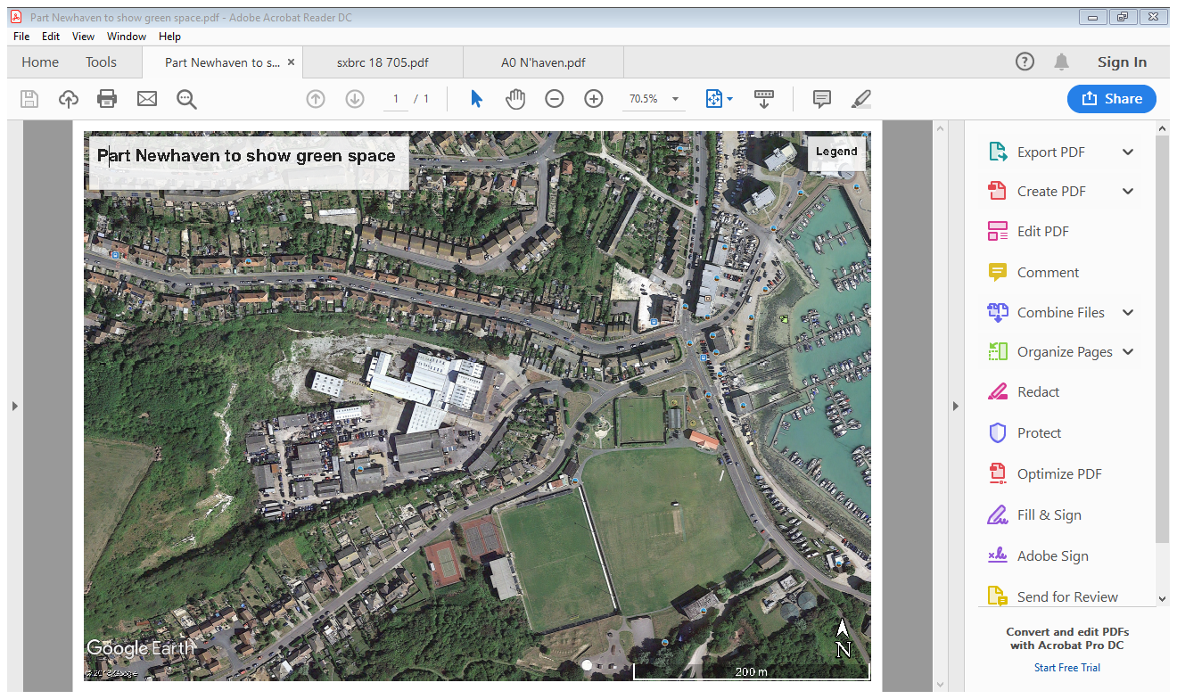

Slide 5
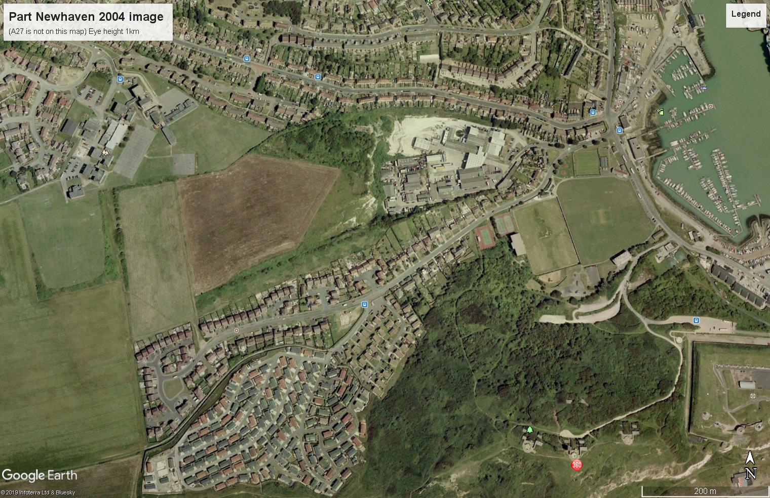

Slide 6
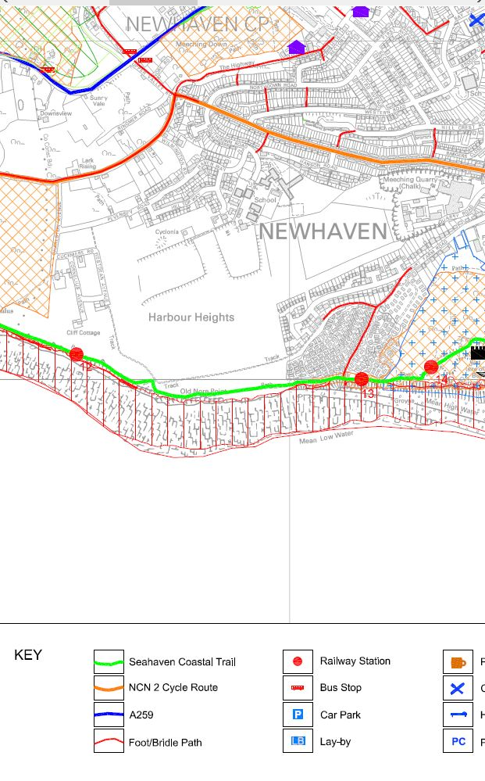

Slide 7
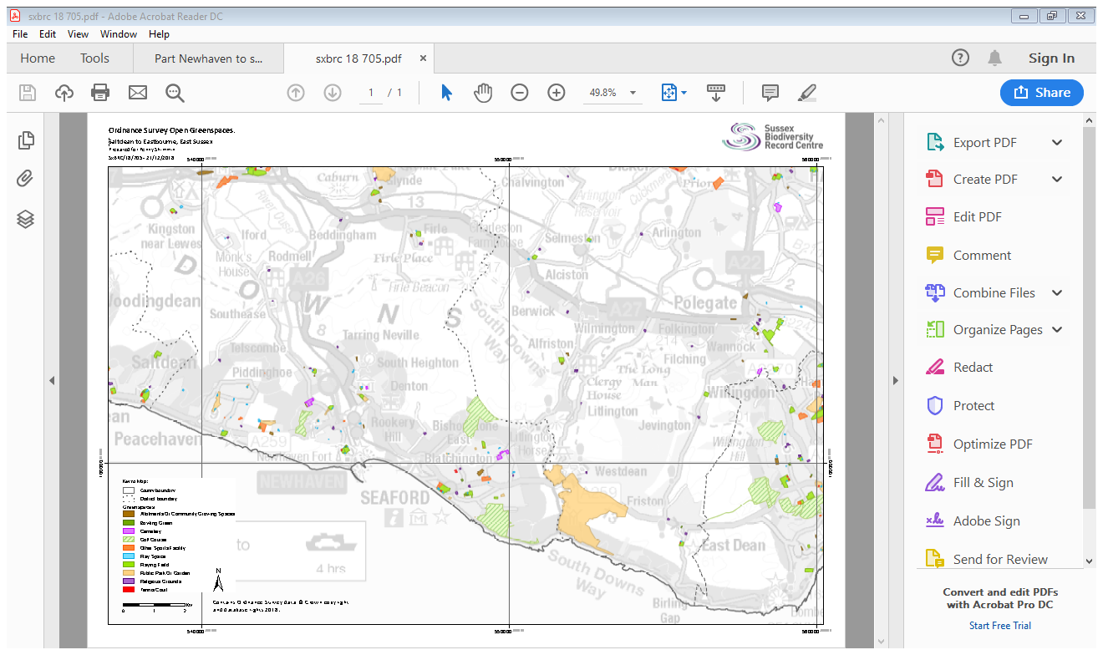

Slide 8
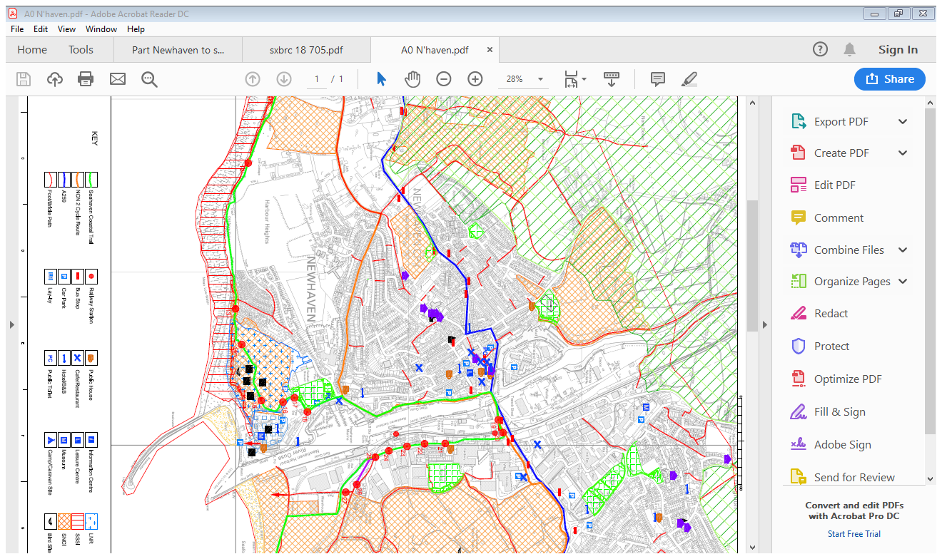

Slide 9
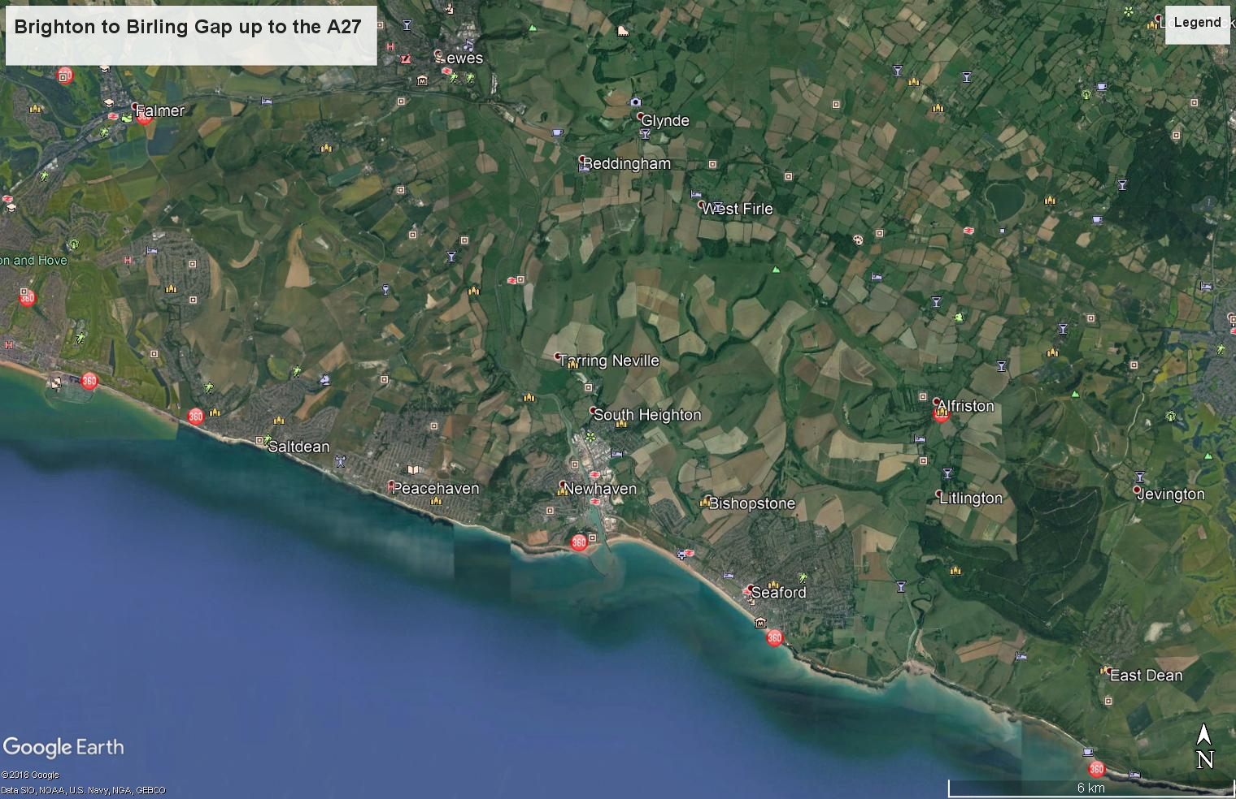

Slide 10
