Slide 1

Early intervention in children with intellectual developmental disabilities: a trial of stepping stones triple P in the UK
Prof Angela Hassiotis
UCL Division of Psychiatry & Camden Learning Disability Service
WPA 2017
Berlin

Slide 2
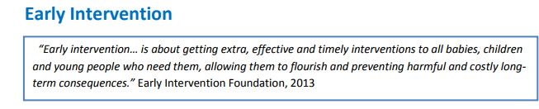


Slide 3
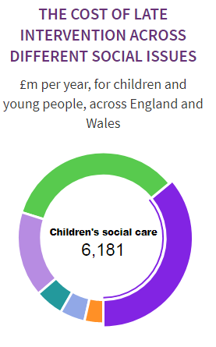

The impact of late intervention: services and supports needed for a child in difficulty that could have been prevented
Local authorities spend per person: £298 (164-531)
Level of spend is associated with deprivation ( urban rural)
£17bn pa in England and Wales

Slide 4
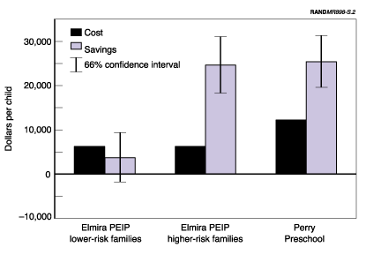
Why early intervention?
To overcome the cognitive, emotional and resource limitations of disadvantaged children
Associated with less public expenditure later in life due to better outcomes
https://www.rand.org/labor.html

Slide 5

Investing in children
Heckman and Masterov
Nurse-family partnership
Quality early childhood development heavily influences health, economic and social outcomes for individuals and society at large
High-quality birth-to-five programs for disadvantaged children can deliver a 13% per year return on investment—a rate substantially higher than the 7-10% return previously established for preschool programs serving 3- to 4-year-olds. Significant gains are realized through better outcomes in education, health, social behaviors, and employment
Nobel Memoria Prize in Economic Sciences
https://heckmanequation.org/resource/research-summary-lifecycle-benefits-influential-early-childhood-program/

Slide 6
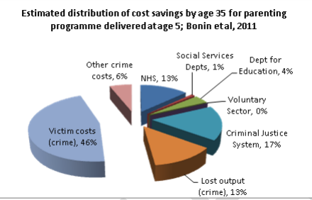
Economic impacts
Usually based on estimates of future employment, earnings, crime, education behavioural problems in childhood
Links between conduct disorder aged 10 and 16 and later educational under-achievement and unemployment (BCS70)

Slide 7
http://www.eif.org.uk/
50+ programmes
Evidence and costs
Lifespan early intervention (prevention)

Slide 8
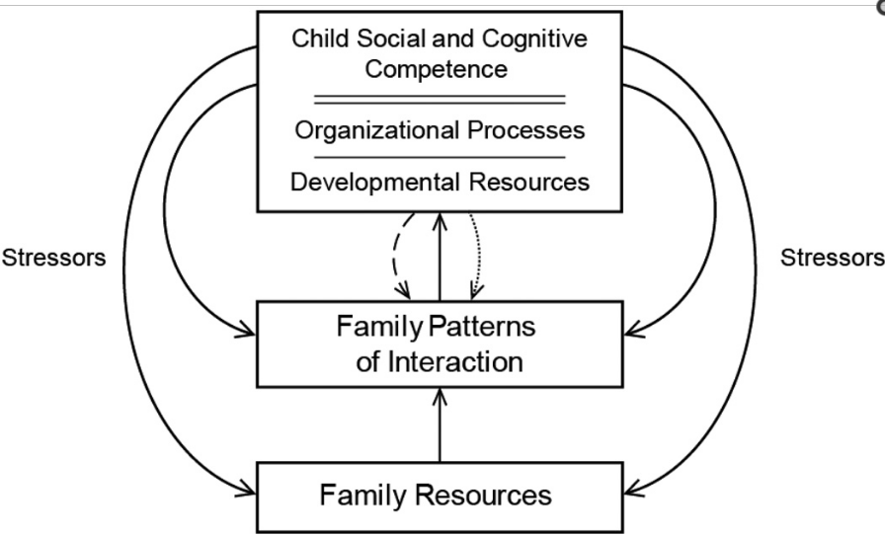

EI 1: The child with delays and its family (Guralnick 2017)
Challenges
child social and cognitive competence, family patterns of interaction, and family resources
Benefits
child development, engaging with professionals and advocacy for the child
Developmental science (syndrome specific/neuroscience/genetics)
Parent responsiveness and patterns of interaction
Parent resources, e.g. stress
Schooling and peer competencies
effect size 0.50 to 0.75 SDs

Slide 9
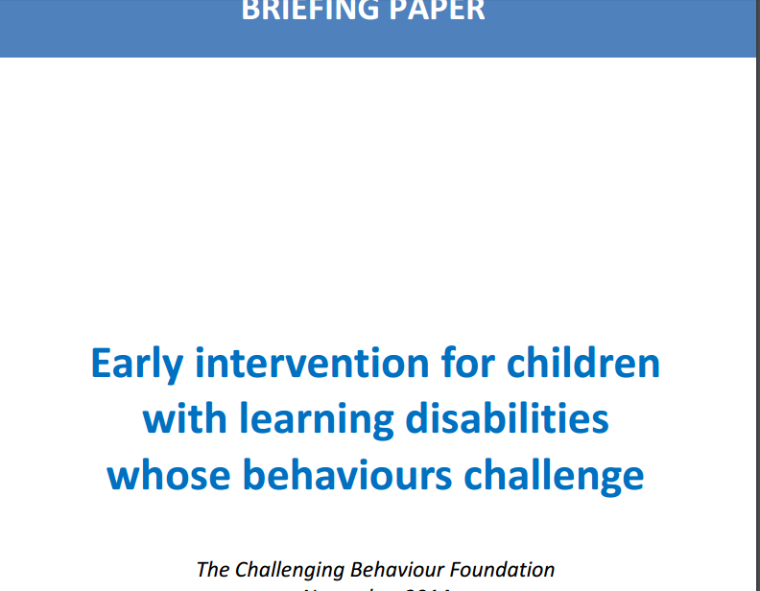

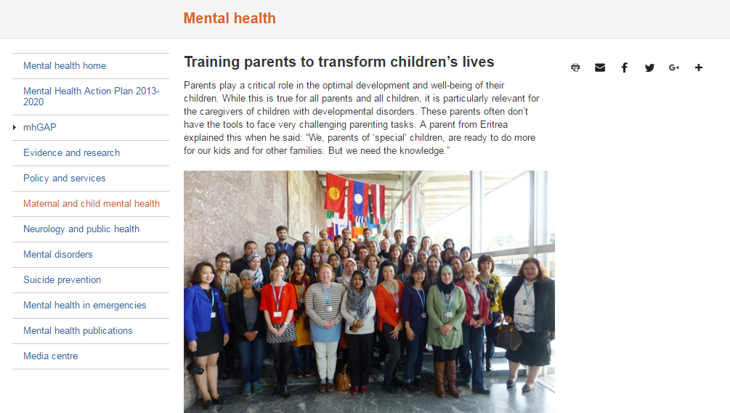


Slide 10
Mental health problems in children with ID
Rutter et al: 30% vs 7% (Isle of Wight studies)
Emerson & Hatton: 39% vs 8% (ONS http://www.lancaster.ac.uk/staff/emersone/FASSWeb/Emerson_07_FPLD_MentalHealth.pdf)
Longitudinal follow-up shows that challenging behaviours persist over time but only 10% of participants receive any intervention (Einfeld et al, 2007)
Lower use of services but level of morbidity

Slide 11

Factors predicting mental illhealth/challenging behaviour in children with ID
Emerson and Hatton (2008): cumulative risk of exposure to indicators of social disadvantage are associated with increased prevalence of emotional disorders, conduct disorders and hyperactivity in children.
lone parent family, income poverty; exposure to 2 or more negative life events; poor family functioning; primary carer with no educational qualifications; maternal mental health issues; poor maternal self-rating of health

Slide 12
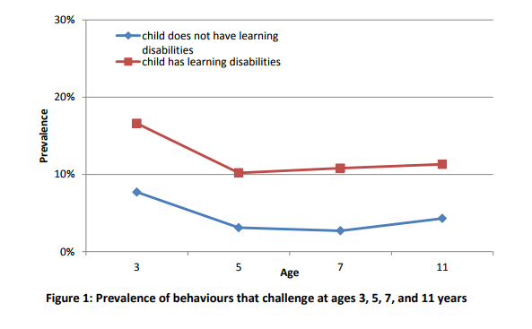
http://www.challengingbehaviour.org.uk/learning-disability-files/Briefing-Paper.pdf

Slide 13
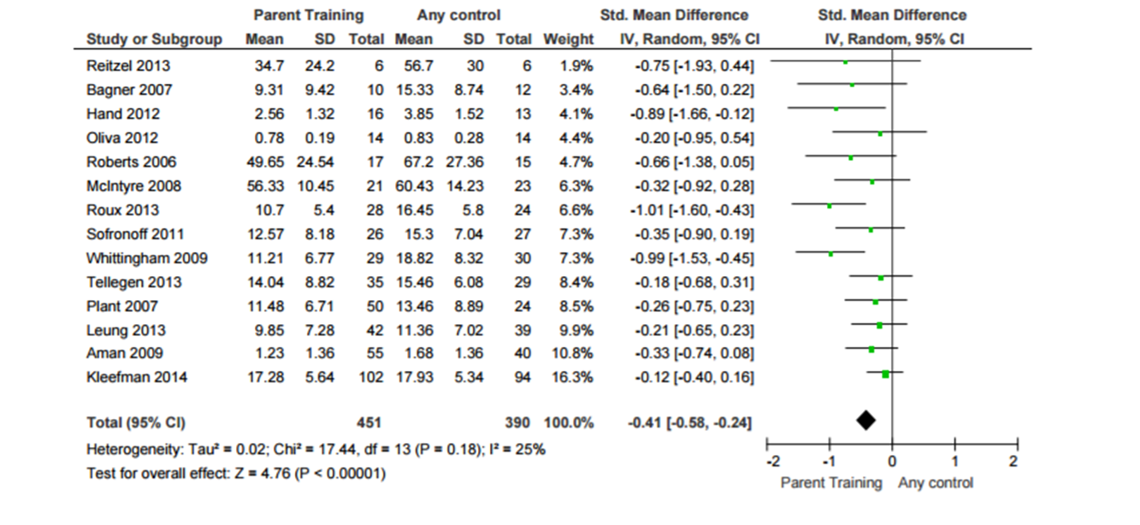
EI 2: the child with delays and challenging behaviour
Early intervention can be helpful and cost effective in supporting families with children who present with challenging or antisocial behaviours.
Parent groups

Slide 14
How do the parenting programmes work?
Focused short-term intervention to address parenting limitations
Use social learning
Various underpinning theories e.g. Behavioural to encourage/discourage behaviour; systemic approaches; attachment based
Parents value the support in a group setting

Slide 15
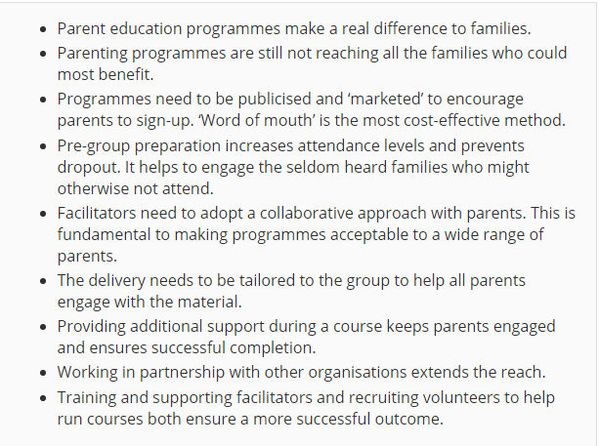
https://www.scie.org.uk/publications/ataglance/ataglance11.asp

Slide 16
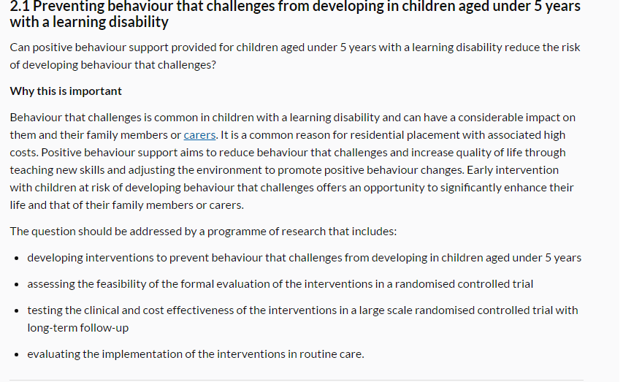
NICE Guideline 11: research recommendation

Slide 17

EPICC-ID Overview
Comparator
Health visitor services; Primary care engagement and advice; Version of early intervention provided by a variety of services; Parenting advice and support sessions by carer groups/third sector organisations.
Parents will receive a list of national and local resources and the Contact a Family guide to challenging behavior
Outcome(s)
Parent reported severity of challenging behaviour measured by preschool Child Behaviour Check List) at 12 months post randomisation
Participants
Parents aged =>18 years of age
Child 30 to 59 months old at identification with moderate to severe ID Parent report of challenging behaviour maintained no less than 2 months
Intervention
Level 4 SSTP, a 9 week programme providing a combination of group and individual support to help parents develop skills to manage their child’s behaviour effectively

Slide 18
SSTP requirements http://www.triplep.net/files/8214/3139/5749/Triple_P_Practitioner_Info_Sheet_Grp_Stepping_Stones_UK_2014.pdf
2x therapists per site
4 days of training (split in 3½ days and a half day 6 weeks later for accreditation)-scheduled for June 2017
Triple P UK offers a community of practice and other peer supports and tutorials to enhance skills and delivery
2½ hr groups of 5-7 parents will be run by 2 therapists x 5 weeks followed x 3 individual telephone contacts with each parent and a final session
Supervision and support by TP trainers
Sessions to be videotaped for fidelity assessment
Therapists will complete study related paperwork and sessions checklists to aid fidelity assessment

Slide 19
Hypotheses
Primary: adding level 4 SSTP to TAU will reduce challenging behaviour at 12 months post randomisation measured with the parent completed preschool Child Behaviour Checklist (CBCL).
Secondary: adding level 4 SSTP to TAU will:
1. reduce challenging behaviour measured at 12 months post randomisation on caregiver completed CBCL (C-TRF)
2. reduce blind rated observed challenging behaviour in the child at 12 months post randomisation on Revised Family Observation Scales
3. be cost-effective

Slide 20
Eligibility
  Inclusion
Parent >18 years; child aged 30-59 months at identification; moderate to severe ID (ABAS General Adaptive Functioning); written informed consent by parent/caregiver; reports of challenging behaviour 2 months/longer
Exclusion
Child has mild, profound or no ID on parent reported ABAS; parent/carer has insufficient English language to complete study questionnaires; another sibling is taking part in the study

Slide 21
Sample size and other aspects
258 children are required to detect a low to moderate (standardised) effect size of 0.40 for the primary outcome CBCL at 12 months at the 5% significance level with 90% power
Internal pilot x 10 m
Treatment fidelity
Process evaluation

Slide 22
Lead-in
Recruitment of study personnel and practitioners and training in SSTP*
Parents of 30-59 month intellectual disabilities (ID) either referred for or concerned with the child’s behaviour. Recruited from clinical service pathways, parent organisations, clinical and research networks
Parent agrees to meet the RA** and child is screened for level of ID (ABAS***)
2 weeks
If challenging behaviour persists and the parents consent to take part, baseline assessment is undertaken and then randomised to trial n=258 (including internal pilot=7 months)
If behaviour improves, no further action
Measures at baseline, 4 and 12 months
Primary: Preschool Child Behaviour Checklist (CBCL)-parent
Secondary: Revised Family Observation Schedule, FOS-RIII; Child Behaviour Checklist Caregiver-Teacher Report Forms; C-TRF; General Health Questionnaire, GHQ-12-parent; Questionnaire on Resources and Stress, QRS-F-parent; Caregiving Problem Checklist-Difficult Child Behaviour-parent; Parenting Sense of Competence Scale, PSOC-parent; Paediatric Quality of Life, PedsQLparent; study specific Child and Adolescent Service Use Schedule, CA-SUS-parent/records; EQ-5D parent.
Other
Case Report Form; Bayley Scales of Infant and Toddler Development 3rd Edition (child-baseline); Client Satisfaction Questionnaire (parent-4 months);
Group SSTP n=155
TAU****
n=103
Number of drop outs recorded
4 months f/u
Post treatment
4 months f/u
Post treatment
Number of drop outs recorded
*: group Stepping Stones Triple P
**: Research Assistant
***: Adaptive Behaviour Assessment System
****: Treatment as usual
12 months f/u
Child 42-71 months
12 months f/u
Child 42-71 months

Slide 23
Health economics
Parent resource utilisation
Cost-effectiveness analysis: mean incremental cost from the health and social care perspective per change in CBCL
Cost-benefit analysis of impact of child’s behaviour on the parents

Slide 24
Other aspects
4 areas (N & S London, NE & NW England)
8 participants recruited and randomised so far

Slide 25


Effectiveness of Parent Mediated Intervention for Challenging Behaviour in Pre-school Children with ID
CI
Angela Hassiotis
Coapplicants (alphabetical order)
Michael Absoud, Jacqueline Barnes, Marinos Kyriakopoulos, Kate Oulton, Eleni Paliokosta, Aditya Sharma, Vicky Slonims, Alistair Sutcliffe, Megan Thomas
Collaborator
Jeremy Turk
Priment CTU
Gareth Ambler, Rachael Hunter, Monica Panca
Contact
Una Summerson
Trial Manager
Michaela Poppe
Research assistants
Vickie Ratti and Holly Walsh

Slide 26

Thank you
@likahassiotis
@EPICC_ID a.hassiotis@ucl.ac.uk

