Slide 1
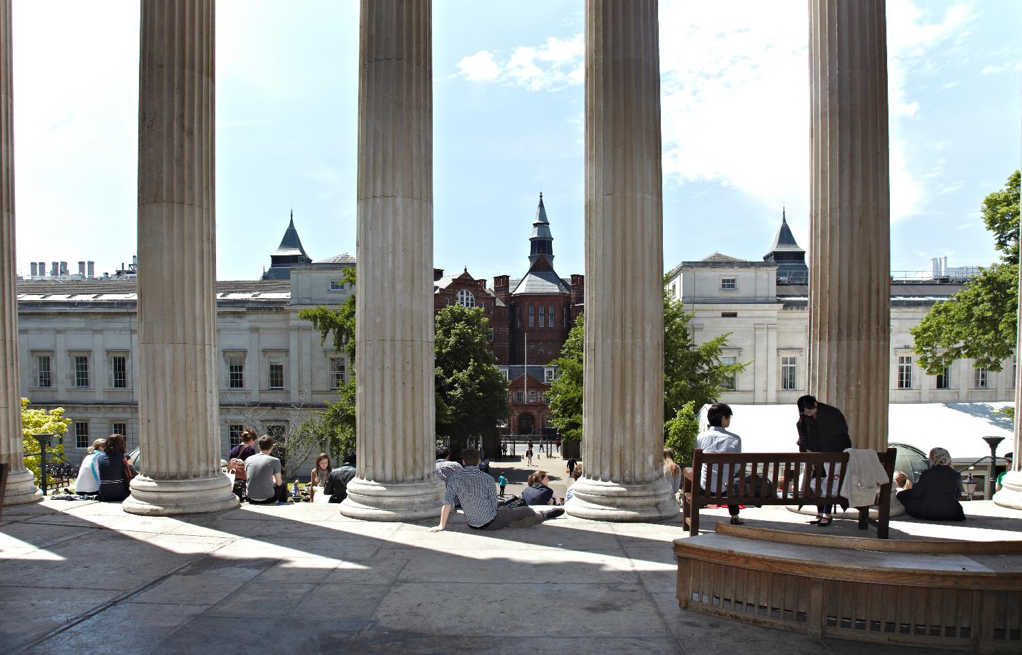
LONDON’S GLOBAL UNIVERSITY
Provost’s View:
Institutional Athena SWAN Renewal

Slide 2
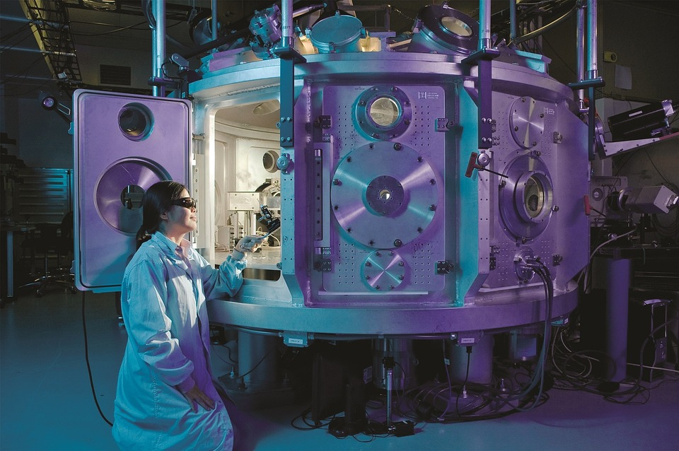
Athena SWAN is a gender equality initiative
UCL currently holds 34 departmental awards, including two Gold awards in addition to our institutional Silver award

Slide 3
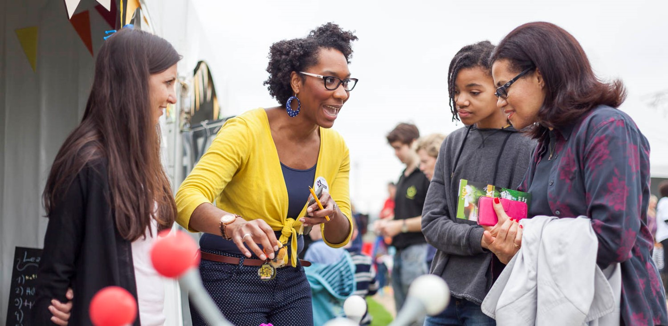
LONDON’S GLOBAL UNIVERSITY
Recent successes
Applications and appointment rates for female academics increasing
Moving towards more equitable representation
at all levels
Percentage of women Heads of Department has increased from 15% to 25%

Slide 4
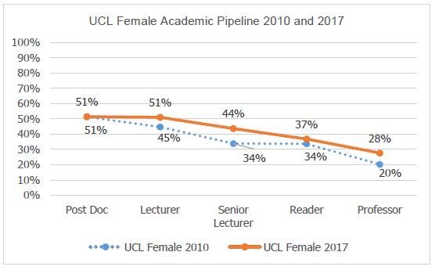
The new Academic Careers Framework has led to a record number of women applying for academic promotion and being successful.

Slide 5
However, we are doing less well on race equality and need to redouble our efforts

Slide 6

Thank you
Taking part in Athena SWAN is a big commitment
Thank you to all those who work very hard on this
Your efforts are very valuable in progressing our goals on equality and diversity
LONDON’S GLOBAL UNIVERSITY
Notes:
thanks

Slide 7
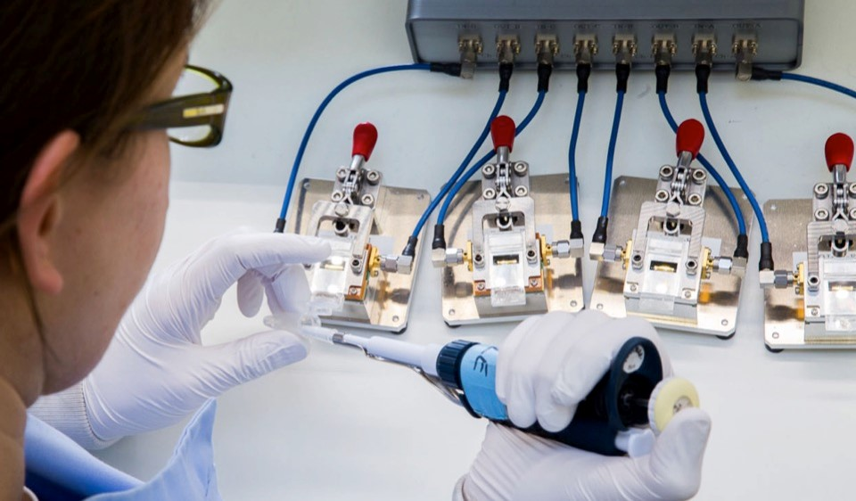
LONDON’S GLOBAL UNIVERSITY
  Engagement with Athena SWAN
  Excellent engagement in STEMM
  More departments in the social sciences and arts and humanities could get involved
  Encourage more men to contribute as Athena SWAN is concerned with gender equality

Slide 8

LONDON’S GLOBAL UNIVERSITY
Want to know more?
For more information about how you can get involved in Athena SWAN, please contact
- Kevin Coutinho
(Athena SWAN manager) at:
k.coutinho@ucl.ac.uk

