Slide 1
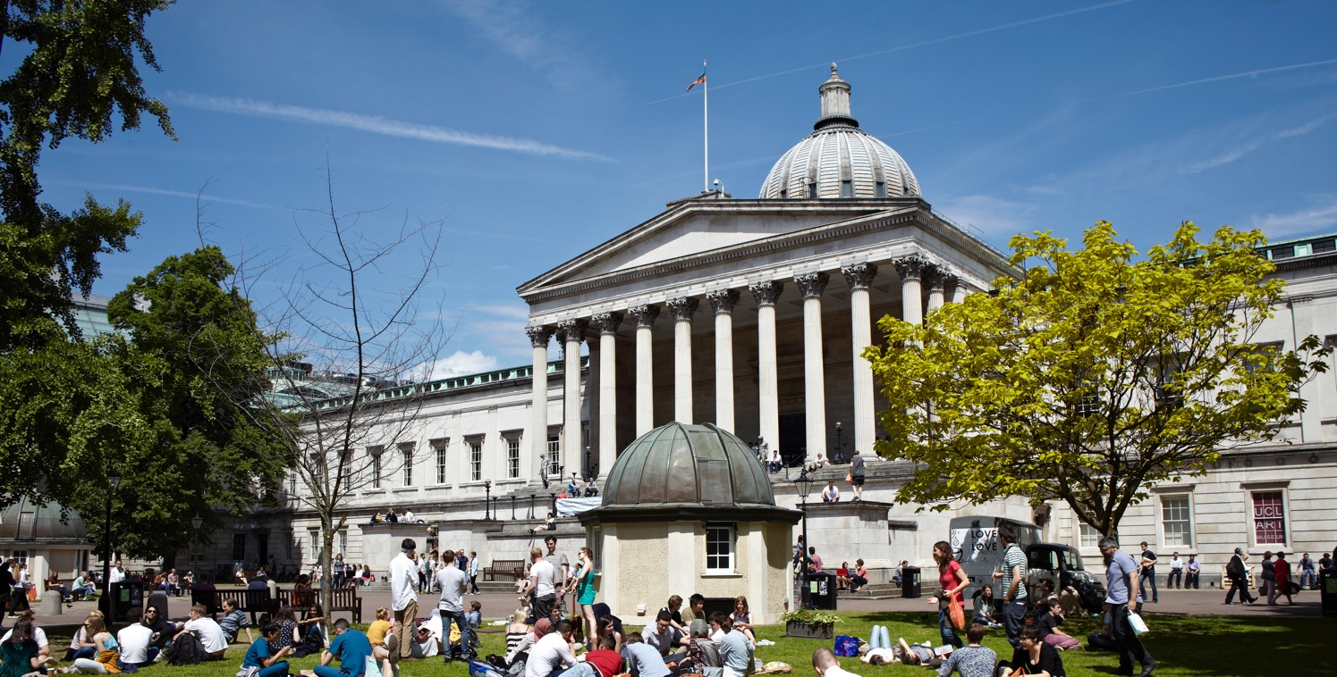
LONDON’S GLOBAL UNIVERSITY
Provost’s View:
Investing in universities brings lasting public benefit: what UCL is doing

Slide 2
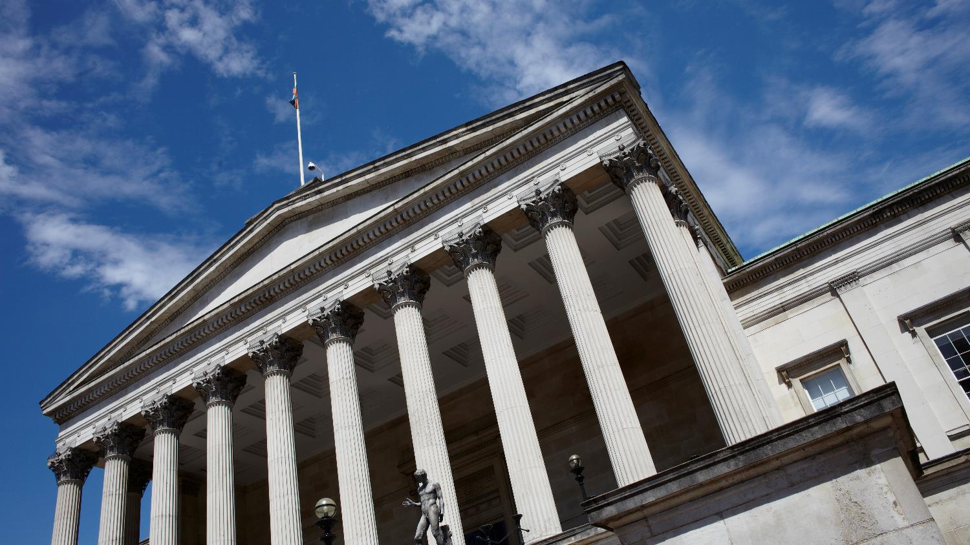
UK universities are an important contributor to the UK’s economy. In 2014/15:
The HE sector supported almost one million jobs…
… and generated £95 billion of gross output in the UK economy.
Big numbers, with a positive effect on many.

Slide 3
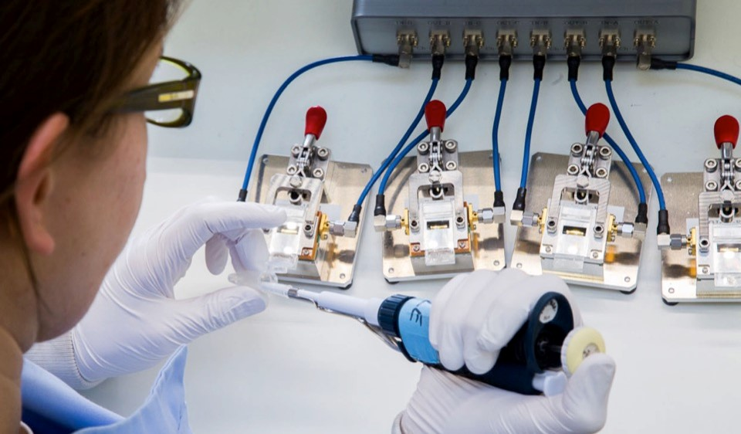
Economic importance, though, is only part of the picture
UK universities are at the forefront of knowledge and discoveries shaping the world today, transforming and improving lives.
We do this by attracting the best academic minds from around the world, and through international collaborations

Slide 4
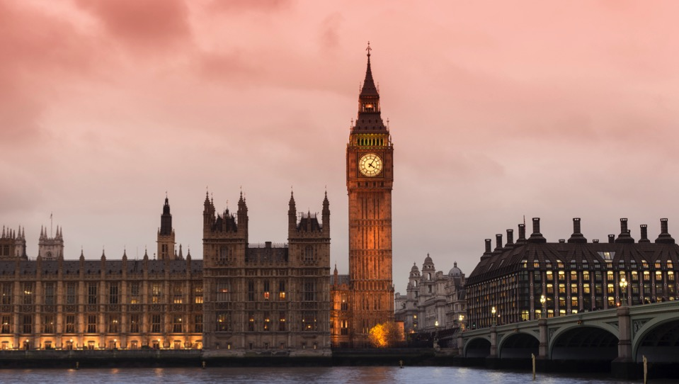
Risks facing the UK HE sector
A “no deal” Brexit scenario could cut UK researchers off from vital Horizon funding
Reported proposals of post-18 Augar Review to significantly reduce funding for universities

Slide 5

Sitting still is not an option – we must respond to these threats
Confident and responsible investment in infrastructure – capital infrastructure, e-infrastructure and people (‘knowledge infrastructure’) to ensure we remain attractive.

Slide 6
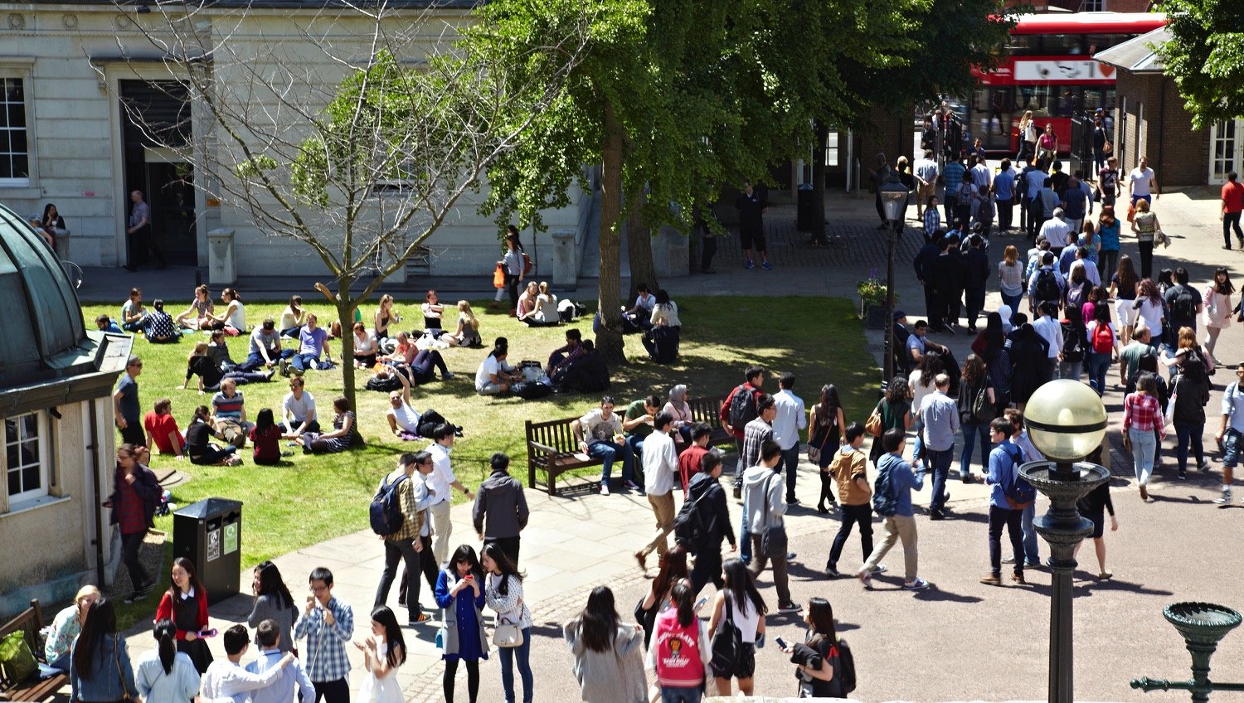
Sitting still is not an option – we must respond to these threats
Confident and responsible investment in infrastructure – capital infrastructure, e-infrastructure and people (‘knowledge infrastructure’) to ensure we remain attractive.

Slide 7

We are in a strong financial
position to do this
Our borrowing compared to other UK universities is modest
Our borrowing is on competitive terms
Dramatic growth in research income through grants and contracts, as well as the It’s All Academic Campaign, which goes from strength to strength
Notes:
Our borrowing compared to other UK universities is modest. The loan we have with the European Investment Bank is now fully drawn and our total borrowing is at £333m which is around 23% of our total income. The average for the Russell Group universities in 2016-17 was 36%, and for the sector as a whole was 33%. The level of borrowing at Imperial, Manchester and Bristol, for example, is higher than ours, both in cash terms and as a proportion of their income. The interest rates on our borrowing are highly competitive and are fixed in advance. Our ability to borrow on such attractive terms reflects the fact that we are viewed as financially robust and low-risk over the long term.
Meanwhile, there has been a dramatic growth in UCL’s research income through grants and contracts. Professor David Price’s most recent report on research indicates that research income in 2010/11 was £283 million and grew to £459 million in 2016/17, with QR income through the REF exercise at £76.4 million (5.9% of the national total), second only to Oxford at £77.7 million and ahead of Cambridge at £75.5 million.
In addition to this, the It’s All Academic Campaign is going from strength to strength, with the total raised standing at £486 million at the end of 2018.

Slide 8

LONDON’S GLOBAL UNIVERSITY
What is this money being used
for, and why?
Investing in people – our tally of academic and research staff is at an all-time high of nearly 6,500
Expanding and enabling the multidisciplinary research environment that is UCL’s hallmark
Image: a candidate Higgs Event from the ATLAS,
one of the two detectors at the Large Hadron Collider.
UCL academics lead the UK contribution.
Notes:
Photo credit: Matt Clayton

Slide 9

LONDON’S GLOBAL UNIVERSITY
What is this money being used
for, and why?
Transforming UCL: improvements include new and expanded teaching and learning space, and the new Student Centre.
Here East and the interim UK Dementia Research Institute (UKDRI) are precursors to two major campus expansions: UCL East and the IoN/UKDRI in King’s Cross

Slide 10

LONDON’S GLOBAL UNIVERSITY
  Moving forward with confident,
  responsible investment
  Ensuring we remain competitive and attractive to staff, students and partners across the world
  Ensuring that we will continue to bring about positive change and lasting benefit

Slide 11

LONDON’S GLOBAL UNIVERSITY
Want to know more?
For more information, or if
there is something else that
you would like to know more about, please contact us at:
provostfeedback@ucl.ac.uk

