Slide 1

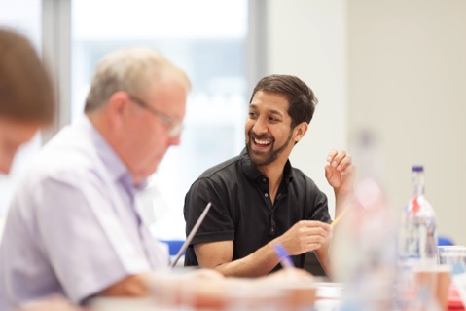


The Provost’s View:
How we are transforming our services to support world-leading academic excellence and help secure our place in the world top 10
LONDON’S GLOBAL UNIVERSITY

Slide 2
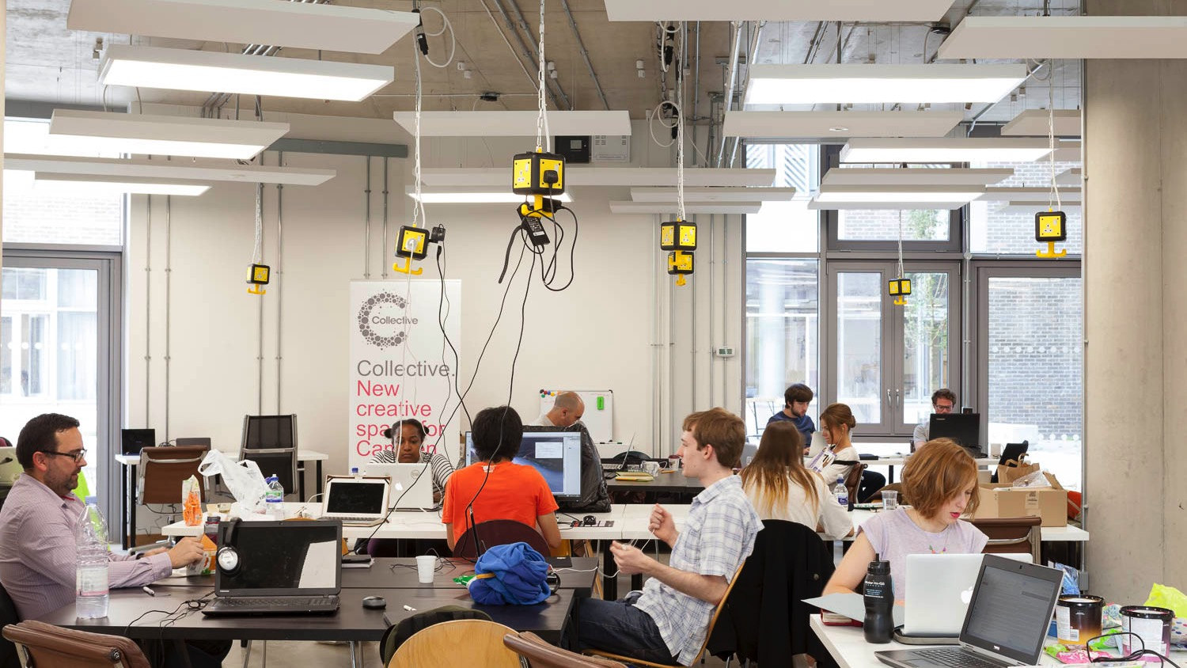
Our professional services are essential in UCL’s continued success
But, too often, results
are achieved in spite
of the underlying processes, systems
and ways of working.
Notes:
Our professional services have an essential role in UCL’s continued success and must be empowered and developed.
Currently, we often get things done through the exceptional commitment of individuals who achieve results in spite of, rather than because of, the underlying processes, systems and ways of working.
We need to get our underlying processes and systems working better to support academic excellence and offer more rewarding and fulfilling careers in professional services. This is why we are transforming our professional services.
To get this right, we need to look at the provision of services across the piece, and at all levels. Where services have been stretched or perhaps not been delivering to their full potential in the past, we have tended to develop work-arounds and different processes, all, of course, with good intent.
But the net collective result is not only inefficient, it is also relatively ineffective, and all of this has, ultimately, led to poor levels of satisfaction with service provision. To allow the status quo to continue is not really an option.

Slide 3

More effective and efficient processes, structures and systems
Tinkering is not enough; nothing less than transformation will do.
Notes:
We need significant change and investment in processes, structures and systems to become more effective and efficient.
We need to look at how we can work more effectively together by identifying what activities need to be delivered close to students and academic staff and what is best provided from central professional services.
This is not about a one-size-fits-all set of structural changes, but it is about joining them up through all the layers of the university and making sure that we do things once, do them well and do them in the most efficient way, as well as in the right place.
Following a decade in which UCL has doubled in size and extended the range and complexity of its activities, we will not fix the challenges we face in delivering excellent service by tinkering; nothing less than transformation will do.

Slide 4
Communities of practice
Bringing colleagues with similar roles into communities that:
share ideas
simplify processes
offer better career development opportunities.
Early success
1.
Four Communities of Practice launched for digital, events, internal communications and student recruitment
2.
Student Recruitment Community of Practice has reviewed and simplified previously complex processes
Notes:
As part of the Transforming our Professional Services programme, several important initiatives are already underway.
Through Communities of Practice, we have started to bring together colleagues who work in similar roles but who are based in different parts of UCL. Through this approach, these communities are sharing ideas, simplifying processes and offering better career development opportunities.
An early ‘Communities of Practice’ success story comes from staff across UCL who provide communications and marketing services, where they have already:
launched four Communities of Practice – uniting communications and marketing colleagues who work in digital, events, internal communications and student recruitment
reviewed and simplified previously complex processes – the Student Recruitment Community of Practice has reduced the number of steps taken from 43 to 12 for departments/faculties to produce and send an email via the Radius CRM to prospective students.

Slide 5
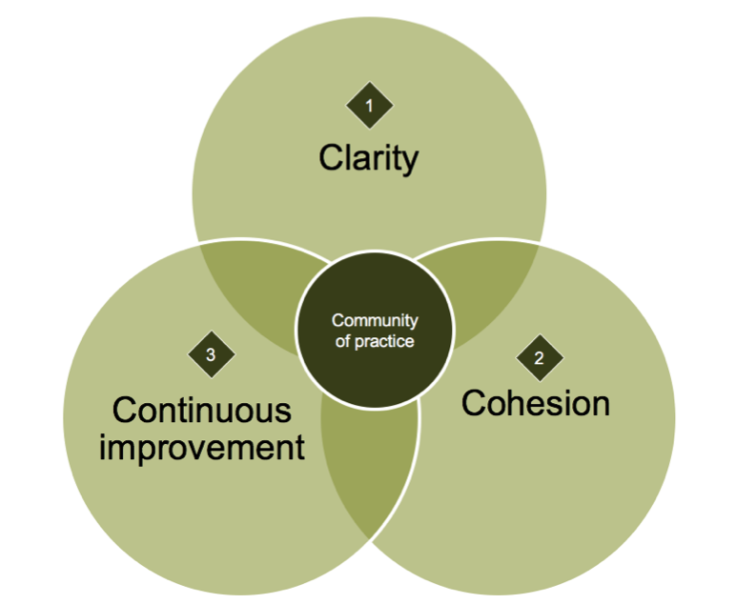
“I’ve had more opportunity
to collaborate with colleagues in other departments over
the past few months than
I have during my past
10 years at UCL.”
If you would like to find out more about Communities of Practice, please contact Alice Chilver.
Notes:
It’s still early days but we’re already hearing great feedback, for example from Chris Neil in Engineering: “I’ve had more opportunity to collaborate with colleagues in other departments over the past few months than I have during my past 10 years at UCL.”
Further roll-outs of new Communities of Practice are being developed, for example in human resources, planning, research support and registry services.
If you would like to find out more about Communities of Practice, you can contact Alice Chilver (Head of Communities of Practice) or visit the Transforming our Professional Services website.

Slide 6
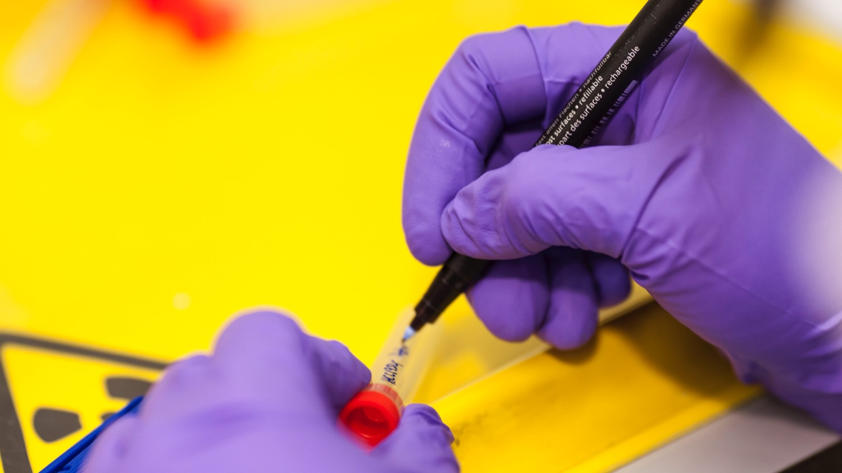
Research and innovation
support services
The contract administration process will be improved by:
addressing capacity issues
simplifying processes
new ways of working together
training colleagues who support researchers.
Notes:
Since the beginning of this year, we have been listening and talking to colleagues across faculties, divisions, institutes and central divisions to hear what is working well and not so well in our professional services. SMT has agreed an initial list of priorities to start work on in 2018. These include:
We recognise the frustration that colleagues have in setting up and administering research and innovation contracts and we need to do better. This will be achieved by: addressing capacity issues; simplifying the processes; developing new ways of working together, with the technology and governance to support; and providing training for colleagues involved in supporting researchers.
This is a fundamentally important service for a world-leading, research-intensive university and we simply have to get this right, as quickly as possible. In the interim, we should acknowledge that colleagues in this service have been working really hard in difficult circumstances, especially given their massively increased workload following our outstanding research grant success.

Slide 7
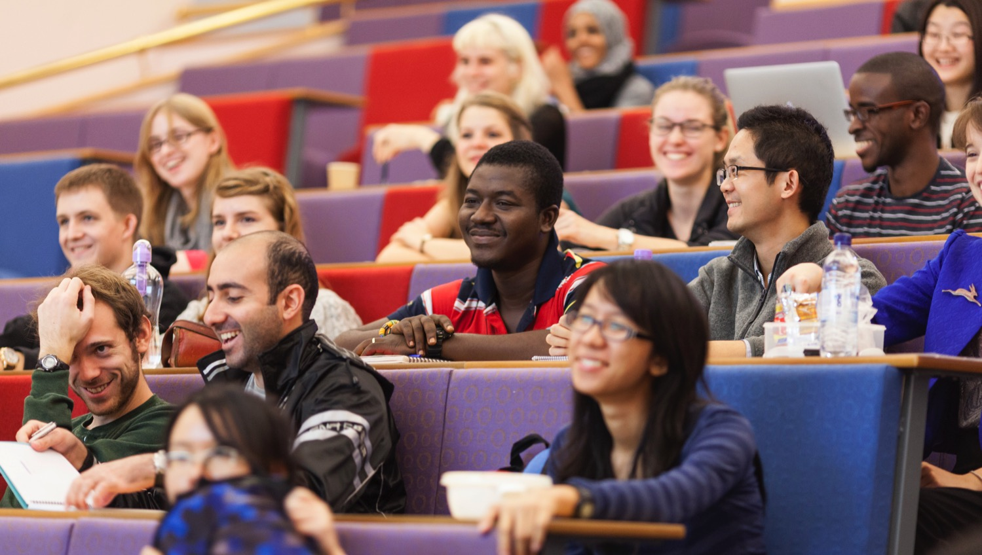
Improving the student experience
We will:
streamline our student lifecycle processes
identify contacts embedded in departments.
Notes:
Our students tell us we need to do better; staff and students alike are frustrated with our current processes and systems. We will start by building on the Portico improvement programme, which will streamline our student life cycle processes and support students by identifying contacts embedded in academic departments.
We will also bring together colleagues from across UCL via new Communities of Practice – as part of this, we will consider best practice for effective education administration and student support teams.

Slide 8
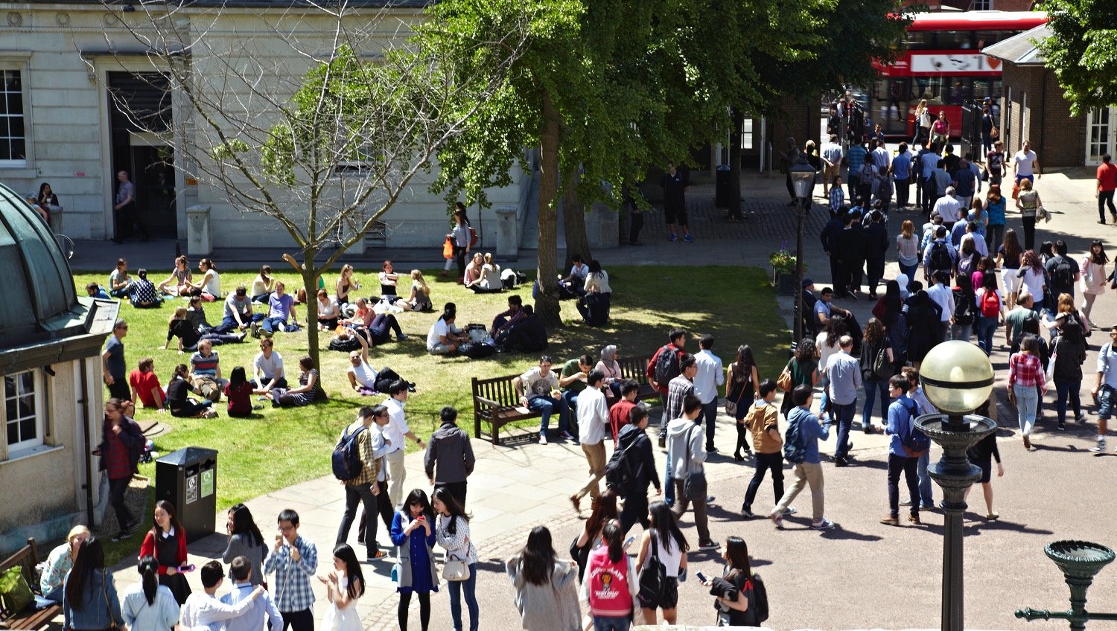
Relieving the pressures on the Bloomsbury estate
A new professional services hub is one option that could free
up space for teaching and research.
Notes:
With the growing pressures on the Bloomsbury estate, space must be prioritised for teaching and research.
We are exploring whether those services, which do not need to be delivered in prime space that could be used for academic activity, could, instead, be brought together and delivered through a new professional services hub.
It is our intention that this hub should be a centre of excellence that will offer not only a highly efficient, but also a much more effective service for students and staff alike.

Slide 9

Better procurement
Improving how we buy bulk items and drive value from our suppliers means more money for the academic mission.
Notes:
Each year, we spend more than £350 million on non-research procurement activity and we believe we can get better value from this.
This will be achieved by improving how we buy bulk items and investing in systems to drive better value for money from our suppliers.

Slide 10
Making better use of our estate
We will prioritise improvements to the small works, timetabling and room bookings processes.
Notes:
We recognise the frustration that our estate causes colleagues when trying to deliver great teaching and outstanding research, so we have prioritised the small works process – clarifying service levels, defining roles and responsibilities across the estates service and improving data and management information to better support departments.
The work underway to improve the timetabling and room bookings processes will continue to be prioritised.
All these improvements are in addition to the Transforming UCL building and refurbishment programme.
So far, it has delivered a new building for the Bartlett School of Architecture, the Wilkins Terrace and new facilities in the Kathleen Lonsdale building for Earth Sciences and Physics students.
While, in 2018, a huge new study space in Torrington Place, the refurbished Laws building, Bentham House, and the new Student Centre are all due to open.

Slide 11


More fulfilling and rewarding careers
We will create pathways and frameworks to help professional services staff develop in their careers.
Notes:
We will prioritise the creation of pathways and frameworks to support professional services colleagues in developing their careers.
This will be piloted for colleagues involved in communications and marketing and then rolled out widely.

Slide 12

Want to know more?
For more information about these plans, or if there is something else that you would like to know more about, please contact us at:
provostfeedback@ucl.ac.uk
Notes:
Want to know more?
For more information about these plans, or if there is something else that you would like to know more about, please contact us at:
provostfeedback@ucl.ac.uk

