Slide 1
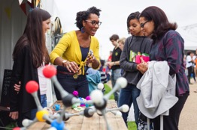
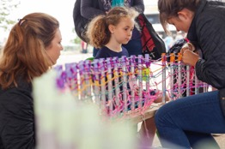
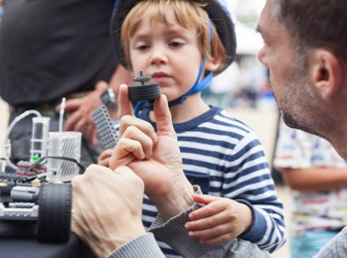
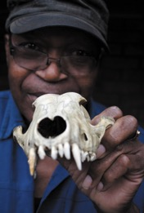
The Provost’s View:
Demonstrating how
we are a force for
the public good
LONDON’S GLOBAL UNIVERSITY

Slide 2


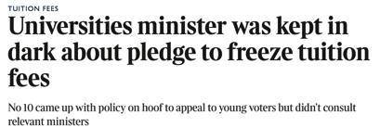

Challenges to universities
The message from Brexit – people don’t understand what universities do.
We must be forthright.
Notes:
We live in turbulent times that are testing. The disenfranchised have expressed a distrust of universities, indicating that they think we’re elitist, disconnected from society, and uncertain about what we’re for. Other challenges include rising inflation, research income that doesn’t cover full costs and a cap on tuition fees.
In a global society that now has to deal with the rise of populism, concerns about immigration, fake news and distrust of experts, universities should become more, not less important. We need to be forthright and make the case that autonomous, internationally competitive universities are fundamentally important to the future of the UK, to the public and our politicians.

Slide 3

Universities are valuable because they:
  provide evidence
  create and share knowledge
  support 1m jobs
  contribute £95bn to the economy.
  Internationally competitive universities are fundamentally important to the future of the UK.
Notes:
Universities are about generating evidence that is testable, verifiable and reproducible. We create and share knowledge that guides society and is a prerequisite for progress and the long-term prosperity of our citizens.
According to UUK figures, the higher education sector supported almost one million jobs and, together with its international students and visitors, generated £95 billion of gross output in the economy in 2014–15.

Slide 4
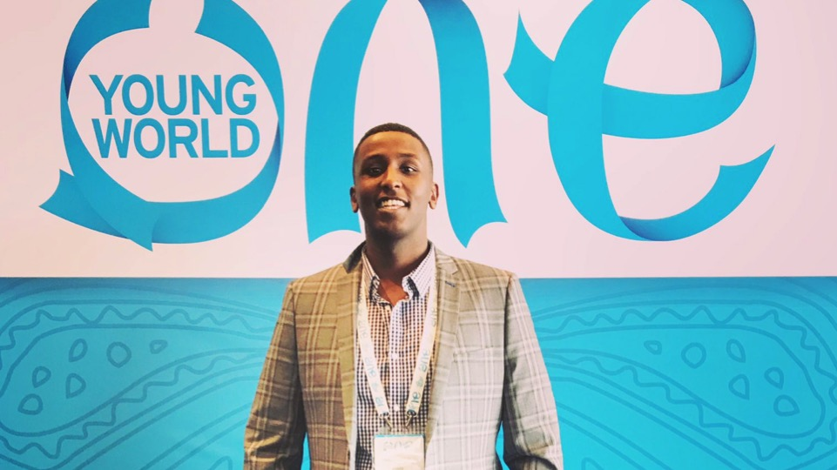
Why is UCL valuable?
Our students become thoughtful, engaged, resilient, good citizens.
We are open, publicly and globally engaged.
We value collaboration, partnership and dialogue.
Medical student Abdul Elmi represented UCL at the One Young World Summit in Bogotá
Notes:
UCL is particularly valuable because:
we provide an ‘essential square’, where robust debate can take place
our students become thoughtful, engaged, resilient, good citizens
we are an open, publicly and globally engaged institution
our research makes a difference.
Abdul Elmi is a UCL Medical Student and as President of the UCL Somali Society he raised £40k for the Somali Drought Appeal.

Slide 5
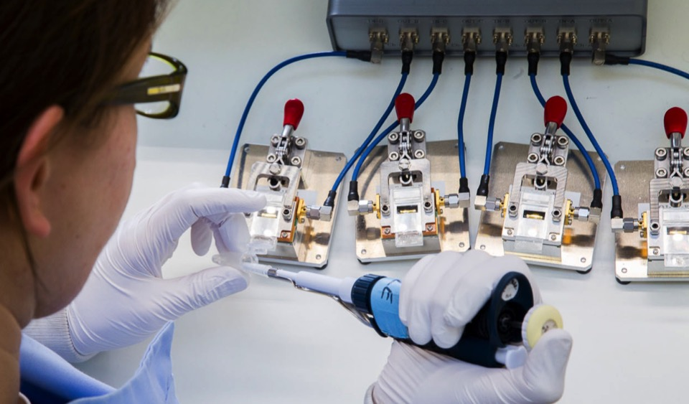
Developing a mobile phone-connected diagnostic tool that can detect HIV in seconds
UCL London Centre of Nanotechnology
Notes:
In the past month, a team led by Professor Rachel McKendry (UCL London Centre of Nanotechnology) has published new research showing promising developments towards a mobile phone-connected diagnostic tool that can detect HIV in seconds.
The newly developed tool needs just a single finger prick of blood to produce a positive test result within 10 seconds.

Slide 6
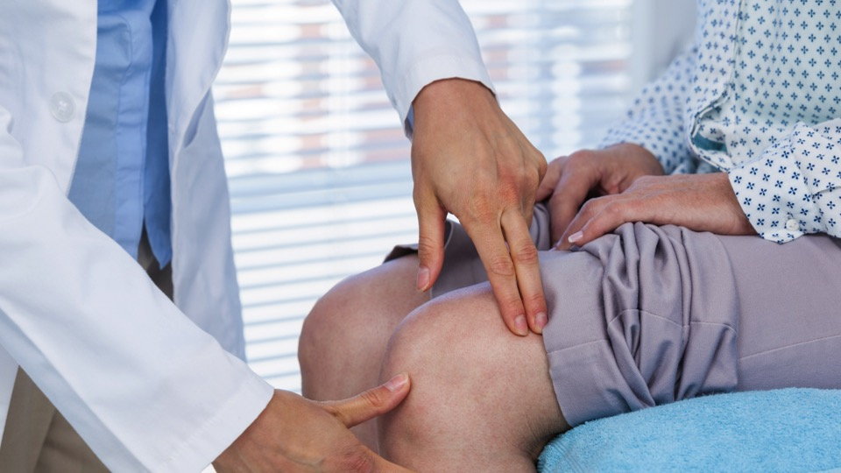
Understanding how rheumatic conditions such as arthritis affect teenagers
The Centre for Adolescent Rheumatology at UCL, UCLH and GOSH
Notes:
The centre has received a £2 million funding boost from Arthritis Research UK to support its pioneering research over the next five years.
The only research centre in the world dedicated to understanding how rheumatic conditions such as arthritis affect teenagers, it demonstrates, once again, how we as a university are always pushing into new areas of enquiry.

Slide 7
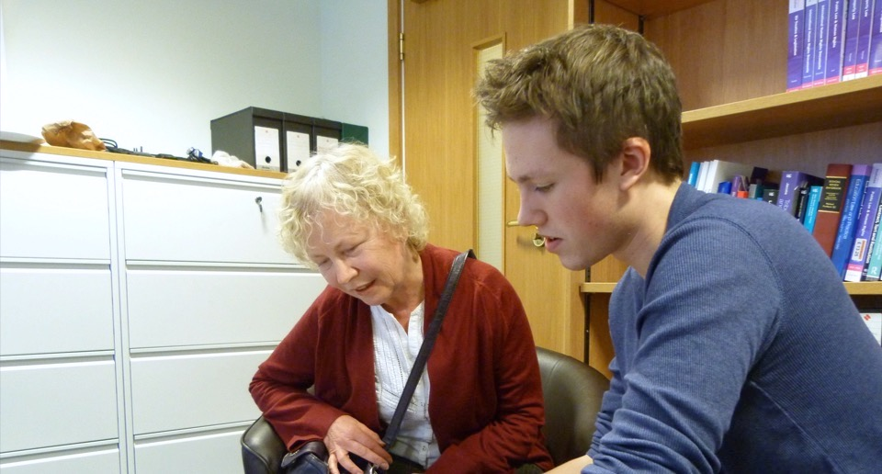
Providing pro bono legal advice to local communities
UCL Centre for Access to Justice (UCL Laws)
Notes:
People’s lives can be also profoundly affected by their experience of our justice system and this is where the UCL Centre for Access to Justice (UCL Laws) comes in – providing pro bono legal advice to local communities, predominantly in the areas of social welfare, community care, education and employment law.

Slide 8

Provided major findings
for the Lammy Review
on how BAME defendants
are treated by the
criminal justice
system
Professor Cheryl Thomas
Notes:
Professor Cheryl Thomas has recently provided some of the major findings for the recent Lammy Review on how BAME defendants are treated by the criminal justice system in England and Wales.

Slide 9

Trains more than 1,200 new teachers every year
Partners with more than 600 London schools
The UCL Institute of Education
Notes:
The UCL Institute of Education trains more than 1,200 new teachers every year and partners with more than 600 London schools.

Slide 10
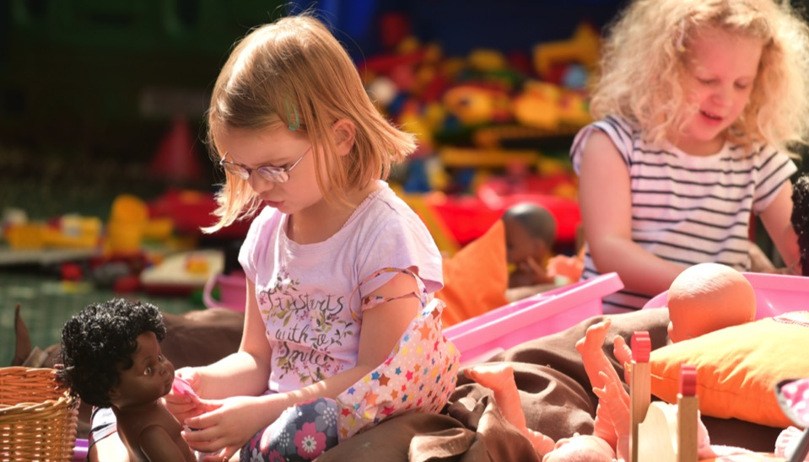
Working on an OECD study to improve children’s early development
Professor Iram Siraj (IOE)
Has provided arguably the most coherent account of autism yet
The Centre for Research in Autism and Education
Notes:
Iram Siraj, Professor of Early Childhood Education, is working with the National Foundation for Educational Research on an OECD international pilot study to improve children’s early development in England.
The Centre for Research in Autism and Education (CRAE) has provided the basis for arguably the most coherent account of autism yet, helping to explain its genetic, neural, behavioural and social characteristics.

Slide 11
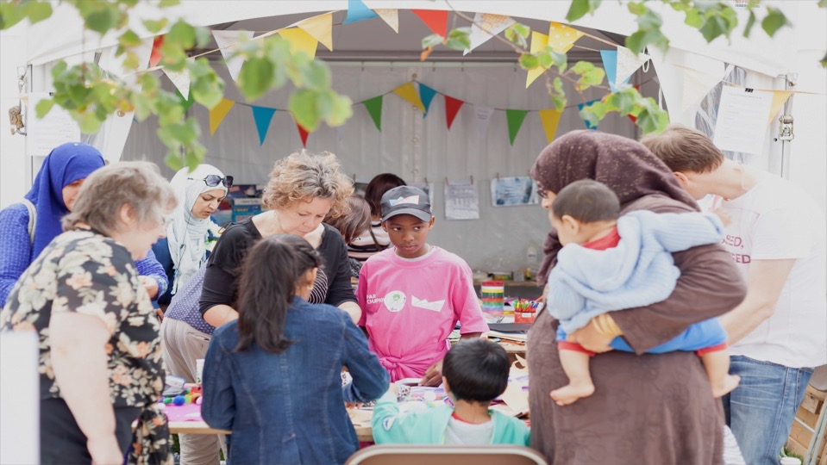
Is the message getting through?
We need to go even further when it comes to engaging relevant communities with our research activity.
Notes:
This includes stakeholders, as well as those who could be advocates on our behalf such as alumni and partners from industry.

Slide 12
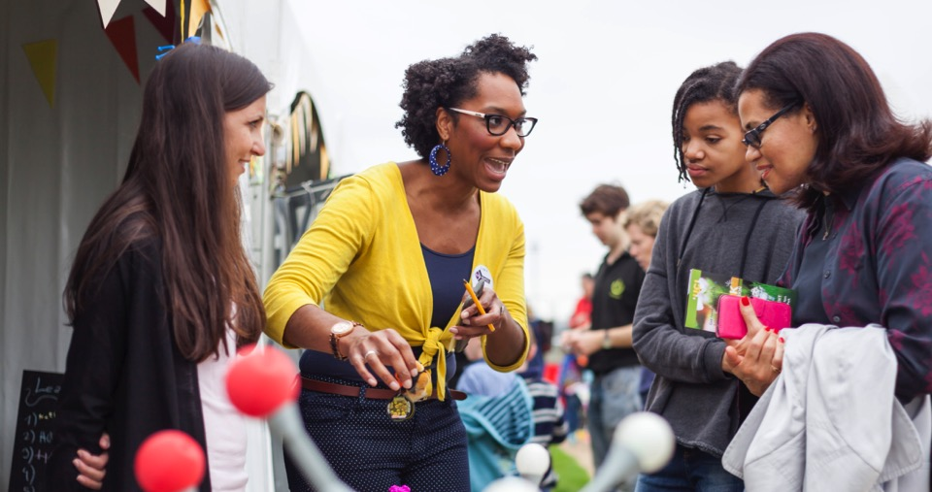
New UCL Public Engagement Strategy:
collaborative models of engagement
involvement of diverse public groups, particularly those whose voices are heard less often
a spirit of experimentation.
Notes:
UCL was the first signatory to the National Co-ordinating Centre for Public Engagement’s ‘Manifesto for Public Engagement’ and our Public Engagement Unit (PEU) in UCL Culture celebrates its 10th anniversary next year.
To mark this anniversary, the team has consulted widely on the new UCL Public Engagement Strategy. It is characterised by three things:
a focus on collaborative models of engagement
involvement of diverse public groups, particularly those whose voices are heard less often
a spirit of experimentation from which learning can emerge.
The following case studies show the strategy in action:

Slide 13

Our Public Engagement Unit (PEU) at UCL Culture celebrates its
10th anniversary next year
Sign up to the UCL Public Engagement Network:
www.ucl.ac.uk/culture/public-engagement/creating-networks
Notes:
UCL Culture and the PEU will be hosting a series of events throughout the anniversary year, culminating in the Provost’s Public Engagement Awards in June 2018.
There is a thriving UCL Public Engagement Network, which offers a great opportunity to share your expertise and learn from colleagues. Sign up to the network and find out more.
The more diverse the communities we listen to and audiences that we engage with, the more UCL will thrive.

Slide 14

Maintaining our campus
In order to achieve all that we do, it’s important that the buildings that we operate in are well-maintained and fit for purpose.
Notes:
In order to achieve all that we do, it’s important that the buildings that we operate in are well-maintained and fit for purpose. Estates are working at a pace to achieve this.

Slide 15
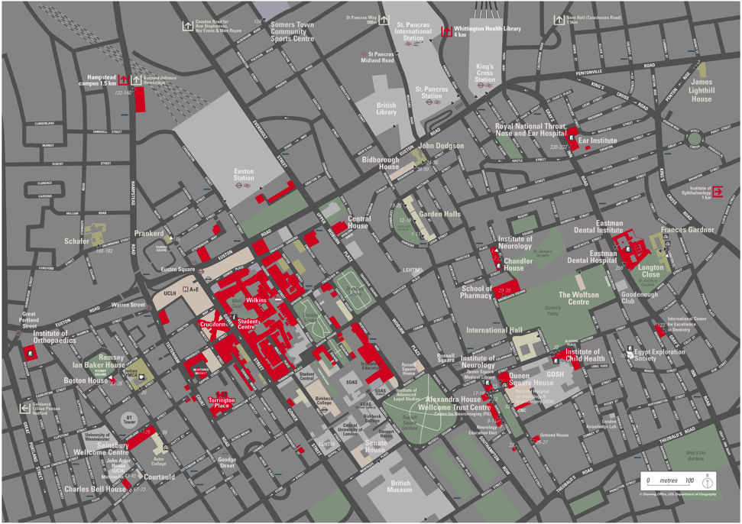
Kentish Town
£124k
Hawkridge House
£105k
James Lighthill House
£96k
Physics Building
£127k
£124k
£292k
Katherine Lonsdale Building
Christopher Ingold Building
School of Pharmacy
£124k
£81k
£46k
Bedford Way
Wilkins Building
Institute of Child Health
£23k
Key maintenance and small works jobs completed over the past three months
Darwin Building
Notes:
So here is a snapshot of a few of the key maintenance and small works jobs that have been completed over the past three months.
School of Pharmacy £292k – completed general maintenance work, including improving the infrastructure for air movement throughout the building.
James Lighthill House 105k– improved the general look, feel and safety of the property.
ICH £46k – upgraded the air conditioning system and other essential buildings works.
Physics Building £96k - improved disabled access by installing a disabled lift, along with other essential maintenance work.
Darwin Building £23k – improved look and feel of key lecture theatres, along with improvements to the air conditioning system and other critical maintenance.
Katherine Londsdale Building £127k – over a three month period, completed major maintenance works including repairs to the backup energy generator for the data centre.
Hawkridge House £124k– completed general maintenance works, from repairing leaks to improving the building’s look and feel.
Christopher Ingold £162k – upgraded mechanical systems including the air conditioning system, as well as replacing all the windows.
Bedford Way £77k – completed key maintenance works, including asbestos removal, emergency lighting repair, heating pipe replacement and modernisation to all lifts.
Wilkins Building £81k – upgraded the look and feel of the location, including a complete refurbishment of the toilets.
If you would like more information, please speak to Andrew Grainger, Director of UCL Estates.

Slide 16

Want to know more?
For more information about these plans, or if there is something else that you would like to knw more about, please contact us at:
provostfeedback@ucl.ac.uk
Notes:
Want to know more?
For more information about these plans, or if there is something else that you would like to know more about, please contact us at:
provostfeedback@ucl.ac.uk

