Slide 1
FPHS Appraisal Survey 2019-2020-2021

Slide 2
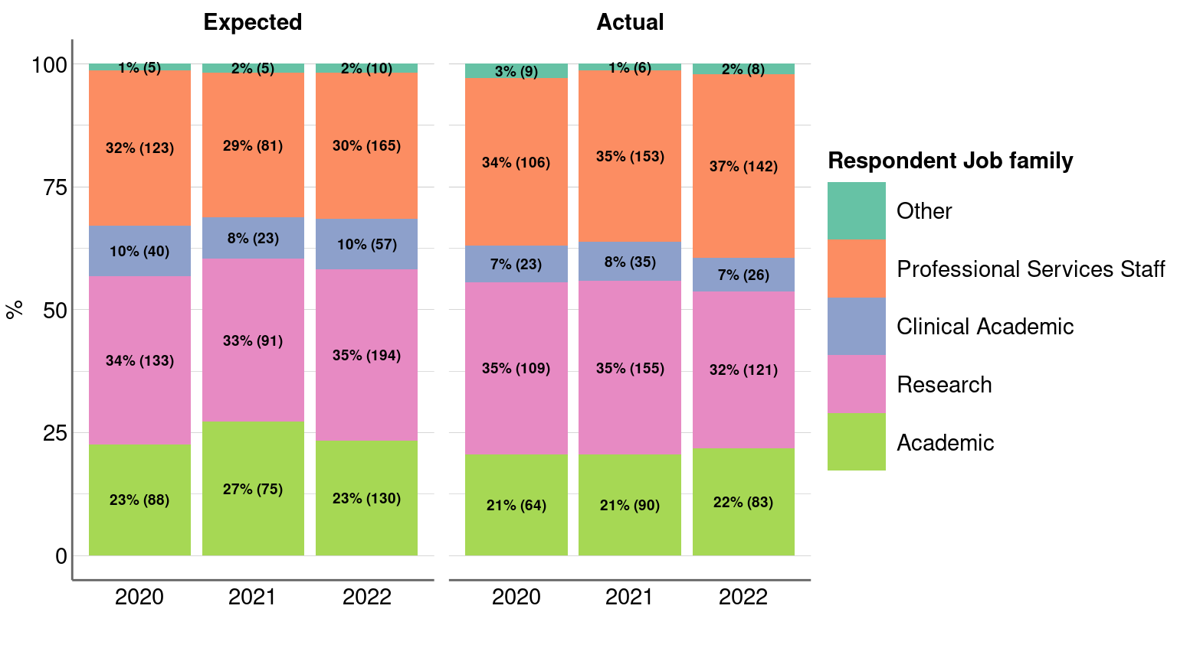
Figure 1: Respondent’s job family

Slide 3
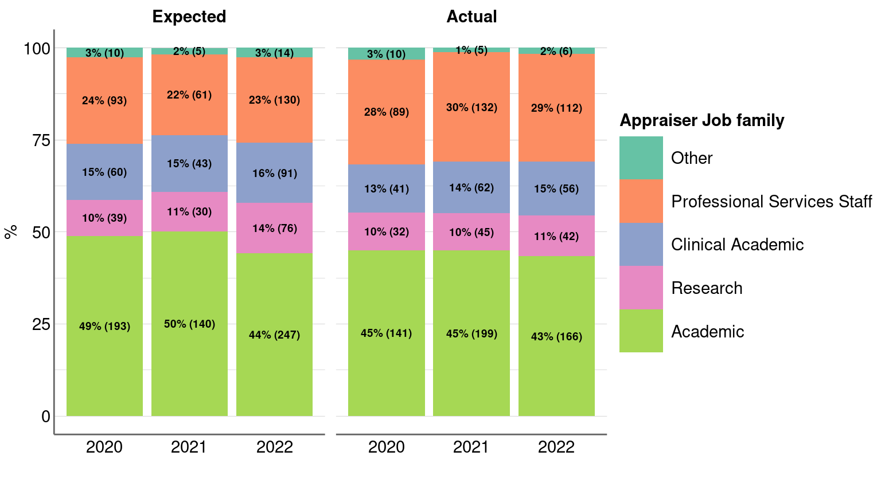
Figure 2: Appraiser’s job family

Slide 4
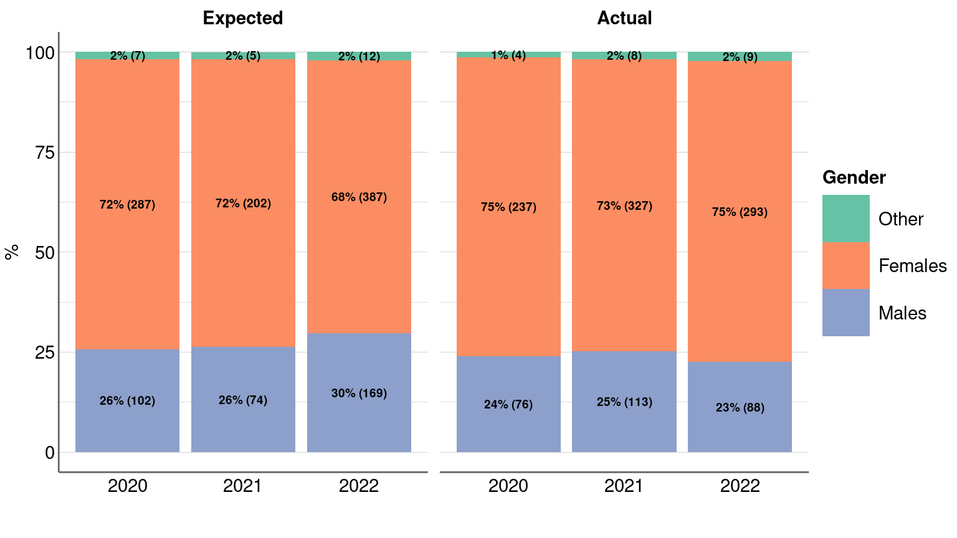
Figure 3: Respondents’ demographics

Slide 5
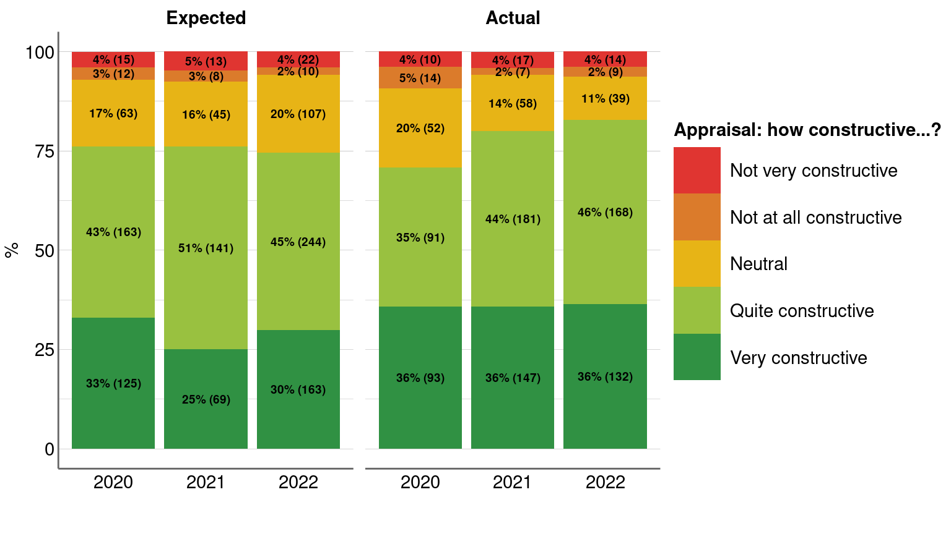
Figure 4: Appraisal constructivity: expectation vs actual

Slide 6
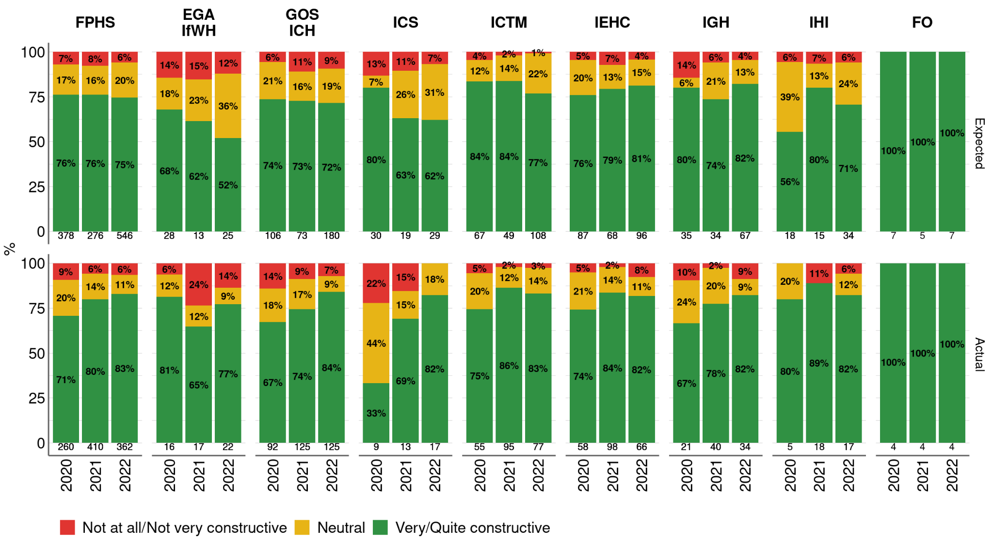
Figure 5: Appraisal constructivity: expectation vs actual
Sample size at base of each bar

Slide 7
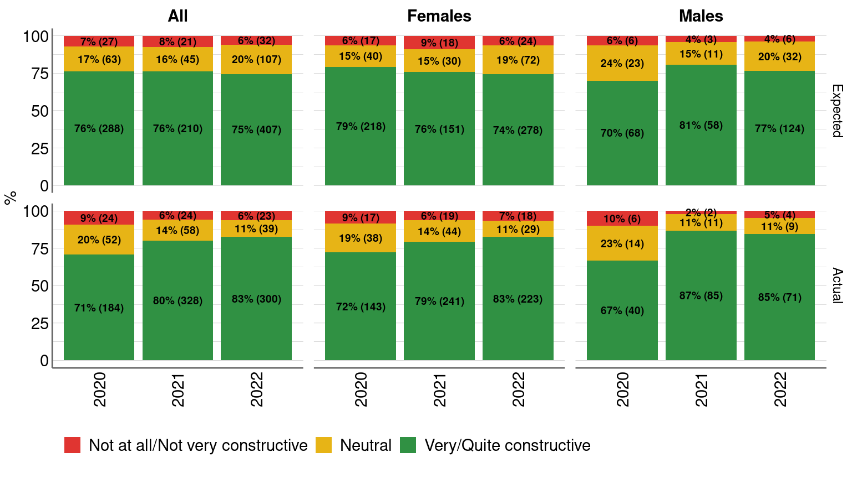
Figure 6: Appraisal constructivity: expectation vs actual
All: consider males, females, and other genders.

Slide 8
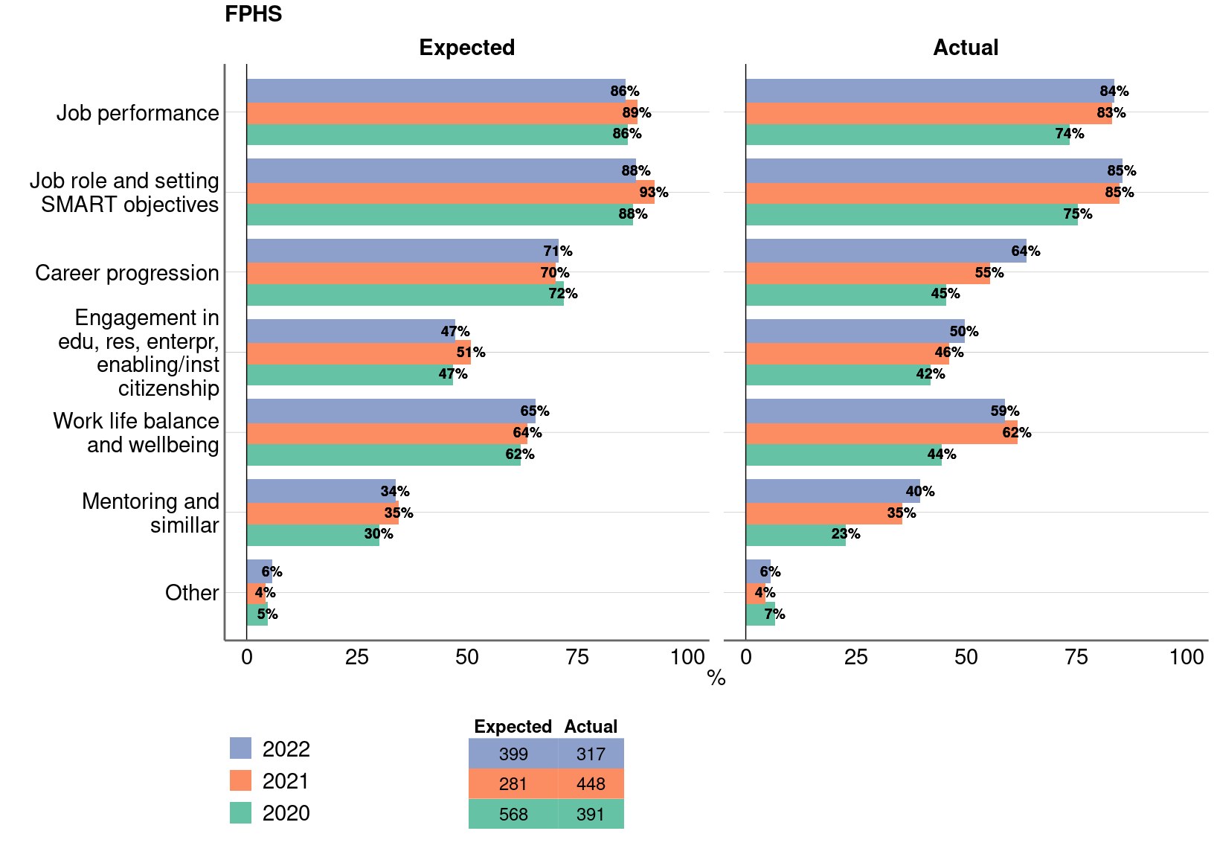
Figure 7: Appraisal discussion – expectation vs actual

Slide 9
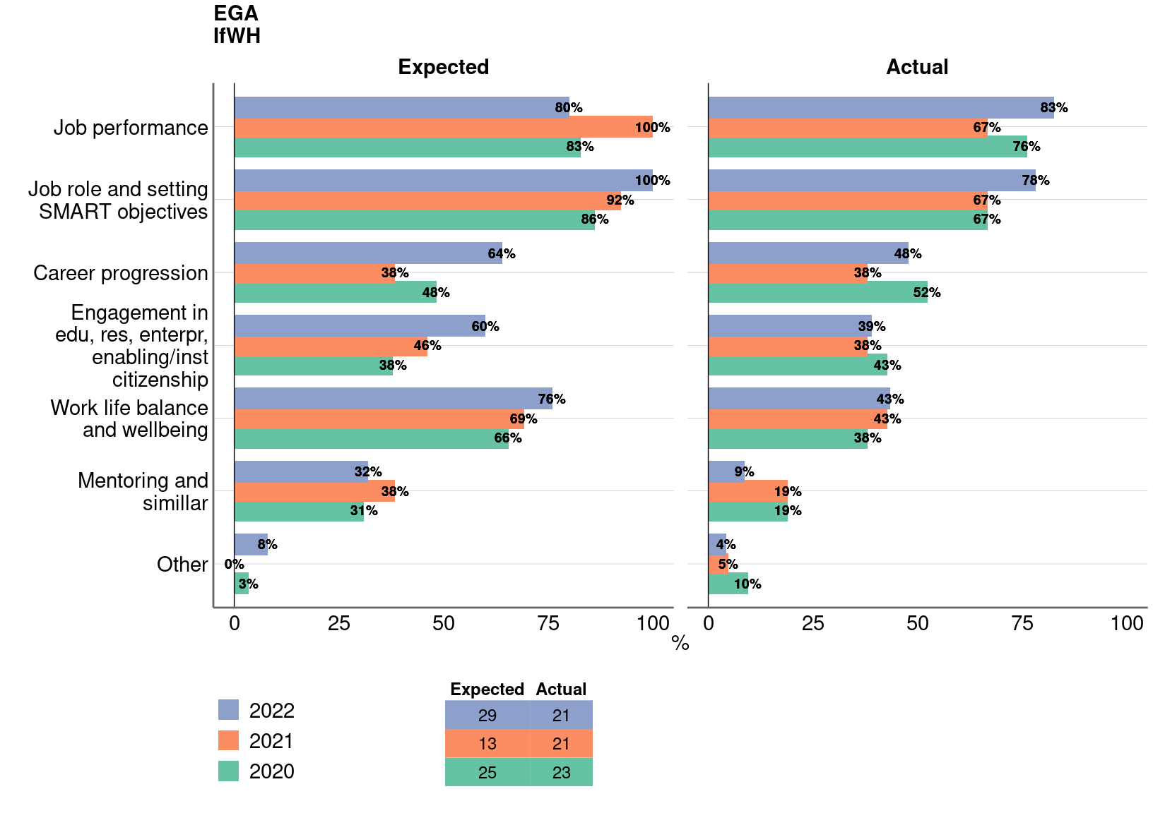
Figure 7: Appraisal discussion – expectation vs actual

Slide 10
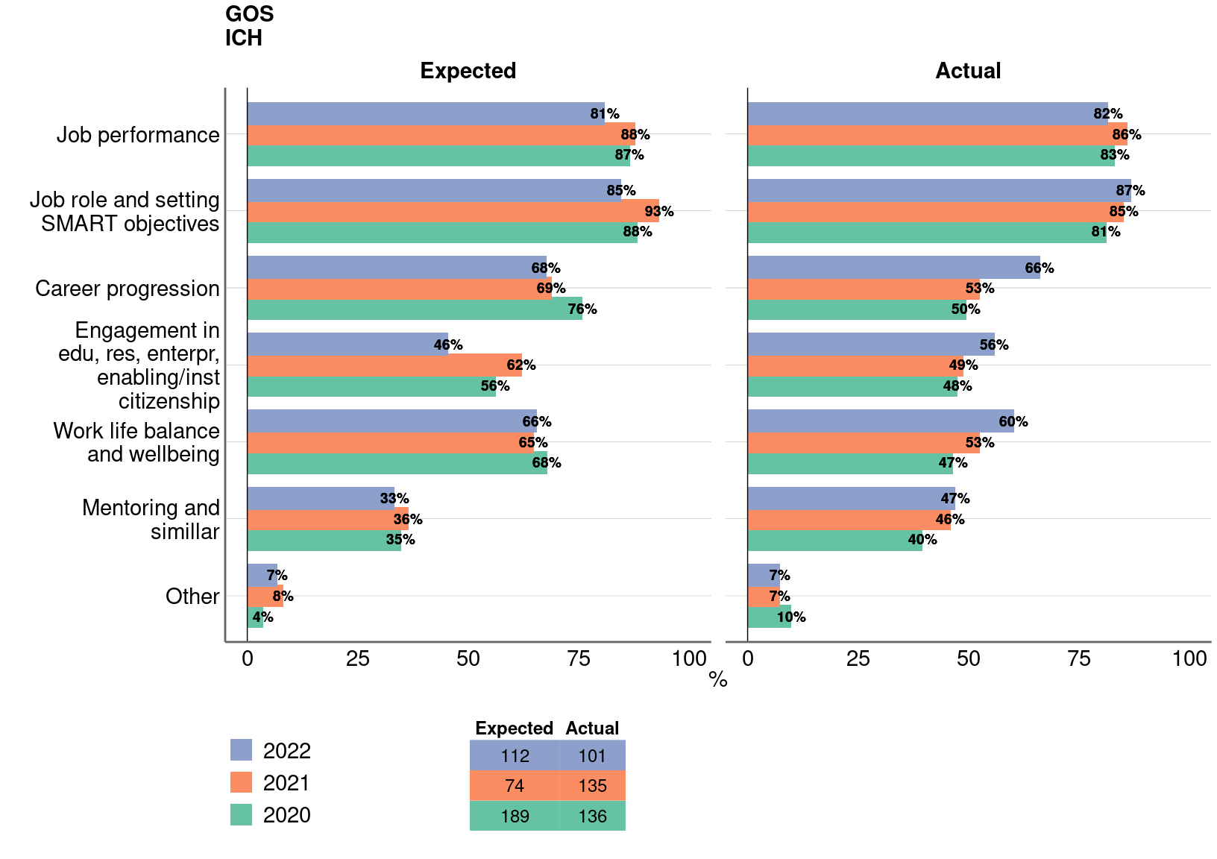
Figure 7: Appraisal discussion – expectation vs actual

Slide 11
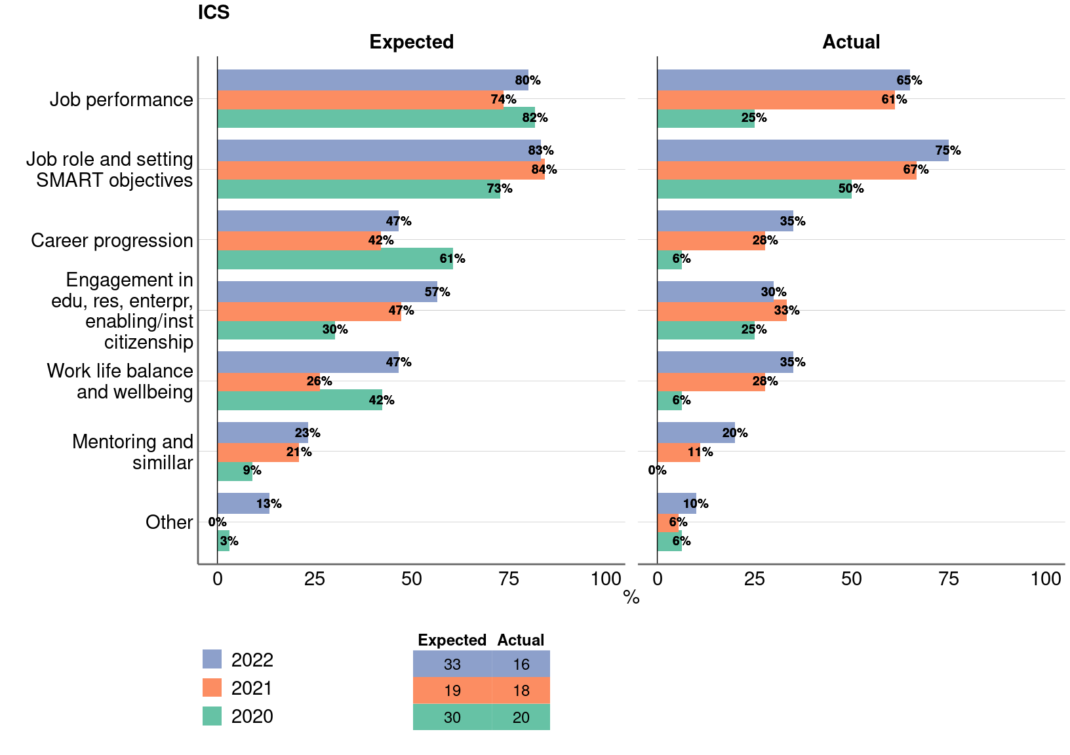
Figure 7: Appraisal discussion – expectation vs actual

Slide 12
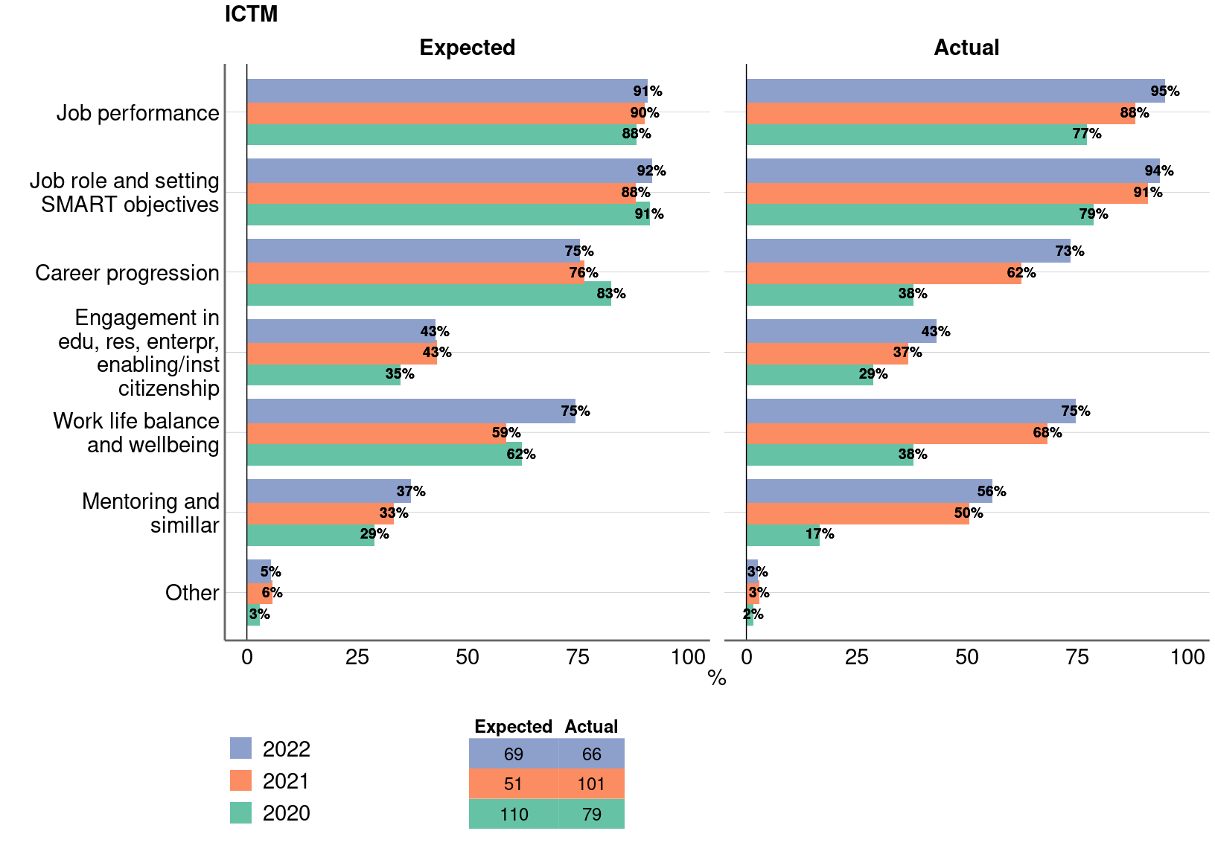
Figure 7: Appraisal discussion – expectation vs actual

Slide 13
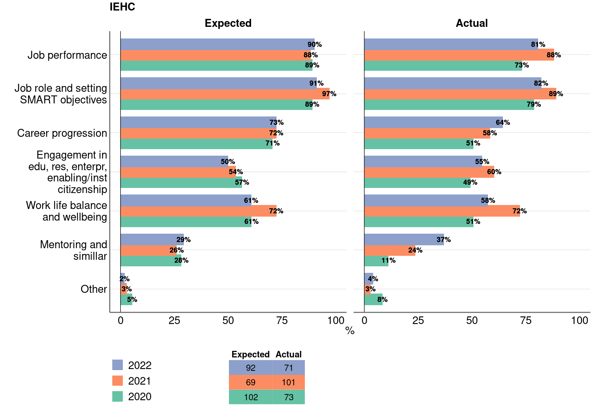
Figure 7: Appraisal discussion – expectation vs actual

Slide 14
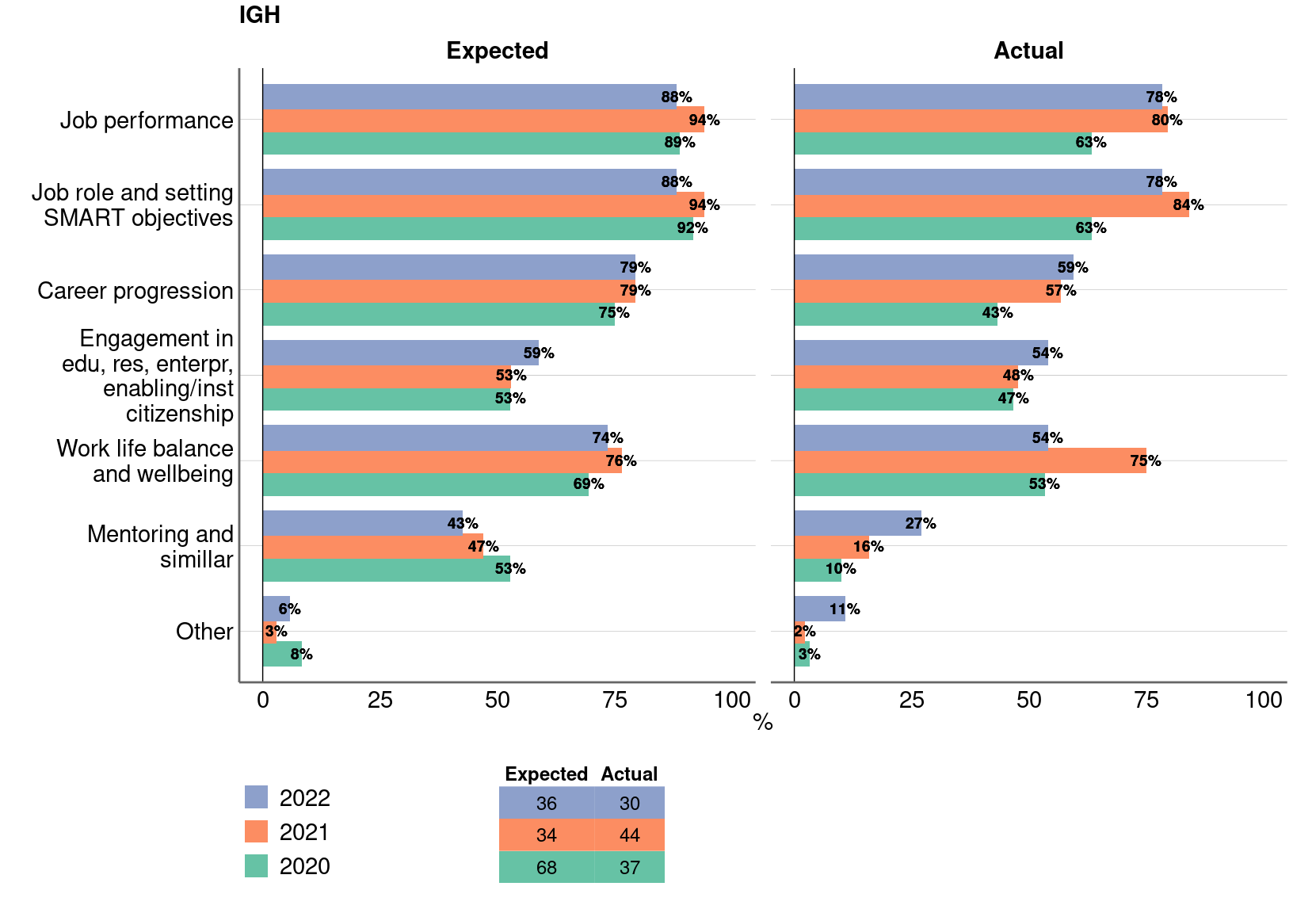
Figure 7: Appraisal discussion – expectation vs actual

Slide 15
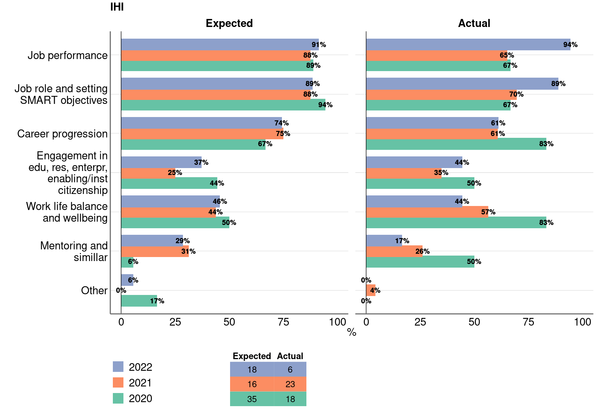
Figure 7: Appraisal discussion – expectation vs actual

Slide 16
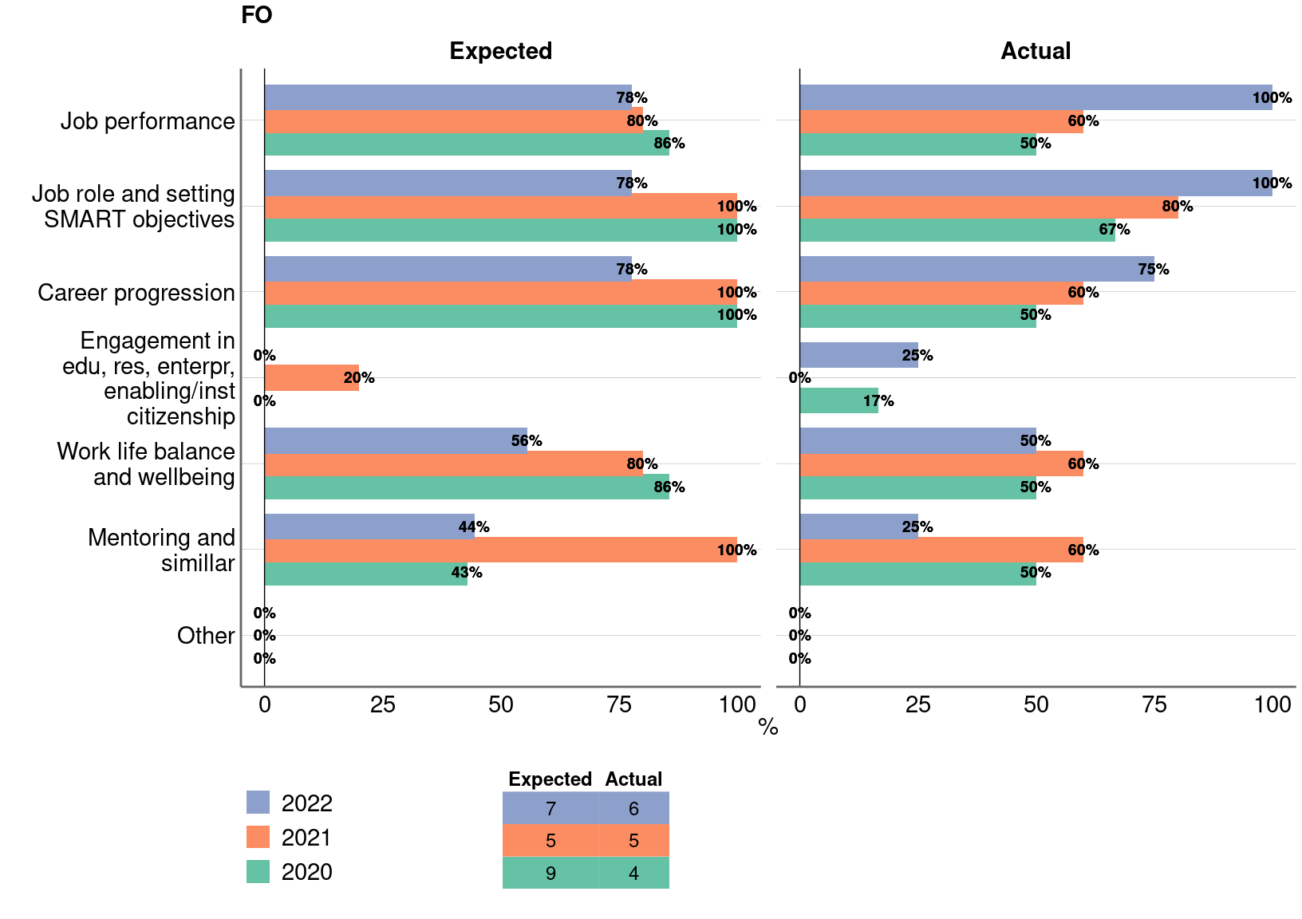
Figure 7: Appraisal discussion – expectation vs actual

Slide 17
Logistic regression models
Outcome: very/quite constructive actual appraisal
Model 1: adjusted for survey year
Survey year: 42% increase in the odds of a very/quite constructive actual evaluation for each year of increase in the survey year.
Model 2: adjusted for survey year and gender
Survey year: 43% increase in the odds of a very/quite constructive actual evaluation for each year of increase in the survey year.
Gender other has 71% decrease odds of very/quite constructive actual appraisal than males.
Models 3-5: Null association between very/quite constructive actual appraisal and institute (ref: GOS), respondent job family (ref: academic), appraiser job family (ref: academic), after adjustment for survey year.

Slide 18
Table 1: Regression models
Model | Variable | OR | 95% CI |  | p
1) Year | Year | 1.42 | 1.17 | 1.72 | 0.0005
2) Year + gender (Ref: males) | Year | 1.44 | 1.18 | 1.75 | 0.0003
 | Females | 0.86 | 0.60 | 1.25 | 0.4346
 | Other | 0.21 | 0.08 | 0.56 | 0.0020
3) Year + Institute (Ref: GOS ICH) | Year | 1.43 | 1.18 | 1.74 | 0.0003
 | EGA IfWH | 0.92 | 0.48 | 1.78 | 0.8045
 | ICS | 0.60 | 0.29 | 1.23 | 0.1656
 | ICTM | 1.48 | 0.97 | 2.26 | 0.0711
 | IEHC | 1.34 | 0.88 | 2.04 | 0.1667
 | IGH | 1.03 | 0.60 | 1.77 | 0.9151
 | IHI | 1.66 | 0.67 | 4.12 | 0.2727
4) Year + job family respondent (Ref: Academic) | Year | 1.41 | 1.16 | 1.72 | 0.0007
 | Research | 0.93 | 0.60 | 1.44 | 0.7500
 | Clinical Academic | 1.14 | 0.56 | 2.33 | 0.7110
 | Professional Services Staff | 0.73 | 0.48 | 1.12 | 0.1456
 | Other | 0.79 | 0.27 | 2.29 | 0.6608
5) Year + job family appraiser (Ref: Academic) | Year | 1.38 | 1.13 | 1.68 | 0.0014
 | Research | 1.12 | 0.64 | 1.96 | 0.6988
 | Clinical Academic | 1.07 | 0.65 | 1.75 | 0.7853
 | Professional Services Staff | 0.72 | 0.50 | 1.02 | 0.0617
 | Other | 0.49 | 0.19 | 1.28 | 0.1446

