Slide 1
UCL
(Almost) everything you ever wanted to know about pensions
Cath Laycock and Megan Green

Slide 2
Introducing the Money and Pensions Service (MaPS)
Established in 2019 by Government, we bring together the three providers of financial guidance, with our five core functions being:
Pension guidance
Debt advice
Money guidance
Consumer protection
Strategy
From June 2021, our three existing consumer brands will be combined to become
Notes:
MaPS currently operates as three consumer brands – The Pensions Advisory Service, the Money Advice Service and Pension Wise. Today, we’ll focus on the pensions side of things.
Our Pensions Guidance function – provision of information to people about workplace and personal pensions; or trained pension experts will help over 200,000 people with their pension queries through our helpline and webchat services and events such as this one. We will also support people aged over 55 to make decisions on their DC pension pots through our Pension Wise service.
We are an arm’s length organisation sponsored by the DWP. That means our job is provide information and guidance- we are impartial and will never tell you what to do or recommend providers and products to you
From June 2021 – briefly explain brand change to MoneyHelper but that this won’t affect the service we provide.

Slide 3
Disclaimer
All the information and guidance provided by MaPS is an opinion in good faith based on our current understanding of the relevant issues and current pension rules.
​
We will not provide any information or guidance that could be construed as regulated financial advice and do not provide detailed tax information.​
​
Any opinions expressed by MaPS should not be regarded as grounds for legal action.

Slide 4
What we’ll focus on today
How much money will you need in retirement?
The State pension
Why save into a private pension?
Types of private pension schemes
How much can you pay into a pension?
How does salary sacrifice work?
Tracing old pensions
Beware of scams – how to avoid losing your pension savings

Slide 5
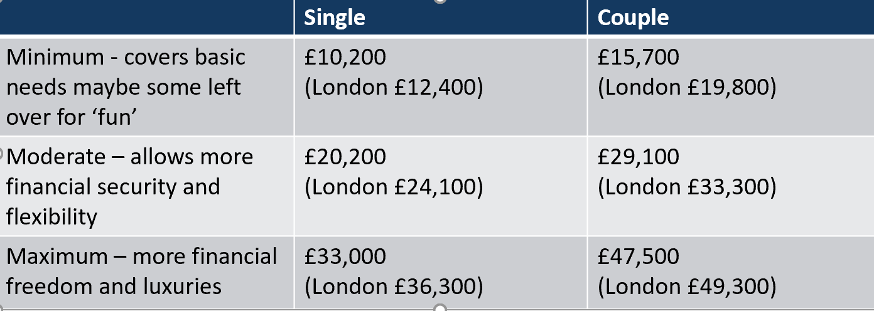
How much money will you need in retirement?
The answer to this question differs for everyone and will depend on your circumstances.
Research published in 2018 set out three suggested levels of expenditure in retirement:
Read more here: https://www.retirementlivingstandards.org.uk/ See what you’re on track to get using this Money Advice Service calculator: https://www.moneyadviceservice.org.uk/en/tools/pension-calculator
Plan your budget: https://www.moneyadviceservice.org.uk/en/tools/budget-planner
How will you fund your retirement? State Pension, Private Pensions or something else?....

Slide 6
The State Pension
A new State Pension was introduced for those reaching State Pension Age on or after 6 April 2016.
The full State Pension is currently £179.60 a week (£9,339 per year) - far below what most people say they hope to retire on.
The State Pension is paid according to your National Insurance record only – it is not possible to rely on your spouse/civil partner’s record.
You will need at least 35 years of qualifying NI contributions to receive the full State Pension.
You can find out your own State Pension Age here: https://www.gov.uk/state-pension-age. For example, a 30-year-old cannot expect to receive their State Pension until their 68th birthday.
You can request a State Pension forecast online to see your current position (a Government Gateway or Gov.uk.verify account is required https://www.gov.uk/check-state-pension).
If there are any gaps in your NI record then you may be able to pay voluntary NI contributions to top up your State Pension.

Slide 7
Why save into a private pension?
A pension is a long-term savings plan designed to help you save money for later life as the State Pension alone is unlikely to be enough.
Your State Pension may not be paid until you are 68 whereas private pensions can be accessed from age 55 (although this may rise to 57 in 2028).
Tax relief - some of your money that would have gone to the government as tax goes into your pension instead.
‘Free money’ from your employer – employers are now required to automatically enrol eligible workers into a pension scheme and pay into their pension.
You may benefit from life cover as a member of the pension scheme (this will depend on the employer/scheme) which will provide a tax-free lump sum if you died whilst still in employment.
If you die before retirement, your beneficiaries may be able to receive some money from your pension and, in certain circumstances, not pay any income tax or inheritance tax.

Slide 8
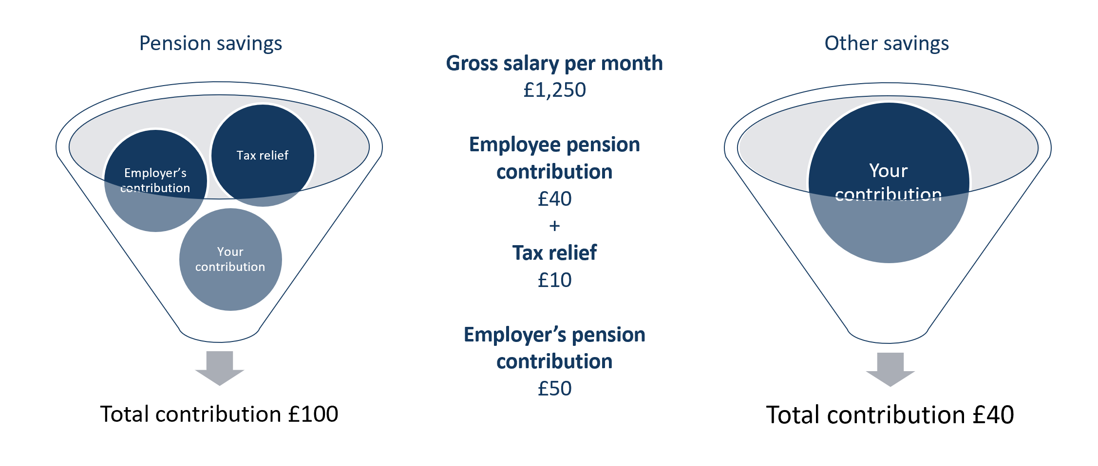
Paying into a workplace pension vs non-pension savings
Notes:
Make it clear this is a general example – not real contribution rates

Slide 9
What type of private pensions are there?
Both DB and DC schemes are a tax efficient way of saving but they differ in design
Defined Benefit (DB) |  | Defined Contribution (DC)
Occupational/workplace arrangements |  | Occupational/workplace and personal arrangements*
Employer takes investment risk – no risk to member |  | Member takes investment risk
Final salary | Career Average (CARE) | Also referred to as money purchase schemes
Pension based on pensionable salary and service at retirement age | Pension based on average pensionable salary throughout career | Pot of money built up and invested in funds of your choice - value dependent upon amount contributed, charges and investment performance
You may be able to take your benefits before the scheme’s normal retirement age (min age 55) |  | You can choose the age at which you can take your benefits (after age 55)
Benefits paid as regular income with the option of a tax-free lump sum |  | Usually provides choice as to how benefits can be taken, including option to receive 25% tax-free lump sum
*Other types of DC pensions include:
Personal pensions
Self-invested personal pensions (SIPP)
Stakeholder pensions

Slide 10
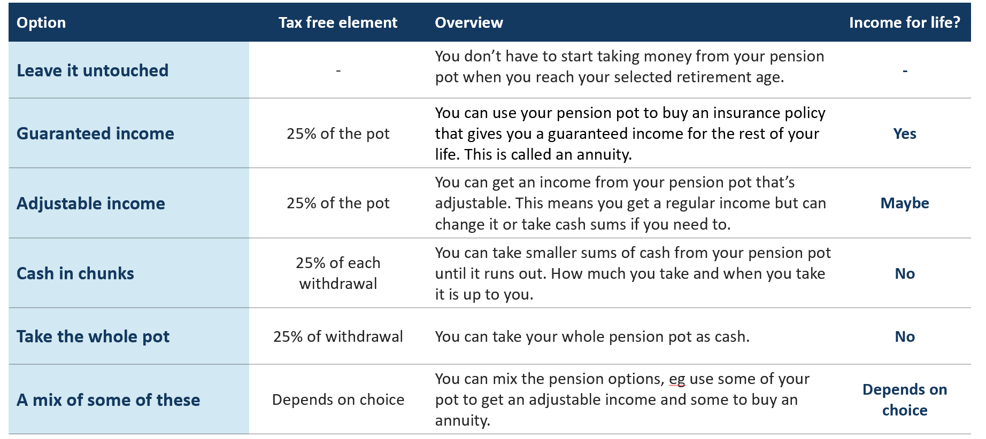
Options for accessing money from DC pensions
A free Pension Wise appointment is available for anyone over age 50 with a DC pension to discuss these options in more detail
Notes:
Don’t spend long on this slide – just to give a brief overview

Slide 11
How much can you pay into a pension scheme each year?
£3,600 or 100% of your gross earnings (subject to the Annual Allowance which is currently £40,000).
In certain circumstances you may be able to ‘carry forward’ any unused allowance.
Be careful - your employer’s contributions count towards the Annual Allowance.
You can pay into more than one pension scheme if you want to.
The rules are complicated – contact us to discuss your personal situation.
There is also a ‘Lifetime Allowance’ on pension savings which can receive tax relief - £1,073,100.

Slide 12
How does paying pension contributions by salary sacrifice work?
Eric (without salary sacrifice)
Gross pay £1,000
Less pension contribution (£100)
Less NI @ 12% (£120)
Taxable pay £900
Less tax @ 20% (£180)
Ernie (with salary sacrifice)
Gross pay £1,000
Less sacrifice pension (£100)
Actual Pay £900
Less Tax @ 20% (£180)
Less NI @12% (£108)
Notes:
(UCL’s contributions to both USS and SAUL are paid via SS.) Talk through example – this is for a net pay arrangement vs sal sac – so for net pay, they do not benefit from NI relief as NI is paid on full gross pay
Salary sacrifice is an especially tax-efficient way for you to make pension contributions.
You can give up part of your salary (your sacrifice), which your employer then pays into your pension, along with their contribution to the scheme.
As you're effectively earning a lower salary, both you and your employer pay lower National Insurance Contributions.
The key advantage of salary sacrifice can be greater take home pay, as you will be paying lower National Insurance Contributions.
N.B Disadvantages if asked
•Your lower salary may affect the amount of money you are able to borrow for a mortgage. Mortgage lenders usually calculate how much you can borrow as a multiple of your salary, although your employer may agree to state your original salary when they supply a mortgage reference.
•Your entitlement to certain State benefits, such as Statutory Maternity Pay (SMP) may be affected. Your employer should be able to tell you whether or not you will be affected in this way
If your employer is providing you with life cover, this is usually worked out as a multiple of your salary. Your employer may provide less life cover if you sacrifice some of your salary.

Slide 13
Tracing old pensions
It is estimated that there are £20 billion of lost pensions.
People are likely to change jobs 11 times during their career.
Ideally you should keep your pension providers up to date with your address. Lots of providers now offer online access to monitor your pensions.
If you don’t have current contact details the ‘Find pension contact details’ tool on the Gov.uk web site may be of help: https://www.gov.uk/find-pension-contact-details
These pensions will be held for you until you are at least age 55 and can start to access them. You can leave them where they are or choose to transfer them to a different pension scheme – for example, if you wanted to combine all your pensions into one place.
See our Spotlights ‘Tracing your Pension’ and ‘Combining Pensions’ for more help and tips
https://www.pensionsadvisoryservice.org.uk/content/publications-files/uploads/Spotlight_Tracing_Your_Pension.pdf
https://www.pensionsadvisoryservice.org.uk/content/publications-files/uploads/Spotlight_Combining_Pensions.pdf

Slide 14
Pension Scams and how to spot them
Contacted out of the blue
Applying pressure to make a decision quickly
Guaranteeing high investment returns
Promising access to your pension before the age of 55
Offer of one-off investments, time-bounds offers, upfront cash incentives, free pension reviews, legal loopholes of government initiatives
Little or nothing in the way of contact names, addresses or phone numbers
IF IT SOUNDS TOO GOOD TO BE TRUE, IT NORMALLY IS

Slide 15
How to protect yourself from a pension scam
There are a number of things you can do:
Make sure anyone giving you financial advice is approved and regulated by the Financial Conduct Authority (FCA): https://register.fca.org.uk/s/
You should ask the scheme that you are transferring from to check the new scheme's HMRC registration - they can make sure if it is a legitimate scheme
Never be rushed into making a decision
Don’t proceed unless you are absolutely certain your money will be safe because once you transfer it’s often too late
The Government has now banned cold calling in connections to pension.
If you’re contacted you should let the Information Commissioners Office know.

Slide 16
How to contact us
Pensions Guidance | Money Guidance | Pension Wise
Helpline: 0800 011 3797 Plus Webchat Online Enquiry Form via our website | Helpline: 0800 138 7777 | To book a Pension Wise appointment, call 0800 138 3944 or online via website
Monday to Friday, 9am to 5pm | Monday to Friday, 8am to 6pm | Monday to Friday, 8am to 8pm Saturday 9am-1pm
pensionsadvisoryservice.org.uk | moneyadviceservice.org.uk | pensionwise.gov.uk

Slide 17
Other useful links:
MAS Budget Planner
https://www.moneyadviceservice.org.uk/en/tools/budget-planner
MAS Saving and Investing
https://www.moneyadviceservice.org.uk/en/categories/saving-and-investing
MAS Pensions Calculator
https://www.moneyadviceservice.org.uk/en/tools/pension-calculator
MAS Retirement Planner
https://www.moneyadviceservice.org.uk/en/articles/when-can-i-afford-to-retire
Find a financial adviser
https://directory.moneyadviceservice.org.uk/en
Money Advice Service (MAS)
https://www.moneyadviceservice.org.uk/en
Money and Pensions Service

Slide 18
Thank you
Any questions?

