Slide 1
LONDON’S GLOBAL UNIVERSITY
Dr Ali Mozaffari

Slide 2
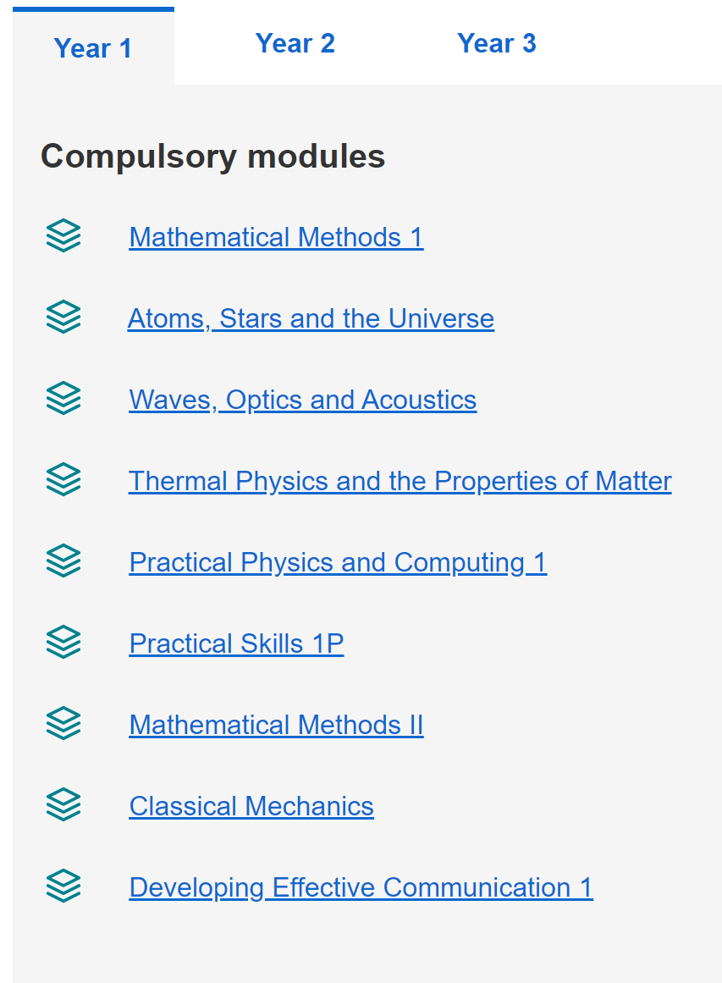
Science Degrees - Physics

Slide 3
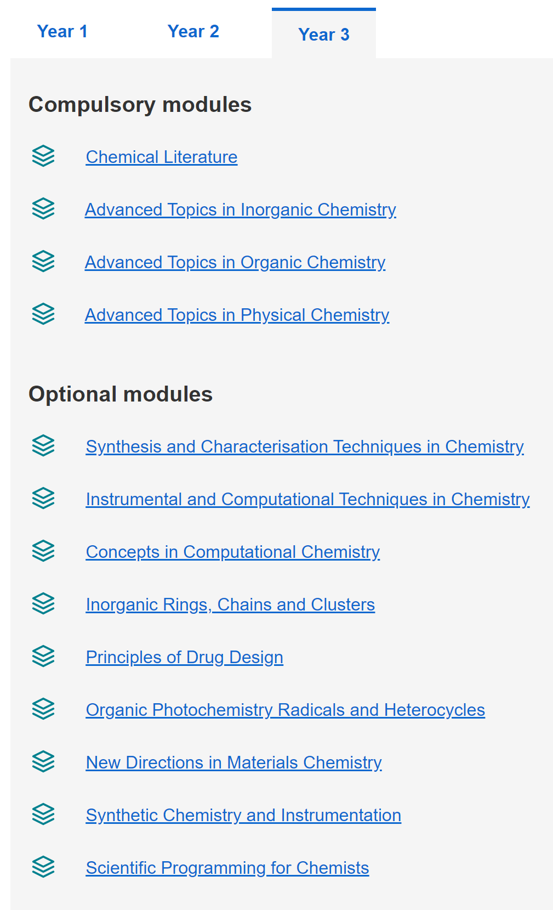
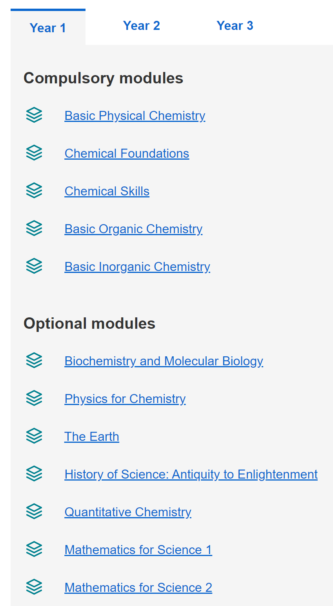
Science Degrees - Chemistry

Slide 4




BSc or Msci?
We offer both a BSc programme as well as an Msci programme, you can apply for either with the same entry offer:
Bachelor of Science Degree (BSc)
Master of Science Degree (MSci)
If you are unsure it is normally easier to apply for the Msci – transfer between the two courses is common place up to the end of term 3 year 3.

Slide 5


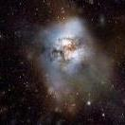
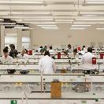

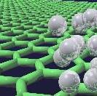
The Ambition of Natural Sciences
In a scientific culture that values interdisciplinary research, join a programme that allows you to explore the interaction between traditional disciplines. The Natural Sciences programme combines two areas of specialism chosen from a wide range of sciences.
Most of your classes take place alongside peers studying a single science, and you will be challenged to produce work comparable to the best students in these disciplines.

Slide 6










An Advert
Notes:
www.socnatsci.org

Slide 7
Subjects within Natural Sciences
  Astrophysics
  Physics
  Medical Physics
  Physical Chemistry
  Inorganic & Materials Chemistry
  Organic Chemistry
  History, Philosophy and Social Studies of Science
  Biomedical Sciences
  Neuroscience and Psychology
  Molecular & Cell Biology
  Genetics, Evolution and Environment
  Geosciences
  Mathematics & Statistics (ONLY be taken as a minor stream)
  Natural Science students study 2 core streams, equal study in years 1 & 2, in year 3 they promote one stream to a major stream and taking some modules in the minor stream.
  Look up all the current stream combinations on our website www.ucl.ac.uk/natural-sciences

Slide 8
Programme Structure
Modules | Years of Consolidation
 | Year 1 | Year 2
1 | Foundation 1 | Stream Choice A
2 | Foundation 2
3 | Foundation 3
4 | Mathematics | Stream Choice B
5 | Stream Choice A
6
7 | Stream Choice B | NatSci Core Module
8 |  | Elective Module
Year 1
4 “foundation modules” plus maths module in first term.
2 core modules for each stream in second term.
Year 2
3 core modules for each stream over first and second term.
A core natural sciences module, either first or second term – students can pick between scientific communication, computing or outreach and public engagement.
An elective module, that students are free to pick (timetable permitting) – typical choices include stream related module or a language module.

Slide 9
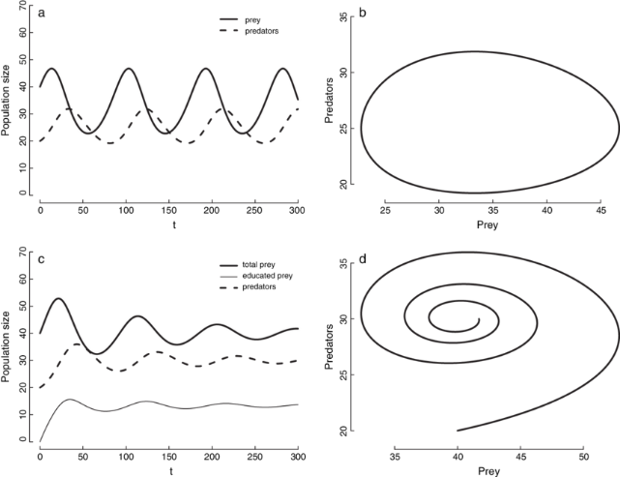
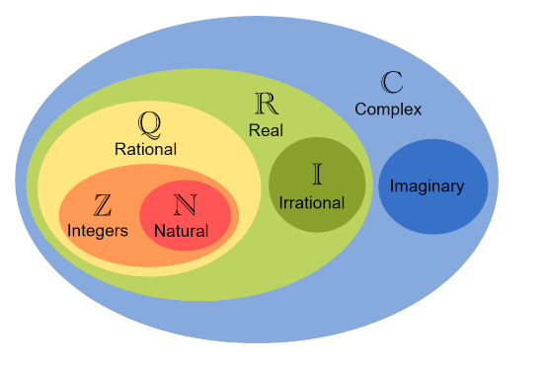
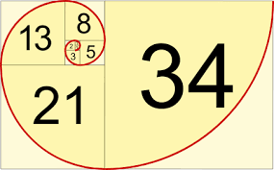
Mathematics for Natural Sciences A
Aimed at students who will study physics, astrophysics or medical physics streams
Develop and extend current understanding in areas such as complex numbers, vectors, matrices, sequences, series, convergence and calculus
Provide practice in mathematical manipulation and problem solving rather than rigorous proofs and derivations.
Start to explore solving mathematical problems using Python coding
Assessed by coursework, online quizzes and a short exam

Slide 10

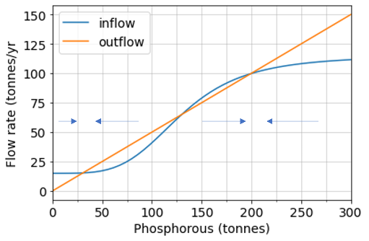
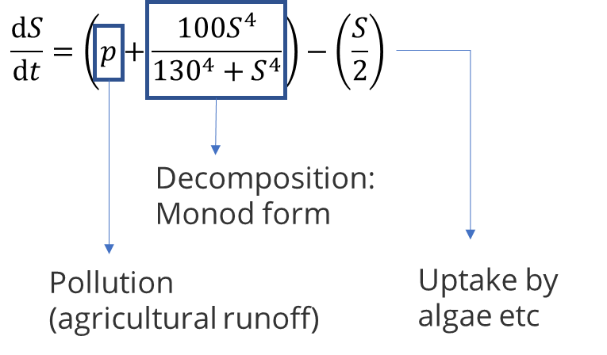
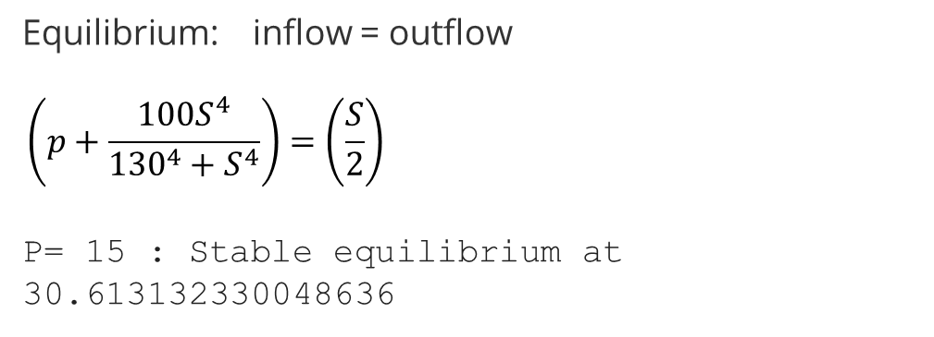
Mathematics for Natural Sciences B
Aimed at students who do not wish to study physics, astrophysics or medical physics
Investigate problems using a combination of analytic and computational approaches
Examine mathematical models of scientific and real-world phenomena
Sustainability and climate focus – e.g. freshwater sustainability, resource use, tipping points
Assessed by coursework (no exam)

Slide 11
Programme Structure
Modules | Years of Consolidation
 | Year 1 | Year 2
1 | Foundation 1 | Stream Choice A
2 | Foundation 2
3 | Foundation 3
4 | Mathematics | Stream Choice B
5 | Stream Choice A
6
7 | Stream Choice B | NatSci Core Module
8 |  | Elective Module
Year 1
4 “foundation modules” plus maths module in first term.
2 core modules for each stream in second term.
Year 2
3 core modules for each stream over first and second term.
A core natural sciences module, either first or second term – students can pick between scientific communication, computing or outreach and public engagement.
An elective module, that students are free to pick (timetable permitting) – typical choices include stream related module or a language module.

Slide 12
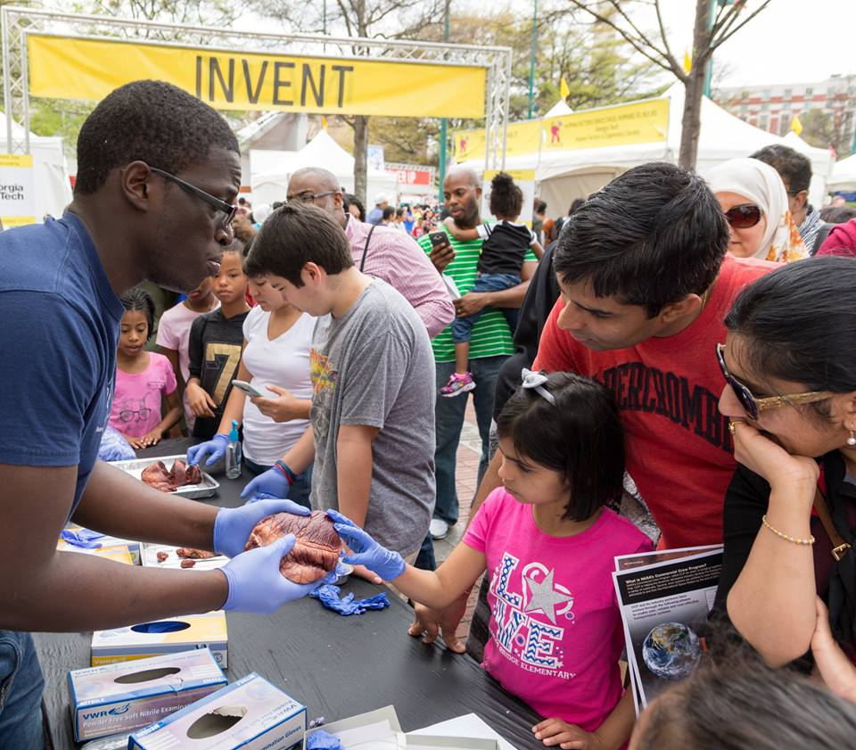
Science for All
Understand current inequalities in science – what are the causes and what are the consequences?
What methods and practices are being developed to address some of the issues?
Conduct site visits and hear from experienced practitioners to learn more about creative ways of involving different kinds of people in science
Work in teams to plan, create, and evaluate a science outreach activity

Slide 13


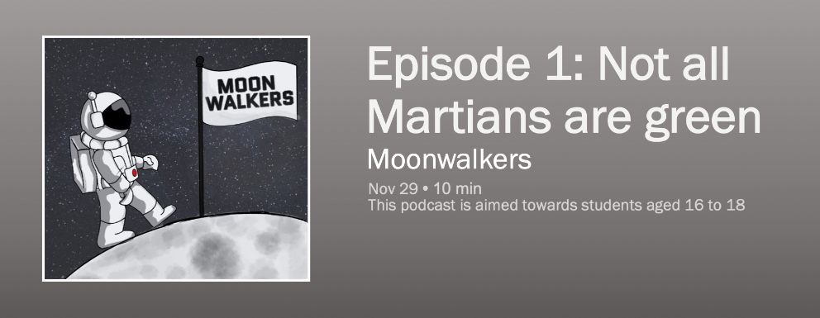
Science Communication
Why is it important to communicate science? And how can we do it well?
Develop a better understanding of the distrust in science and scientists felt by some members of society
Work in groups to plan and record an episode of a science-themed podcast

Slide 14
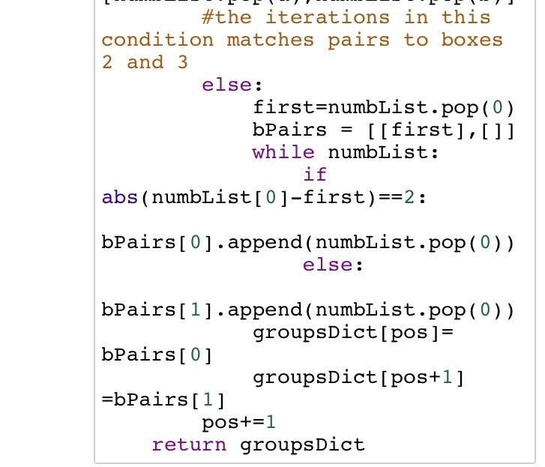
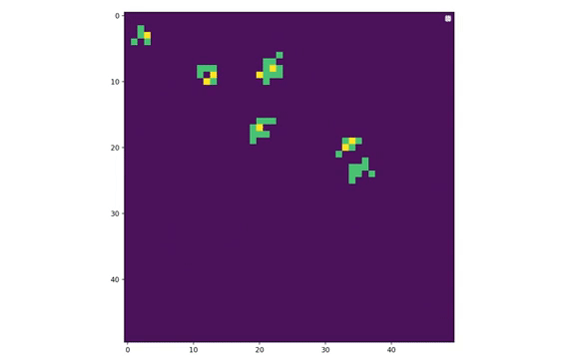

Programming for Scientists
Develop practical skills in programming using the Python language
Apply techniques to real-world scientific problems
The main assessment is a group project in which teams build a simulation of a scientific phenomenon, such as the spread of an epidemic:

Slide 15
Programme Structure
Year 3
Typically five modules in the major stream including a scientific critical literature review and three modules in the minor stream.
Year 4
Major research project - equivalent to three to five taught modules depending on stream).
Entry conditional on performance in previous years (minimum 60%).
Modules | Years of Specialisation
 | Year 3 (BSc) | Year 4 (MSci)
1 | Major stream (including literature review) | Major stream (including research project)
2
3
4
5
6 | Minor stream
7
8

Slide 16


Literature Review
A literature review is an essential part of research - a good review can be used to identify and communicate the state of the art in a topic, reveal gaps and contra-indications in understanding, and place the investigator’s own contributions in the context of existing literature.
Under the supervision of a member of academic staff, students undertake a 3000 word critical literature review on a topic related to their major stream.
Interrogate appropriate research databases using search terms to find relevant literature.
Critically assess the literature and make judgements about research quality.

Slide 17

Students who…
excel in (and enjoy!) more than one area of science
appreciate different perspectives, such as quantum chemistry vs quantum physics vs condensed matter physics
can synthesise understanding at the interface between traditional subjects
are “technically-minded”, and wish to become specialists (not “general scientists”)
are resilient, resourceful and enjoy a challenge
Who should apply?
Imperceptible blending

Slide 18

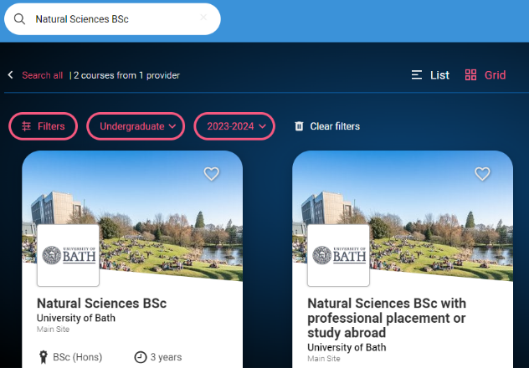
https://digital.ucas.com/search
Searching on UCAS

Slide 19
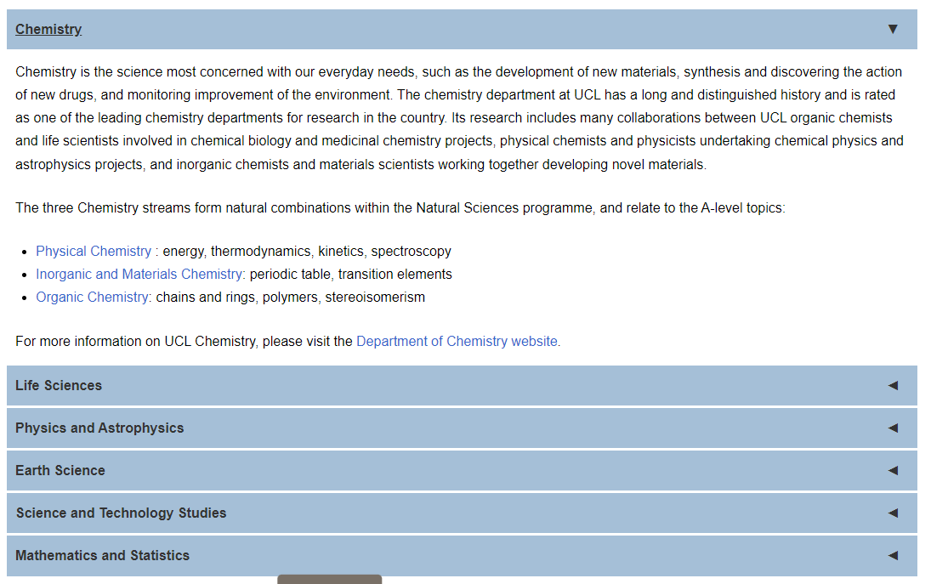
Entry Requirements
Entry requirements A*AA – minimum of two “science subjects” at A-level or equivalent:
Biology, Chemistry, Mathematics, Physics
Access UCL – contextual offer can be BBB depending on circumstances.
See website for subject specific entry requirements:
www.ucl.ac.uk/natural-sciences/

Slide 20

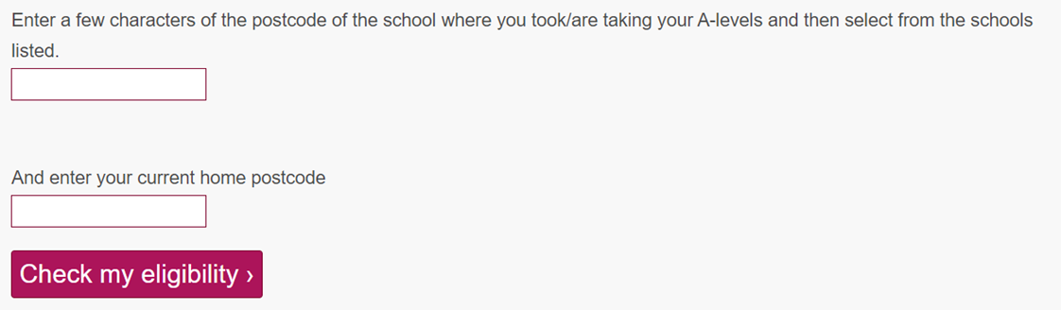
Access UCL
Did you know that you might be eligible for a lower grade offer at UCL?
Go online and search Access UCL then enter your school postcode and your home postcode to find out if you’re eligible.

Slide 21
Statements should contain the following:
  Transmit passion – why are seeking this course of study?
  Who are you – what motivates you in your field? Do you have preferred subject(s)
  Where you want to be in five years time – are you after a solid degree for an industrial / professional / technical career area or seeking further study for research?
  How much do you know around the edges of your study – do you read books / the web / journals? ALWAYS come armed with at least a couple of recent articles / news stories to interviews!
  How will you cope with the transition from school to university – do you do anything beyond just studying at school?
  What else will you be doing? Gap year? Interest in study abroad?
Personal Statements

Slide 22
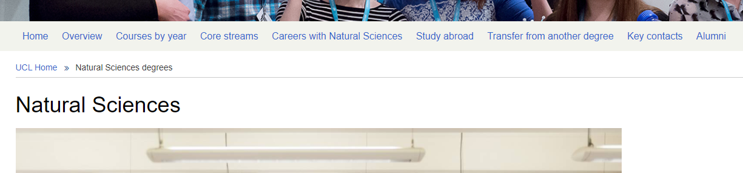
Further Information?
http://www.ucl.ac.uk/natural-sciences
Admissions Tutor: Dr Ali Mozaffari
email: natsci@ucl.ac.uk

