Slide 1
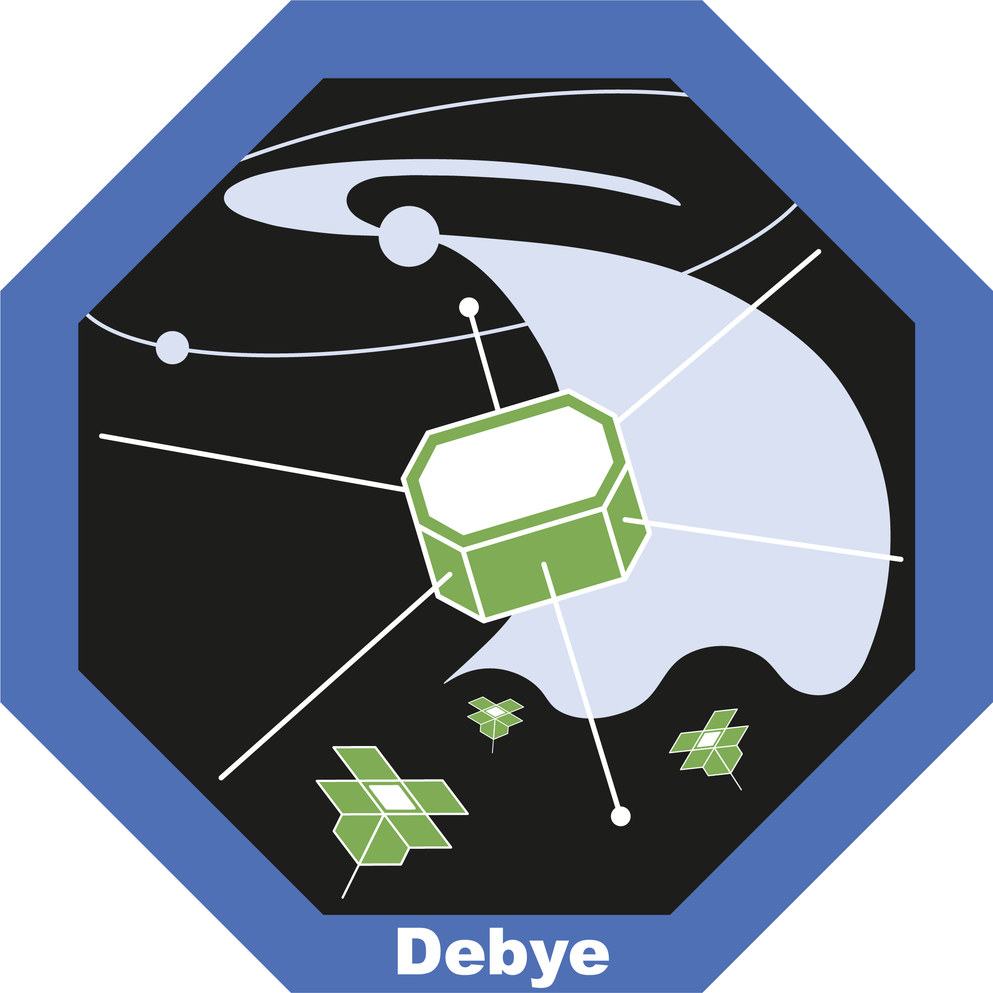

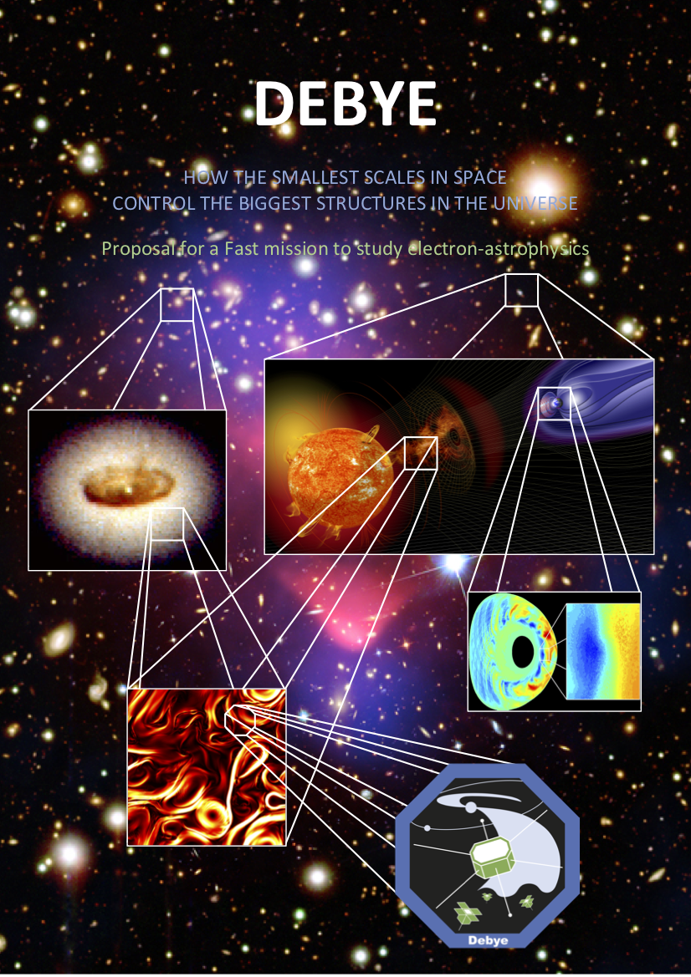

MULLARD SPACE SCIENCE LABORATORY
Debye: how the smallest scales in space control the biggest structures in the Universe
Mission PI: Robert Wicks,
Co-PI Science: Daniel Verscharen
12 April 2019
@DebyeMission

Slide 2
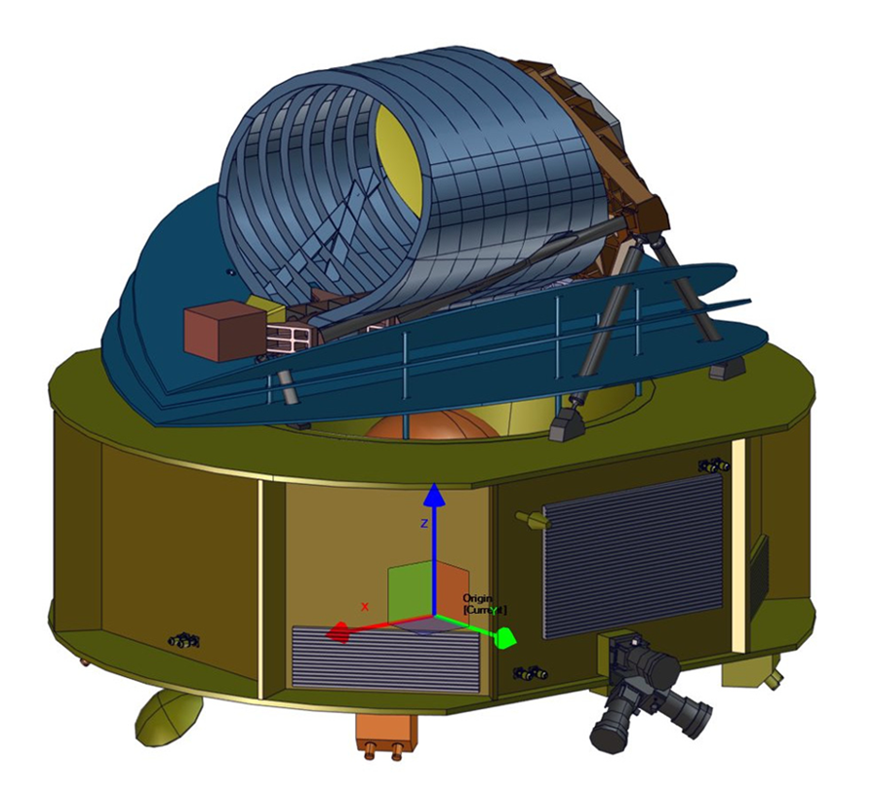
ARIEL (M4) mission:
ESA’s F-class programme
The F-class (F=fast) will launch as a co-passenger with ARIEL (M4).
Debye is one of six F-class candidates under consideration by ESA.
Proposal deadline: 20 March 2019
ESA interview: 7 May 2019
Ranking: July 2019
Selection: February 2020
Adoption: November 2022
Launch: 2028
Ariane 6 launcher

Slide 3
Debye: an electron-astrophysics mission
How are electrons heated in astrophysical plasmas?
(Alexandrova et al. 2009)
Objectives:
O1. What is the nature of waves and fluctuations at electron scales in astrophysical plasmas?
O2. How do electron-scale waves and fluctuations transfer energy to the plasma electrons?
O3. How do energy partition and transfer vary with plasma conditions?

Slide 4
Debye: an electron-astrophysics mission
How are electrons heated in astrophysical plasmas?
Debye will be the first dedicated electron-astrophysics mission to study the connections between the smallest scales in space and the biggest structures in the Universe.
Debye will measure solar-wind electrons with up to 4 spacecraft at L₂ to learn about plasma electrons throughout the Universe.
Debye’s research will be the backbone for astrophysics missions like Athena.
(Credit: M. Pulupa)

Slide 5
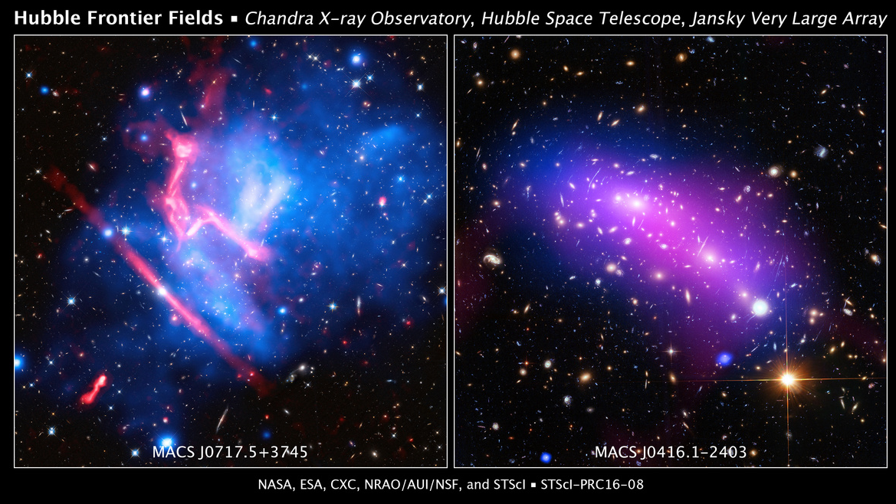
Electron-astrophysics: the new frontier
Examples for current grand-challenge problems in electron-astrophysics:
Heat transport in the intracluster medium
Ion vs. electron heating in accretion disks
The solar wind provides a unique means for observing electron-kinetic processes and turbulence.
Debye is designed to be the vehicle to achieve a breakthrough in our understanding.

Slide 6
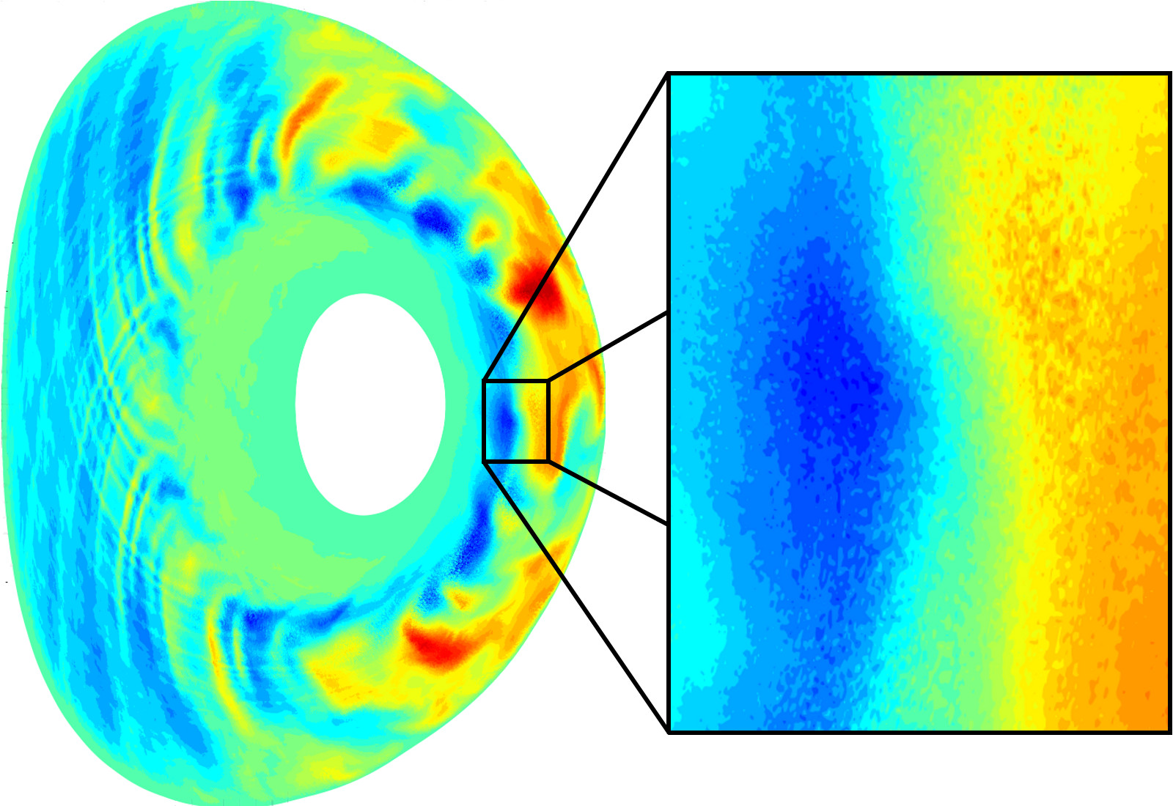
Electron-astrophysics: implications for laboratory plasmas
Solar-wind turbulence becomes more electrostatic at smaller scales.
Thus it resembles turbulence found in laboratory plasma devices.
For example, Debye will be able to measure theorised couplings between whistler-wave and ETG turbulence.
Simulation of ETG turbulence in the TCV-Tokamak (Credit: Daniel Told).

Slide 7
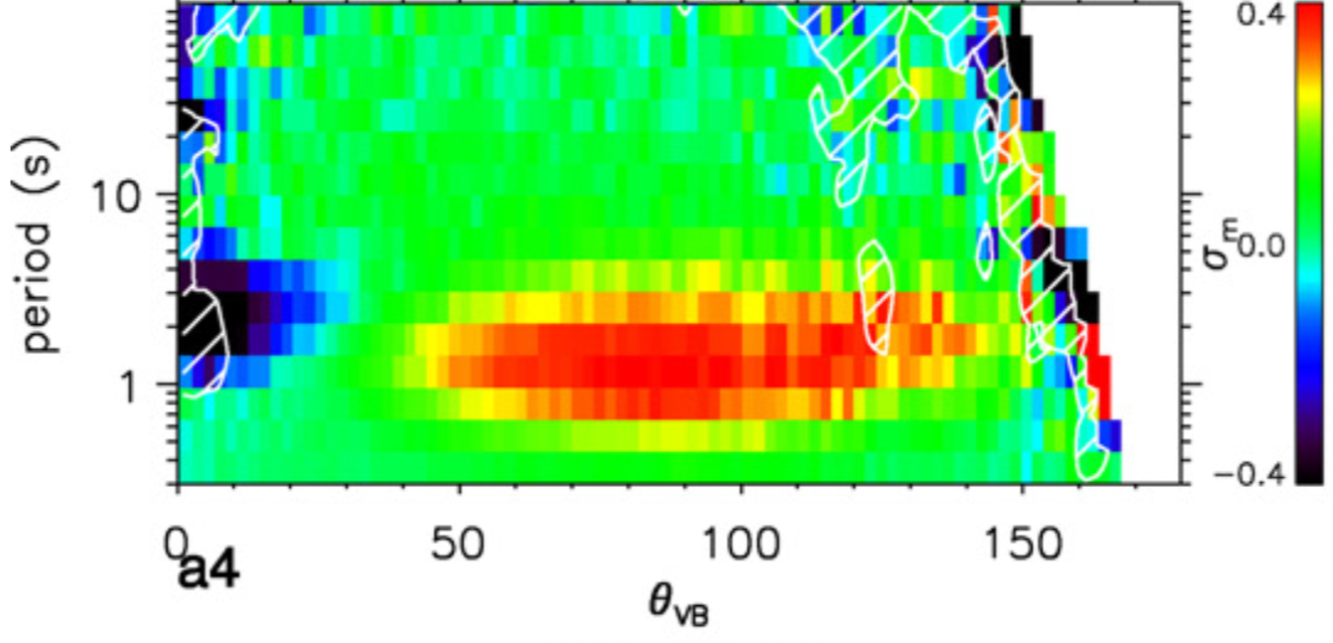
Identify the nature of fluctuations at electron scales
Objective 1:
Although some questions remain open, a consistent picture of ion-scale turbulence has emerged.
However, the nature of electron-scale fluctuations is not well understood.
What is their polarisation?
What are dominating modes?
How intermittent are they?
How important are instabilities?
Magnetic helicity at ion scales (He et al. 2011).

Slide 8
Identify the nature of fluctuations at electron scales
Requirements:
We require multi-point measurements of the magnetic field at electron scales.
We also require electron-scale measurements of the electric field.
Debye is a truly multi-scale mission: trombone configuration.

Slide 9
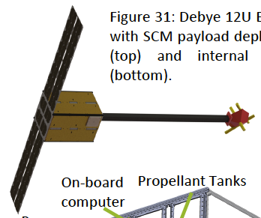
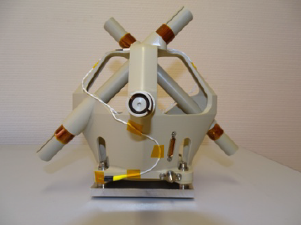
Identify the nature of fluctuations at electron scales
Requirements:
We require multi-point measurements of the magnetic field at electron scales.
EM of JUICE/SCM
Small-sat concept with SCM

Slide 10
Candidate mechanisms for electron heating
Objective 2:
Once we understand the nature of electron-scale fluctuations, we must understand their effects on electrons.
Landau damping
Cyclotron damping
Stochastic heating
Reconnection
The dissipation of electron-scale turbulence affects the plasma’s behaviour on its largest scales.

Slide 11
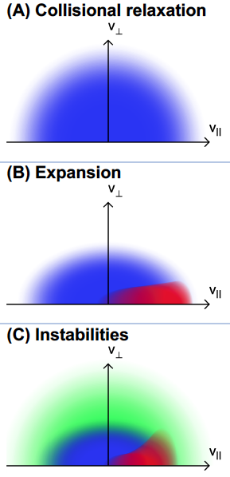
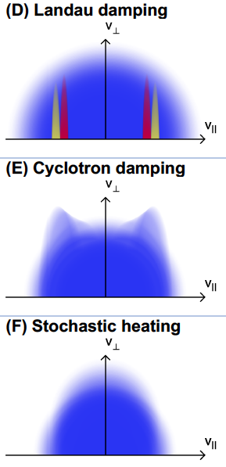
Candidate mechanisms and their signatures
All kinetic mechanisms create characteristic signatures in the electron distribution function.
We must understand the relative importance of
collisions,
expansion,
instability, and
dissipation
in the solar wind and extrapolate our results to other astrophysical plasmas.

Slide 12
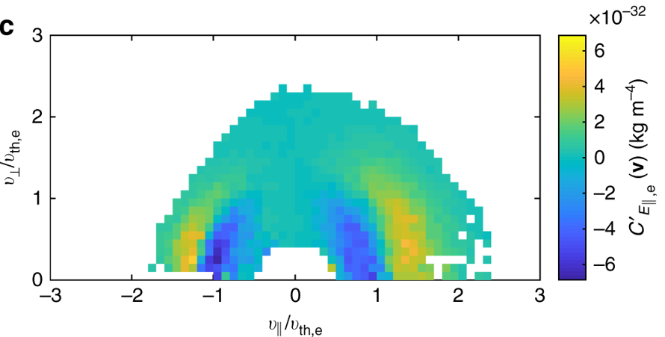
Identify the energy-transport mechanisms between fluctuations and electrons
Requirements:
We require rapid measurements of electric fields and electron pitch-angle distributions and the electric field.
We will measure one electron pitch-angle distribution every 5 ms to resolve electron scales.
Wave-particle correlation method (Chen et al. 2019):

Slide 13
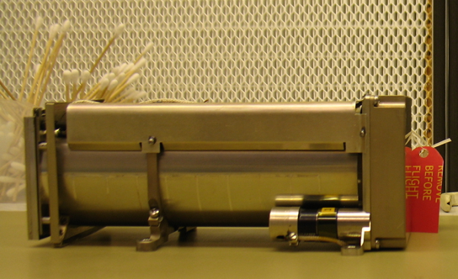
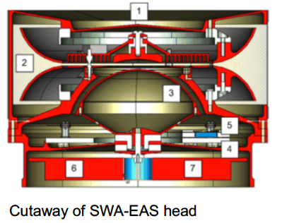
Identify the energy-transport mechanisms between fluctuations and electrons
Requirements:
We require rapid measurements of electric fields and electron pitch-angle distributions and the electric field.
BepiColombo/MMO MEFISTO boom deployer unit.
Wave-particle correlation method
(Chen et al. 2019)

Slide 14
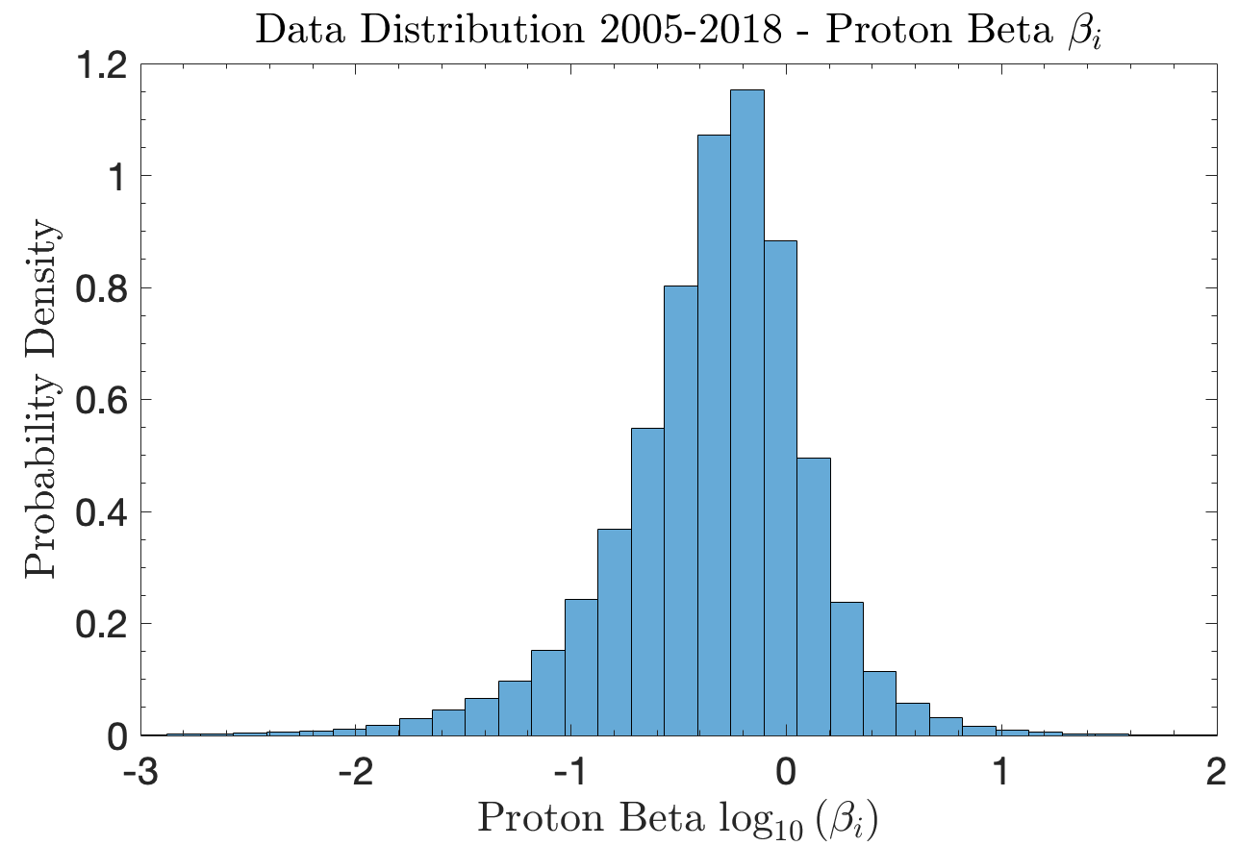
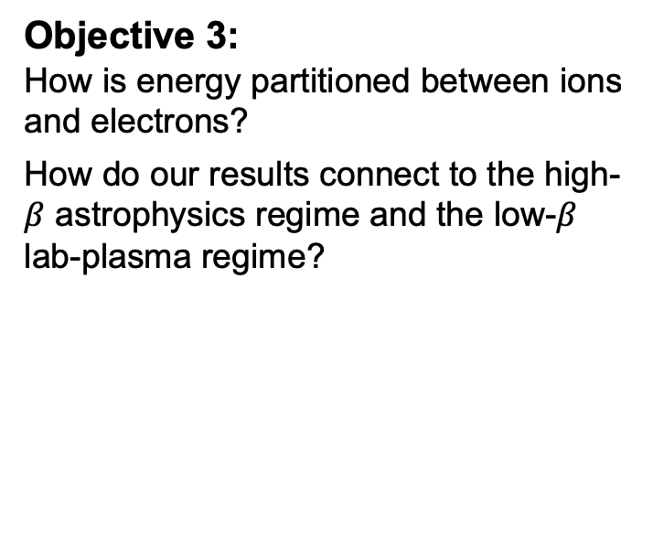
Identify energy partitioning and dependence on plasma conditions
Objective 3:
How is energy partitioned between ions and electrons?
How do our results connect to the high-$β$ astrophysics regime and the low-$β$ lab-plasma regime?

Slide 15
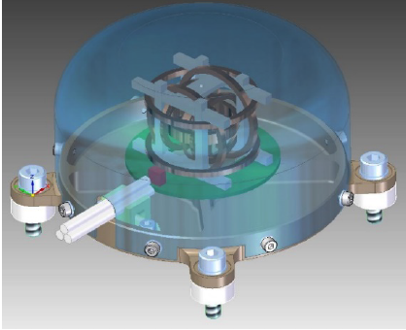
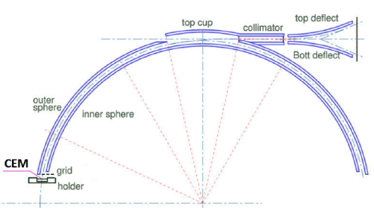
Identify energy partitioning and dependence on plasma conditions
Requirements:
We require context measurements (proton and low-frequency magnetic field) and sufficient statistics.
PEA
FGM

Slide 16
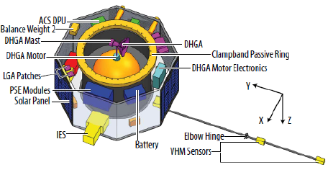
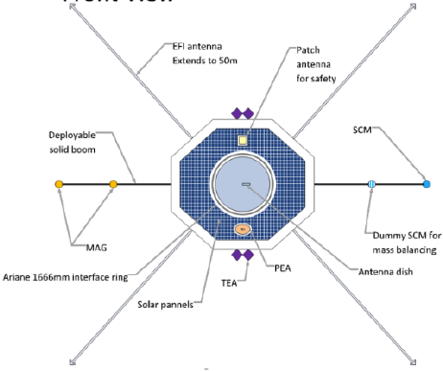
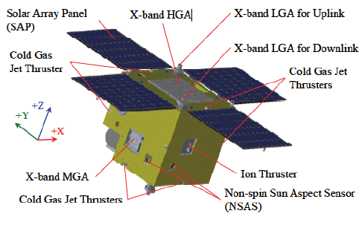
Mission configuration and profile
1 Main SpaceCraft (MSC) with up to 3 Deployable SpaceCraft (DSC) – contributions from NASA and JAXA provide 2 DSC
NASA DSC
ESA DSC
JAXA DSC

Slide 17
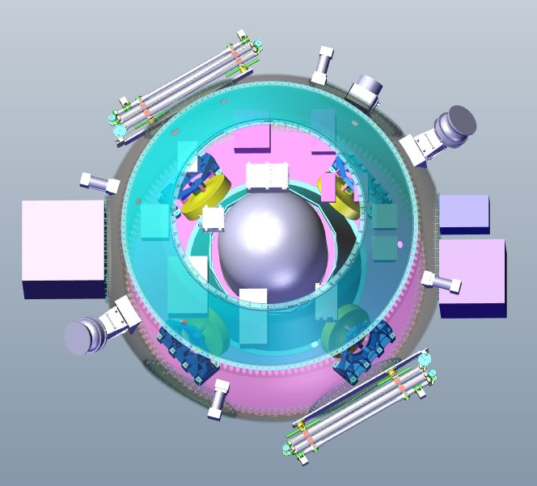
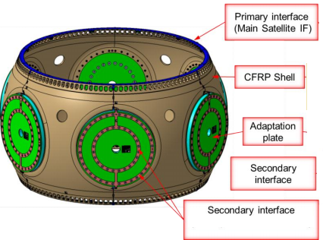
Mission configuration and profile
1 Main SpaceCraft (MSC) with up to 3 Deployable SpaceCraft (DSC) – contributions from NASA and JAXA provide 2 DSC.
Airbus APMAS bus is a structural support ring with integrated propulsion, comms, and avionics.
It is cannot accommodate a large dish antenna and so the data rate is significantly reduced (5 Mbps).
However, it is TRL 9 and can carry > 4000 kg, easily meeting ESA requirements.
Payload and DSC attach via interface rings.
Figure 28: APMAS dispenser-structure components.

Slide 18
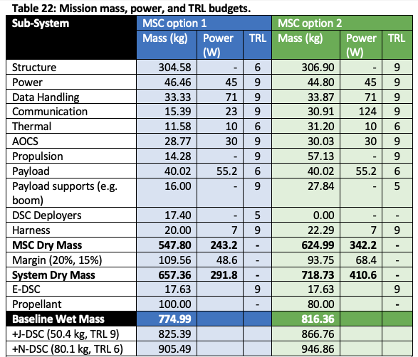
Mission configuration and profile
MSC 1 is a novel design with performance able to support all mission objectives
MSC 2 is an existing design but requires compromise in mission goals.
All components build on strong heritage and have thus high TRL to achieve launch readiness by 2028.

Slide 19
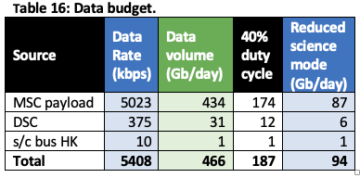
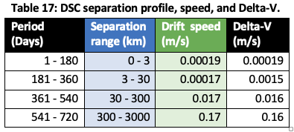
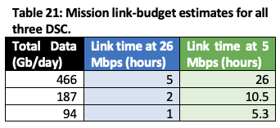
Mission Operations
MSC will insert into L2 orbit, DSC will deploy, then booms and antenna.
Once health-check is performed, DSC will begin moving away from the MSC at a slow speed.
Payload will operate for ~12 hours per day
Data will be telemetered between DSC and MSC every day when payload if OFF.
Ground contact time depends on MSC design, but we aim for ~ 2 hours/day. Onboard data storage means this can be combined to 4 hours / 2 days, or 6 hours / 3 days.

Slide 20
Mission Options

Slide 21
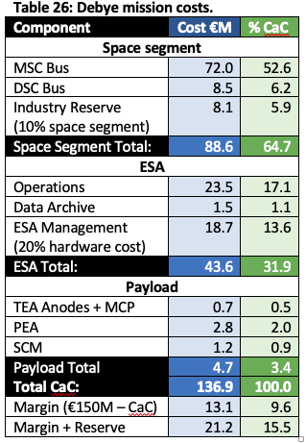
Mission Costs
Debye costs are calculated using the ESA F-class call guidance.
Gomspace estimate €8M for E-DSC.
CNES did not support F-class and so where instrument costs could not be passed to other institutions, ESA will fund the development and AIT of the payload.
We have €13.1M margin (9.6%) and an industrial reserve of €8.1M.
Not sure that €72M is enough: ESA may increase this number.

Slide 22
Conclusions
Debye is a proposed electron-astrophysics mission (to be launched in 2028) to answer the question:
How are electrons heated in astrophysical plasmas?
If selected, it will perform multi-point measurements of electron-scale physics to study how the smallest scales in space control the biggest structures in the Universe.
Follow us on Twitter:
@DebyeMission

