Slide 1
The Cruciform Hub: A new home for medicine at Gower Street
Ben Meunier
Kate Cheney

Slide 2
UCL Master Plan
“The Master Plan establishes a strategic development framework within which the Bloomsbury Campus can be developed.”
http://www.ucl.ac.uk/masterplan

Slide 3
Hubs

Slide 4
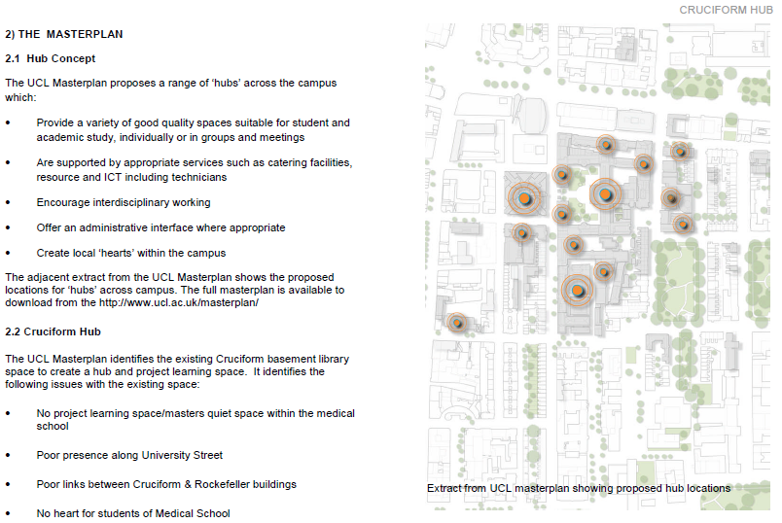

Slide 5
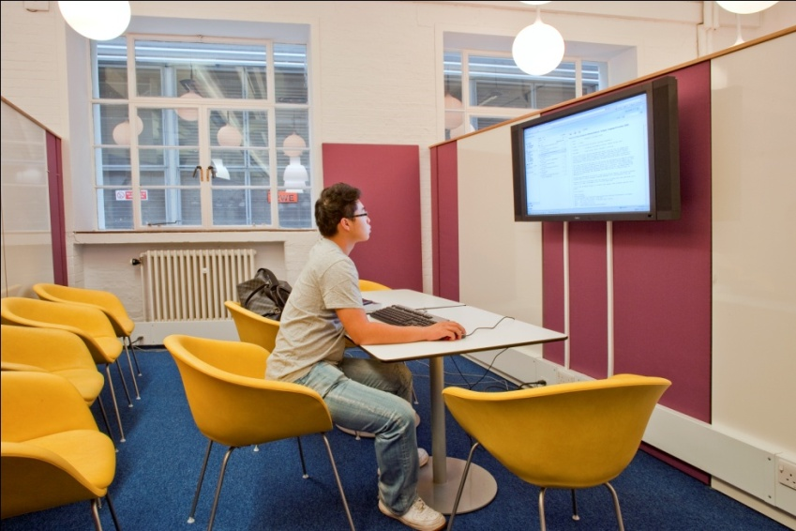
The Learning Laboratory
Information Services Helpdesk
Library Enquiry Desk
Largest computer cluster at UCL
Social Learning space
Project working “pods”
Self-service Short Loan Collection
RFID issue/return terminals

Slide 6
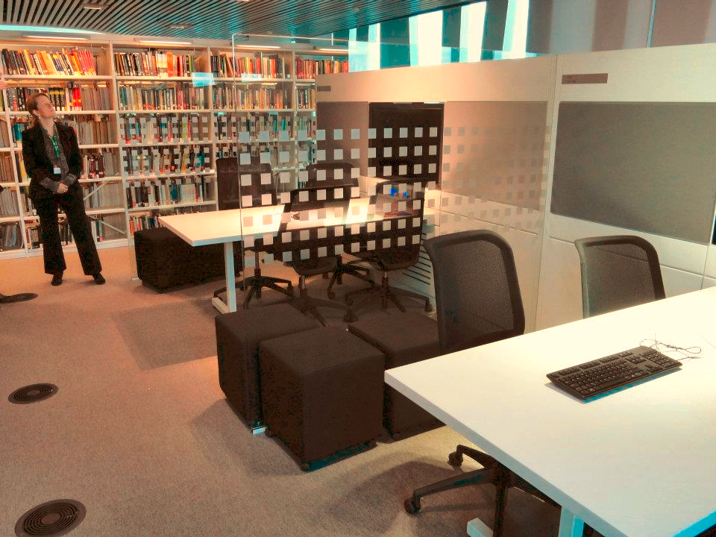
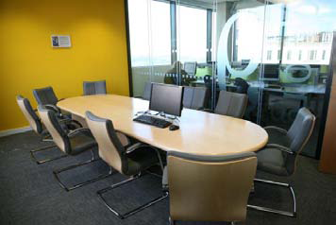
The Library as a place – conversion and innovation

Slide 7
User input and feedback
User Survey
(November 2011)
Over 1,000 responses!
Workshops with library staff – Ongoing
Workshops with students – Ongoing
Medical & Postgraduates student sabbatical officer, LTSS and academic members of Project Board

Slide 8
Survey feedback – what students would like
“stricter quiet study areas and separate dedicated group study rooms”
“more points to plug in laptops”
“increased access and individual study areas”
“water fountain is a must”
“more silent study space that is open late“
“Electronic check out machines like those found in the Science Library”

Slide 9
What do students want?
If the video does not play, it can be downloaded here.

Slide 10
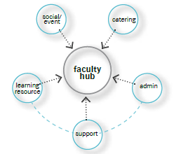
What can we deliver in the Cruciform hub?
Study Space, with separate silent, quiet and noisy areas
Longer Opening Hours
Collections
Library/IT support

Slide 11
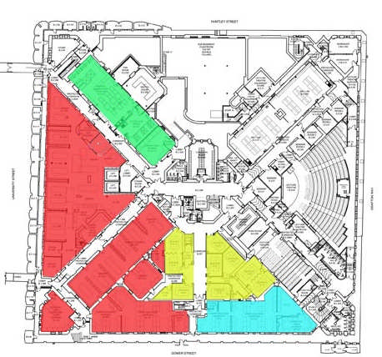
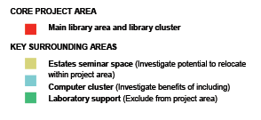
Cruciform Hub - location

Slide 12
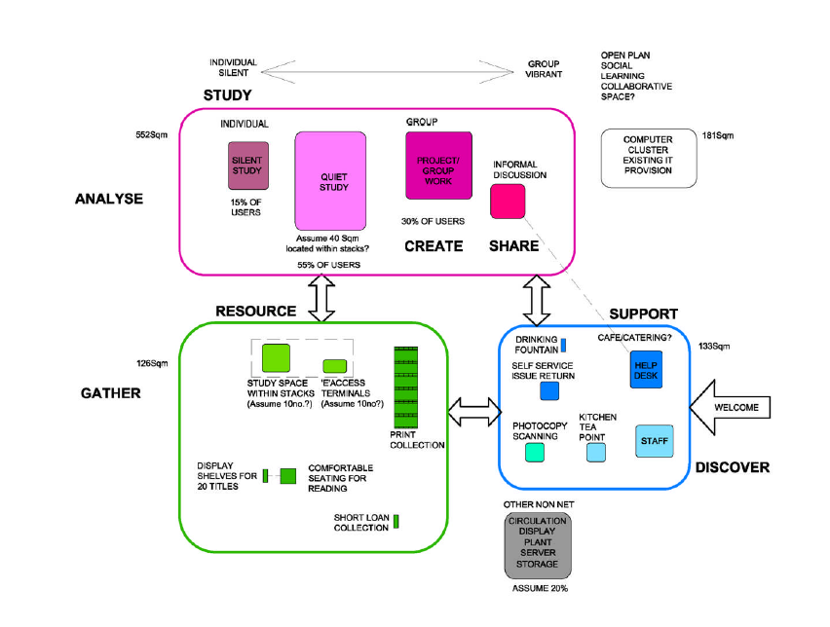

Slide 13
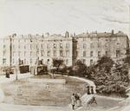
UCL’s medical history held by Special Collections
Carswell drawings, rare texts, hospital history
Opportunity to make collections part of the learning experience, with original exhibits and interactive digital displays

Slide 14
Programme
• Stage A-B Appraisal and Strategic Brief: December 2011 to February 2012
• Stage C Concept Design: March 2012 to May 2012
• Stage D Design Development: June 2012 to August 2012
• Planning Submission: September 2012
• Stage EFG Technical Design and Tender: August 2012 to May 2013
• Stage J&K Construction to Completion: June 2013 to August 2013
• Completion: Start of Term September 2013

Slide 15
Any questions?

