Slide 1
UCL Library Services and UCL Publications Board: New Developments in e-Publishing at UCL
Martin Moyle Group Manager, IT Services, UCL Library Services m.moyle@ucl.ac.uk

Slide 2
UCL Library Services
Contents
UCL Discovery and Overlay Journal Publishing
Retro-digitisation of research theses
Open Access Monographs

Slide 3
1. UCL Discovery and Overlay Journals
UCL Discovery is UCL’s Open Access publications repository
see http://discovery.ucl.ac.uk
Hosts publications data from UCL Research Publications System (RPS)
And, copyright permissions allowing, hosts UCL research outputs
articles, chapters, proceedings, theses, reports, datasets, video...
openly and freely available, worldwide

Slide 4
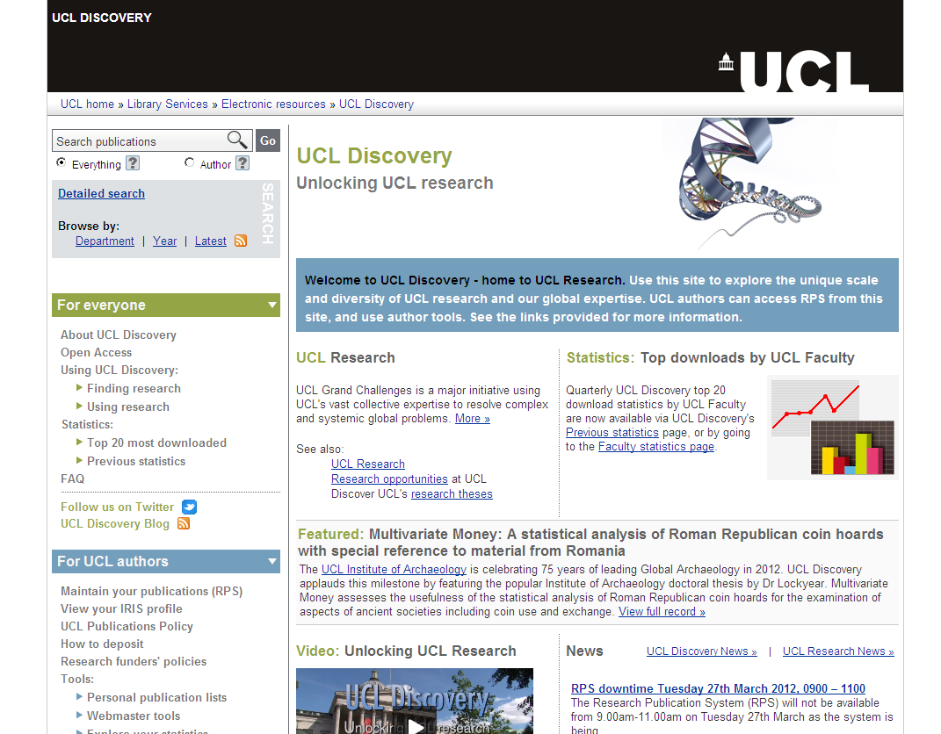

Slide 5
UCL Discovery
Supports one of the UCL White Paper’s top-level Aims: to promote UCL Research
Highly visible web presence
Growing body of evidence that Open Access increases citation counts
Funders nearly all have Open Access requirements as a condition of funding
Deposited research outputs can receive high number of downloads...

Slide 6
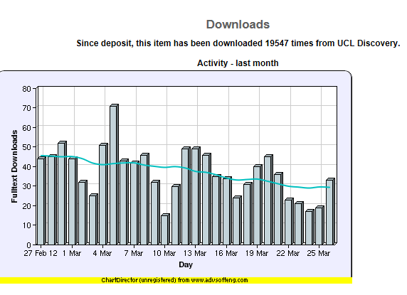
Leicester, A. and Windmeijer, F. (2004) The 'fat tax': economic incentives to reduce obesity. (IFS Briefing Notes BN49 ). Institute for Fiscal Studies: London, UK.
http://discovery.ucl.ac.uk/14931/

Slide 7
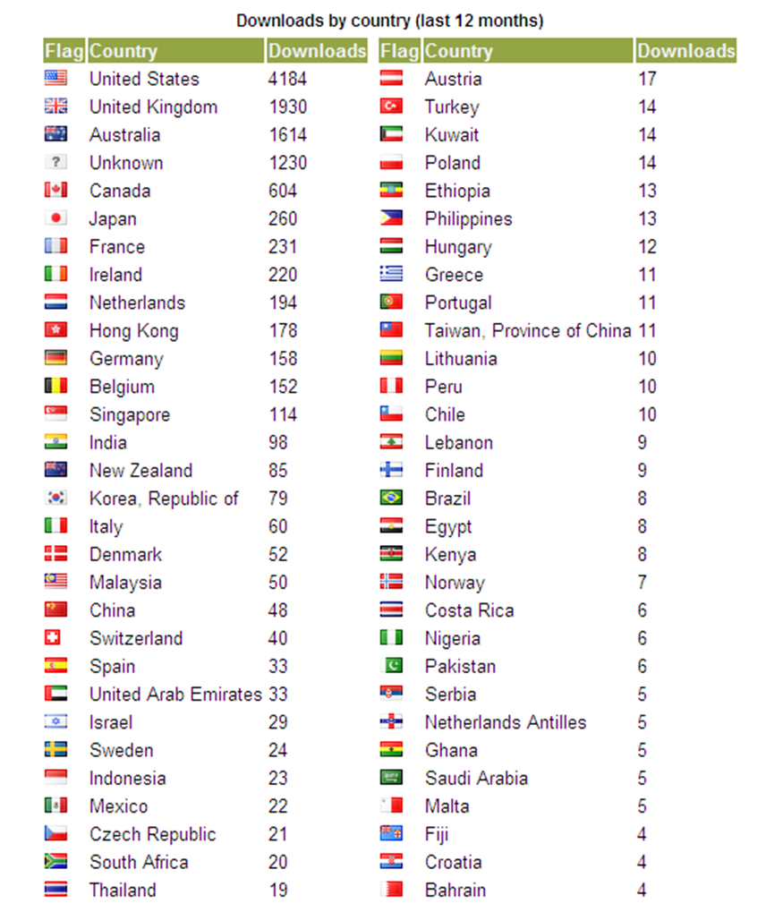
Source of ‘Fat tax’ downloads, last 12 months

Slide 8
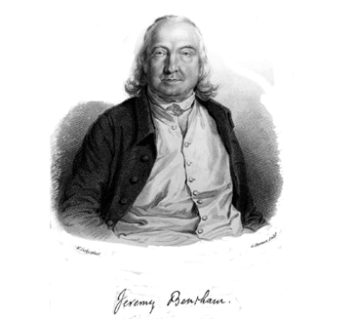
Overlay Journals
UCL has an overlay journals system for the in-house publication of journals
Full-text resides in UCL Discovery and the overlay layer for presentation uses OJS (Open Journal Systems)
2 UCL journals currently available
Journal of Bentham Studies
See http://ojs.lib.ucl.ac.uk/index.php/jbs
Slovo from UCL SSEES postgraduates
See http://ojs.lib.ucl.ac.uk/index.php/Slovo
A third, UCL Commercial Law Review, in preparation

Slide 9
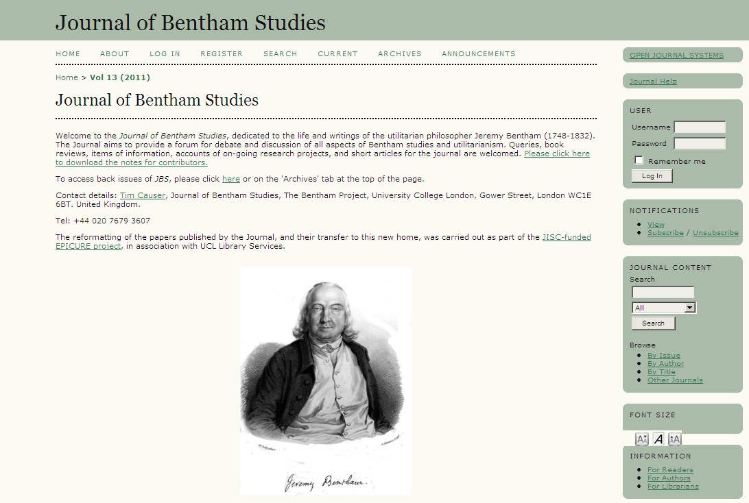

Slide 10
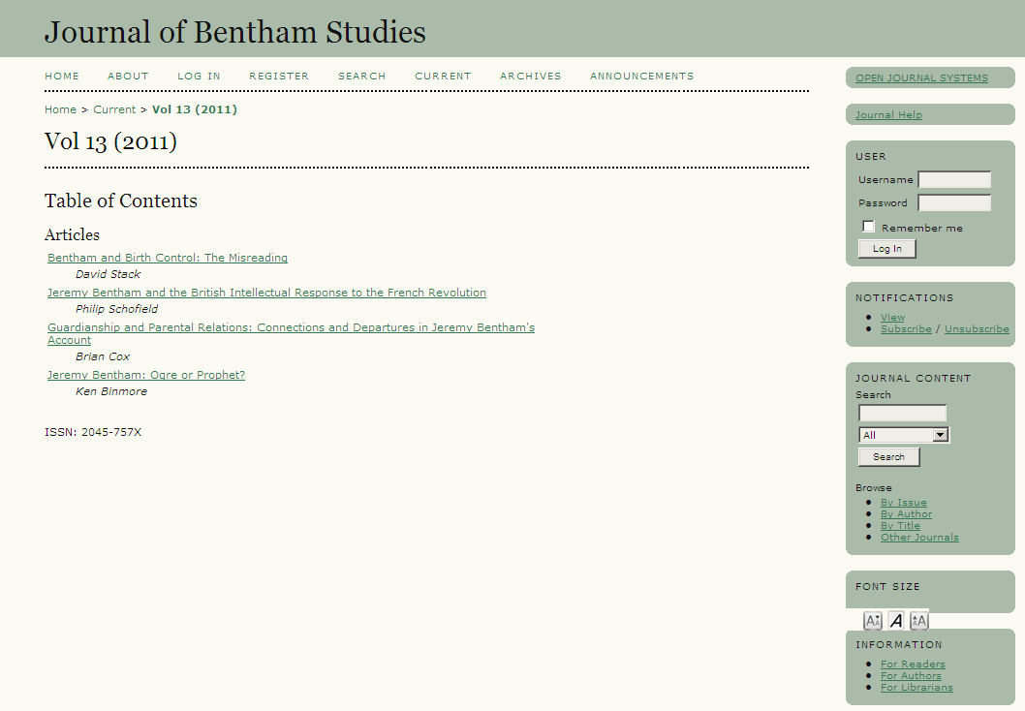

Slide 13
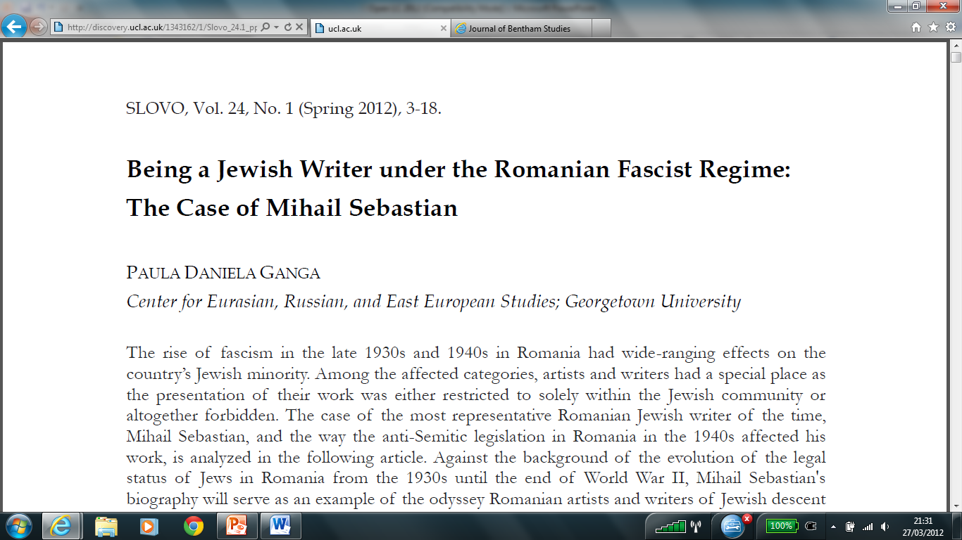

Slide 14
Roles and responsibilities
Library provides OJS Administrator account and advice - OJS configuration, copyright, licensing, digital preservation, citation index coverage, etc.
UCL Discovery hosts articles and provides internet visibility, tools for awareness and embedding, download activity reports
Department runs the journal

Slide 15
2. Research theses
Most UCL Ph.D theses since 2008 are openly available in UCL Discovery
heavily used
good advert for UCL research and graduate recruitment
UCL has concluded an agreement with ProQuest for 2,000 older UCL research theses, where UCL has copyright permissions for format migration, to be digitised and made available in Open Access in UCL Discovery
This is a pilot for a bigger retro-conversion project with ProQuest

Slide 16
3. Open Access monograph publishing
UCL working with LERU (League of European Research Universities)
Developing an EU bid for shared Open Access Publishing infrastructures
For Open Access monographs in Arts, Humanities and Social Sciences
Firm partners in England, Scotland, Spain, France, Germany, Netherlands

Slide 17
Open Access monograph publishing
Challenges
Building shared e-only publishing infrastructure
Identifying potential publications
Identifying correct Business Model
Who pays? Funder? University? Individual?
Full proposal due in Autumn 2012
EU Commission already very interested in this innovative publishing model

Slide 18
Thank you
Contact: m.moyle@ucl.ac.uk

