Slide 1
Challenges and Opportunities for 2012-13
Dr Paul Ayris
Director of UCL Library Services and UCL Copyright Officer
President of LIBER (Association of European Research Libraries)
e-mail: p.ayris@ucl.ac.uk

Slide 2
Contents
UCL Masterplan for the Bloomsbury campus
UCL Stratford
UCL’s digital library
Student Experience: ReadingLists@UCL
Open Access developments
Communication tools

Slide 3
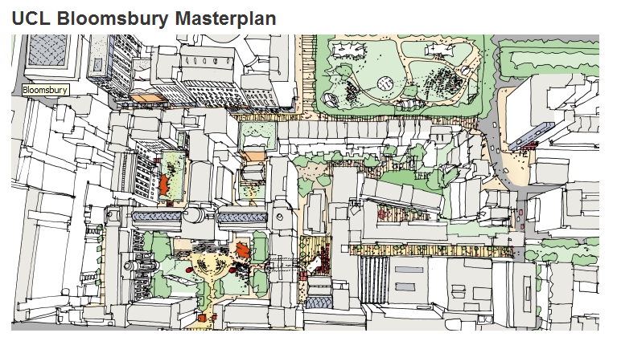

Slide 4
1. UCL Masterplan for Bloomsbury campus
£75 million is the initial estimate for the creation of the consolidated UCL Main and Science Libraries in the Main Quad
Aberdeen University Library, a newbuild, cost just under £60 million
UCL is therefore planning for a major development of its library, research and learning estate in the next 10 years

Slide 5
1. Cruciform Hub
Backed by a comprehensive survey of UCL and NHS users, which resulted in 1,000 returns to the survey
The first UCL Hub to be discussed, and it is to be library and learning space
24-hr opening for parts of the year a feature
Introduction of eating and drinking spaces part of the future vision for library spaces
Cruciform Hub, delivered by Summer 2013, will set the tone for all Faculty hubs in UCL

Slide 6
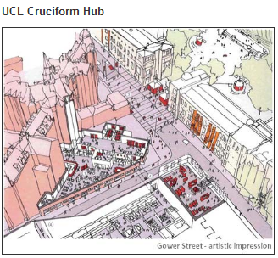

Slide 7
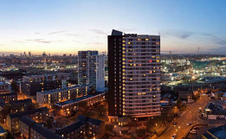
2. UCL Stratford
23 acres of space
Equivalent of the size of the UCL Bloomsbury campus
UCL Library Services has submitted a paper suggesting how library and information services should be represented on the site
Wherever there is student accommodation, there is a need for library/learning space
UCL Stratford represents a major opportunity for Public Engagement in London

Slide 8
3. UCL’s digital library
£1 million recurrent funding programme agreed by UCL SMT between 2011-12/2013-14 to make UCL’s digital library one of the best digital library offerings in the world
Academic Support Group has benchmarked UCL’s digital holdings against global competitors
Student Barometer and International Student Barometer already point to UCL’s digital library as one of the main areas of improvement in recent times
Digital Library is the future for research libraries

Slide 9
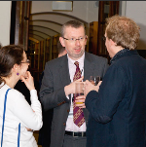
4. ReadingLists@UCL
Early feedback from students using the service in Term 1 shows that they are keen to see more widespread use of the service
94% of those responding saying that they would like an online list for all of their modules
Communication Plan for every Department in UCL
For more information on ReadingLists@UCL, including how to get started with the system, see
http://www.ucl.ac.uk/library/readinglists.shtml

Slide 10
5. Open Access
2012 has seen major developments in UCL’s Open Access agenda
DART-Europe - Access to 291,216 open access research theses from 408 Universities sourced from 20 European countries
UCL Discovery is the repository for the deposition of full-text materials in line with UCL’s Open Access mandate
Ph.D dissertations a particularly strong representation of UCL research in UCL Discovery
Public-Private partnership with ProQuest will double the number of Open Access Ph.D dissertations available
Overlay journals service now available for the in-house publication of journals

Slide 11
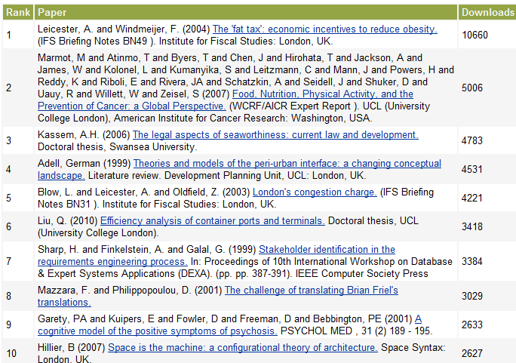
PhDs

Slide 12
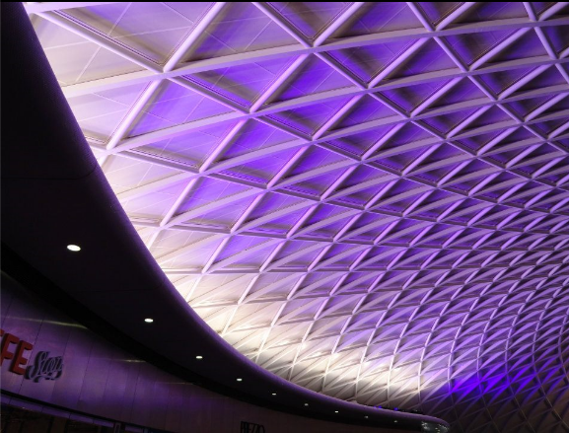
6. Communication tools
Termly public Newsletter
See http://www.ucl.ac.uk/Library/Newsletter
Web news
See http://www.ucl.ac.uk/library/news
Videos for new developments
See http://www.ucl.ac.uk/library/video.shtml
Social media
See http://www.ucl.ac.uk/library/social-media.shtml

Slide 13
Agenda for Open Forum
14:20 - The Cruciform Hub: Ben Meunier, Assistant Librarian (Building Projects) and Kate Cheney, Joint Academic Support Manager, Biomedicine
14:40 - Enriching the Student Experience with ReadingLists@ucl: June Hedges, Co-ordinator, Teaching & Learning Support Section
14:55 - New developments in e-publishing in UCL Library Services: Martin Moyle, Group Manager, IT Services
15:05 - Open Forum: general questions and answers

