Slide 1
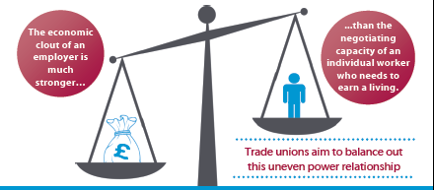
Trade unions and economic inequality
Dr Lydia Hayes, Cardiff School of Law
Notes:
Thank you for inviting us to talk this evening. To kick things off my contribution will draw on the argument that Tonia and I built in the booklet Trade unions and economic inequality which was published jointly by CLASS and the Institute of Employment Rights. Collective bargaining, or rather its lack, it is a subject which deserves much greater prominence in debates about economic inequality. Particularly in the context of the financial crash of 2008 there has been a certain sense of political resignation to the idea that economic forces are out of control, because they are apparently beyond our control. So to set economic inequality in the context of the decline of collective bargaining and inadequate legal support for trade unions is a particularly important reminder, should one be needed, of the man-made nature of economic inequality and the contribution of trade union law to the shape of our economy, the richness of people’s life opportunities and the potential for them to exercise democratic influence, as wealth creators, in work.

Slide 2
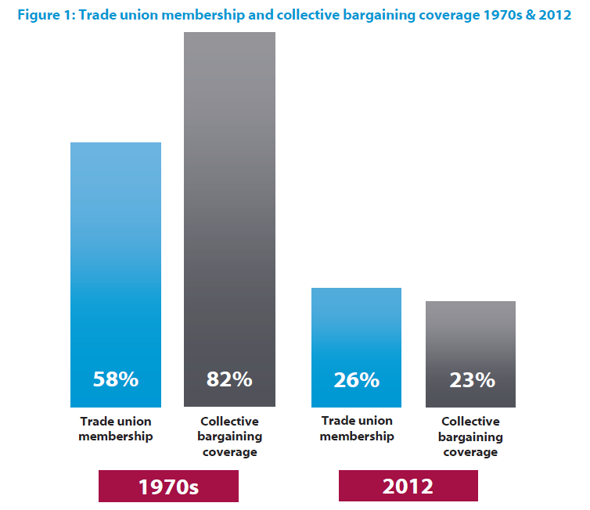
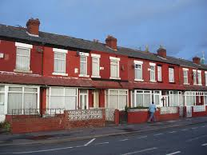
International and in everyday life
Notes:
A report published by IMF economists last week provides a welcome contribution to the debate and highlights how the benefits of collective bargaining might be recognised in relation to concern for the economic prospects of advanced economies at an international level – I will talk about this in a moment. I will also give an overview of the report that Tonia and I wrote and then I want to focus in on the idea of collective bargaining and economic inequality in everyday life – using the example of the homecare industry to indicate the relationship between collective bargaining and individual employment rights.

Slide 3
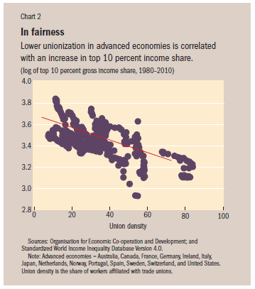
Trade unions: research for the IMF
Florence Jaumotte & Carolina Osorio Buitron, Power from the People, Finance and Development, March 2015
Income inequality = increases in income share among top 10% of earners
Risk = lower and less sustainable growth in medium term + manipulation of economic and political systems in favour of wealthy
Research Focus – tax reduction and financial deregulation? Or labour market institutions and unions?
‘Erosion of unions’ is ‘a key contributor’ to rising income shares at the top
Deunionisation explains half of the rise in income shares amongst top 10%
Union membership as a measure of bargaining power – but which aspects of unionisation ?
Notes:
The report published by IMF economist Florence Jaumotte and Carolina Osorio Buitron locates income inequality as a consequence of out of control increases in income amongst the top 10% of income earners in advanced economies. There is a certain consensus that economic inequality has been caused by problems at the top, caused by the wealthy, as an inevitable occurrence linked to globalisation, particularly the free movement of capital, and to technology as a catalyst for labour market changes, particularly a rise in demand for skilled workers and the benefit that this offers to top earners. Whilst the report does not dispute this assessment, it notes that this view has skewed the research agenda and research has focused on changes directly linked to the top of the income distribution and thus has largely ignored structural changes in the middle and amongst lower income earners. So Jaumotte and Buitron choose not to look at reductions in income tax for the wealthy or the impact of financial deregulation on economic inequality, instead they look at the role of labour market institutions, the decline of union membership and the relative value of minimum wages.
Whilst being careful not to make a value judgment about economic inequality as being ‘bad’, they point out that higher inequality is associated with lower and less sustainable growth in the medium term AND that it leads to a reduction in the overall welfare of a population if top earners are able to manipulate the economic and political system in their favour.
They find strong evidence that lower unionisation is associated with higher shares of wealth among top earners – and here is the graph showing the correlation. Recognising that correlation and cause are not the same, they strip away the statistical influence of shifts in political power, social norms regarding inequality, sectoral employment shifts and increases in education levels. The conclusion is that the ‘erosion’ of unions is a key contributor to economic inequality and they attribute half, 50%, of the increased income enjoyed by the top 10% of earners to deunionisation. Their suggestion is that IF economic inequality is hurting societies, there are grounds for governments to take policy action which includes ‘a reaffirmation of labour standards that allow willing workers to bargain collectively’.
This was the key message in the publication that Tonia and I wrote in the context of the UK.

Slide 4
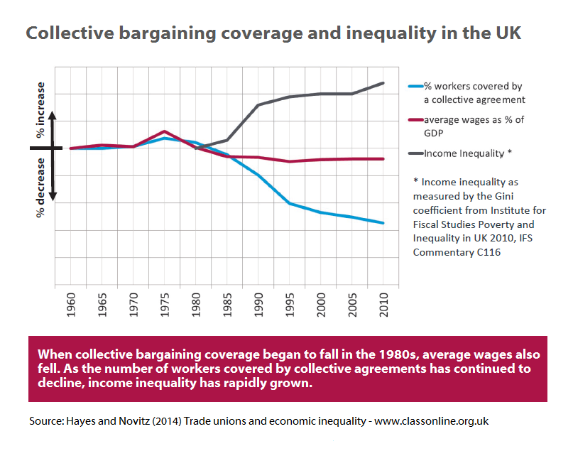
Trade unions: our research
Income inequality = decline in collective bargaining coverage in UK
Risk = good health, discrimination, decent work, wage hardship
Research Focus – how trade unions promote economic equality?
Bargaining power of trade unions =
better employment standards, more generous pay setting, health & safety, transparency, social inclusion
‘Dismantling of sectoral bargaining’ was a factor in economic inequality and had found legal expression through the support of UK governments.
Greater economic equality depends on health of collective bargaining.
We need a renewal of trade union rights – but which aspects of law ?
Notes:
The IMF research uses union membership figures as a measure of union bargaining power and proposes that future research needs to assess which aspects of union activity are more successful in reducing economic inequality. Tonia and I started at the point where perhaps the IMF report ends. We located economic inequality as the decline in bargaining power which had arisen because of weak collective bargaining coverage in the UK. We began with regard for a reduction of collective bargaining power since the 1970s. On the basis of the evidence we reviewed we raised concerns that economic inequality put a number of social factors at risk. First we noted that people living in unequal societies have poorer health outcomes and that holds across the population. Health risks associated with work are not shared equally and that weaker bargaining power leaves low-waged workers, young people and migrant workers most exposed to workplace danger, and this included the risk of work related cancers. We found evidence that economic inequality also manifested in discrimination at work. Economic inequality meant that some workers did not have enough hours of work to be able to make ends meet while others were working very long hours under constant pressure. Insecurity of work, casual, temporary and agency work was widespread under conditions of economic inequality. Government disregard for economic inequality had increased wage hardship amongst low earners, particularly amongst public service workers and in the service industries more widely. Economic inequality it seemed was also manifest in the rising use of foodbanks and the concerns of medics about malnutrition-related admissions to hospital.
When we turned to the evidence about what collective bargaining could achieve we found systematically that trade unions delivered higher wages to their members but it was at a sectoral level where trade unions could make an impact on economic inequality. In addition, trade union bargaining improved health and safety at work, not only by reducing accidents but also by reducing exposure to chemicals, radiation and other hazards, and establishing safer working across sector. Collective bargaining reduced pay differentials between men and women and when collective bargaining was absent, there was a corresponding stark increase in wage inequality. We saw that it was collective bargaining which enabled trade unions to represent their members and create better treatment for everyone by ensuring transparency over procedures and the implementation of labour standards.

Slide 5
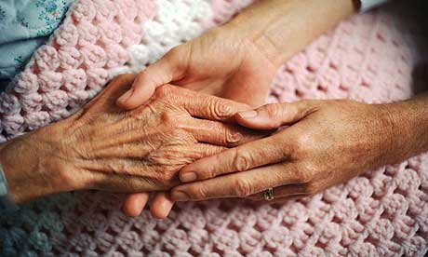
The fastest growing employment sector since the financial crash
Homecare: a sectoral example
Contracts of Employment Act 1963
Equal Pay Act 1970 / Equality Act 2010
Benefits won through collective bargaining and representation
National Minimum Wage Act 1998 / National Minimum Wage Regulations 1999
97% of homecare workers now employed in the independent sector (over 700,000 workers)
A majority on zero-hours contracts
‘Good Neighbourliness’?
... A few, irregular, hours of partly-paid work
Notes:
So what impact can collective bargaining have on labour standards at a sectoral level and what happens when the protection of collective bargaining in removed ? I want to use the example of homecare services to illustrate the intimate connection between individual employment rights and the status of collective bargaining. During World War II the labour of women was required in support of the war effort and hence families were depleted of the female labour which had served the needs of older and disabled people at home. The War Cabinet instructed local authorities to develop local registers of women who would be prepared to act as stand-in domestic helpers. This home-helps service continued as a local authority function – the women were not paid a wage as such but given a few hours of casual partly-paid work in recognition of their ‘good neighbourliness’ (as it was officially designated). Prior to the Contracts of Employment Act 1963 home-helps were not regarded as proper local authority employees and contemporaneous accounts detail that, should a woman no longer be required, or fall ill, she would simply be given no more work.
It was not until the 1970s however that the right to a formal contract of employment and fixed hours of work was achieved for and by this workgroup, and only then on account of collective bargaining. Similarly, although the right to equal pay had been available from 1975, it was not until the 1990s that this group reaped the benefits. They did so on the basis of being part of collective bargaining structures which enabled their work to be aligned with the work of men in work of equal value. Again, it was collective bargaining which saw their transition from home-helps to homecare workers and their recognition as skilled employees, at grade 5 of local authority job evaluation schemes.
However, because of a lack of collective bargaining coverage across the care industry in the private sector, when homecare services were privatised, the rights of homecare workers to be paid equally to men in local authority employment evaporated. Considerable cost savings were achieved by local authorities. Homecare was, and remains, the most highly gender segregated occupation in the UK labour market. Homecare employers in the private and independent sector have been able to dramatically cut wage levels. Women are unable to bring equal pay claims because they have no eligible male comparators against whom they can compare their wages.
Today, homecare is an industry which is almost entirely located in the independent sector. Wages have plummeted, homecare workers are no longer represented by collective bargaining, they have lost the ability to align their pay with men in work of equal value, they have lost their occupational pensions and occupational sick pay benefits. Their terms and conditions are now tracked against minimum standards set out in law. And yet, a majority are on zero hours contracts. They have no fixed hours of work and no guarantees of work. Local authorities now subject them to systems of electronic monitoring of their working time. This means that, at best, they are only paid for the minutes they spend inside service users homes. Hampshire County Council saved a £1 million in 2013/14 by introducing this scheme and most of the savings effectively come out of homecare workers’ wages. These women are, once again, reduced to accepting a few hours of casual and partly paid work.

Slide 6
Churchill’s serious national evil?
Homecare: a sectoral example
‘We are astonished that up to 220,000 care workers earn less than minimum wage and seemingly little has been done to rectify this.’ Adult Social Care in England, House of Commons Committee of Public Accounts 2014/15
V. Wass, Cardiff Business School. LJB Hayes and V Wass, Wellbeing and the social care workforce (forthcoming).
Notes:
Winston Churchill famously said that it was ‘a serious national evil that any class of His Majesty’s subjects should receive less than a living wage, in return for their utmost exertions’. For seven year since the financial crash of 2008, there have been repeated ‘revelations’ about the failure of homecare employers to pay homecare workers’ in accordance with the UK’s National Minimum Wage law. Yet the Public Accounts Committee recently expressed its ‘astonishment’ that over 200,000 homecare workers are now thought to be paid less than the National Minimum Wage when all their working time is taken into account. Without collective bargaining, and without collective representation of the interests of homecare workers across the homecare sector, it would seem that it is not possible for homecare workers to secure even basic minimum labour standards.
Problems have been exacerbated by sectoral delicensing and the removal of training standards in the care sector following the financial crisis. Whilst homecare workers, in theory, have access to the same legal rights as other workers, we can see vividly in this graph that they have a weak bargaining position. In relation to other workers, their pay has fallen markedly in relation to other workers since 2008.
The story of what has happened to homecare workers serves to show that economic inequality is not a static problem. It is dynamic lived experience and an unfolding picture which not only reflects the availability of minimum labour standards, but is critically connected to the availability and capacity of sectoral collective bargaining. Tonia will now talk about the need for better legal support of trade unions to enable them to act effectively, in order to reduce economic inequality.

