Slide 1

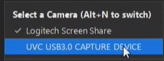

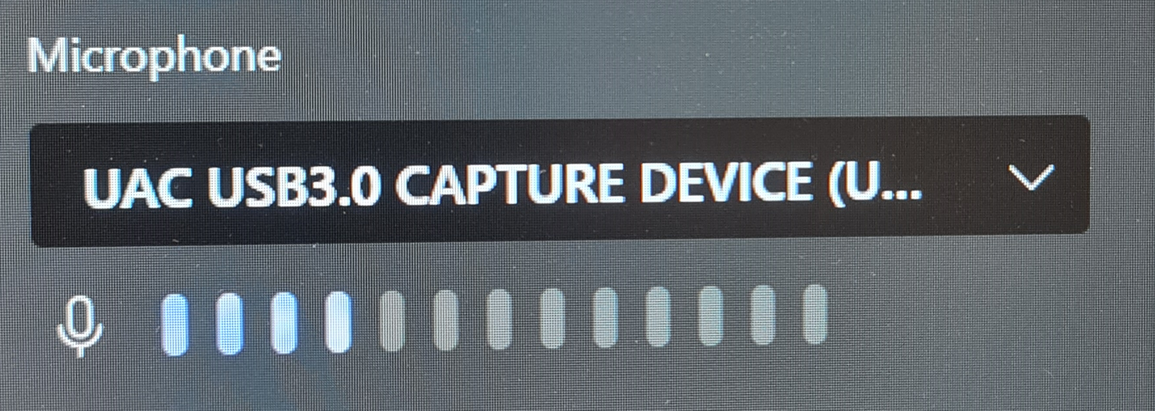
ISD Basic Hybrid guidance for Lecturecast spaces
The hybrid equipment is a temporary solution; therefore you may experience some issues.
Please call the AV Hotline via the speed dial button on the in-room phone for help.
Turn the system on at the control panel.
Select either PC (if using in-room PC) or LAPTOP HDMI.
Note The PC is recommended as the most reliable way to connect.
If using a LAPTOP – Plug the HDMI cable and plug the BLUE HYBRID USB cable into your laptop.
Start Zoom or Teams.
  PC - The PC should default to the settings listed below
  LAPTOP - select the following in-room camera, audio and microphone settings.
CAMERA/VIDEO:
UVC USB 3.0 Capture Device
AUDIO (in room):
Crestron Display Audio
or Extron Audio
MICROPHONE:
UAC USB 3.0 Capture Device
TURN OVER for instructions on finding Zoom & Teams device settings AND using the visualiser.

Slide 2
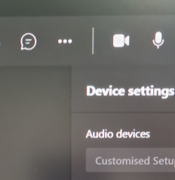
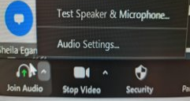
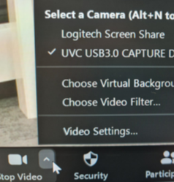
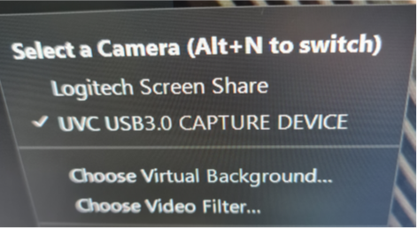
ISD Basic Hybrid guidance for Lecturecast spaces
Teams device settings
Click the 3 dots to open Settings.
Zoom device settings
Click the upward arrow on the headphone icon for audio settings.
Click the upward arrow on the camera icon for audio settings.
Visualiser settings
The visualiser functions as an alternative camera input.
Select Logitech Screen Share.
May also appear as Wolfvision.
Please note: remote students cannot be heard when using the visualiser via Zoom or Teams.

