Slide 1
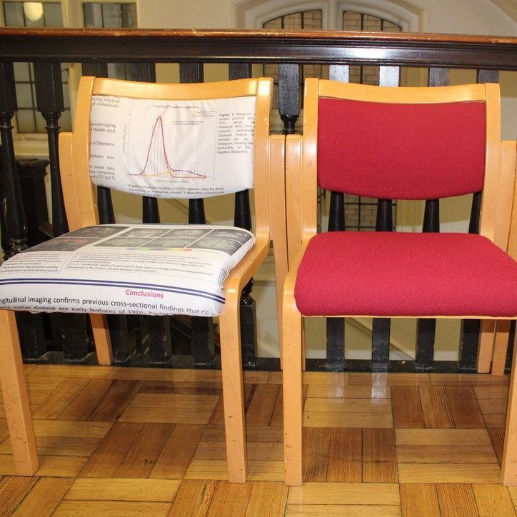
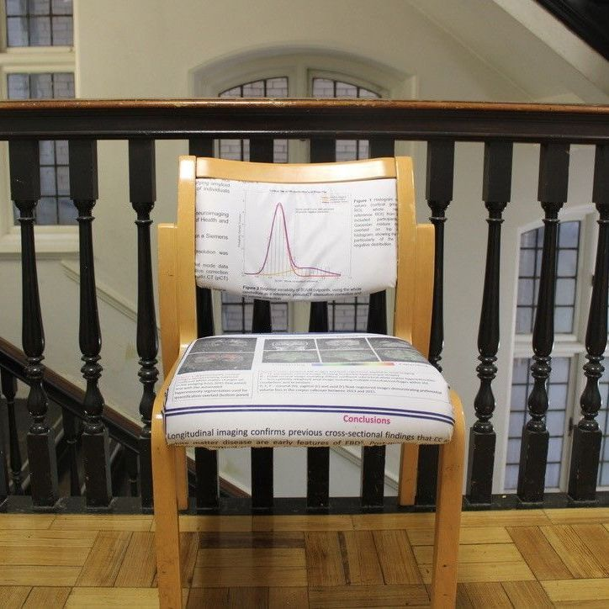
GREEN CASE STUDIES
UPCYCLING
The Dementia Research Centre has found an ingenious way to upcycle office chairs, salvage some old conference banners, and turn a regular piece of furniture into a functional exhibition piece. This was made possible by the Institute of Making who offered the expertise, workshop and tools for replacement of the old chair with a banner that references a past conference, showcasing both their incredible research and adding a sentimental touch. This upcycling provides a good example that we should be considerate of making the most of our possessions, and how must challenge the harmful loop of over-consumption and unnecessary waste.

