Slide 1
Welcome to Queen Square Library
A shared resource between the UCL Queen Square Institute of Neurology and the National Hospital for Neurology and Neurosurgery (UCLH)
Queen Square Library website
www.ucl.ac.uk/ion/library/
neurolibrary@ucl.ac.uk

Slide 2
Accessibility
This presentation is available online as a powerpoint and video on the Queen Square Library website: www.ucl.ac.uk/ion/library/

Slide 3
What do you expect..?
Quiet space ​Books​
Computers​ Reading​
Studying Training​
Librarians ​ Articles​
Help with searching Research​

Slide 4
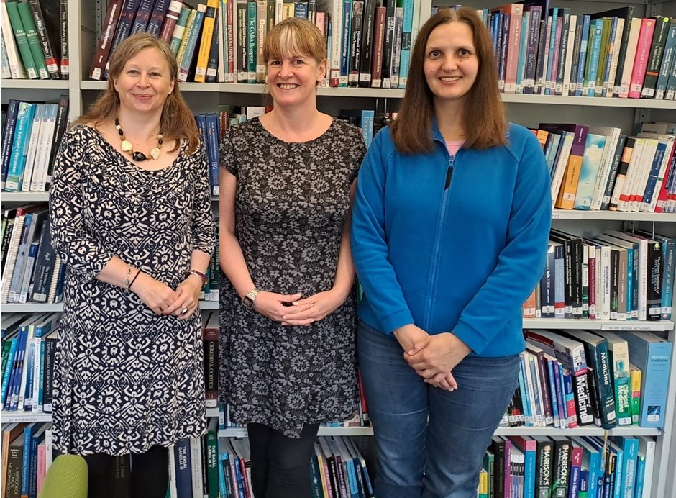
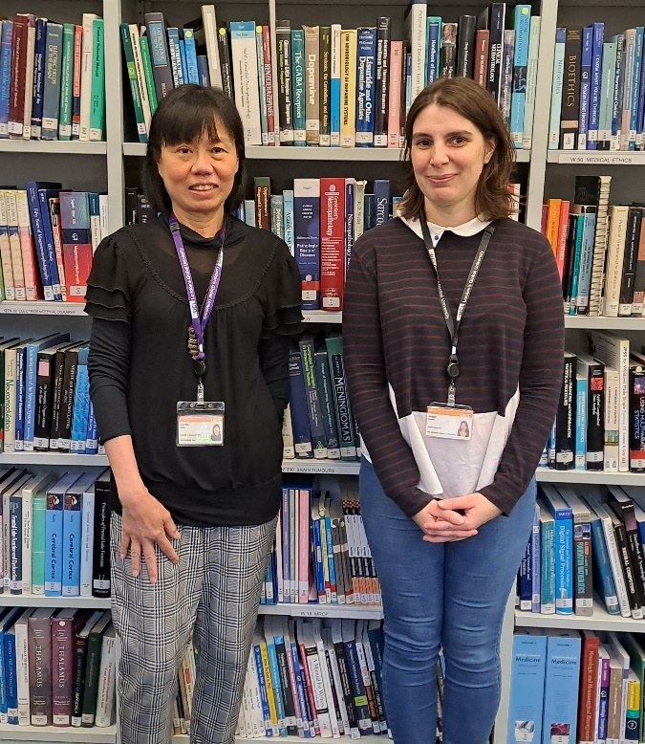
Meet the Queen Square Library team
Sarah, Kate and Urszula Lai Han and Abi
Contact: neurolibrary@ucl.ac.uk

Slide 5
Access to e-resources
NHS OpenAthens:
NHS-purchased databases, ejournals and ebooks;
Register for NHS OpenAthens from a Trust computer or using nhs.net email;
Request form for electronic articles/book chapters licenced to UCL.
Please contact neurolibrary@ucl.ac.uk for further information.

Slide 6
Training and support
Searching databases, finding information & answering your reference enquiries;
Training sessions ranging from a brief introduction through to in-depth training;
Guides on Queen Square Library web site: www.ucl.ac.uk/ion/library
Please email neurolibrary@ucl.ac.uk for further information.

Slide 7
Current awareness and document delivery
Customised email alerts e.g. from KnowledgeShare. ​
Books and articles on inter-library loan e.g. from the British Library.​
Please contact neurolibrary@ucl.ac.uk for further information.

Slide 8
Queen Square Archives
Archives of the National Hospital (mostly 1860-1948):
original case notes;
annual reports and minutes;
1000s of photographs.
Many of these are digitised on the Queen Square Archives website: www.queensquare.org.uk Please contact: neuroarchives@ucl.ac.uk

Slide 9
Print resources and onsite facilities
Print books and journals: Queen Square Library focuses on neurology and neurosurgery. ​
Walk in access to UCL ejournals.​
UCLH computers. ​
Study spaces.​
Printing, photocopying and scanning.
Please complete the online form to register for access to all UCL Libraries www.ucl.ac.uk/library/membership/nhs-library-membership
Please check our website for our latest opening hours.

Slide 10
Library websites
UCL Libraries: www.ucl.ac.uk/library
Queen Square Library: www.ucl.ac.uk/ion/library
full details of all our services, including access to the Library catalogue, links to key databases and patient information.​
UCLH libraries: www.uclh.nhs.uk/libraries
Queen Square Archives: www.queensquare.org.uk

Slide 11
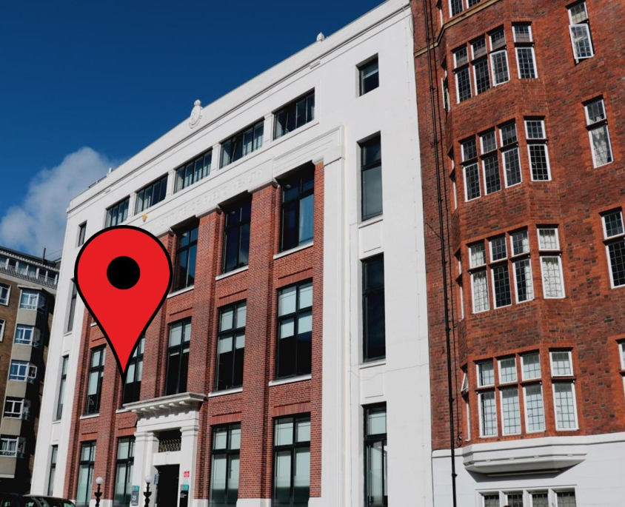
How to contact us
neurolibrary@ucl.ac.uk
1st Floor, 23 Queen Square.
We are usually open Mon-Fri but always check our website for the latest opening hours.
www.ucl.ac.uk/ion/library

