Slide 1
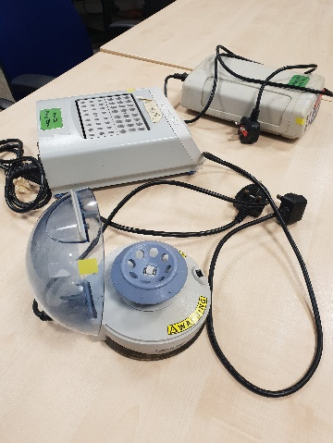
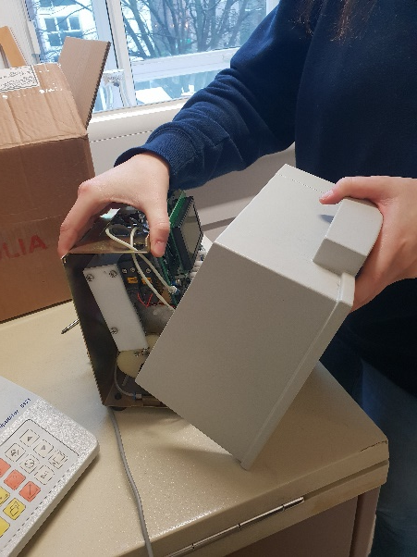
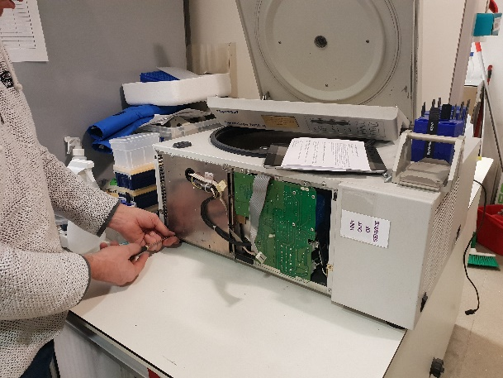
SUSTAINABILITY CASE STUDIES
EQUIPMENT REPAIR WORKSHOPS
A service funded by UCL Sustainability aiming to reduce the unnecessary disposal of easily fixable lab equipment. IoN has held workshops in Wakefield Street and QSH. Labs are welcome to bring faulty electrical lab equipment, e.g. roller, shaker, centrifuge, etc. and get these checked by a team of engineers. They are able to carry out minor repairs straight away and free of charge More workshops to follow in 2020

