Slide 1
Everyone is welcome to participate –
so come and get involved! Contact: Sarah Lawson sarah.lawson@ucl.ac.uk (Office) & Steffy Czieso s.czieso@ucl.ac.uk (Labs)

Slide 2
Meet your IoN Green Team
Labs
IoN Department | Green Lab Reps
DND | Sue Noy, Ayisha Shabbir, Casandra Gomez Paredes, Emma L Bunting, Georgie Lines, Katie Kelly, Rosie Baverstock-West, Sarah Aldous
NMD | Charlotte Spicer, Debbie Hadley, Ellie Rhymes , Jack Belsten, Kim Dhillon, Nana Ghansah, Sergey Novoselov, Shanti A Lu, Stephanie Efthymiou, Valentina I Galassi Deforie
DCMN | Ariana Gatt, Clement Veall, Filipa L Lourenco De Almeida, Georgie Lines, Mark Gaskin, Natalie Woodman, Paul Hammond, Revi Shahar Golan, Rina Bandopadhyay
DCEE | Daman S Rathore, Jenna C Carpenter, Marion S Mercier, Olivia Goff
DRI | Cliona Farrell, Kevin Patrick Williams, Michael P Sheridan, Mireia Mato Prado
Imaging/ 12QS | Barbara Dymerska, Christian P Lambert, Clive Negus, Daniel Bates, Jamahl Holland, Madeleine Scott, Ric Davis
NMD Cruciform | Charu Reddy, Lorenza Magno, Susannah Baird
BRR – Spinal Repair | Daqing Li, Kamile Minkelyte
Offices
IoN Department | Green Office Reps
BRR | Judith Jolleys, Amy Gent (RSH)
DCEE | Joe Willis (33QS), Liam Trench (Ormond House)
DCMN | Riona Fumi (33QS)
Imaging | Barbara Dymerska (12QS)
DND | Lloyd Prosser (DRC), Coral Brown (QSH)
NMD | Debbie Hadley (QSH)
7 & 23 Queen Square | Angela Alton, Oksana Shapoval, Samantha Robinson, Sarah Lawson, Sandra Porteous
UK DRI | Amber Simpson, Mireia Mata Prado (33QS)
Neuroinflammation | Judith Jolleys, Heather Ormsby (RSH)
If you would like to join the Team, contact s.Czieso@ucl.ac.uk or sarah.lawson@ucl.ac.uk

Slide 3
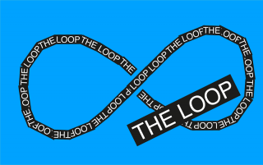
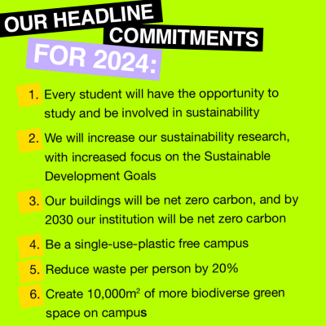
Check out the UCL Sustainability web page
www.ucl.ac.uk/sustainable/ offers useful information on what UCL is doing and how you can get involved. The website provides material and resources, case studies, advice on sustainable catering and a list of contacts for help and support!

Slide 4
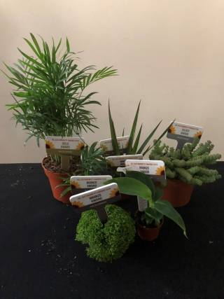
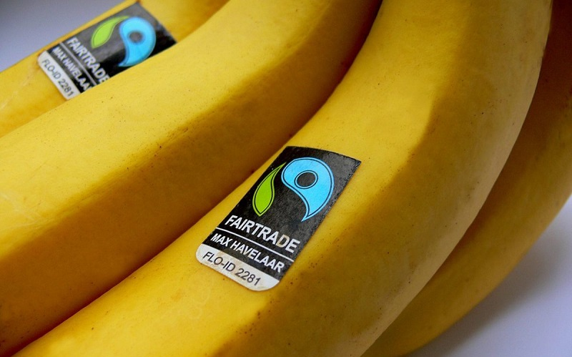
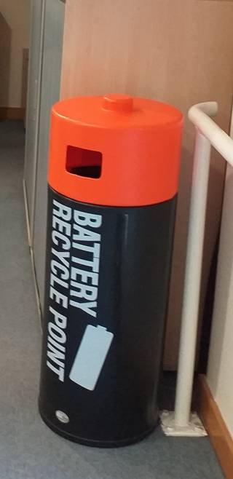
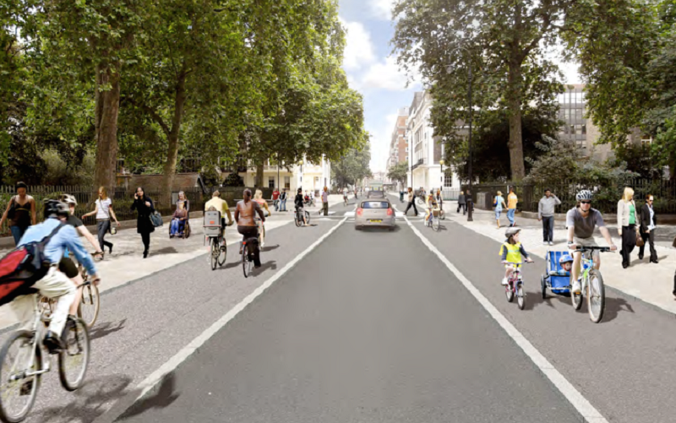
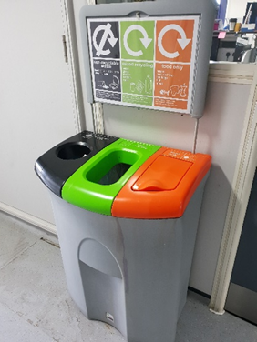
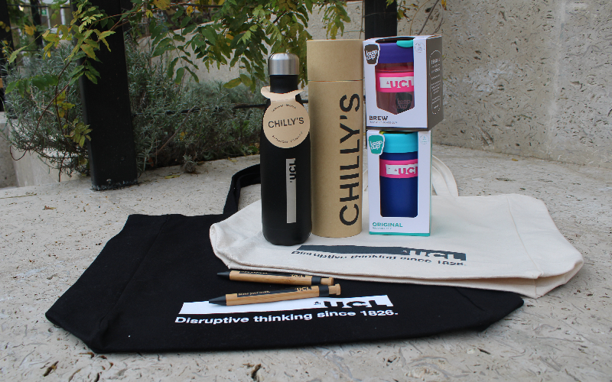
What You Can Do – Office Resources
Take part in UCL big switch offs
Ditch the disposable
Use recycled paper & double sided printing
Buy Fairtrade
Grow plants
Follow UCL heating and cooling policy
Promote sustainable travel
Use WARP-It and recycle
More ideas in the IoN Office sustainability reference guide!

Slide 5
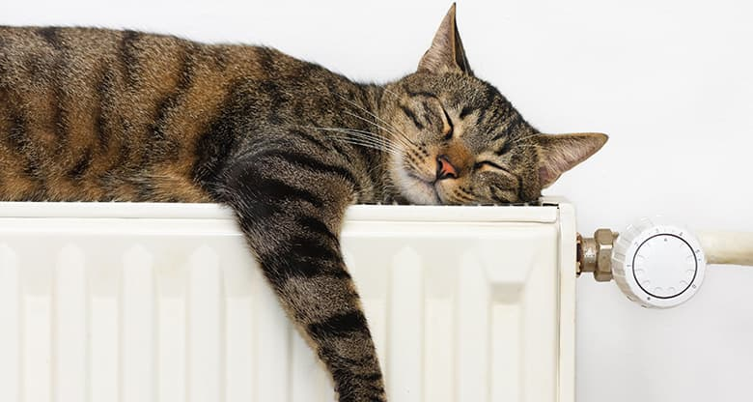
What You Can Do – Working from Home
Switch to a green energy provider
Adjust your Thermostat
Unplug devices as much as possible
Use Eco-Friendly Office Supplies
Save bandwidth (and energy) by blurring your background in Teams calls
Use the optimal energy saving settings on your computer
Use sustainable search engines such as ECOSIA

Slide 6
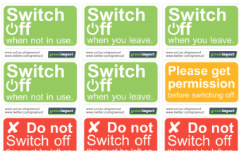
What You Can Do – Lab Resources
FUME CUPBOARDS
What can you do?
Close your fume cupboard sash.
This can save thousands per year!
Turn down/off if allowed
REPORT maintenance issues
to ESTATES using the Estates
Service Request Form
https://www.ucl.ac.uk/estates/
Switch off equipment
that is not in use!

Slide 7
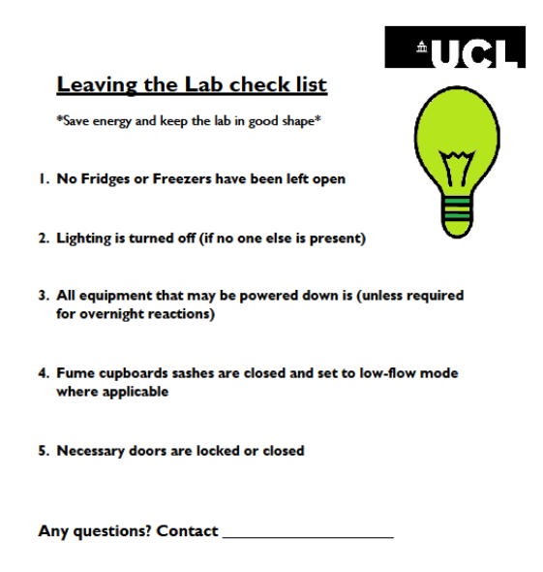
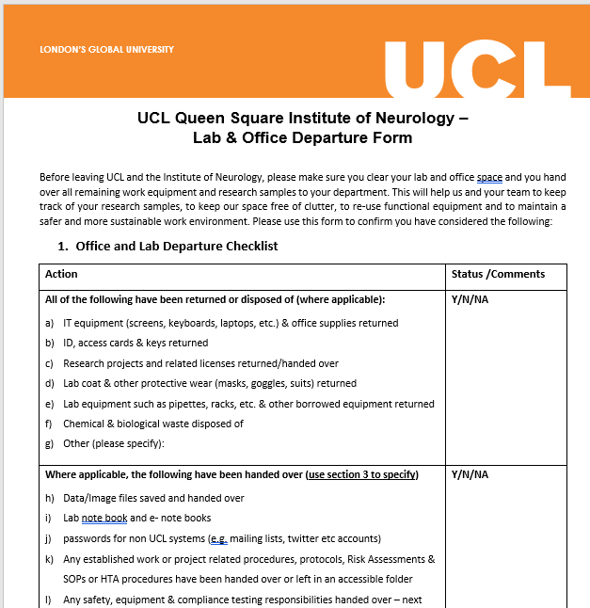
What You Can Do – Lab Resources
Use the IoN Lab and Office departure checklist
To make sure functional items can be re-used by others and your freezer samples are archived or disposed before you leave IoN.
ALL IoN departments
are participating in LEAF!
LEAF is a standard in sustainable science and contains Bronze, Silver, and Gold criteria covering a range of Improvements. LEAF has calculators to help you estimate your savings in ££ & tonnes of CO2.
Get in touch with the IoN green team for advice!
Use the ‘Leaving the Lab checklist’
Daily before leaving work
All resources can be found on the UCL
Sustainability/Resources Website

Slide 8
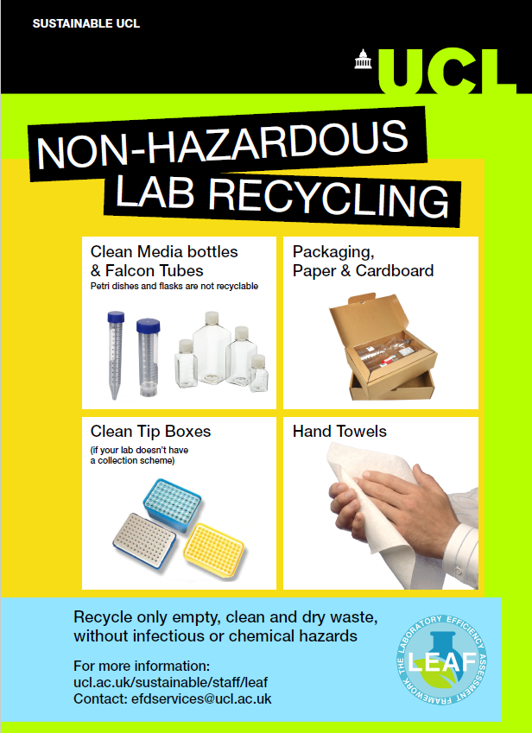
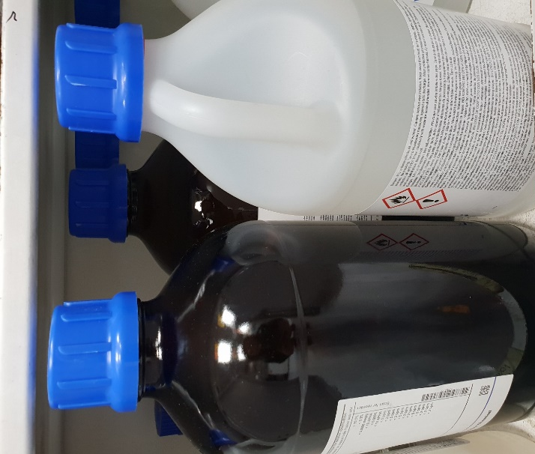
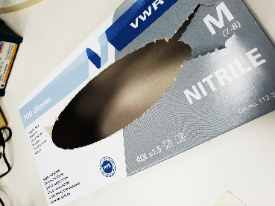
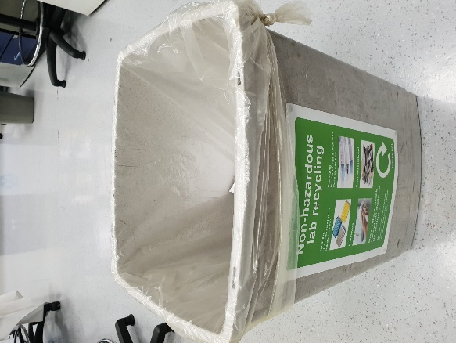
What You Can Do – Lab Waste
Uncontaminated/non-hazardous waste like packaging, empty glove boxes and hand paper towel should go into recycling, not clinical waste!
Did you Know?
Empty plastic and glass solvent bottles can go into normal recycling waste if fully evaporated, rinsed and with the label crossed out !

Slide 9
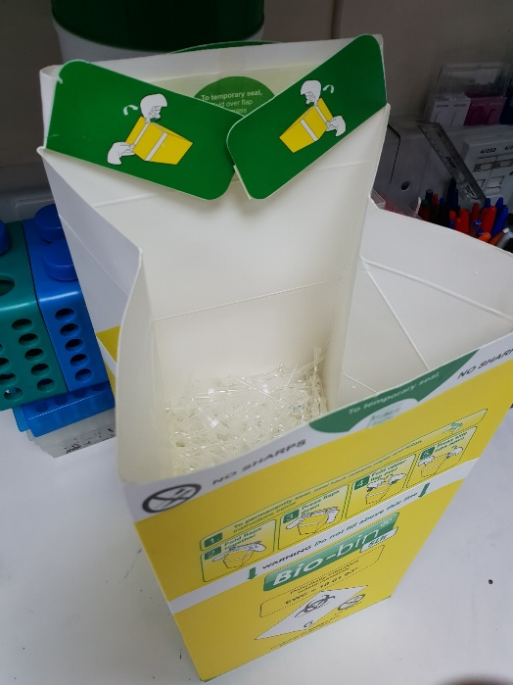
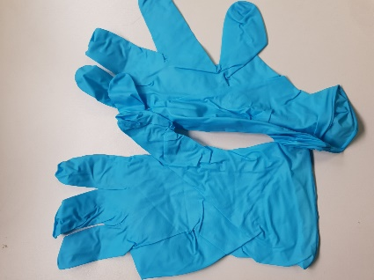
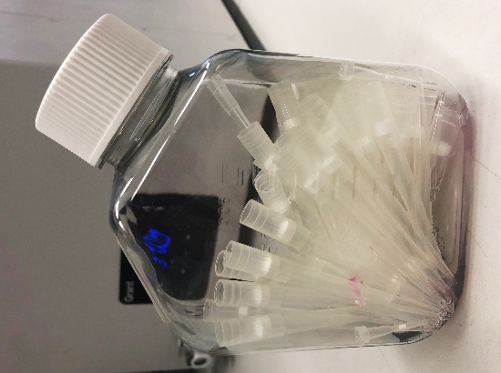
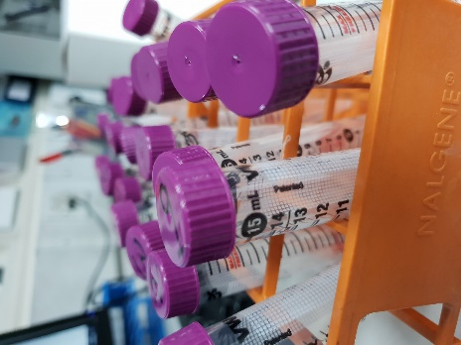
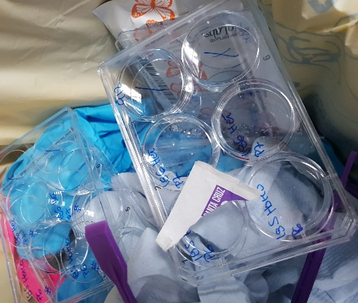
What You Can Do – Lab Waste
Only potentially contaminated or
hazardous lab waste like gloves,
sample tubes & dishes should go
into yellow clinical bins
Pointy pipette tips should go into
robust Bio-Bins or you might want to recycle your used media bottles
Did you Know?
None of UCL’s waste goes to landfill. 60% of waste is recycled, yellow clinical bins go for high temperature incineration with energy recovery!

Slide 10
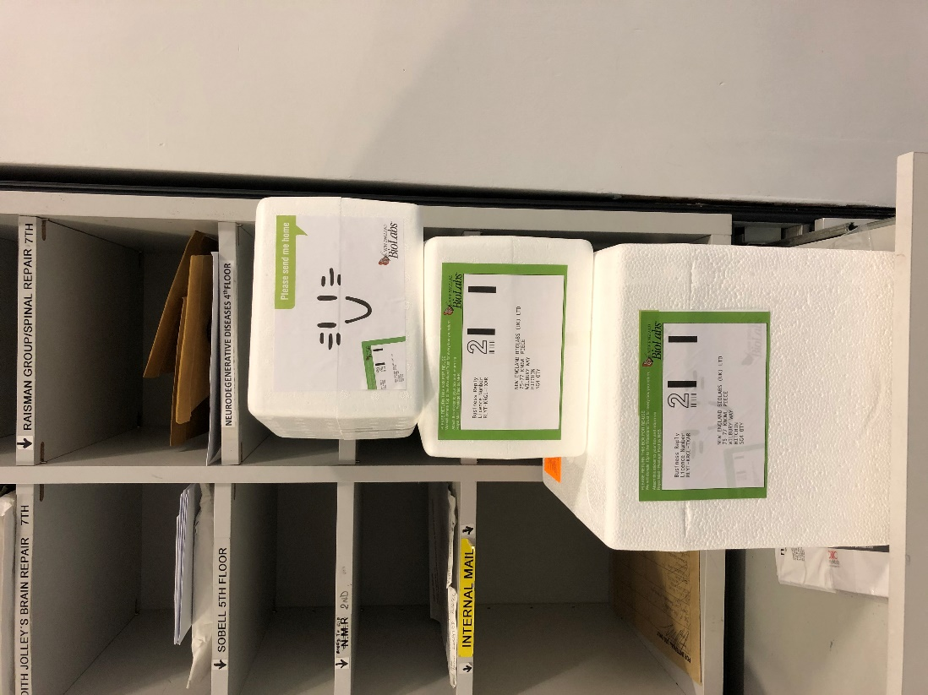
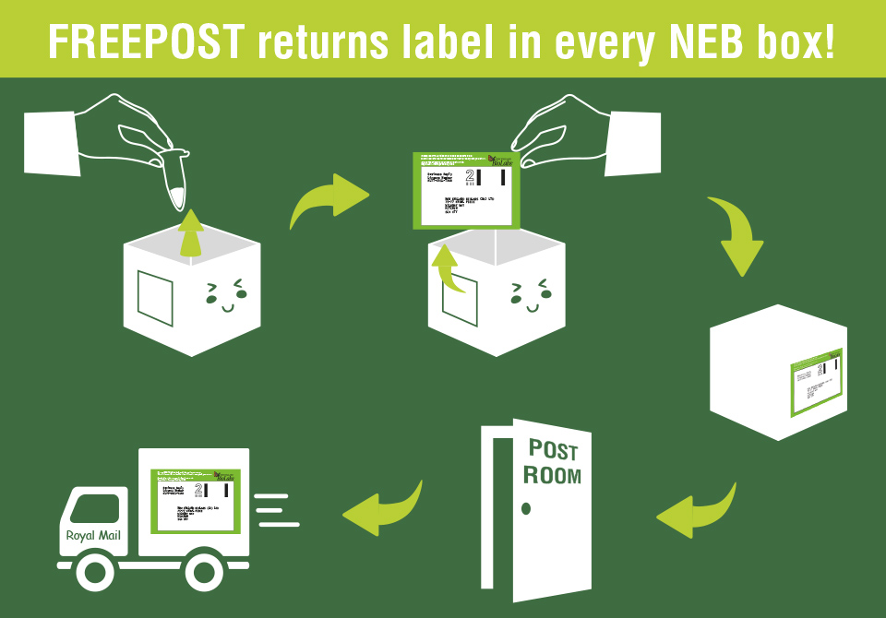
What You Can Do – Lab Waste
NEB and Promega offer free Polystyrene box returns!
All boxes have a pre-paid address label that can be
used to post the polystyrene boxes back to the company.

Slide 11
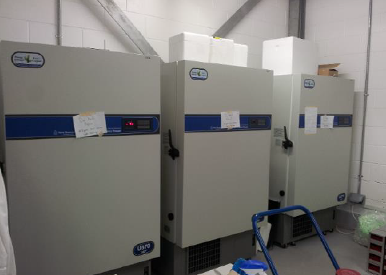
What You Can Do – Freezers
Switch your -80°C Freezers to -70°C!
Other things you can do to make your freezer more sustainable:
Regular freezer maintenance/defrosting
Clean filters
Monitor sample storage/use the IoN departure checklist
Did you Know?
-80°C will consume 25-30% more energy per unit when compared to -70°C

Slide 12
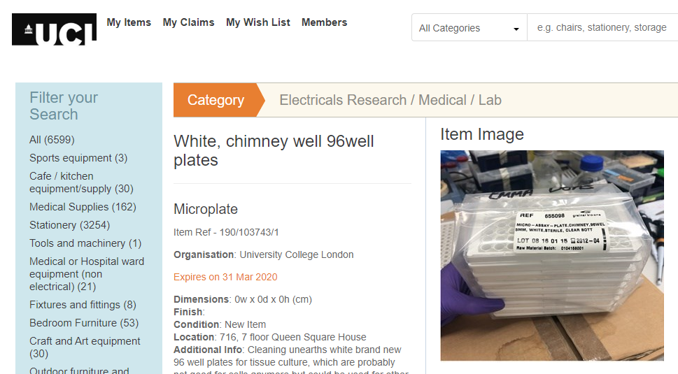
What You Can Do – Use Warp-It
WARP-IT is an online platform which allows staff to freely trade items which
otherwise may be disposed of.
If you require any new furniture, lab equipment/consumables, or have any usable items you
would like to dispose of, consider using Warp-It!
You can register or log into Warp-It at:
www.warp-it.co.uk/company/ucl
Speak to your IoN green team for advice.

Slide 13
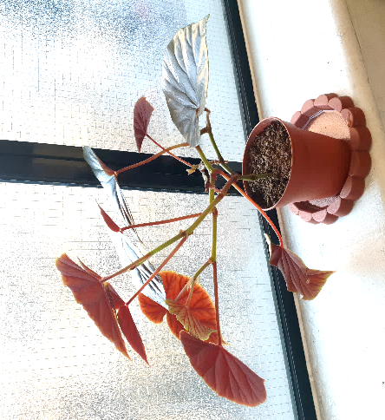
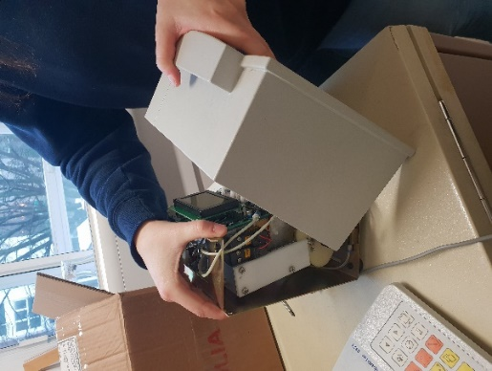
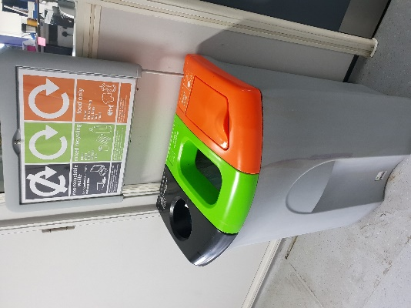
What ION is doing
ION Pledges
All of our events will now be vegetarian catering and we avoid plastic water bottles
Achieve Green Impact Gold Office Award
Organise an IoN green day
Co-ordinate an IoN wide LEAF group
Make waste and sustainability part of the IoN Labs induction
Set up a Lab equipment repair service for IoN buildings
Introduce the Sustainable Travel Policy

Slide 14
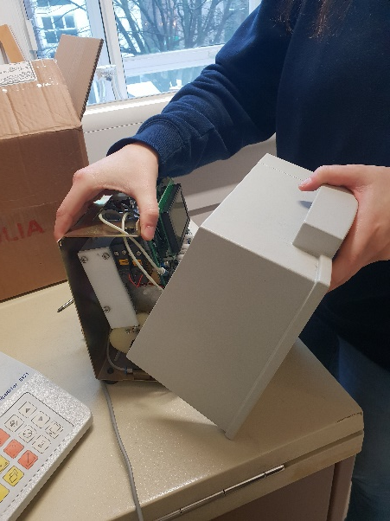
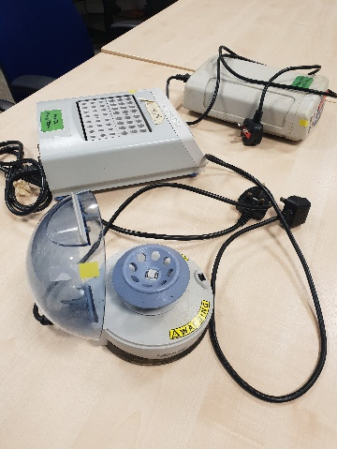
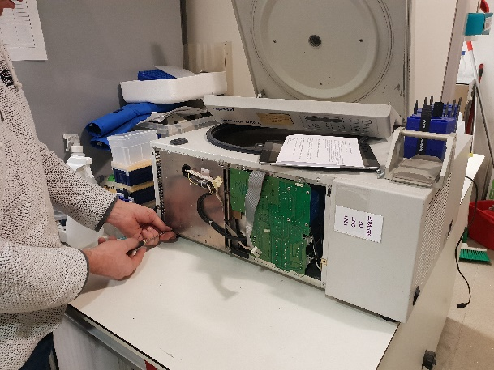
What ION is doing
Sustainability Awards 2023
Equipment Repair Workshop
In 2019 we had our first
IoN equipment repair workshop at 1 Wakefield with QSH to follow in July 2022. A service
funded by UCL Sustainability and IoN, aiming to reduce the unnecessary disposal of easily fixable lab equipment.
ION Labs and offices are participating in LEAF and Green Impact for a number of years. The 2023 winners are:
3 | Award
IoN offices & Library | Gold (Green Impact)
IoN DRC offices | Gold (Green Impact)
NMD | Gold (LEAF)
DND | Gold (LEAF)
DCEE | Gold (LEAF)
DRI | Gold (LEAF)
BRR- Spinal Repair Unit | Gold (LEAF)
DCMN | Gold (LEAF)
NMD-Cruciform Building | Gold (LEAF)
Imaging Neuroscience | Gold (LEAF)

Slide 15
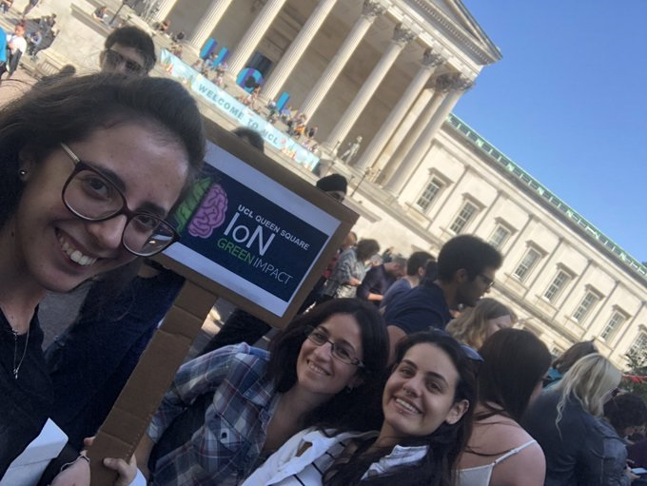
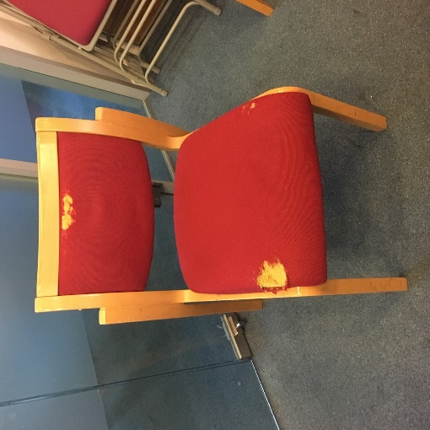
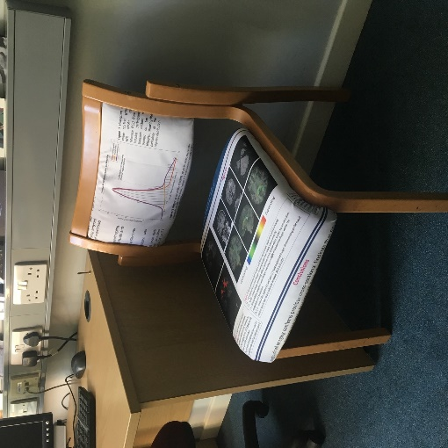
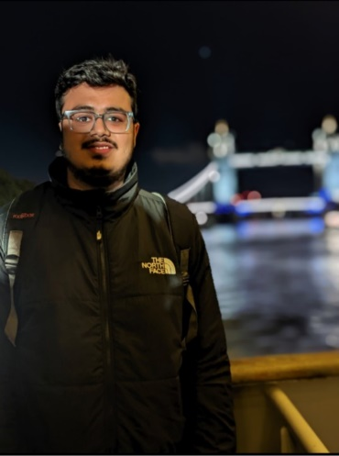
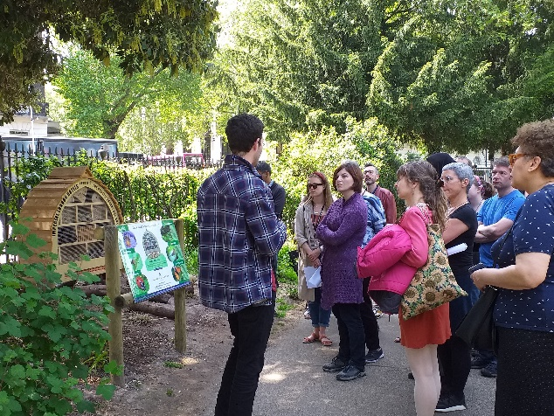
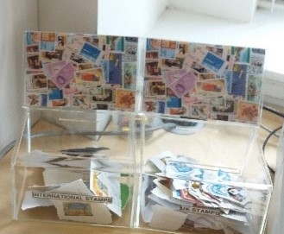
What IoN has done
What ION is doing
Strike:
Upholstering:
Student Sustainability Ambassador: Shashwat Guha (MSc Clinical Neuroscience)
Members of the green team
Participating in UCL climate strikes
The Dementia Research Centre (DRC) create fabric versions
of posters which can be re-used - including to re-upholster
chairs (fabric posters from Science Direct;
upholstery training by UCL Institute of Making)
Bird Walks:
Organised series of Bird walks with
(UCL Conservation Society)
Stamp collection for RNIB:
in co-ordination with UCL Libraries
Know your Campus: facilities map for ION students

Slide 16
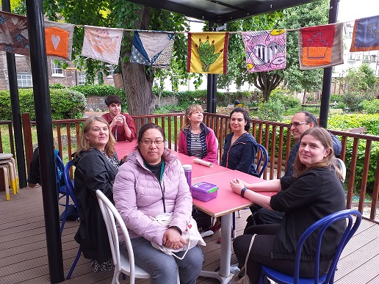
What ION is doing
Recycling:
We put up a lot more recycle
bins in labs and offices
IoN has introduced the sustainable travel policy:
effective 15th February 2022: air travel for all UK-based business travel and any business travel to Northern Europe that is supported by Eurostar/ train links will no longer be reimbursed or permitted.
Wild Bloomsbury Walk & Lunch:
ION Green Teams and Wellbeing Champions walk through Brunswick Square, St George’s Gardens, finishing with a picnic lunch in Calthorpe gardens
12 Queen Square –
Imaging Neuroscience
Queen Square House

Slide 17
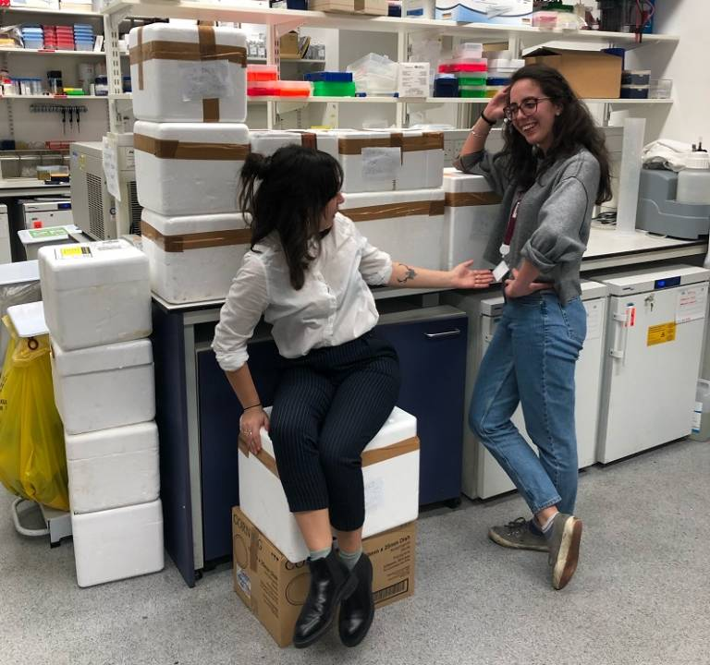
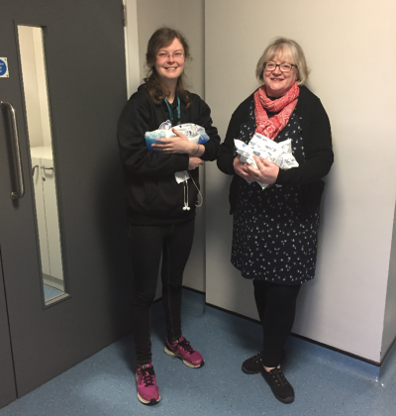
What IoN has done
What ION is doing
UCL Sustainability – Case Study
Ice Pack Reuse in Laboratories – New Solutions Needed
Read more about how labs at IoN are trying to get ice packs recycled
on the UCL Sustainability web page:
https://www.ucl.ac.uk/sustainable/case-studies/2020/jan/ice-pack-reuse-laboratories-new-solutions-needed

Slide 18
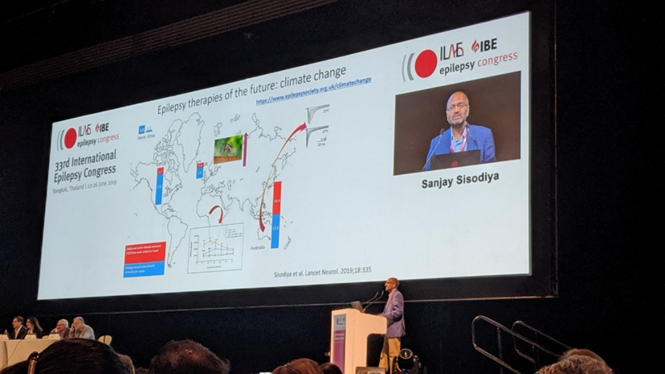
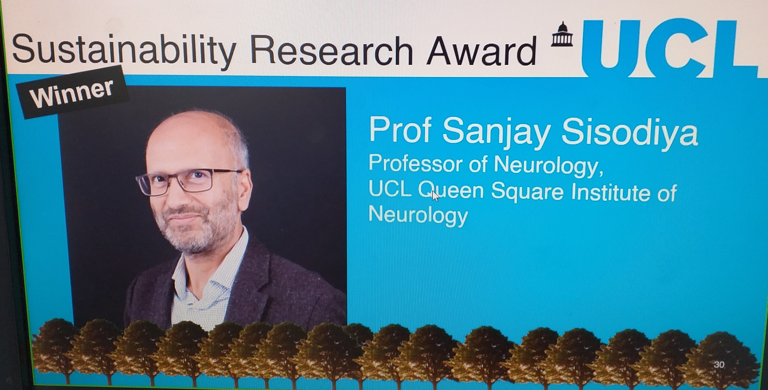
What IoN has done
What ION is doing
EpilepsyClimateChange
Professor Sanjay Sisodiya is co-ordinating investigations of the impact of climate change on people with neurological conditions. To address these issues, Professor Sisodiya established a consortium of neurologists, scientists, epilepsy nurses, representatives from industry and charities supporting people with epilepsy, called Epilepsy Climate Change

Slide 19
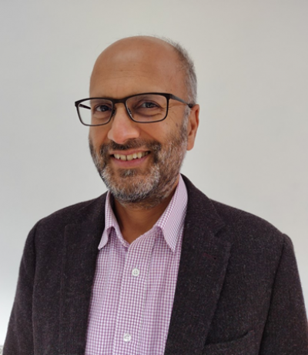
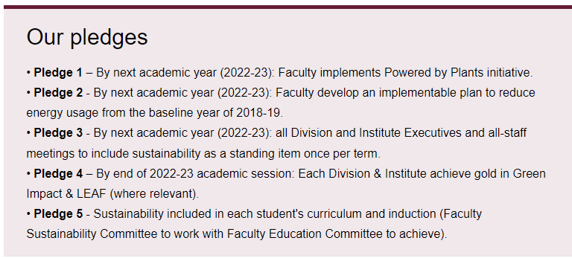
Senior Level Support
The Faculty of Brain Sciences has launched a Faculty Sustainability Committee
https://www.ucl.ac.uk/brain-sciences/about-faculty/sustainability
IoN appoints Deputy Director for Sustainability
Sanjay Sisodiya
https://www.ucl.ac.uk/ion/intranet/green-impact

Slide 20
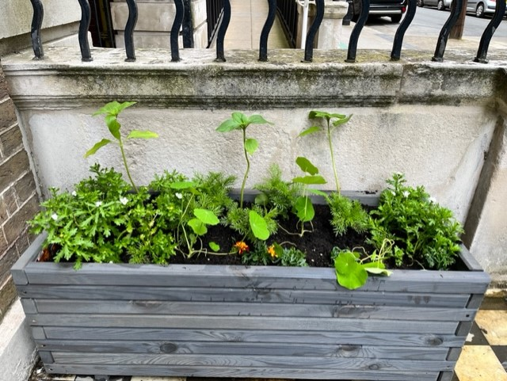
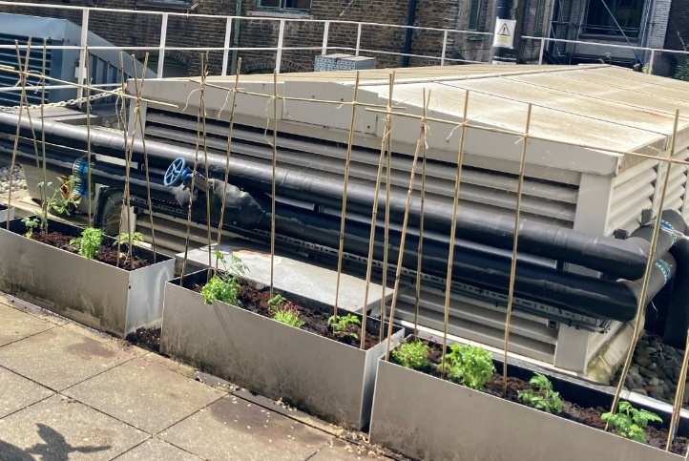
What ION is doing
Achievements in 2023 include:
Hot Brain climate conference May 2023;
Digital Detox campaign by Student Ambassador;
New planter outside 7 Queen Square;
Vegetable patch at 12 Queen Square;
Mental Health Awareness Week walk with Wellbeing Champions.

Slide 21
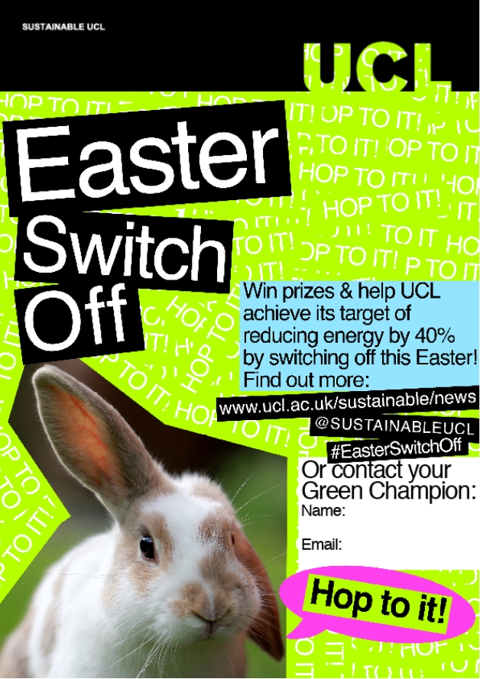
What IoN has done
Easter and Christmas Switch-Off
… don’t forget to participate in UCL’s big Holiday Switch-Offs!
Easter and Christmas Switch-Off Resources such as posters & checklists can be found on UCL’s Sustainability web page:
https://www.ucl.ac.uk/sustainable/easter-switch-resources
https://www.ucl.ac.uk/sustainable/christmas-switch-resources

Slide 22
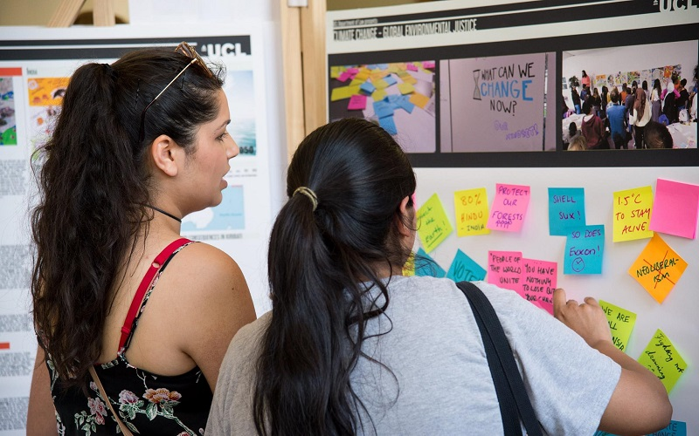
What IoN has done
Contacts
Help and Support
UCL Sustainability website www.ucl.ac.uk/sustainable/
IoN website and intranet www.ucl.ac.uk/ion/sustainabillity
If you are interested in getting involved, please contact :
IoN's Green Office Champion: sarah.lawson@ucl.ac.uk
IoN's Green Labs Champion: Steffy Czieso s.czieso@ucl.ac.uk

