Slide 1
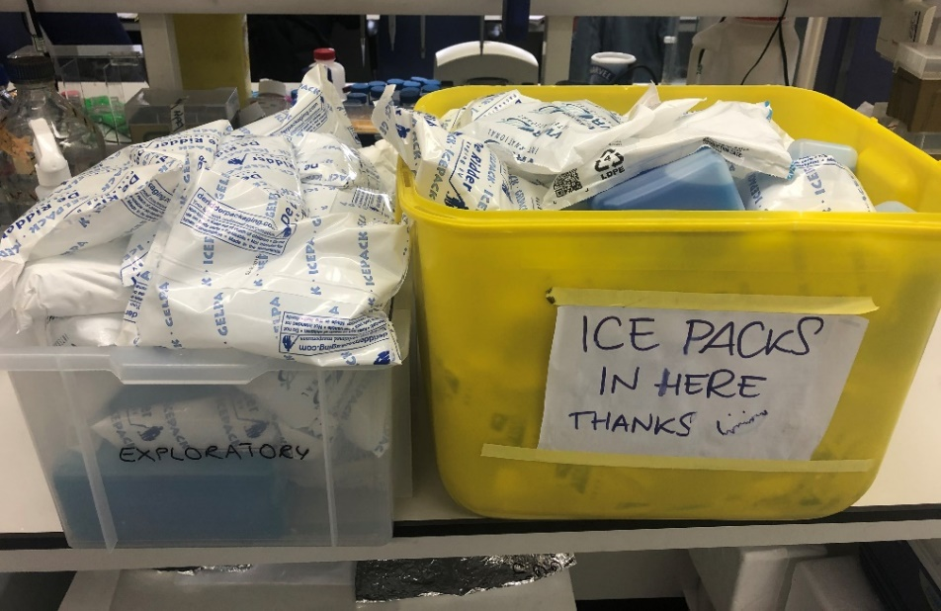
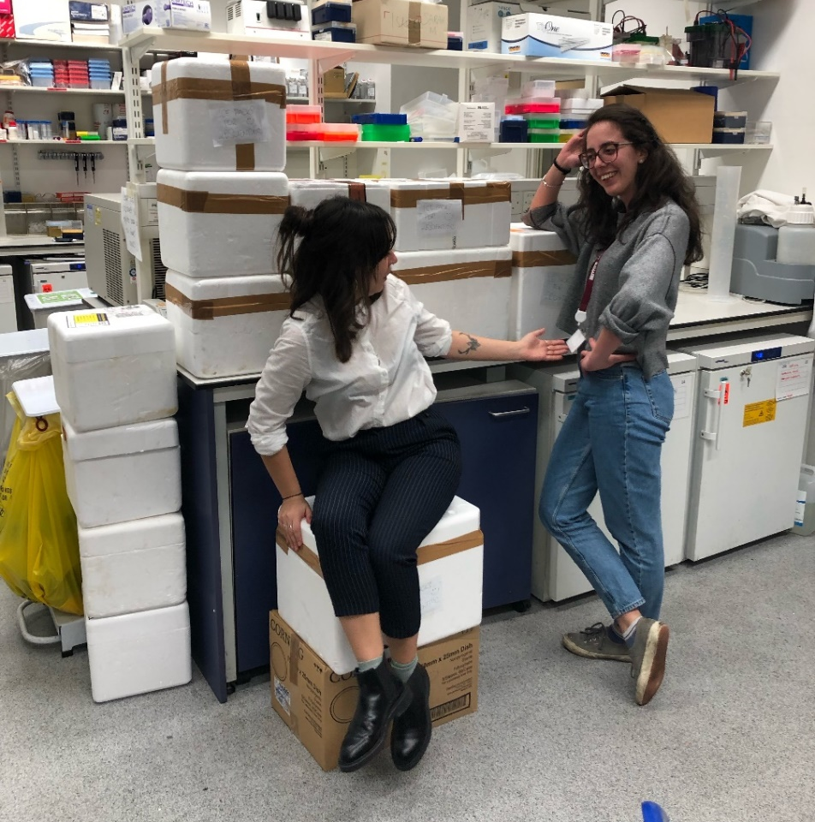
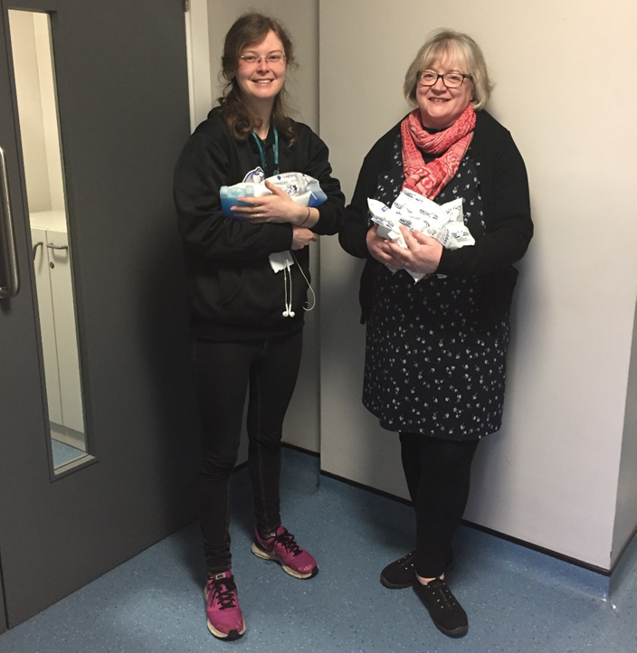
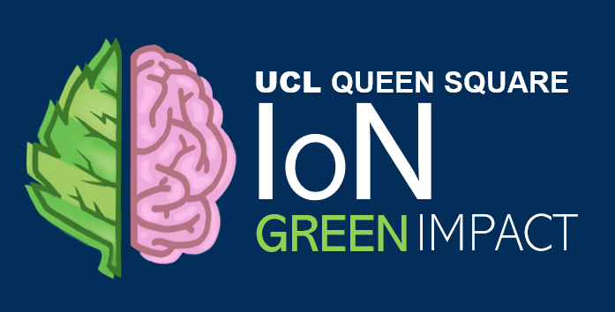
SUSTAINABILITY CASE STUDIES
ICE PACK RECYCLING
Labs at the Institute of Neurology receive lots of deliveries every day, often with excess ice packs. These are difficult to recycle and mostly end up in clinical waste. A small company, 2B Scientific, set up an ice pack take-back reuse scheme, which many labs in IoN gladly took part in. We quickly collected more than 35 kg of ice packs in a couple of months! Unfortunately, the company was not able to keep up with the volume of returns and discontinued the scheme. The success of the scheme shows how much we want and need a solution for the excess packaging we receive every day. We are challenging suppliers to provide better ways to deliver reagents but are constantly looking for new ways to reuse the ice packs. Get in touch with us if you have any ideas! ☺

