Slide 1
Queen Square Library
A short history

Slide 2
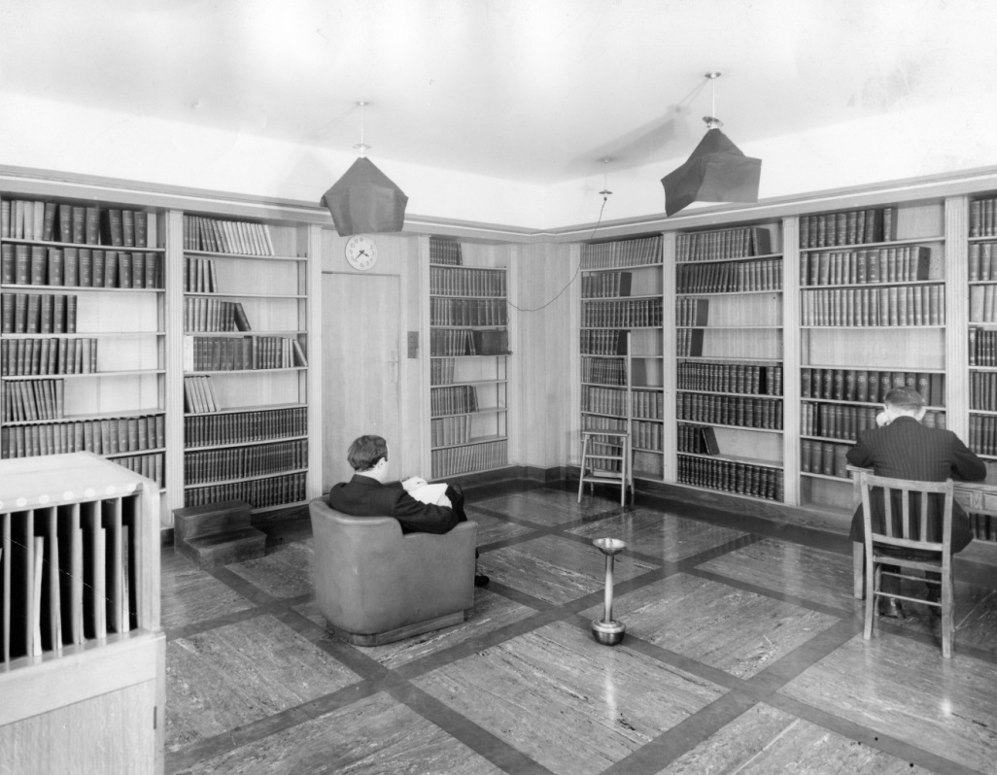
There are printed records mentioning the existence of an established medical library at Queen Square as early as the National Hospital’s Annual Report of 1923.

Slide 3
To honour the Foundation that contributed to the substantial cost of its building, the Institute decided that the Library should be called the Rockefeller Library.

Slide 4
It was not until 1956 when the name “Rockefeller Library” started to be used officially.

Slide 5
In the early years, the Library was located in Alexandra House.

Slide 6
In 1980 the Library moved to its current accommodation on the 1st floor of 23 Queen Square.

Slide 7
In 1982 the Hallpike family donated the funds to build an additional room.

Slide 8
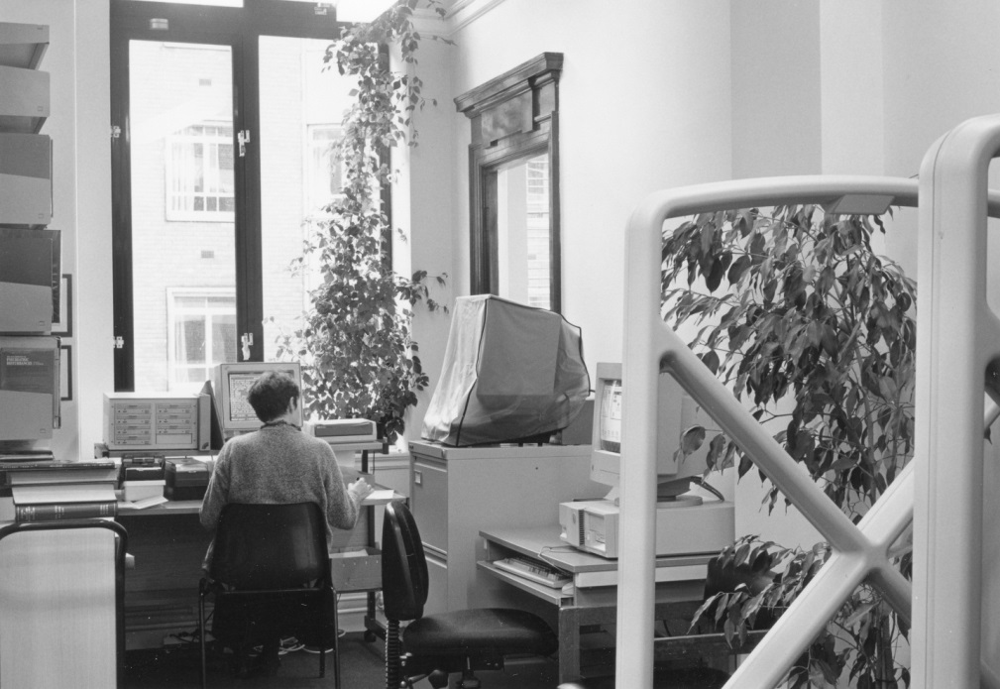
In 1995 the Library underwent a first refurbishment during which several partitions were removed, a security system was installed and more shelf space was created.

Slide 9
In December 2009 the Library temporarily relocated into a corner of CAMLIS (Complementary and Alternative Medicine Library and Information Service) during a major redesign and refurbishment project.

Slide 10
This project was generously supported by the Brain Research Trust and the National Brain Appeal.

Slide 11
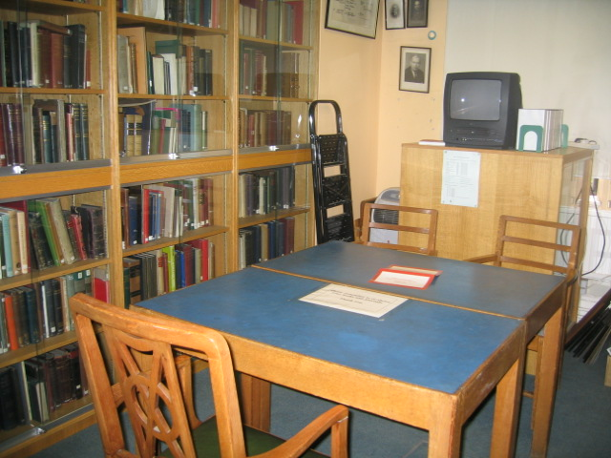
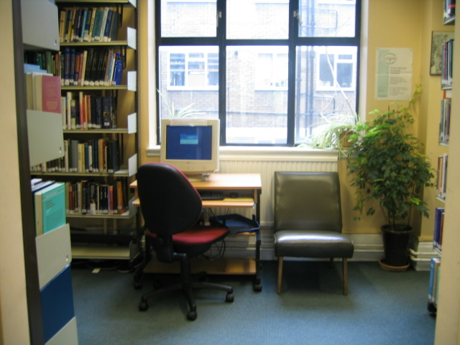
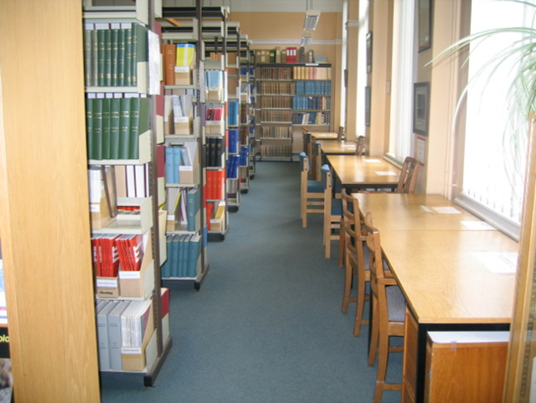
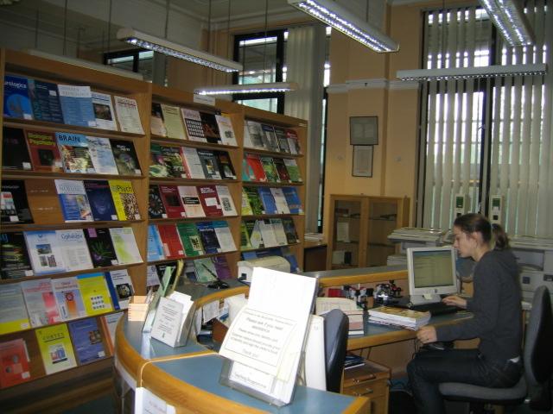
Library pre-2009/10 refurb
Notes:
Improved storage & access.
Previously: cramped space, very basic (not very effective) aircon, difficult retrieval (distant from the staff desk), no dedicated area to view items

Slide 12
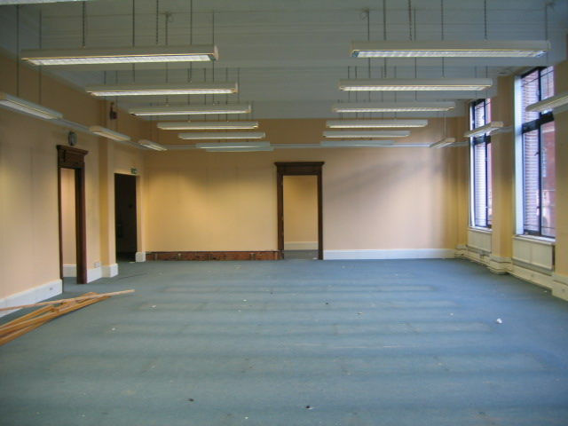
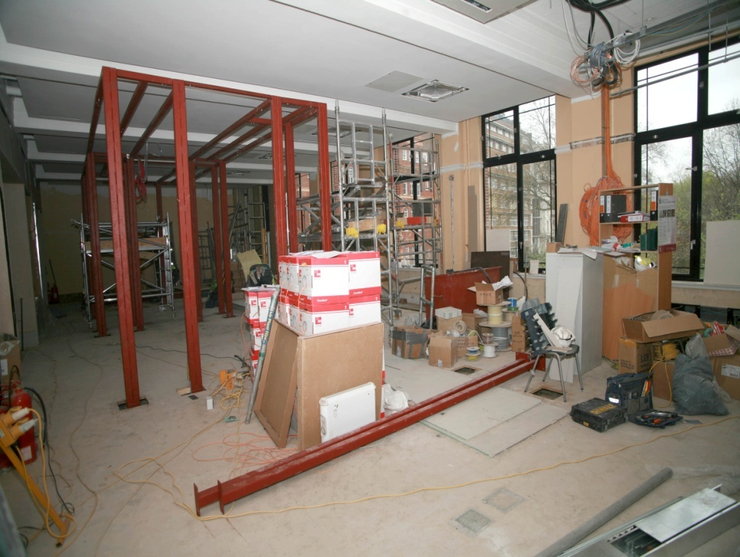
Building work…ng…

Slide 13
Re-opening June 2010
On time and on budget
A home to house and display the archive and museum collections
An IT training suite for hands-on information skills training
More PCs, including increased access to UCLH intranet and electronic resources
Greater variety of study spaces for library users
Increased library staff space, including a desk for each member of staff

Slide 14
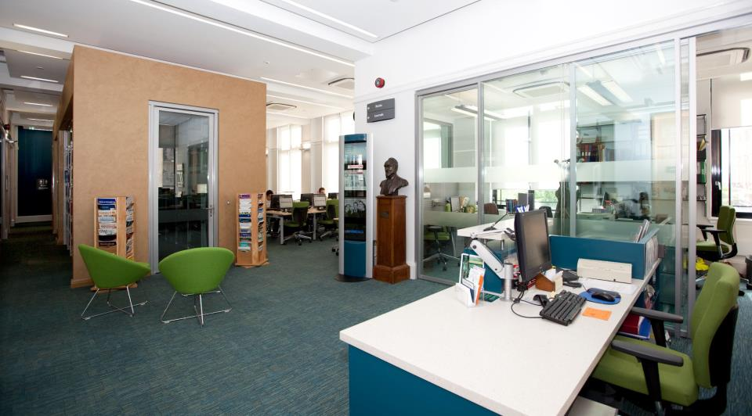
The new layout and facilities have been of tremendous benefit to all staff at Queen Square and have helped to further promote the Queen Square brand internationally.

Slide 15
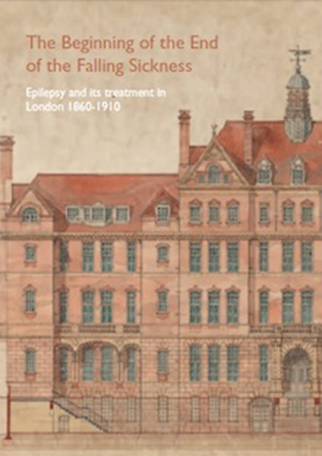
Since re-opening….
Exhibitions, including: 150th Anniversary exhibition on founding and early years of hospital (2010) and Epilepsy exhibition at 10th European Congress on Epileptology (2012)
The Library is renamed the “Queen Square Library” (2011)
Successful Wellcome (Research Resources in Medical History) bid - £83,000 to preserve and catalogue collections (2011)
Launch of Queen Square Archive website (2011)
NHS Library Quality Assurance Framework (LQAF)
Innovation awards (2010)
Introduction of new services:
information skills training programme
archives enquiry service

Slide 16
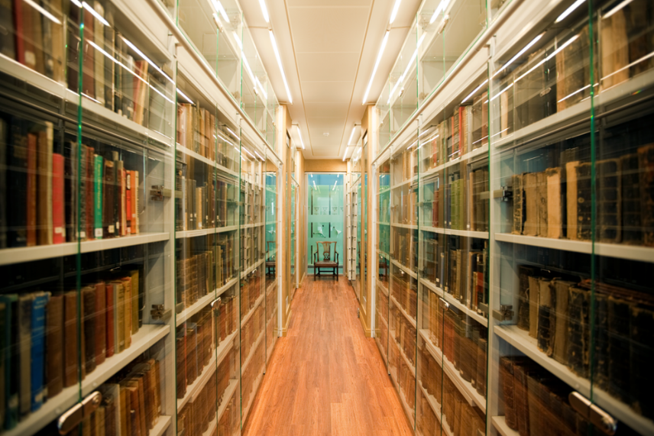
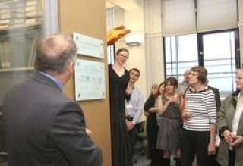
In June 2015 the Queen Square Library marked the 5th anniversary of the reopening by renaming the Archive pod – which houses approximately 3,000 rare and classic books dating from 1598 to the 1970’s.

Slide 17
The Archive pod is now known as the Louise Shepherd Room. A commemorative plaque is dedicated to Louise who was librarian at Queen Square library from 1993 to 2012.

Slide 18
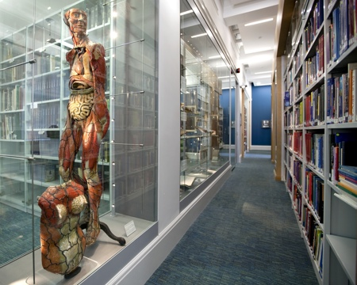
Queen Square Archives
NHNN case notes 1863-1946
Extensive administrative records for NHNN from 1859 – 1948.
Queen Square Archives also includes unpublished papers, lectures, events ephemera, 5000 photographs, objects including framed photographs and paintings, medical equipment, plaques, certificates

Slide 19
Archives Usage
a wide variety of internal and external users, from family history researchers, to returning groups of international students, to authors of the Queen Square history book launched in the Library in 2018
500 image requests, 30,000 page views, 300 items are consulted onsite each year
We have recently hosted several UCL research projects , including hysterical epilepsy, encephalitis and Parkinsons Disease.
“Being able to have direct access to the records … provided an unforgettably enriching experience for my students.
..The material held in the Queen Square Archives contains information that is most relevant to any modern understanding of what constitutes madness and its treatment”
Rik Seefeldt, University of Wisconsin-River Falls
“the most detailed source we have from a single hospital treating shell shock cases during the war” Dr Stefanie Linden, Author of They Called it Shell Shock

Slide 20
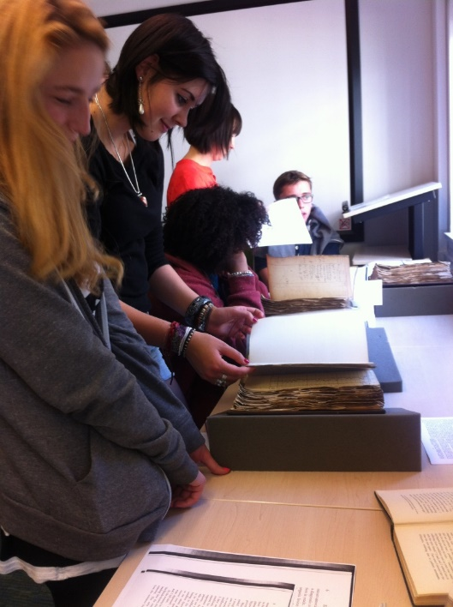
Public engagement
Queen Square Archives have an active online and onsite display programme, including hosting artist collaborations, and discussions with UCL Head of Public Art over QS Archive displays at the Grays Inn Road site.
The First World War collection of case notes has featured in several BBC TV and radio documentaries, numerous research papers and books and an international event in 2023 (https://queensquare.org.uk/archives/interesting/shell-shocked)
a brief history of NHNN video – requested by Camden Local Studies and Archives
virtual content on @neurolib in line with Explore your Archive themes

Slide 21
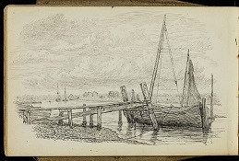
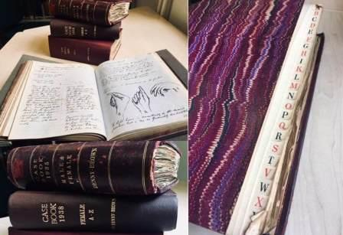
Digitisation and indexing
A hand written index of 1500 volumes of patient case notes has been transcribed into a database. Gowers’ case notes from the 19th century and WW1 case notes have been digitised
Approximately 3000 photographs have been digitised and are available on the Queen Square Archives website by browsing digitised images;
Annual Reports and Board of Management minutes from 1859-1948 have been digitised. All Annual Reports and Minutes from 1926 are also available as searchable collections
Other digitised items include: Medical staff employment records, National Hospital plans, Gowers lectures, Hughlings Jackson papers, Gowers drawings and sketchbooks.
Over 400 of our 19th Century Rare Books have been digitised and made available online as part of the UK Medical Heritage Library digitisation project

