Slide 1
QSBB work experience event feedback
Friday, August 07, 2020

Slide 2
280
Total Responses
Date Created: Saturday, July 18, 2020
Complete Responses: 280

Slide 3
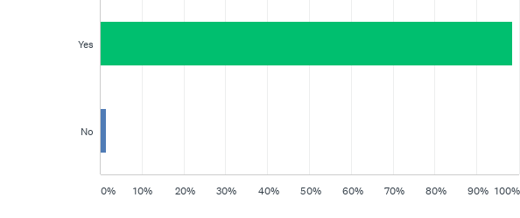
Q2: Do you believe the QSBB event helped you towards achieving your goal?
Answered: 276 Skipped: 4

Slide 4
Q2: Do you believe the QSBB event helped you towards achieving your goal?
Answered: 276 Skipped: 4

Slide 5
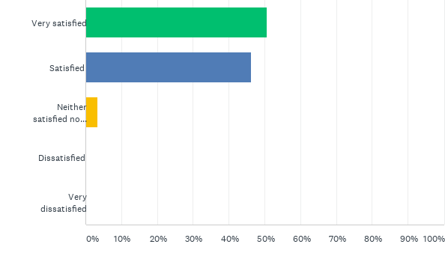
Q3: How satisfied were you with the event?
Answered: 277 Skipped: 3

Slide 6
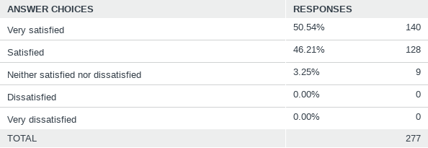
Q3: How satisfied were you with the event?
Answered: 277 Skipped: 3

Slide 7
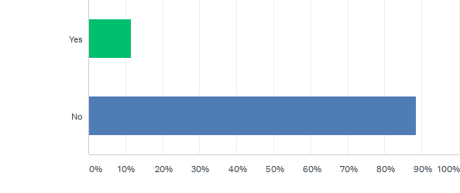
Q6: Did you observe or hear of something that you would have liked to be included in our programme but which was not offered to you? (please explain why you would have liked this included).
Answered: 279 Skipped: 1

Slide 8
Q6: Did you observe or hear of something that you would have liked to be included in our programme but which was not offered to you? (please explain why you would have liked this included).
Answered: 279 Skipped: 1

Slide 9
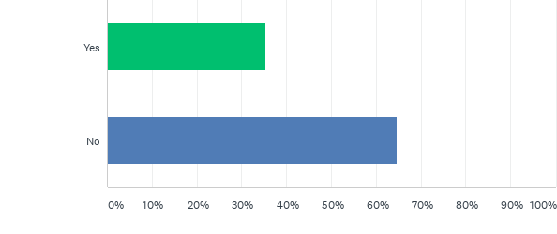
Q7: Were any elements of the programme presented in a manner too complex/difficult to understand, or overly simplified?
Answered: 277 Skipped: 3

Slide 10
Q7: Were any elements of the programme presented in a manner too complex/difficult to understand, or overly simplified?
Answered: 277 Skipped: 3

Slide 11
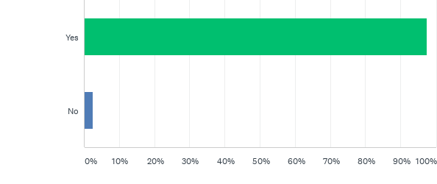
Q8: This is the first time we have held work experience as a virtual event. Do you think this worked well?
Answered: 279 Skipped: 1

Slide 12
Q8: This is the first time we have held work experience as a virtual event. Do you think this worked well?
Answered: 279 Skipped: 1

Slide 13
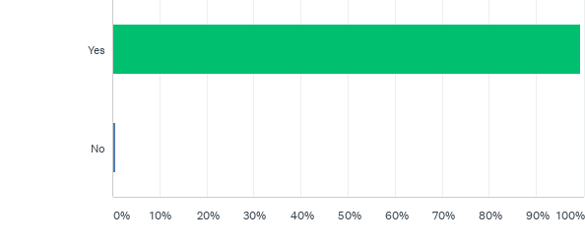
Q9: If we were to run this event again would you recommend it to other students?
Answered: 279 Skipped: 1

Slide 14
Q9: If we were to run this event again would you recommend it to other students?
Answered: 279 Skipped: 1

Slide 15
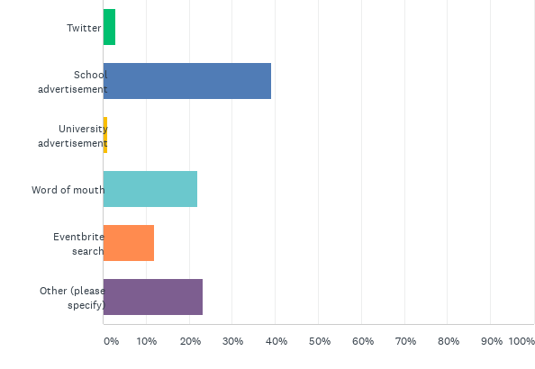
Q10: Where did you hear about this event?
Answered: 279 Skipped: 1

Slide 16
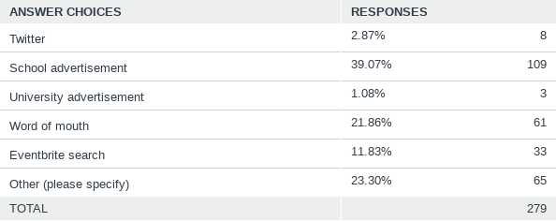
Q10: Where did you hear about this event?
Answered: 279 Skipped: 1

Slide 17
Q11: Did you find the event well organised?
Answered: 277 Skipped: 3

Slide 18
Q11: Did you find the event well organised?
Answered: 277 Skipped: 3

Slide 19
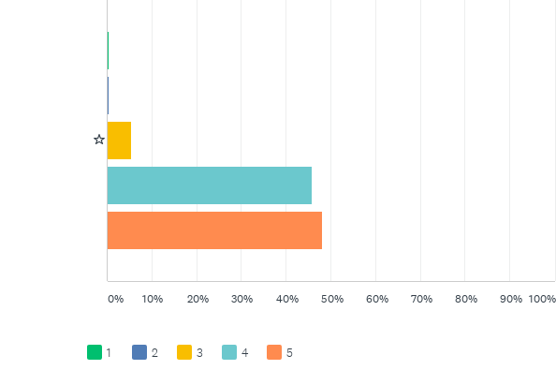
Q12: How many stars would you give the event overall?
Answered: 280 Skipped: 0

Slide 20
Q12: How many stars would you give the event overall?
Answered: 280 Skipped: 0

