Slide 1
New and Emerging Treatments in PD
Nirosen Vijiaratnam
Janet Owens Fellow
Department of Clinical and Movement Neurosciences
UCL Queen Square Institute of Neurology

Slide 2
PD Neurodegeneration
Alpha synuclein aggregation
Lysosomal
Dysfunction
Risk Factors
Age
Genetics
Diet
Toxins
Diabetes
Cell to cell propagation
Mitochondrial
Dysfunction
Neuroinflammation
Cell Death/Survival
Modified slide courtesy of T Foltynie

Slide 3
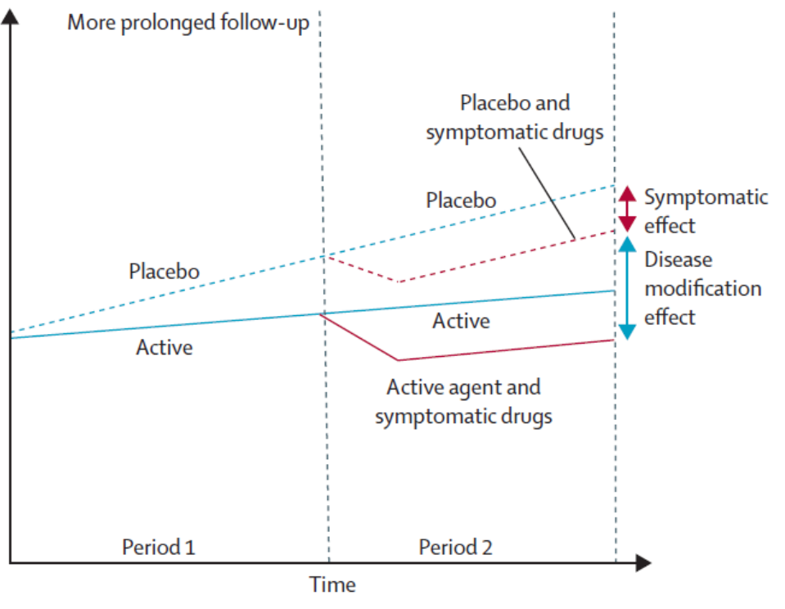

Symptom relief or Disease modifying?

Slide 4
Patient selection & demonstrating disease modification
Clinical markers
Remote monitoring of PD symptoms
Blood tests/Genetics
Cerebrospinal fluid
Imaging

Slide 6
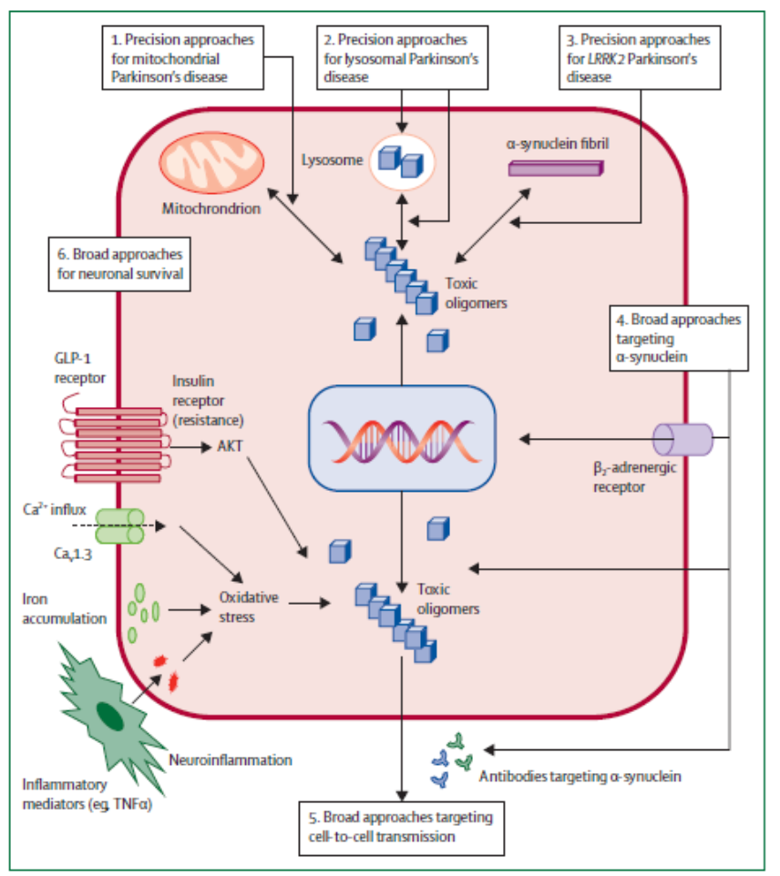

Slide 7
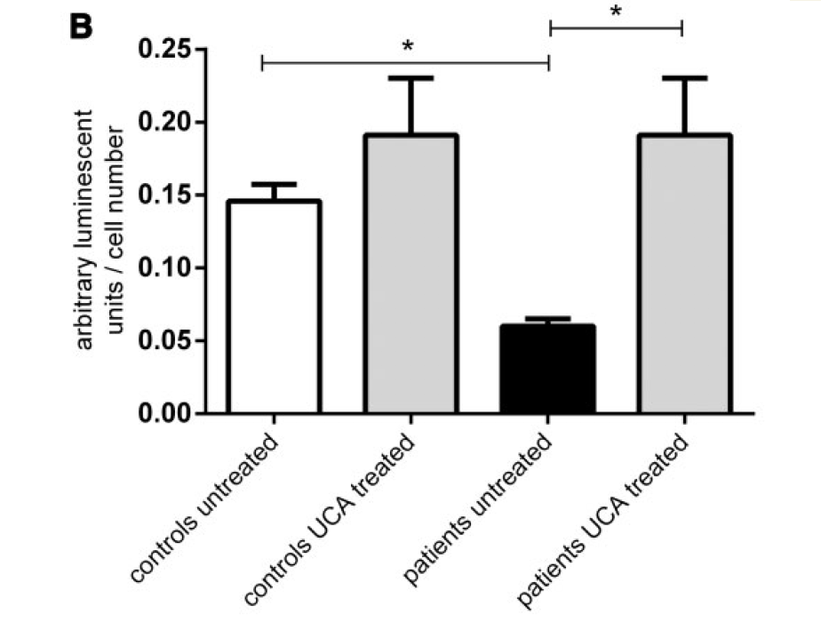
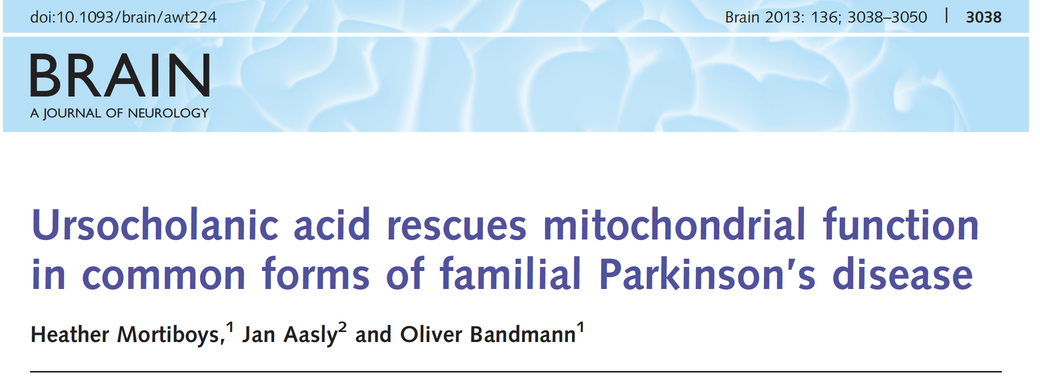
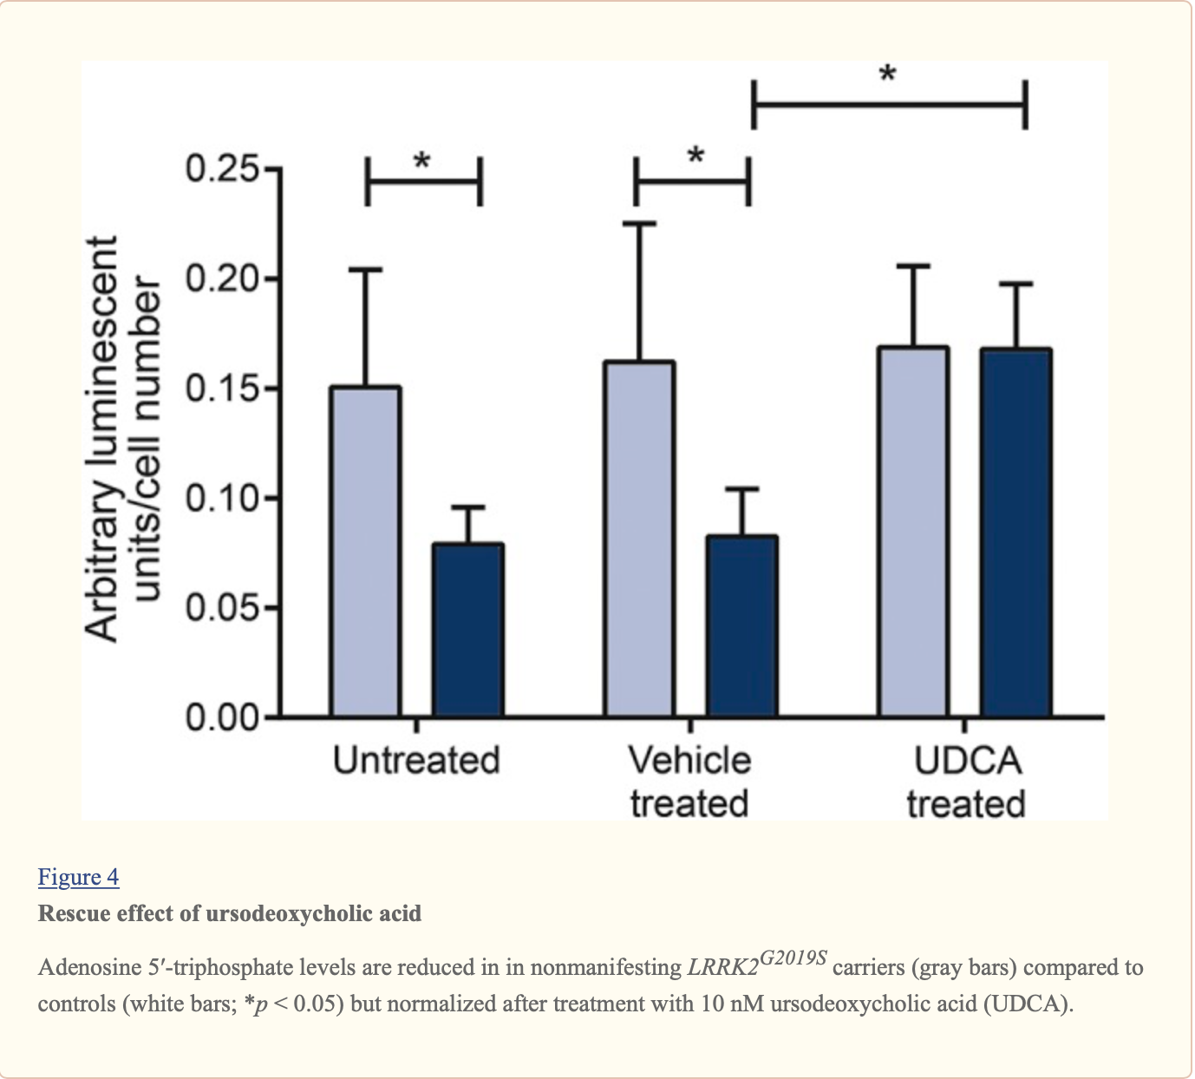
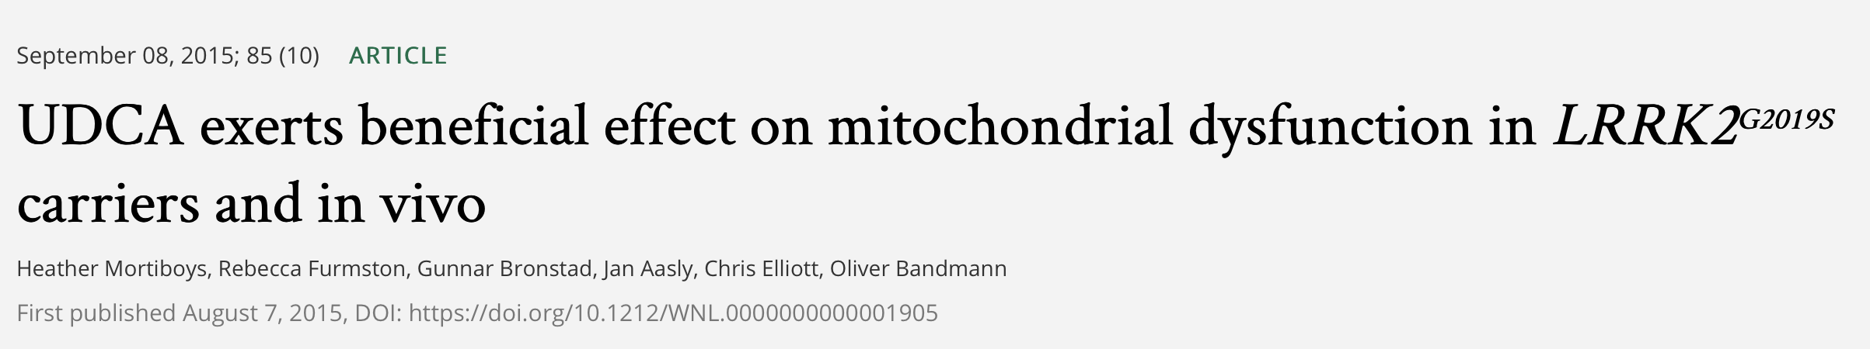

Slide 8
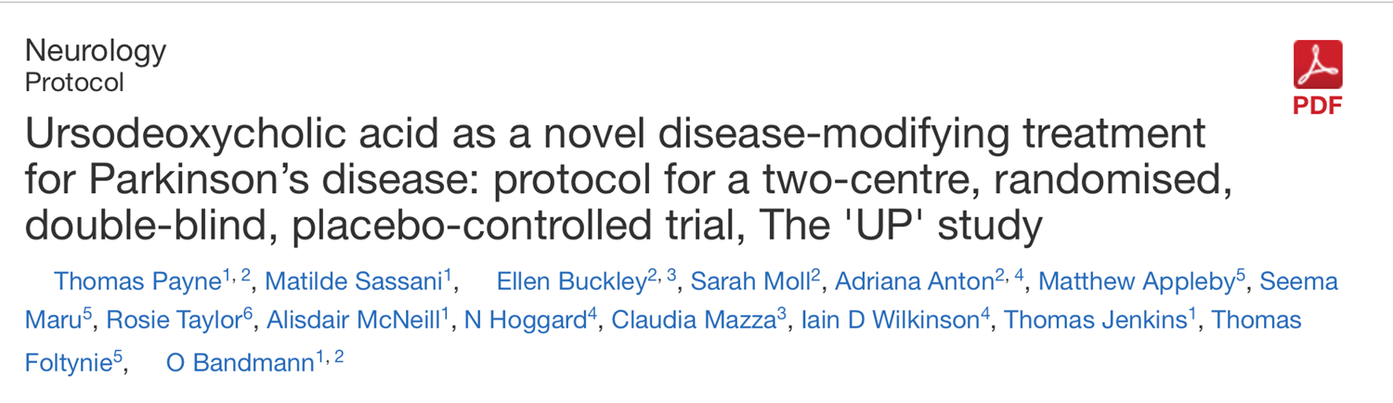
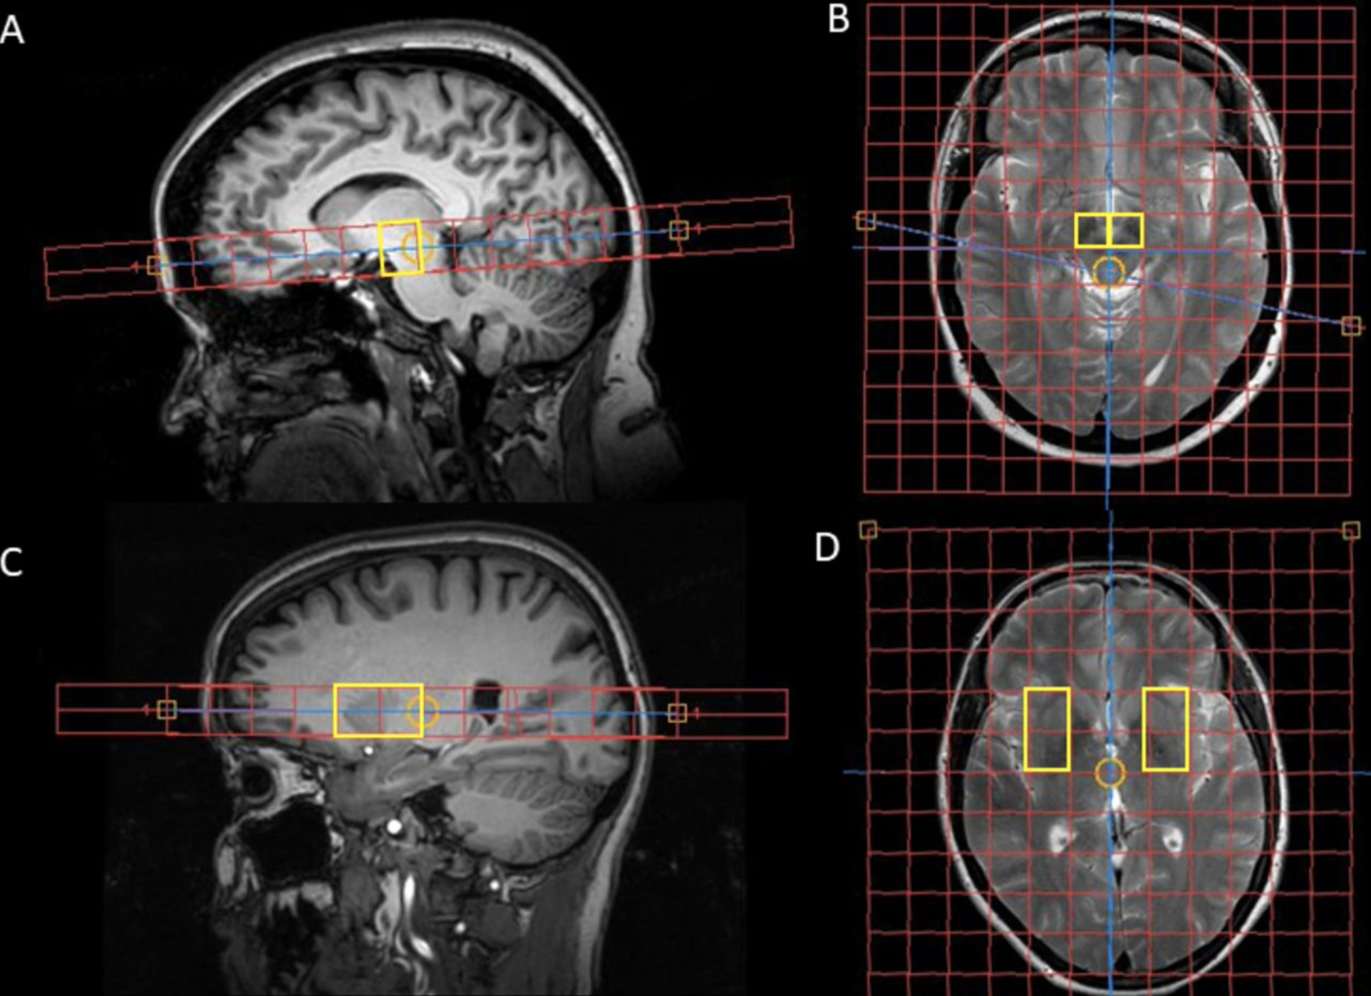
30 patients
UDCA for 12 months according to weight
Safety, tolerability
Pilot data for efficacy.

Slide 10
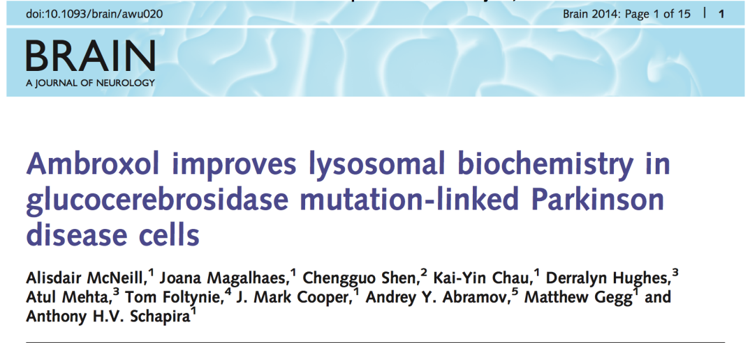
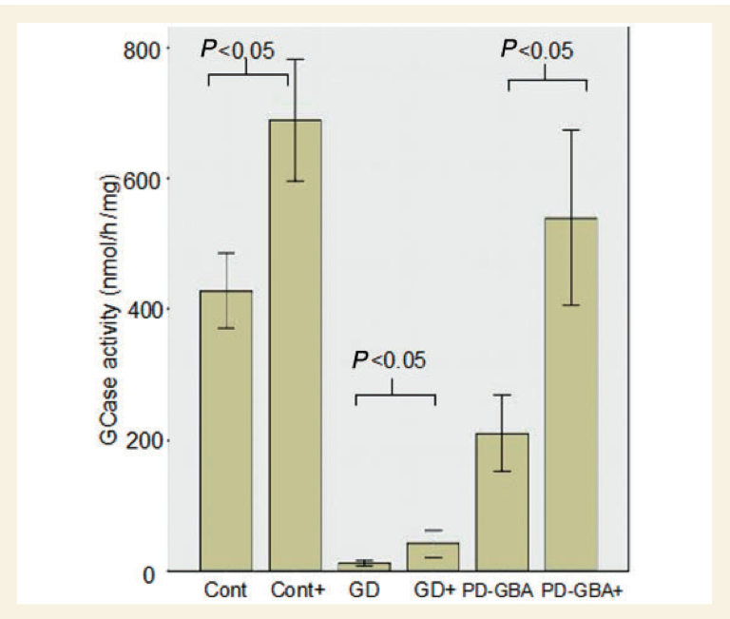
Precision approaches for lysosomal parkinsons
Gcase enzyme activity lower in PD GBA carriers, patients with GD, PDGBA, Controls
Ambroxol used to treat humans for airway mucus hyper-secretion diseases and found to increase mutant GCase activity and protein levels
Notes:
Fibroblast lines from skin biopsies
Gcase enzyme activity lower in PD GBA carriers, patients with GD, PDGBA, Controls
AMBROXOL
Ambroxol was identified from a drug screen of 1000 compounds searching for agents with activity to boost GCase function. ABX treatment significantly increased mutant GCase activity and protein levels in GD fibroblasts.
ABX has been used to treat humans for airway mucus hyper-secretion diseases (chronic bronchitis, asthma, and cystic fibrosis). Furthermore, it has been used as an alternative preventative treatment for hyaline membrane disease in newborns, because it increases surfactant secretion in the lungs. It also has been shown to have anti-inflammatory and antioxidant properties
Adminstered to in vitro preparations of fibroblast- skin biopsies taken from healthy individuals, GD patients and patients carrying GBA mutations with PD. Clear increase in GCase activity.

Slide 11

AIM-PD trial
N= 20 (10 GBA mutations, 10 sporadic)
Dose- 420mg tds for 6 months
2016 until 2018
Primary outcome- GCase and Ambroxol levels in blood/ CSF
Secondary outcome- Safety, Tolerability
Forward plans are to assess the optimal dose

Slide 13
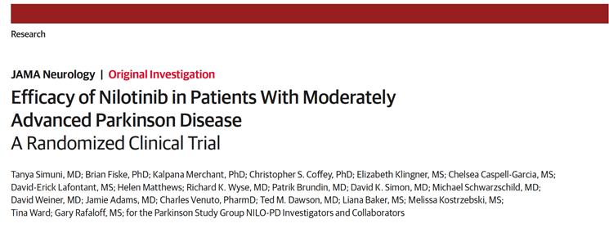
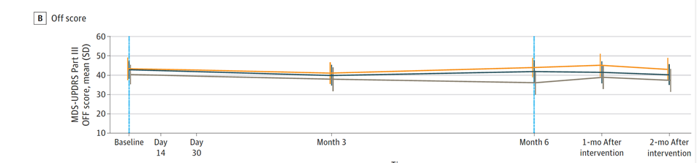
C-abl is a non-receptor tyrosine kinase
Multiple actions in cell survival
C-abl promotes accumulation of alpha synuclein
C-abl inhibitor licensed for treatment Chronic Myeloid leukaemia
Nilotinib- improvements in small open label study at 24 weeks (Pagan et al. 2016)
76 patients
Randomised 1.1.1 Placebo, 150mg, 300mg
<0.5% penetration into CSF
No effect on cABL

Slide 14


Slide 17
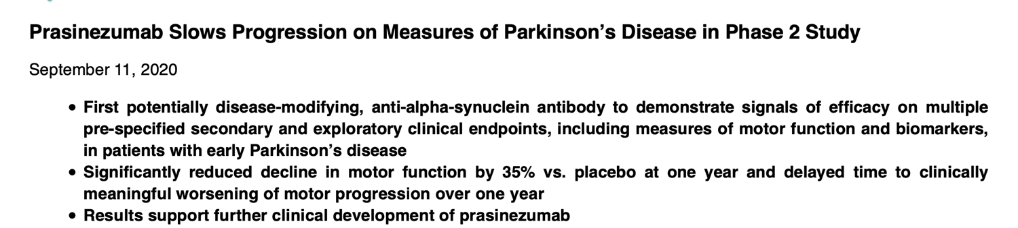
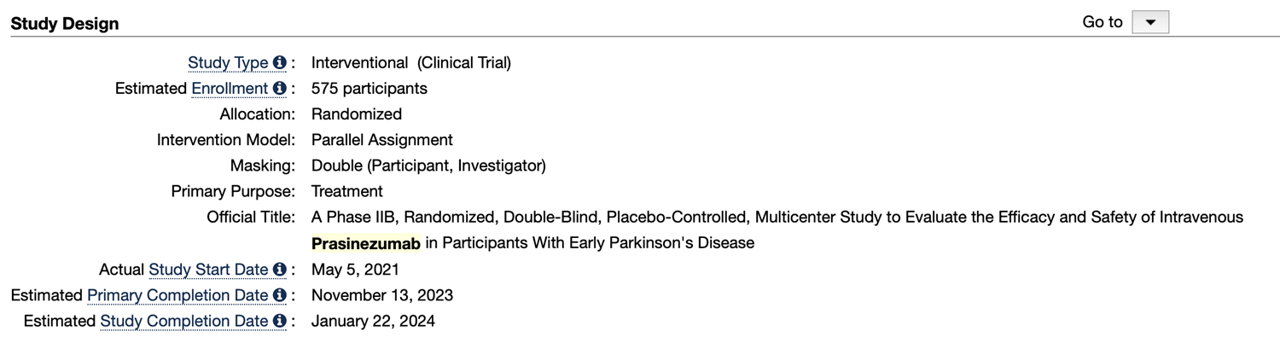

Slide 20
Small cohort size
Differences in baseline severity of patients between groups
No improvement in secondary outcome measures
More evidence of pathophysiological process change suggesting disease modifying action

Slide 21

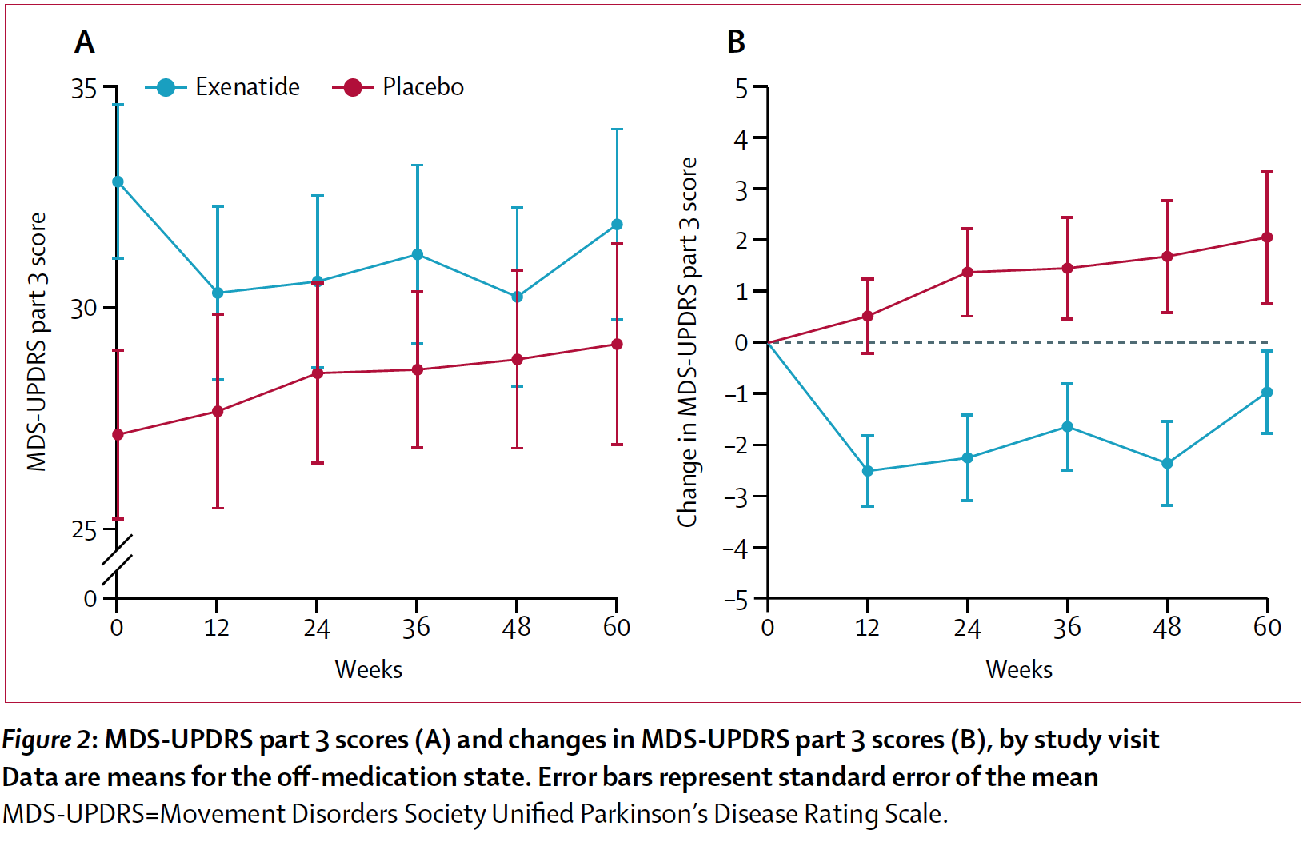
Exenatide PD- Phase 3- UK
60
72
84
96
Slide courtesy of T Foltynie

Slide 23
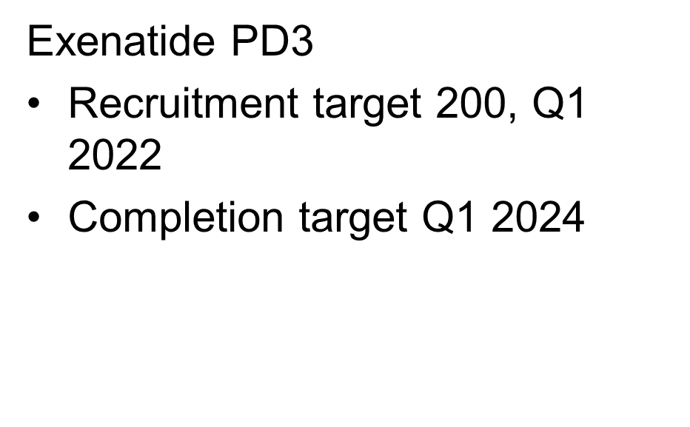

Slide 24



Slide 25
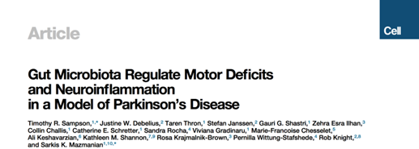
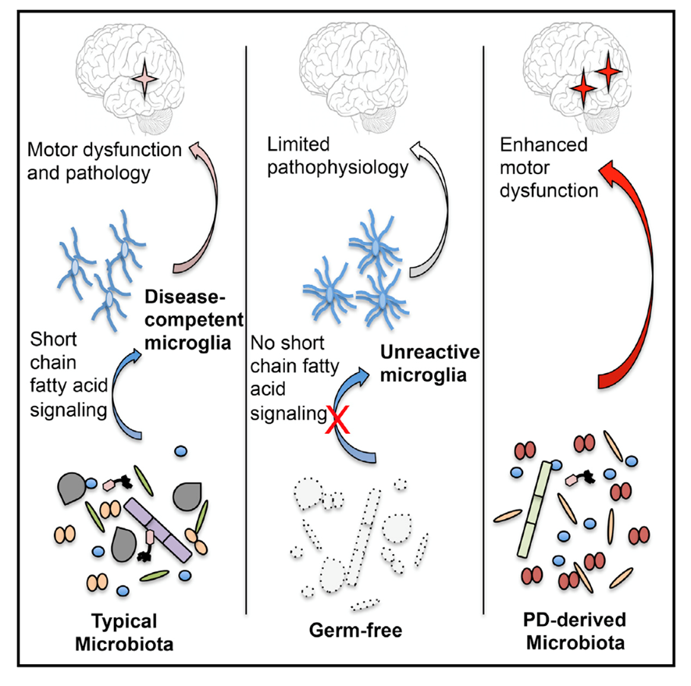

Dietary supplementation/ plans
Probiotics/Prebiotics/Synbiotics
Live biotherapeutic products
Faecal microbiota transplantation

Slide 26
Conclusions
Parkinson’s is complex and its underlying mechanisms and their stages/degrees can vary between individuals despite similarities in presentations
Deciding which agent should be used at the right time and what is the best way to measure these aspects to demonstrate disease modification will likely determine future success
Despite previous disappointing trial results, understanding these underlying aspects and changing approaches will hopefully deliver our goal of disease modification over the next decade

