Slide 1
Advanced search skills: Literature searching for projects & dissertations using biomedical databases
Kate Brunskill
neurolibrary@ucl.ac.uk
www.ucl.ac.uk/ion/library
Menti login

Slide 2
Learning objectives
Explore advanced search methods, including:
defining the topic;
selecting search sources;
developing a search strategy in multiple sources;
saving & reporting the search;
managing references, citing & generating bibliographies.
Also refer to Student Handbook & Moodle guidelines.

Slide 3
The search cycle
Visit LibrarySkills@UCL for an overview and further help.

Slide 4
Basic vs advanced search
Before you start, decide if you need an advanced, systematic search or if a basic search will do.
Basic - focused, precise:
for short projects;
to scope a topic;
it doesn’t matter if you miss some papers;
one database is enough.
Advanced - broad, sensitive:
for systematic reviews and dissertations;
to fully explore the evidence;
to identify as many relevant studies as possible;
to reduce bias by searching multiple databases.
Some MSc students do a systematic review for their research project; or a shorter review for a Library Project. There is not usually scope for a full systematic review, but the principles of undertaking a thorough, replicable search, collating and critically appraising a body of evidence in an unbiased way, will apply.

Slide 5
Characteristics of a systematic review
Aims to avoid bias.
Clear inclusion & exclusion criteria.
Comprehensive, replicable search.
Uses multiple databases to better capture the evidence.
Clear reporting of methods of analysis and synthesis.
Sometimes uses meta-analysis to combine data.
For an overview of types & levels of systematic review refer to UCL’s SR guide. It includes guidance & a reading list: https://library-guides.ucl.ac.uk/systematic-reviews

Slide 6
Please share a few words about your experience of advanced searching … … & issues you might have encountered.
Go to www.menti.com and type in the access code
21 02 11 2
3.05

Slide 7
Steps involved in a systematic review
1. Exploratory searches
7. Title & abstract screening
2. Define research question
8. Full text screening
3. Write and register protocol
9. Data extraction
4. Develop and run search strategy
10. Risk of bias checking
5. Export results
11. Analysis and synthesis
6. De-duplicate results
12. Write-up and dissemination

Slide 8
Today we focus on the search stages
Start with a scoping search & check for existing reviews.
Refine your topic if necessary.
Choose inclusion / exclusion criteria:
Topical: Population, Intervention, Comparison, Outcomes.
Practical: study design, language, date, type of publication.
Choose source(s) and then develop a search strategy.
Record where and when you searched and how much you found.
Record how you searched, to ensure you can report it.
Be prepared to revisit, refine or repeat your search.
Make sure you allow enough time!

Slide 9
Plan: defining the topic

Slide 10
Scoping & checking for existing SRs
Begin with a general scoping search.
Good places to check for existing SRs include:
Cochrane
Prospero
Epistemonikos
Databases with in-built SR filters.
For more tools, see library-guides.ucl.ac.uk/systematic-reviews/identifying-studies

Slide 11
Break down the topic
Take a broad topic - Is there a link between Covid & stroke?
Develop a focused question - Do patients with stroke & concurrent Covid have increased stroke severity?
Break the question into individual concepts.
Consider using a framework – examples include:
PICO(ST): Population, Intervention, Control, Outcomes, (Setting, Timing).
SPIDER: Sample, Phenomenon of Interest, Design, Evaluation, Research type.
… & others: if there is no framework to fit your research question, you should still break your question into its concepts.

Slide 12
Please share the keywords you would use if you were searching for this topic: Do patients with stroke & concurrent Covid have increased stroke severity?
Add your suggestions for keywords in www.menti.com
21 02 11 2
3.20

Slide 13
Plan: choosing search sources

Slide 14
Please share the sources you might use to search for the topic: Do patients with stroke & concurrent Covid have increased stroke severity?
List your chosen search tools in www.menti.com
21 02 11 2

Slide 15
Some popular choices…
PubMed; Scholar; Google; Library search (@ UCL this is called Explore); PsycInfo; Sciencedirect, AI chatbots, and others...
Health warning! Some of these sources may not be suitable for a systematic search.
individual publisher websites introduce selection bias.
some tools don’t cater for replicable searches - e.g. UCL Explore, Google Scholar.
some tools are unreliable - e.g. AI chatbots ‘hallucinate’ (making up fake references).

Slide 16
Where to find good search sources
Try the UCL databases list: https://library-guides.ucl.ac.uk/az.php to find, for example:
medical & biomedical databases: Medline, Embase.
general science & social science databases: Web of Science, Scopus.
specialist databases: BIOSIS, CINAHL, AMED, PsycINFO, … & many others!

Slide 17
Search: how to build the search

Slide 18
Turn the question into a workable search
Topic = Do patients with stroke & concurrent Covid have increased stroke severity?
Remove non-essential elements to focus on the core concepts - e.g. Covid, stroke.
Identify variant spellings, synonyms, associated terms:
covid, covid-19, coronavirus, corona virus, 2019-nCoV, SARS-CoV-2, SARS-CoV, severe acute respiratory syndrome Coronavirus 2 (& more…?)
stroke, intracerebral hemorrhage, intracerebral haemorrhage, cerebrovascular accident (& more…?)

Slide 19
Doing the search – the basics
Adapt to the source as each uses different syntax.
Search only the core concepts & remove other words.
Add synonyms to increase sensitivity.
Use brackets to group & separate concepts.
Use AND / OR to combine concepts.
To increase sensitivity, include subject headings (where available & if they add value) as well as keywords.

Slide 20
Doing the search – issues to look out for
Beware syntax errors and typos.
Watch out for search techniques that increase precision but might reduce sensitivity!
using “quotes around phrases”.
applying limits or filters.
focusing on certain fields (e.g. search for words in the title only).
Also be careful with techniques that increase sensitivity but reduce precision & may cause results overload!
using truncation*
Ask a librarian if you want advice about your syntax!

Slide 21
Doing the search - subject headings
Using subject headings as well as keywords can improve sensitivity but bear in mind:
Subject headings differ between databases; you need to check and adjust when moving between databases.
Some databases add subject headings automatically, in others you have to add them manually.
Research each subject heading before use - scope, date of introduction, broader / narrower options.
Use explode to include a subject heading’s sub-categories (sensitivity).
Use focus to find papers where the subject heading is the major topic.
Use sub-headings to focus on particular aspects (precision).

Slide 22
Doing the search – using limits & filters
In-built limits or filters
To select a sub-set of results, including aspects like:
date;
language;
age groups;
publication type;
human & animal studies.
Health warning! Remember filters can over-limit a search. Always mention their use in your methods.
Study design filters
You can also use pre-built filters from InterTASC, Cochrane, SIGN & others to focus on study types:
RCTs;
non-randomised studies;
qualitative research;
systematic reviews;
meta-analyses;
& others.
3.35

Slide 23
Questions?

Slide 24
Putting the searching into PubMed
PubMed is one route for access to Medline, a key source for medical / biomedical topics. Coverage: 1940s onwards, 5,000+ journals, 36 million+ citations, 40+ languages (90% English).
Offers a facilitated search & easy to access - https://library-guides.ucl.ac.uk/pubmed (note: how to add UCL links).
Note: other routes to Medline are available and we recommend Ovid for systematic searches – for a mre controlled search; extra tools; extra databases. Access is via the UCL databases page (login is required off-site).

Slide 25
PubMed demo
PubMed translates your search & adds elements automatically.
Typing a full question tends to be ineffective & limit your results:
Do patients with stroke & concurrent Covid have increased stroke severity?
A field-based search is precise but also limits your results:
(covid[Title]) AND (stroke[Title])
For the best sensitivity, explore one concept at a time.
Add variants & synonyms, combine using OR within brackets.
Combine separate concepts with AND between the brackets.
(Covid OR Covid-19 OR coronavirus OR coronavirus* OR "Corona virus*" OR "2019-nCoV" OR "SARS-CoV-2" OR "SARS-CoV" OR "Severe Acute Respiratory Syndrome Coronavirus 2“) AND (stroke OR strokes OR intracerebral haemorrhage OR intracerebral hemorrhage OR cerebrovascular accident* OR CVA)
Double-check the syntax and fix errors.

Slide 26
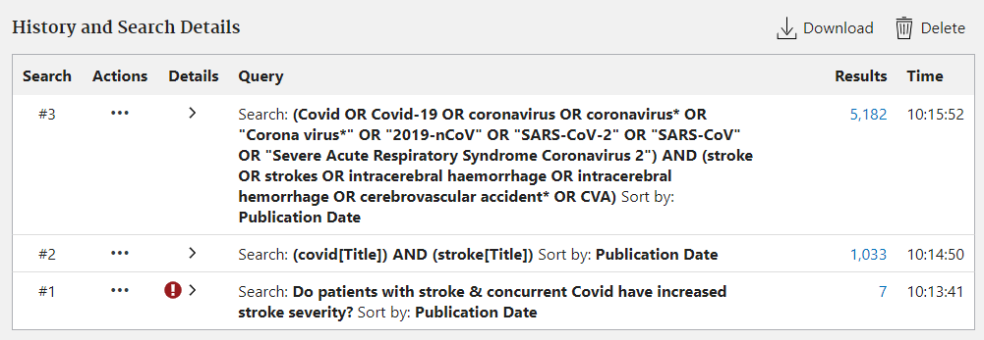
Demo of PubMed

Slide 27
Take a break!
break until 4.05

Slide 28
Evaluate & Manage: refine, save & report

Slide 29
Examine the results
Be reflective as you search & consider revising the syntax if necessary.
Make a note of extra keywords you discover as you search & be prepared to revise your initial search to include these additional keywords.
How many results is enough? Aim for a balance of sensitivity and precision.
too sensitive? Finding too many irrelevant results? Work out which keywords led to their retrieval & consider removing them.
too precise? Missing results? If known items were not retrieved by your search, work out why & consider adding more keywords / synonyms to make the search more sensitive.

Slide 30
Save the method & capture the results
Remember to record the search details: which source(s) you searched, when, what syntax you used (noting any limits) and how many items you found in each source.
Remember to capture the results using Endnote or similar.
For systematic searches, consider using a PRISMA flow diagram to structure your reporting.
Demo: how to save your syntax in PubMed, how to select citations and use the Send to menu to capture results.

Slide 31
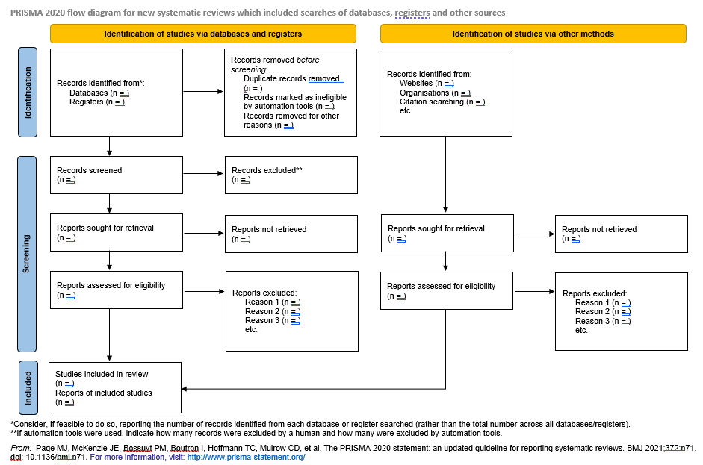
PRISMA flow diagrams - www.prisma-statement.org

Slide 32
Questions?

Slide 33
Search: how to build the search (again)

Slide 34
Translating the search to other databases
For a systematic search, you will search more than one source to minimise bias: e.g. country, language, or publication bias.
Try to match your approach from one source to the next but remember you cannot cut & paste as different sources use different syntax & commands.
Keywords might be the same but the commands used to enter them will differ between sources.
Subject headings are likely to differ between sources, or may not be used at all by some sources.
Every source is different – consult our guides, attend a training session, or ask for advice.

Slide 35
Translation examples
PubMed
("antipsychotic agents"[MeSH Terms] OR "antipsychotic*"[Text Word] OR "neuroleptic*"[Text Word]) AND ("dementia"[MeSH Terms] OR "dement*"[Text Word] OR "alzheimer disease"[MeSH Terms] OR "alzheimer*"[Text Word])
PsycInfo (via Ovid)
1 exp Neuroleptic Drugs/
2 (neuroleptic* or antipsychotic*).mp.
3 1 or 2
4 exp Dementia/
5 (dement* or alzheimer*).mp.
6 4 or 5
7 3 and 6
Web of Science – SCI & SSCI
TS=(neuroleptic* OR antipsychotic*) AND TS=(dement* OR alzheimer*)
Scopus
( TITLE-ABS-KEY ( neuroleptic* OR antipsychotic* ) AND TITLE-ABS-KEY ( dement* OR alzheimer* ) )

Slide 36
Some extra tools in Ovid
Including some useful techniques not available in PubMed.
Truncation – used at the end of a word to find variant endings.
$ or * – rat$ finds rat, rats but also rate, rational, etc.
$n or *n – rat$1 finds rat, rats, rate but not rational, rated, etc.
Wildcards – used inside a word to find variant spellings.
# – 1 character: wom#n finds woman or women.
? – 1 or 0 characters: colo?r finds color or colour.
Adjacency – to find words that appear next to or near each other.
ADJ – to find words next to each other in the specific order: brain ADJ (tumour or neoplasm) finds brain tumour, brain neoplasm, etc.
ADJn – to find words near to each other, in any order: doctor adj5 relationship finds doctor patient relationship, patient doctor relationship, relationship of the doctor to the patient, etc.

Slide 37
Translating our sample search
E.g. to Embase via Ovid
At UCL access to Embase is via Ovid (not embase.com).
Embase is a popular second database for biomedical topics – coverage from 1970s onwards, over 6,000 journals, over 20 million citations, from over 90 countries.
Access is via the databases page; UCL login required for off-site access.
Guide to searching Ovid databases: https://library-guides.ucl.ac.uk/OvidSP

Slide 38
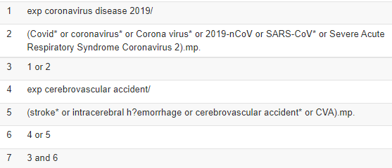
Ovid Embase demo
Start with the same list of keywords:
Covid, Covid-19, coronavirus, Corona virus, 2019-nCoV, SARS-CoV-2, etc.
stroke, intracerebral haemorrhage, intracerebral hemorrhage, etc.
Typing the full question tends to fail completely in this source.
Search for one concept at a time, for textwords plus subject headings, combined with OR.
Add the second concept using AND - e.g.

Slide 39
Save the method & save the results
Remember to record the search details: which source(s) you searched, when, what syntax you used (noting any limits) and how many items you found in each source.
Remember to capture the results using Endnote or similar. Again, For systematic searches, consider using a PRISMA flow diagram to structure your reporting.
Ovid demo: use the save options below the search history to capture the syntax. Select citations & use the Export menu to capture the results.
4.30

Slide 40
More places to look
Consider adding more search sources and broadening the search by:
searching grey literature – unpublished material such as dissertations, theses, conference proceedings, reports, etc.
exploring trials: unpublished and ongoing.
consulting experts in the field and/or searching for their papers;
browsing the contents of key journals (hand-searching);
checking reference lists / citations for known papers (Web of Science or Scopus are good tools to track who has cited who).
Beware: the last 3 steps can be prone to selection or publication bias. Remember to record additional activities in your methodology.

Slide 41
Questions?

Slide 42
Communicate: pulling things together

Slide 43
Reporting the search syntax
Remember, syntax contains database-specific commands, so you cannot usually cut and paste into another database.
PubMed syntax
(Covid OR Covid-19 OR coronavirus OR coronavirus* OR "Corona virus*" OR "2019-nCoV" OR "SARS-CoV-2" OR "SARS-CoV" OR "Severe Acute Respiratory Syndrome Coronavirus 2“) AND (stroke OR strokes OR intracerebral haemorrhage OR intracerebral hemorrhage OR cerebrovascular accident* OR CVA)
Embase Ovid syntax
exp coronavirus disease 2019/
(Covid* or coronavirus* or Corona virus* or 2019-nCoV or SARS-CoV* or Severe Acute Respiratory Syndrome Coronavirus 2).mp.
1 or 2
exp cerebrovascular accident/
(stroke* or intracerebral h?emorrhage or cerebrovascular accident* or CVA).mp.
4 or 5
3 and 6

Slide 44
Managing results
Manage your results:
save the results in your tool of choice to organise them;
de-duplicate the results from different sources;
screen results, applying your inclusion and exclusion criteria to decide which to exclude / include / revisit.
Screening stage 1 - title & abstract.
Screening stage 2 - full articles for detailed screening.
To find full articles: use Endnote Find Full Text feature; use FindIt@UCL links; check UCL Explore for print journals; ask us for help with items not available at UCL.

Slide 45
Software for SRs
You can use generic software (e.g. Excel); reference management software (e.g. EndNote) or specialist systematic review software.
See our software guide and refer to the Systematic Review Toolbox a searchable online directory of SR tools.
Take some time to understand the tools available and decide which would support you best. Some are free, others have a cost.

Slide 46
Citing and creating bibliographies
Add citations to your document to give credit to others.
Add a bibliography of the papers you are quoting & citing.
Use Endnote, Mendeley, or a similar tool to insert citations, edit their appearance, and to generate bibliographies using hundreds of styles (e.g. Harvard).
For full instructions, attend a training session or use the online guides for Endnote, Mendeley, and Zotero, and the References, Citations and Avoiding Plagiarism guide.
Also remember to cite use of tools such as AI bots, if their use is permitted.
4.45

Slide 47
What next?
Visit LibrarySkills@UCL https://library-guides.ucl.ac.uk/skills to find:
Bookable skills sessions covering a range of topics including how to search sources like PubMed or Ovid.
Online guides including guides to searching various sources, plus:
- Search skills for independent research. - Systematic Reviews search guide.
Contact neurolibrary@ucl.ac.uk or libraryskills@ucl.ac.uk for help.

Slide 48
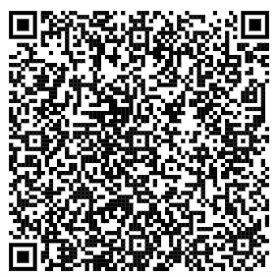
Feedback
https://tinyurl.com/ION-skills-feedback-2023
4.50
Notes:
https://ucl-global.libwizard.com/f/neurology-sessions?1305092=Advanced%20search%20skills%20lecture:%20ION%20students&1305093=1666306800000

