Slide 1
Tiling Patterns
Module 1: Investigation 2
Repeating and Alternating Patterns

Slide 2
Module 1: Investigation 2
Activity 1.2.1 – Repeating Flowers
Activity 1.2.1
Repeating Flowers

Slide 3
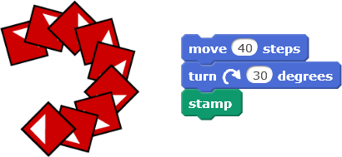
Module 1: Investigation 2
Activity 1.2.1 – Repeating Flowers
Open project 1-Tile Repeat, save as a copy and rename.
Click on the move-turn-stamp script again and again…
What was the minimum number of clicks you needed to complete the pattern?

Slide 4
Module 1: Investigation 2
Activity 1.2.1 – Repeating Flowers
Add the repeat block to your script.
Fill in the minimum number of repeats needed to complete your pattern.

Slide 5
Module 1: Investigation 2
Activity 1.2.1 – Repeating Flowers
Duplicate your script.
Change the numbers in the repeat and turn blocks to create different patterns.

Slide 6
Module 1: Investigation 2
Activity 1.2.1 – Repeating Flowers
Discussion Questions
Did you manage to create a complete flower?
Did your Tile sprite touch the edge of the stage? What happened?
What number did you put in your repeat block? If this was higher or lower would it change the pattern? How?
How many degrees did your Tile sprite turn for each stamp?
How did you decide what values to use in the repeat and turn blocks?
How many degrees did your Tile sprite turn in total to create the whole flower? Was this always the same?

Slide 7
Module 1: Investigation 2
Activity 1.2.2 – Unplugged: Calculating Angles
Activity 1.2.2: Unplugged
Calculating Angles

Slide 8
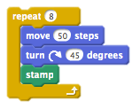
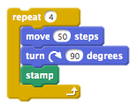
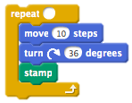
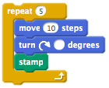
Module 1: Investigation 2
Activity 1.2.2 – Unplugged: Calculating Angles
Number in repeat block
Number of degrees in turn block
Total number of degrees Tile sprite turned
8 45 degrees ____ degrees
____ ____ degrees 360 degrees
____ 36 degrees ____ degrees
5 ____ degrees ____ degrees
Extension
Can you work out the numbers used in the script that created this pattern?
____ ____ degrees ____ degrees

Slide 9
Module 1: Investigation 2
Activity 1.2.2 – Unplugged: Calculating Angles (Answers)
Number in repeat block
Number of degrees in turn block
Total number of degrees Tile sprite turned
8 45 degrees 360 degrees
4 90 degrees 360 degrees
10 36 degrees 360 degrees
5 72 degrees 360 degrees
Extension
Can you work out the numbers used in the script that created this pattern?
6 60 degrees 360 degrees

Slide 10
Module 1: Investigation 2
Activity 1.2.3 – Alternating Flowers
Activity 1.2.3
Alternating Flowers

Slide 11
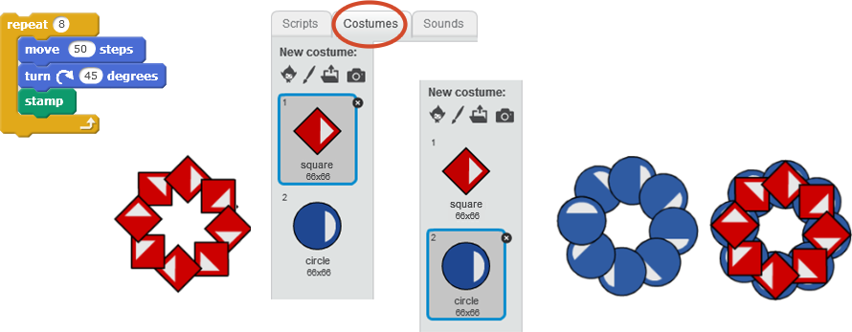
Module 1: Investigation 2
Activity 1.2.3 – Alternating Flowers
Continue in your project 1-Tile Repeat, save as a copy and rename.
Run one of your previous scripts to stamp a pattern. Then run it again with different costumes.

Slide 12
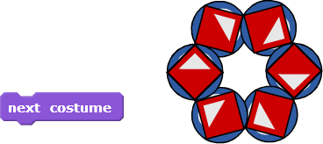
Module 1: Investigation 2
Activity 1.2.3 – Alternating Flowers
Use the next costume block in your scripts to create the pattern below.
Now create some of the patterns below or similar patterns.

Slide 13
Module 1: Investigation 2
Activity 1.2.3 – Alternating Flowers
Discussion Questions
Where did you place the next costume block in your script? If you moved it how might this change your pattern?
Did you use one next costume block or more? Did you build a single script to stamp the whole pattern in one click?
How many squares and circles were in your patterns?

Slide 14
Module 1: Investigation 2
Activity 1.2.4 – [Extension] Repeating and Alternating
Activity 1.2.4 [Extension]
Repeating and Alternating

Slide 15
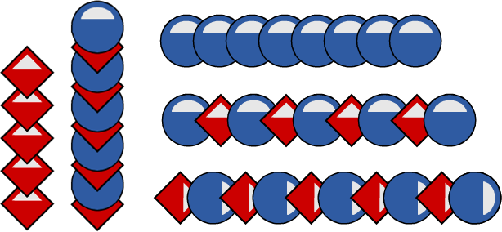
Module 1: Investigation 2
Activity 1.2.4 – [Extension] Repeating and Alternating
Continue in your project 1-Tile Repeat, save as a copy and rename.
Edit your scripts to create patterns similar to the ones below.
more advanced patterns

Slide 16
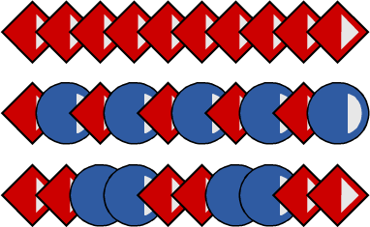
Module 1: Investigation 2
Activity 1.2.4 – [Extension] Repeating and Alternating
Discussion Questions
Which patterns did you manage to create?
Can you describe a strategy that you used to create one of your patterns?
Did you use different sequences of costumes in your patterns?

Slide 17
Module 1: Investigation 2
My Investigation 2 check list:
I used the repeat block to run my script several times.
I found the minimum number to put in the repeat block to complete the circular pattern.
I clicked the green flag to reset the stage and the sprite.
I used the next costume block in my scripts.
I created different patterns with alternating costumes.
I built a single script to stamp the whole pattern with different costumes in one click.

Slide 18
Module 1 Investigation 2: Key Vocabulary
repetition means running a sequence of commands a certain number of times
repeat block is a control block which runs the blocks inside a specified number of times
wait a command which waits a specified number of seconds, e.g. 1, 2 or 0.2, then continues with the next blocks
total turn total number of degrees the sprite turns when running a script
costumes are alternative ways that a sprite can look on the stage
next costume a command which switches to the next costume in the list of the sprite’s costumes. The next costume after the last one is the first one in the list again
pattern repeating sequence when stamping sprite’s costume or costumes

