Slide 1
Geometric similarity landmark activity
Examples of pupils’ work

Slide 2
Examples are from
Investigation 5, Q. 2 "What is the relationship between corresponding angles in mathematically similar shapes?"

Slide 3
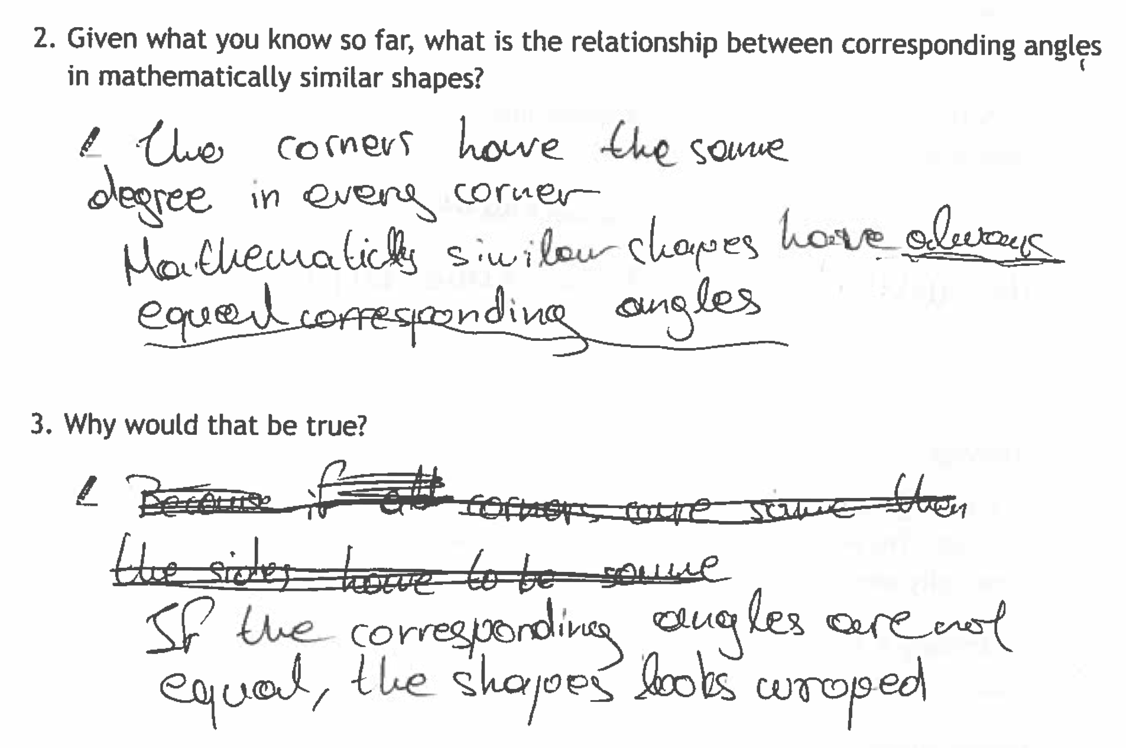
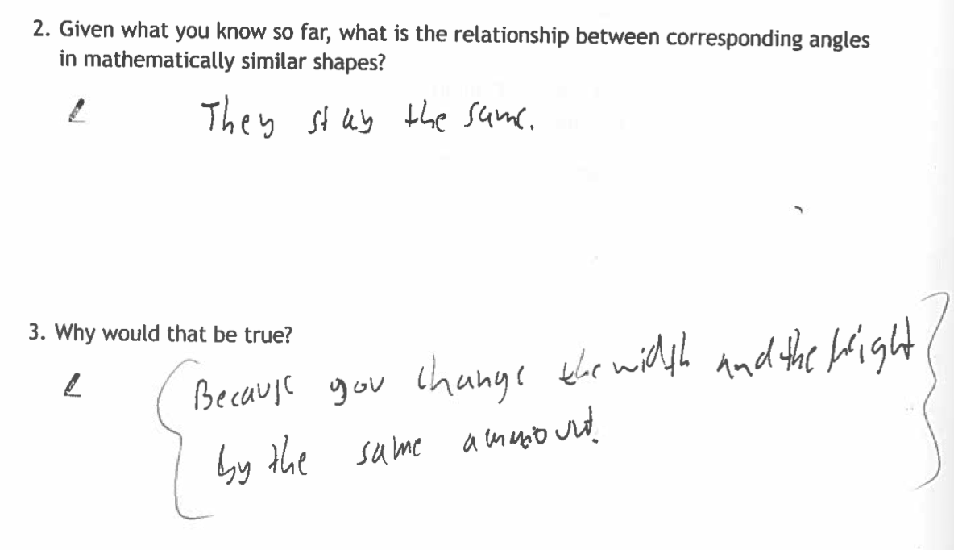
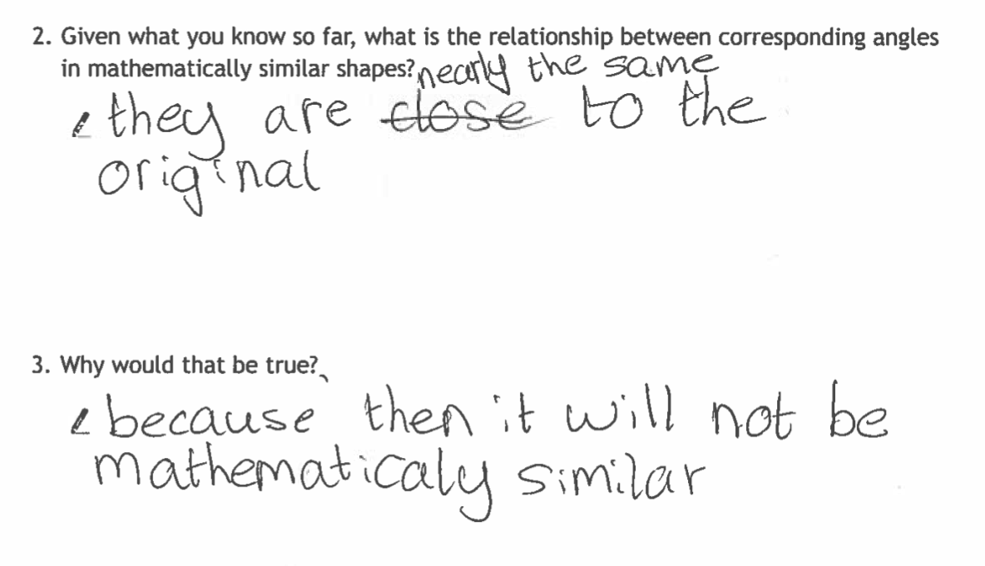
"What is the relationship between corresponding angles in mathematically similar shapes?”(Inv 5, Q2 3)
How will you use the software to enable pupils to respond to this challenging set of questions?

