Slide 1
Geometric similarity
Examples of pupils’ work

Slide 2
Examples are from
Investigation 2, Q. 4-5 "What is the relationship between an original and a mathematically similar shape?"
Investigation 3, Q. 11-12 "Describe what a scale factor is. Describe how to use it..."
Investigation 4, Q. 7 "Devise a set of instructions so that anyone can create mathematically similar enlargements."
Investigation 5, Q. 2 "What is the relationship between corresponding angles in mathematically similar shapes?"

Slide 3
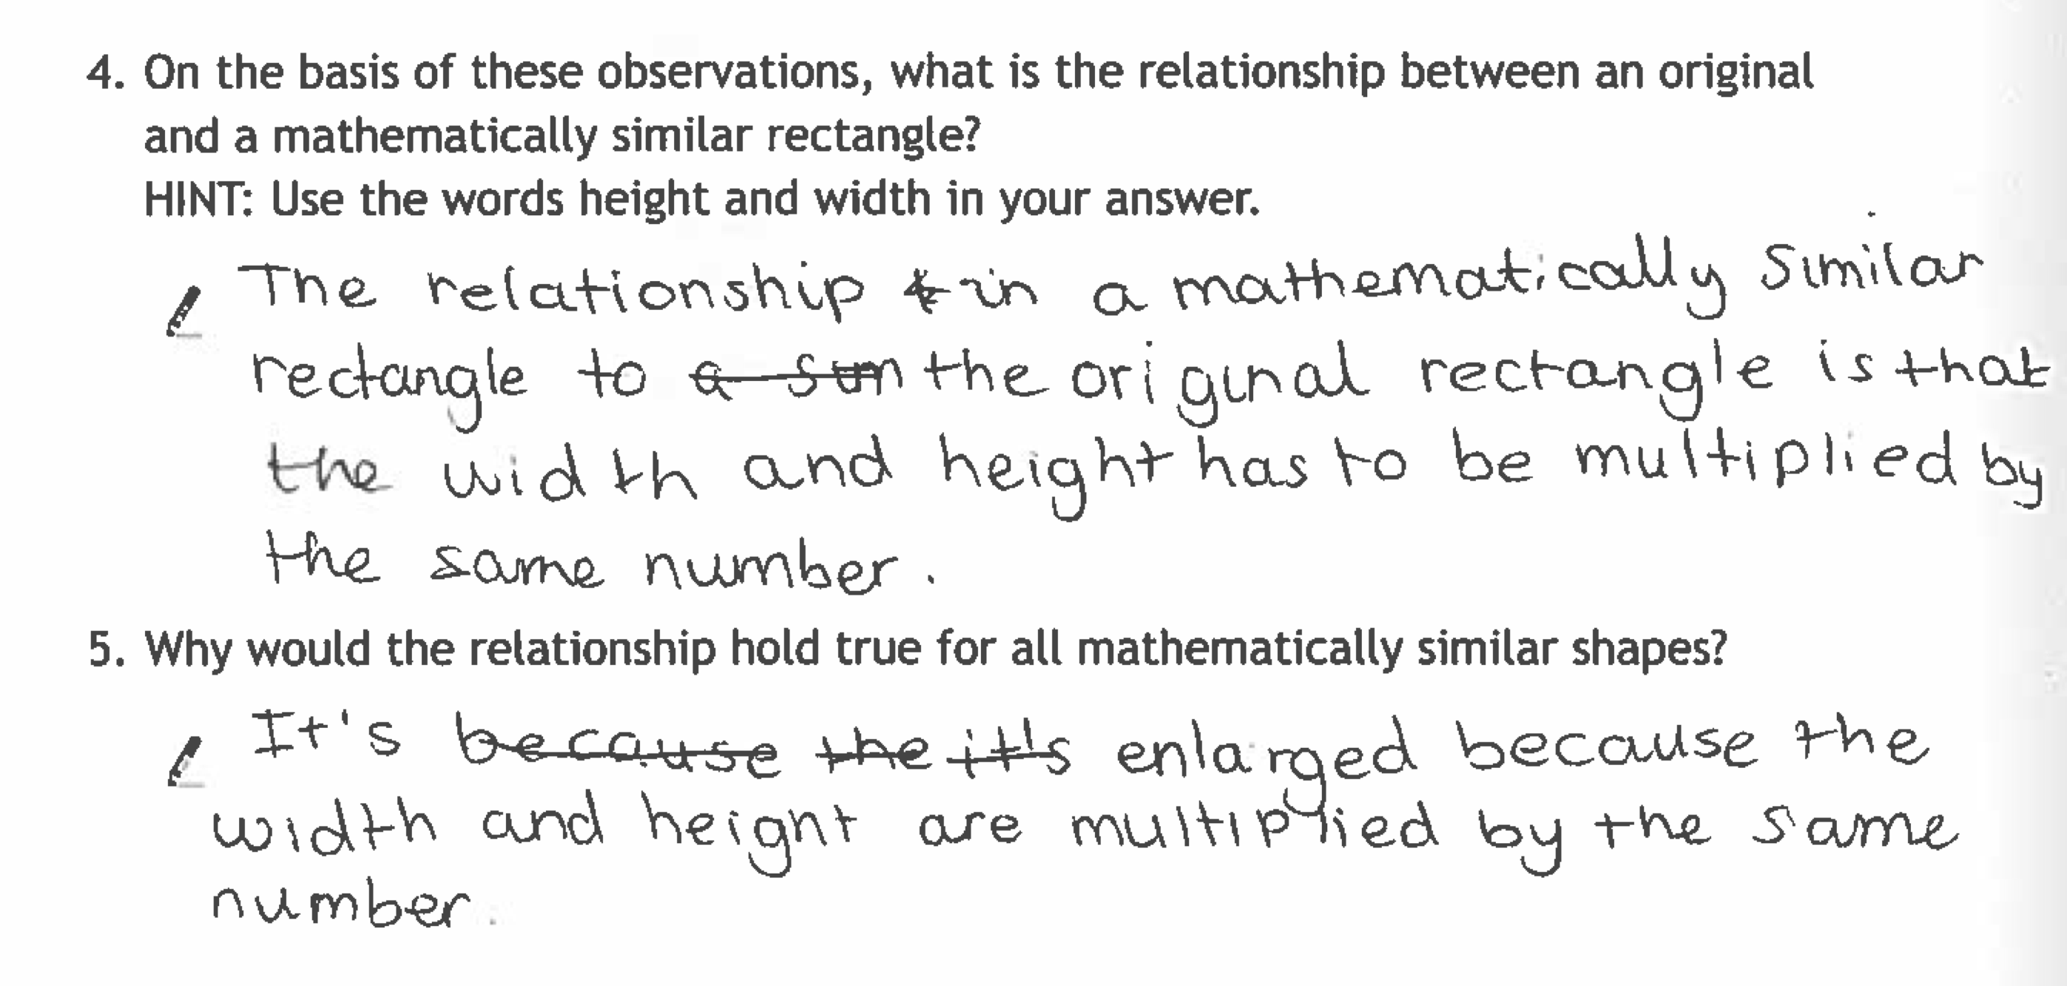
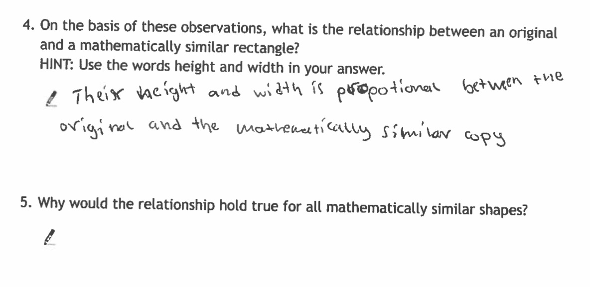
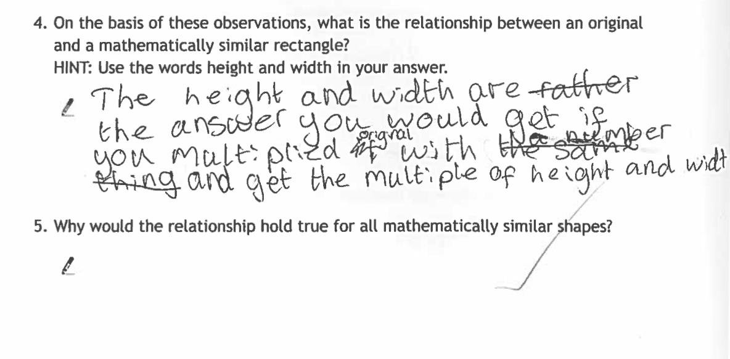
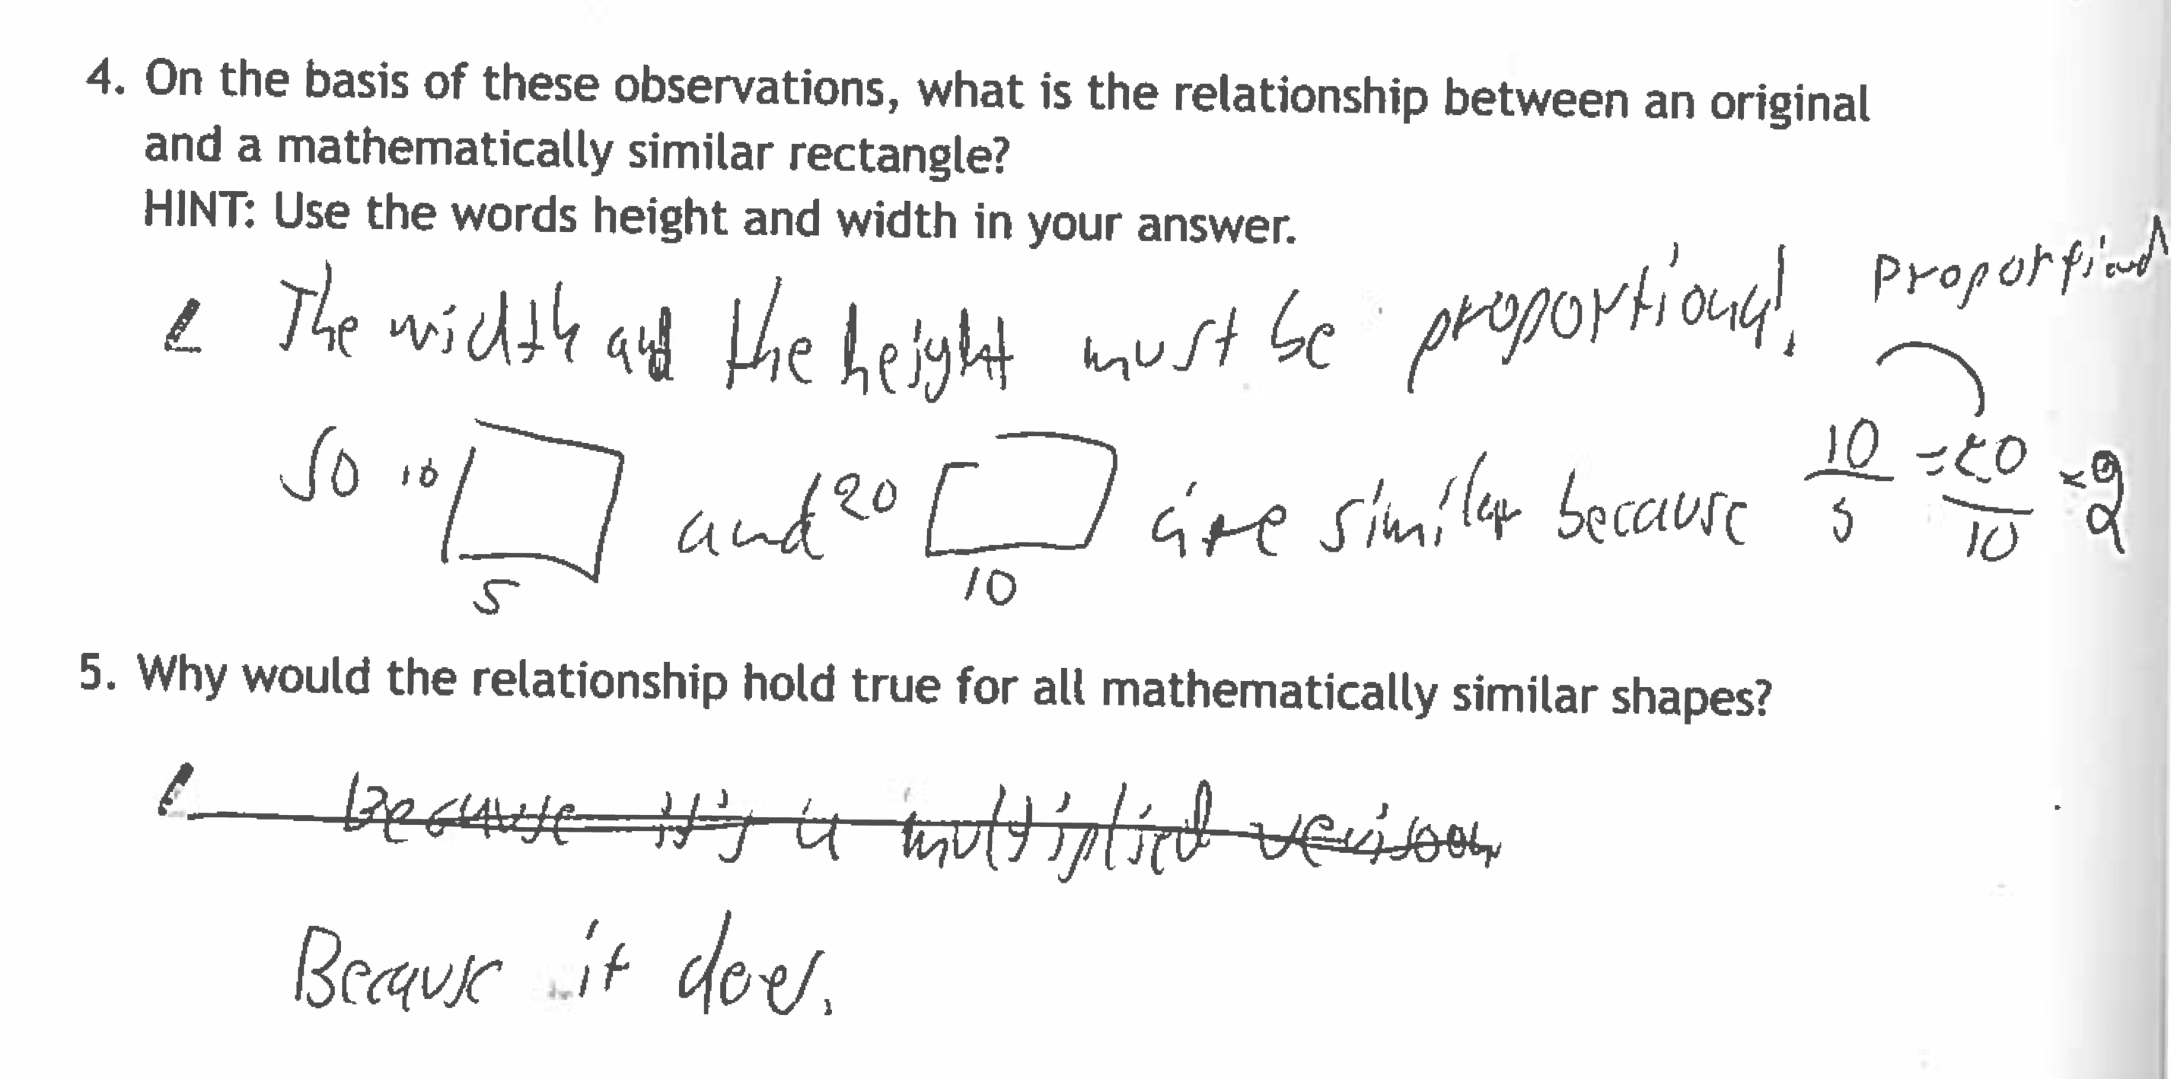
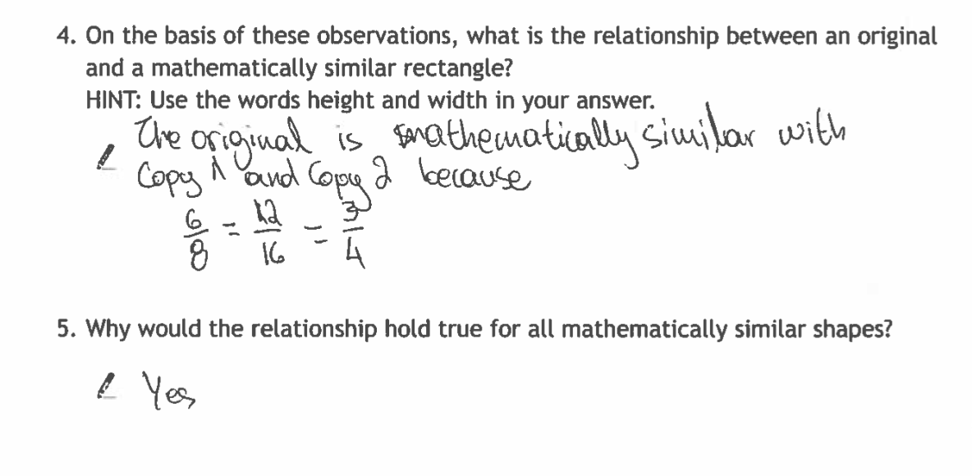
"What is the relationship between an original and a mathematically similar shape?"(Inv 2, Q. 4-5)
Discuss the responses…
How might you use these to stimulate discussion?
How could pupils answers to Q.4 support them to extend their reasoning to polygons other than rectangles?

Slide 4
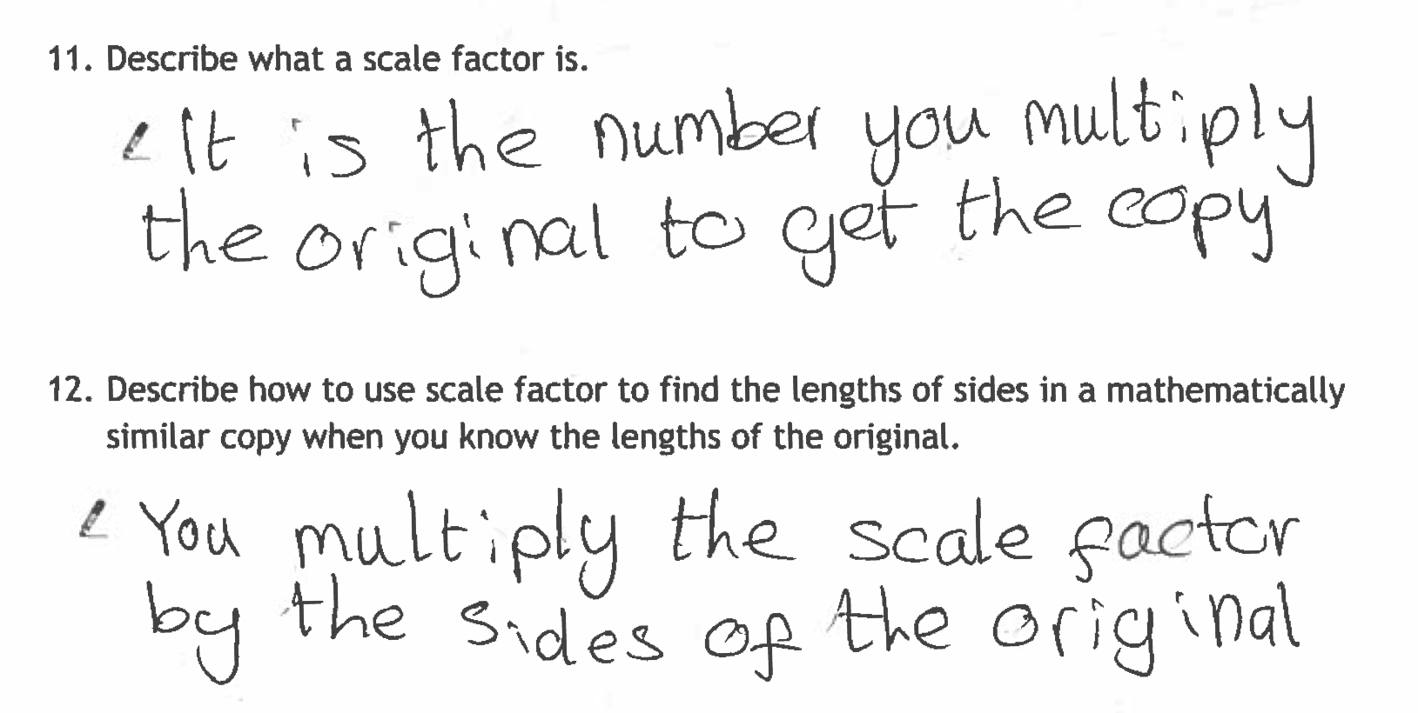
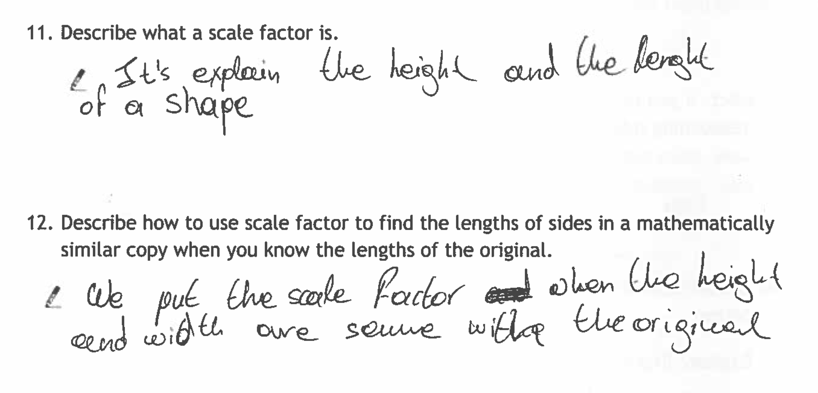
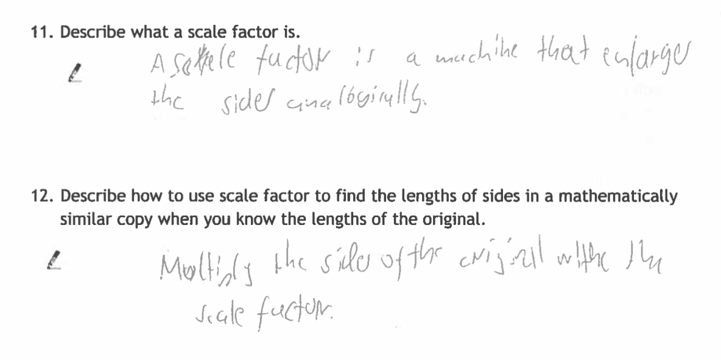
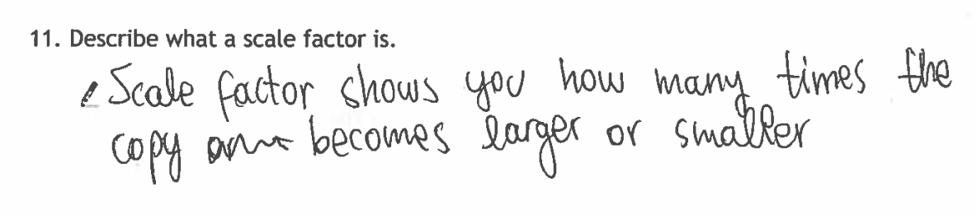
"Describe what a scale factor is. Describe how to use it...”
(Inv 3, Q. 11 12)
Which responses show deeper understanding?
How can use of the scale factor slider help pupils’ reasoning?

Slide 5
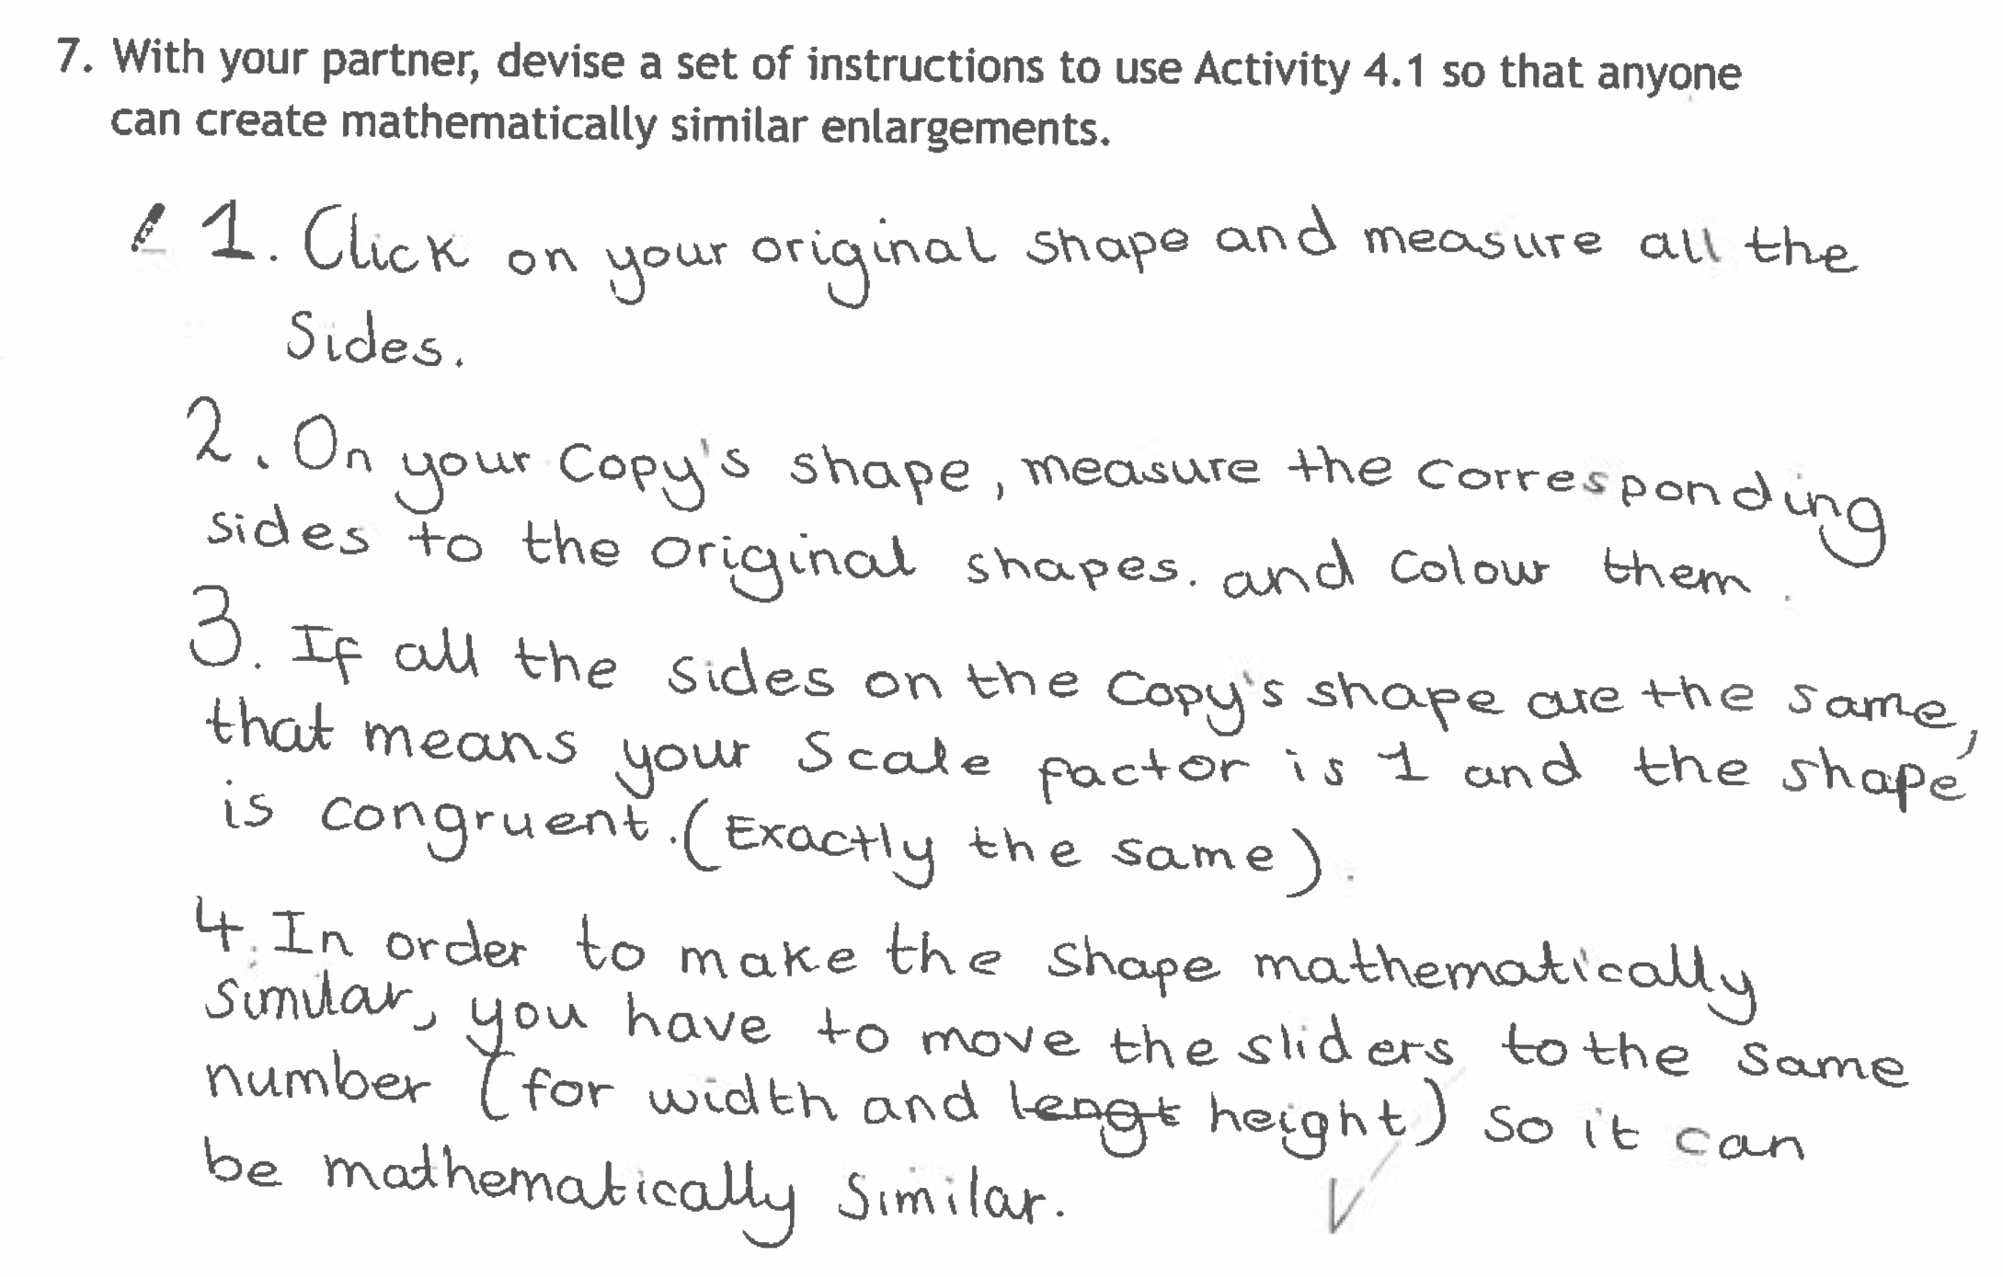
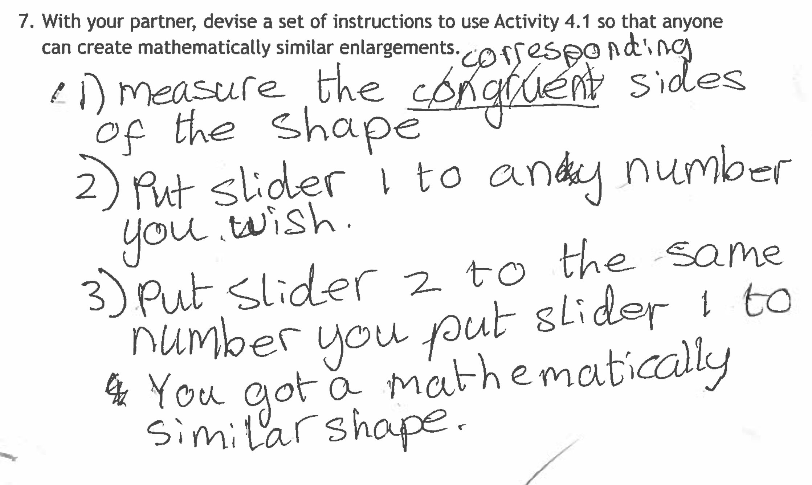
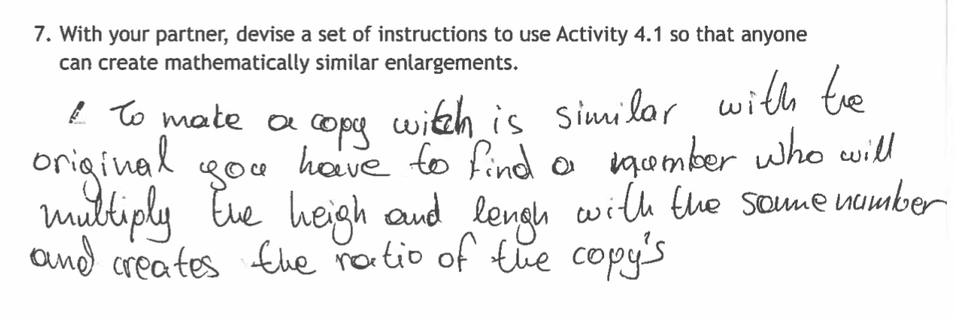
"Devise a set of instructions so that anyone can create mathematically similar enlargements."(Inv 4, Q 7)
How might using the Activity 4.1 software help to critique these instructions?

Slide 6
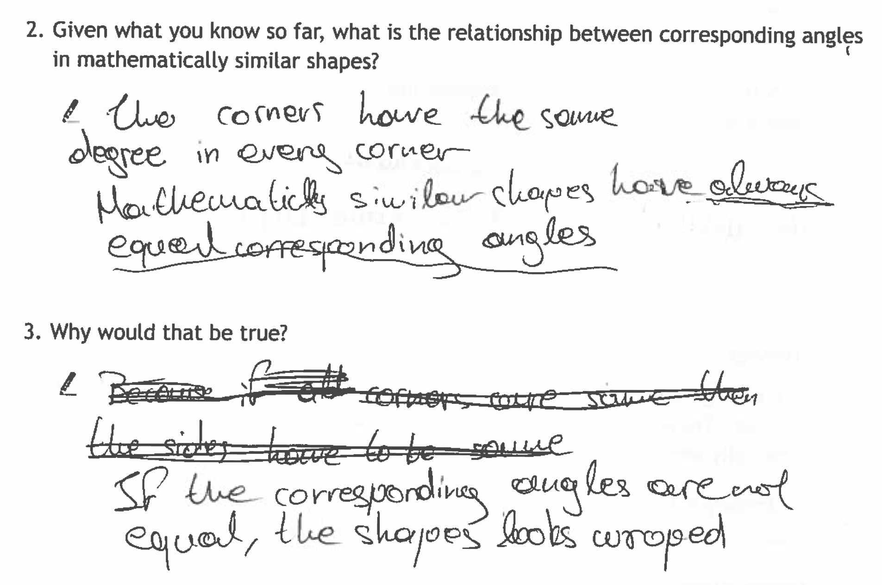
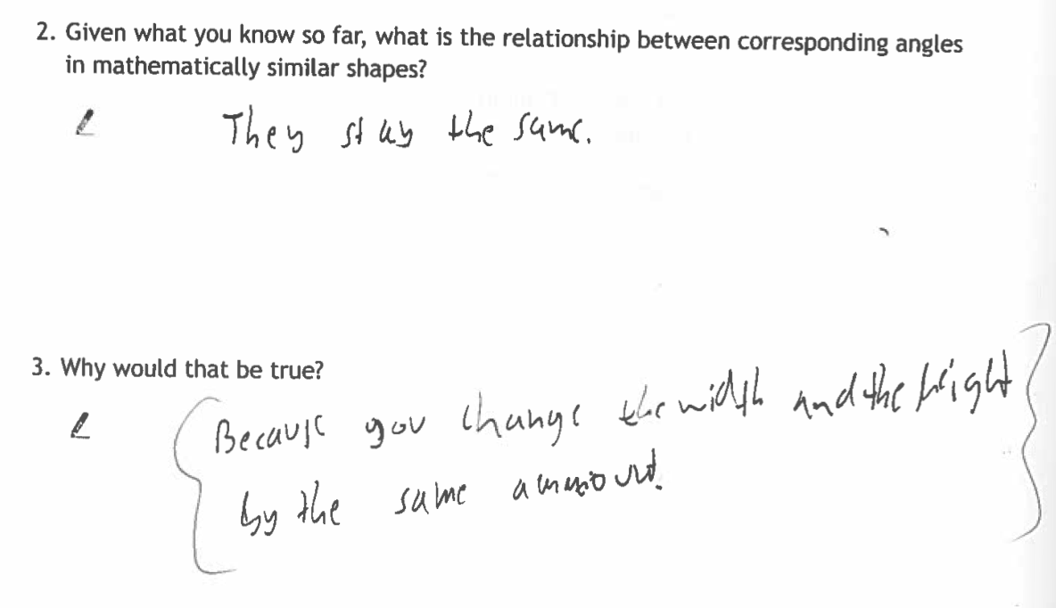
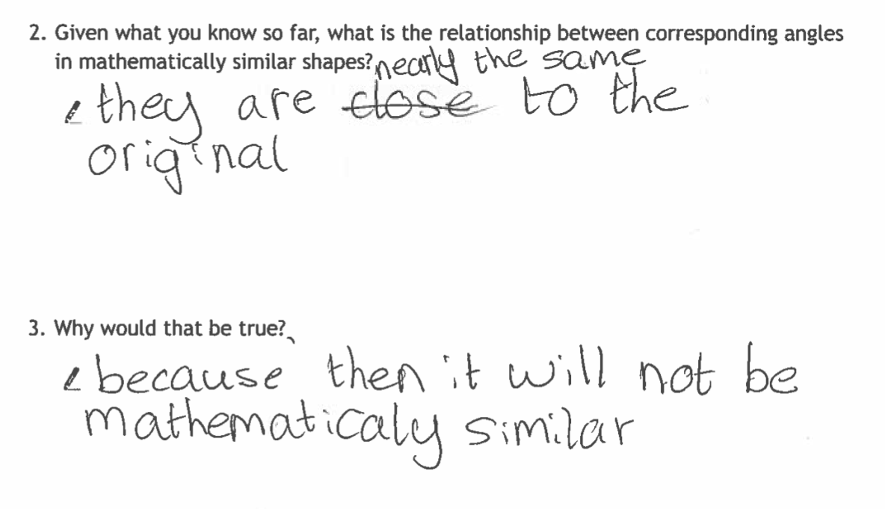
"What is the relationship between corresponding angles in mathematically similar shapes?”(Inv 5, Q2 3)
How will you use the software to enable pupils to respond to this challenging set of questions?

