Slide 1
Linear functions
Examples of pupils’ work

Slide 2
Examples are from
Investigation 2, Q. 1D "What is speed?”
Investigation 3, Q. 1C "Explain how fast the car is going in two ways.”
Investigation 4, Q. 1A "How fast is Shakey going? How do you know?”
Investigation 4, Q. 1D "Compare the equations of Fast Shakey and Slow Shakey. Describe any differences”
Investigation 4, Q. 2 “Describe how time, distance and speed are represented…”

Slide 3
"What is speed?” (Inv 2, Q1D)
Discuss the responses…
How might you use all or any of these responses to stimulate a discussion?
What mathematical language might you need to develop?
How could you use the software (Inv 2) to support discussion?

Slide 4
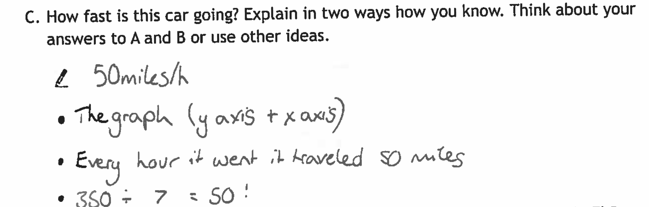
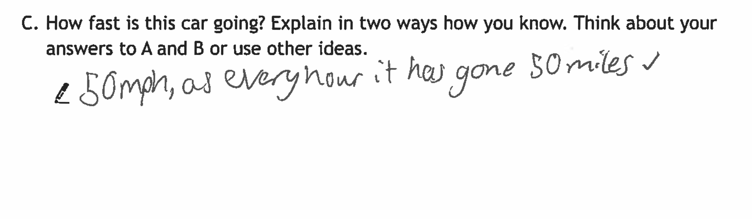
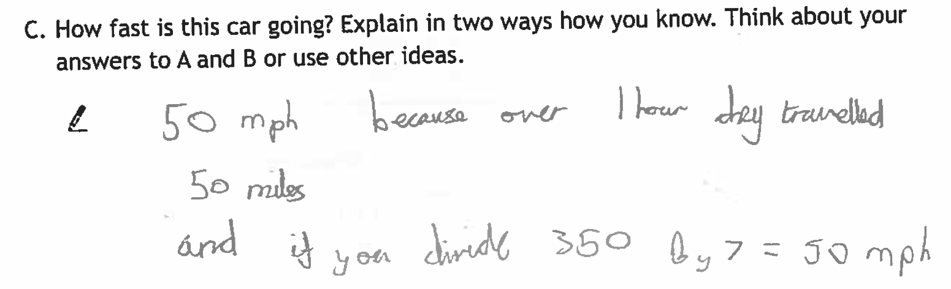
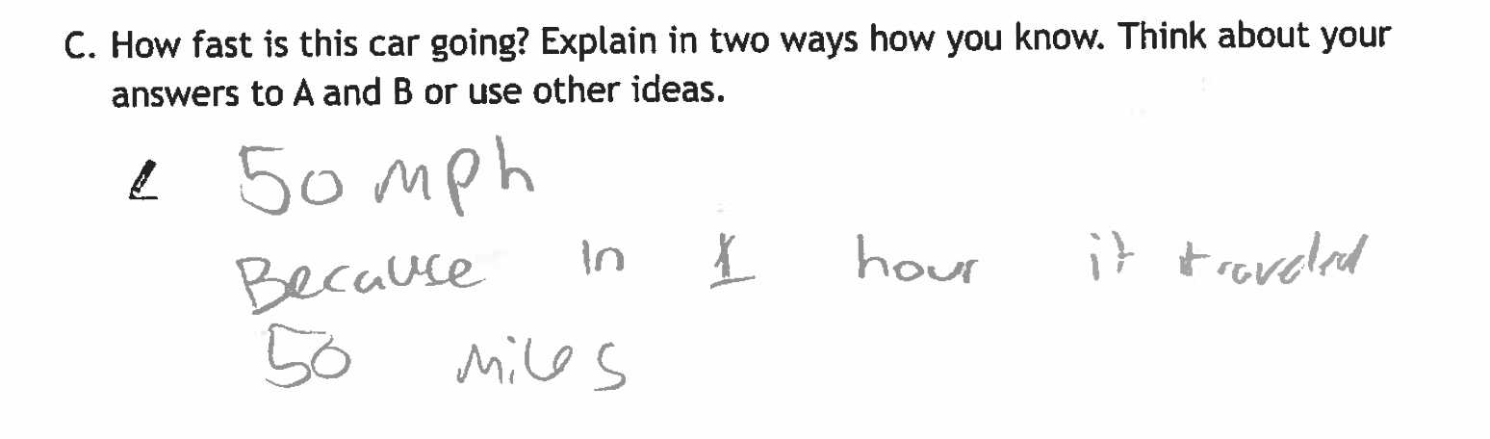
"Explain how fast the car is going…”(Inv 3, 1C)
Which concepts of speed are pupils using? (i.e. unit rate, overall distance÷overall time, ...)
Which show deeper understanding?

Slide 5
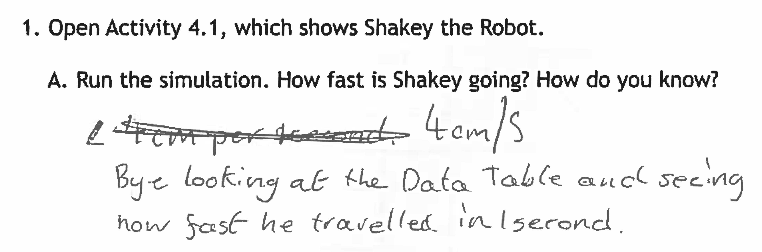
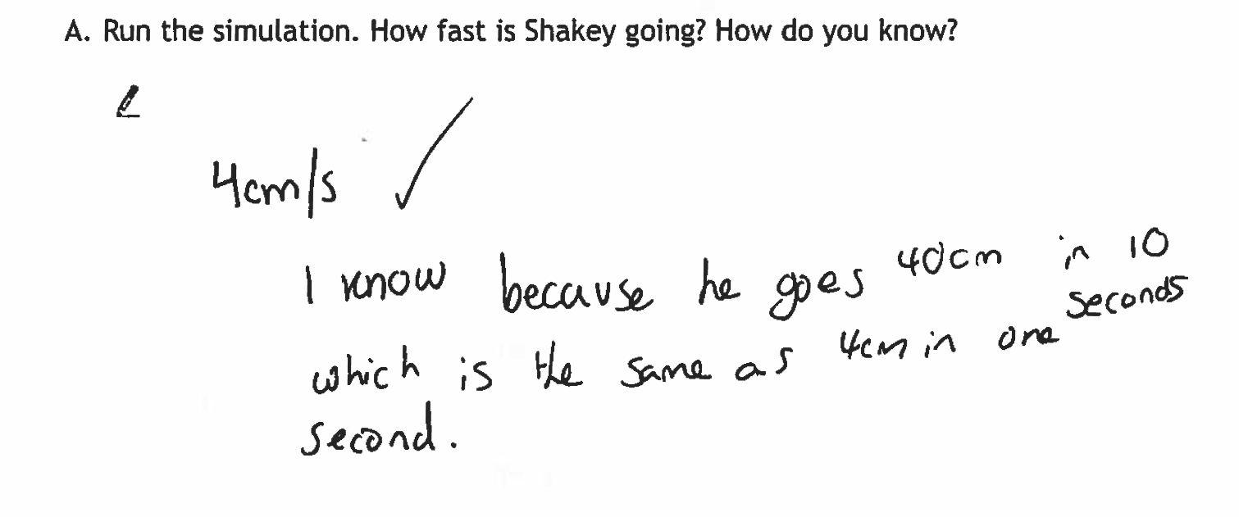
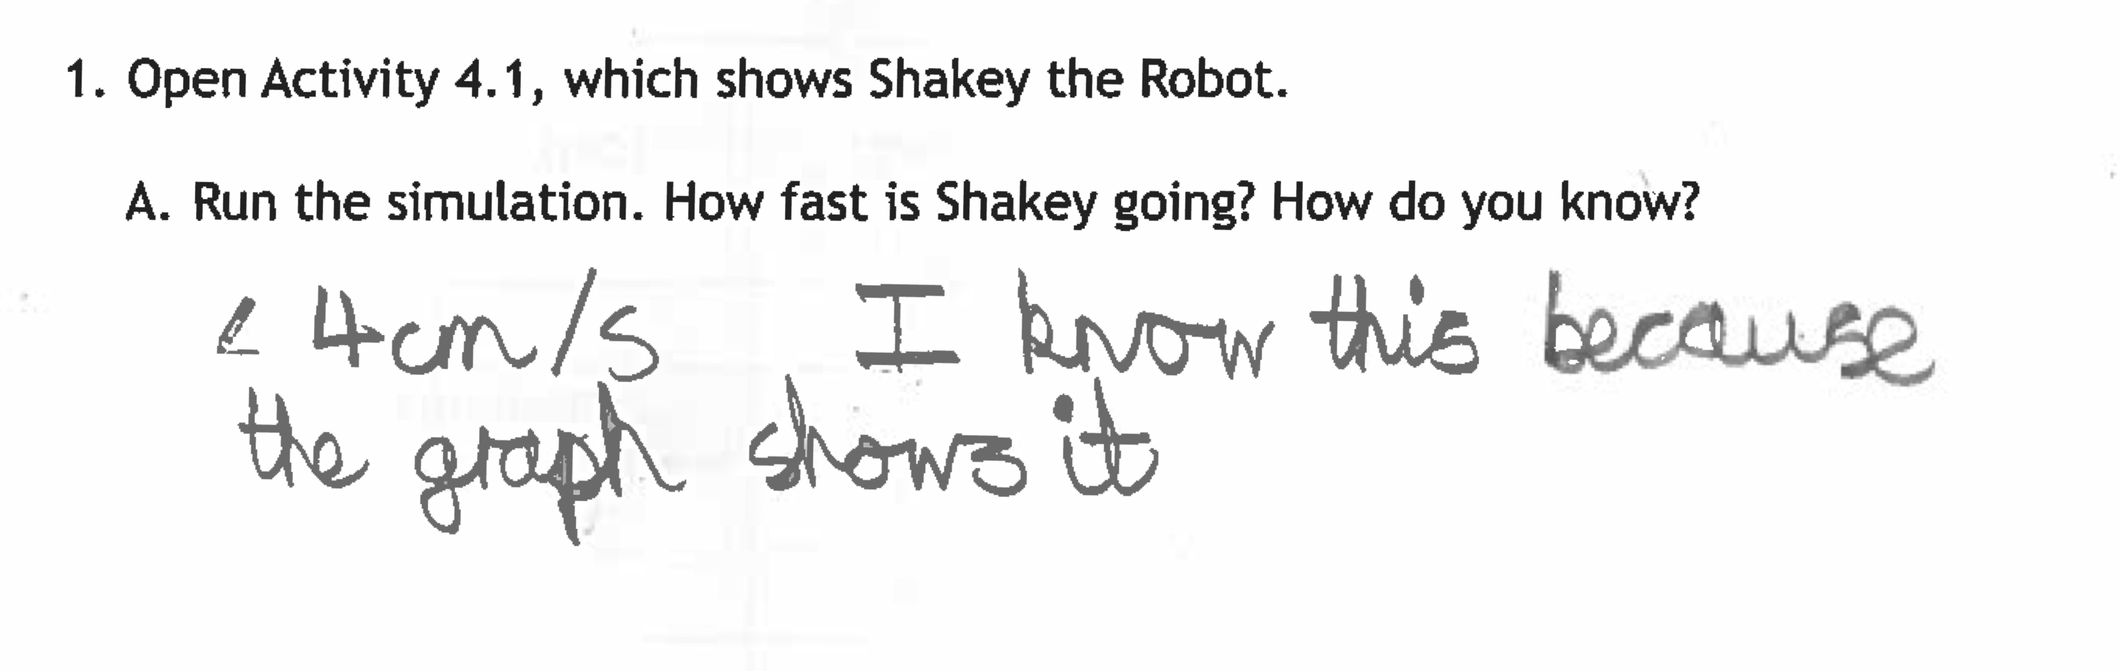
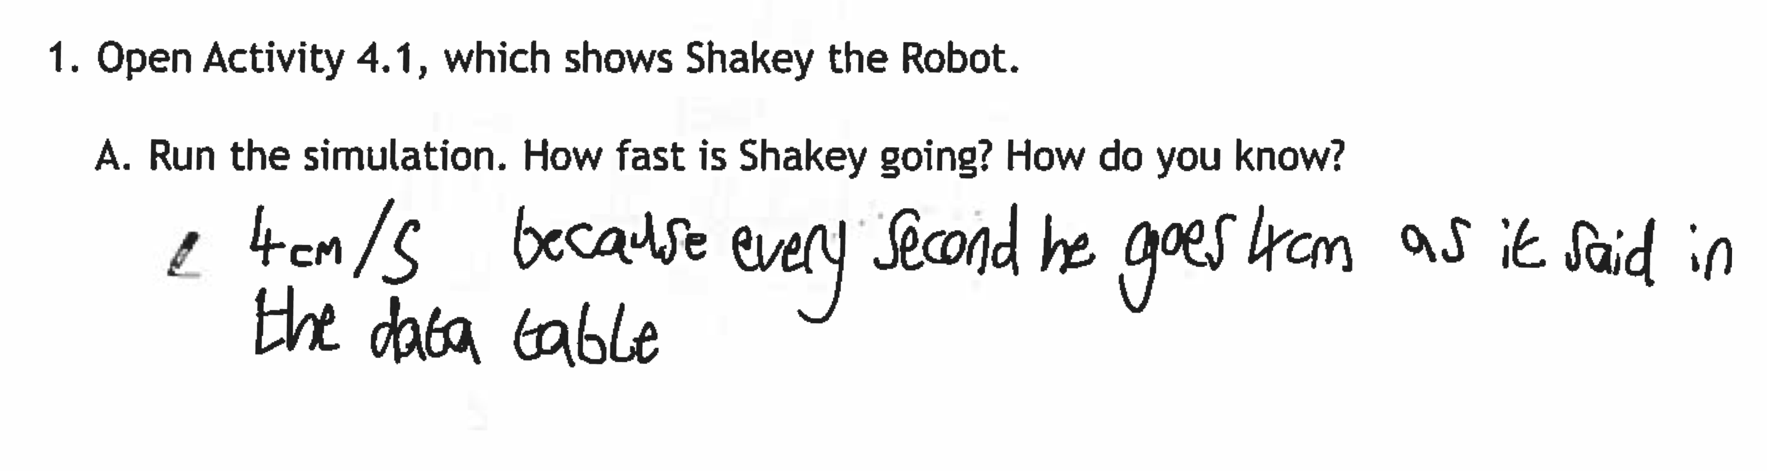
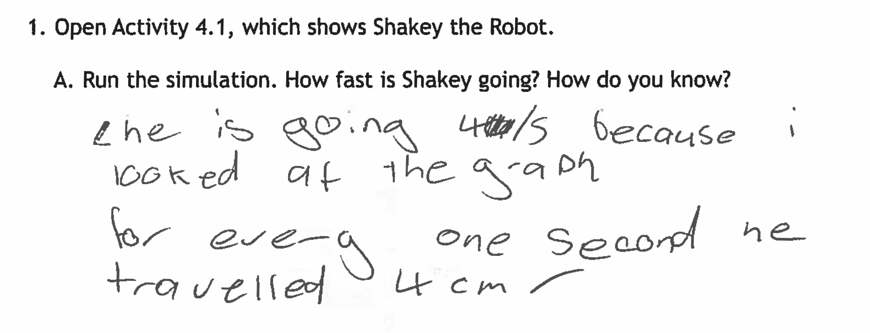
"How fast is Shakey going? How do you know?” (Inv 4, Q.1A)
Which representations are the pupils using to work out the speed?
How could you use the software (Inv 4) to promote discussion of different strategies?

Slide 6
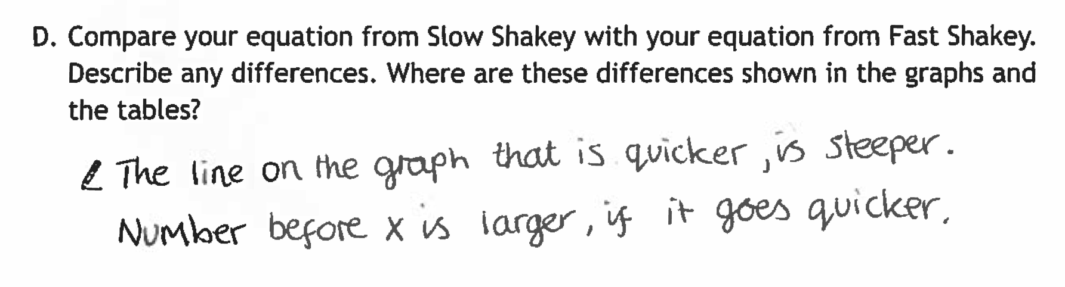
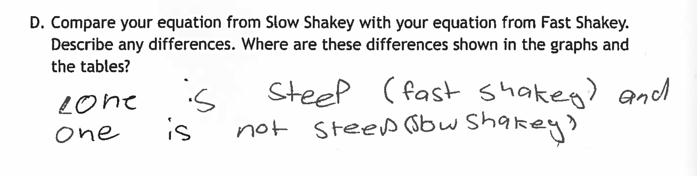
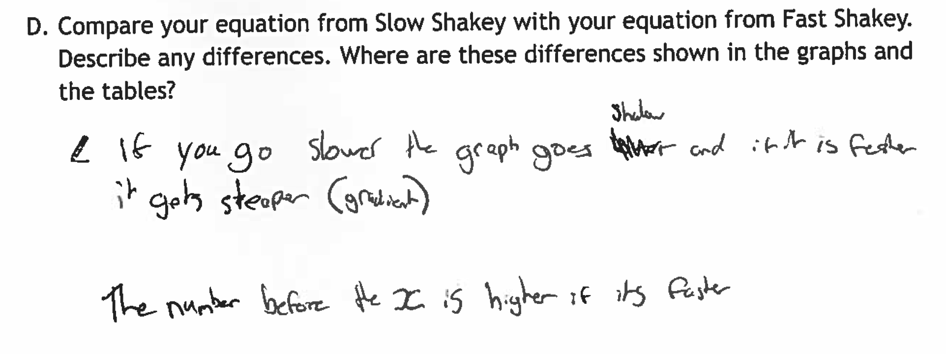
"Compare the equations of Fast Shakey and Slow Shakey…” (Inv 4, Q1D)
Which differences is it important to focus the pupils’ attentions towards?
How might using the software help?

Slide 7
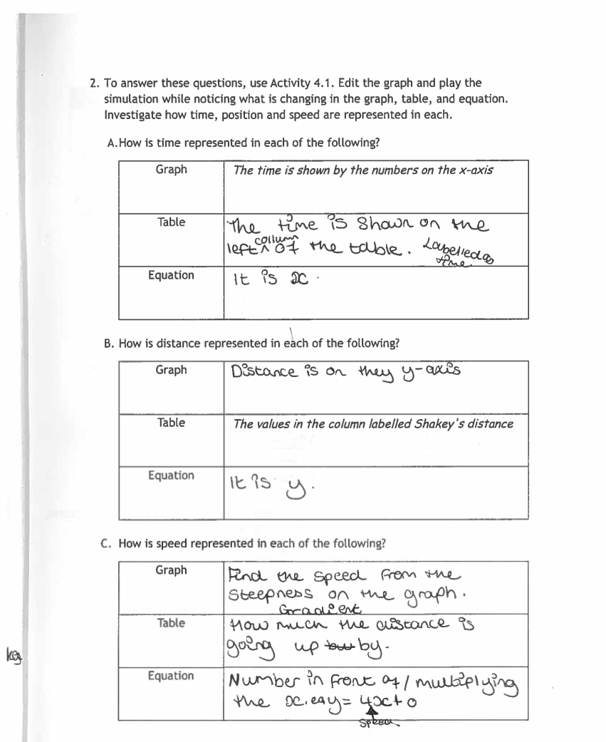
" “Describe how time distance and speed are represented…”(Inv 4, Q2a)
How will you use the software to enable pupils to respond to this challenging set of questions?

