Slide 1
PD Session 1: Linear functions

Slide 2
Preparation for the session
You will need:
Laptops or tablets with access to the Cornerstone Maths software in the Google Chrome browser
Printed copies of the Teacher Guide and Pupil workbook (Part 1)
Printed copies of the PD tasks
Printed copy of the Lesson Study guide

Slide 3
Overview
(a very brief) intro to Cornerstone Maths
linear functions – exploring the mathematical ideas (without and with technology!)
big picture of the linear functions unit of work
working through the early investigations
collaborative lesson planning of the landmark activity
next steps – ‘lesson study cycle’ and reporting back...

Slide 4
Introductory video
https://mediacentral.ucl.ac.uk/Player/2736
Notes:
link to the project video, which is located at https://mediacentral.ucl.ac.uk/Player/2736

Slide 5
(brief) Overview of Cornerstone Maths
Cornerstone Maths seeks to exploit the dynamic and visual nature of digital technology (DT) to stimulate engagement with mathematical ways of thinking by:
focusing on the ‘big mathematical ideas’
making links between key representations
providing an environment for students to explore and solve problems within guided structured activities
embedding activities within ‘realistic’ contexts
5
Notes:
02/20/12
5

Slide 6
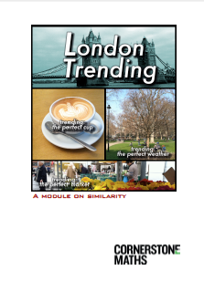
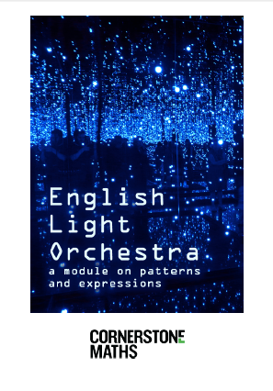
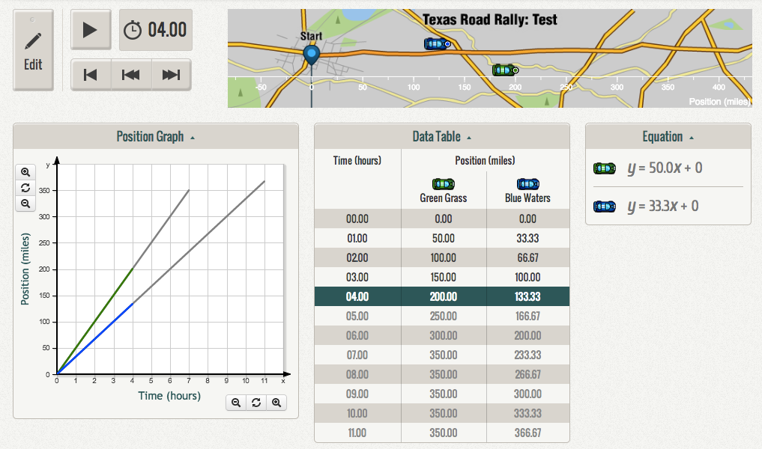
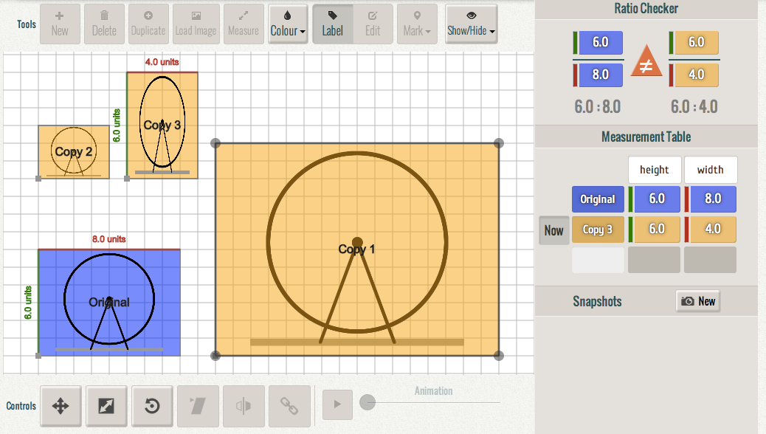
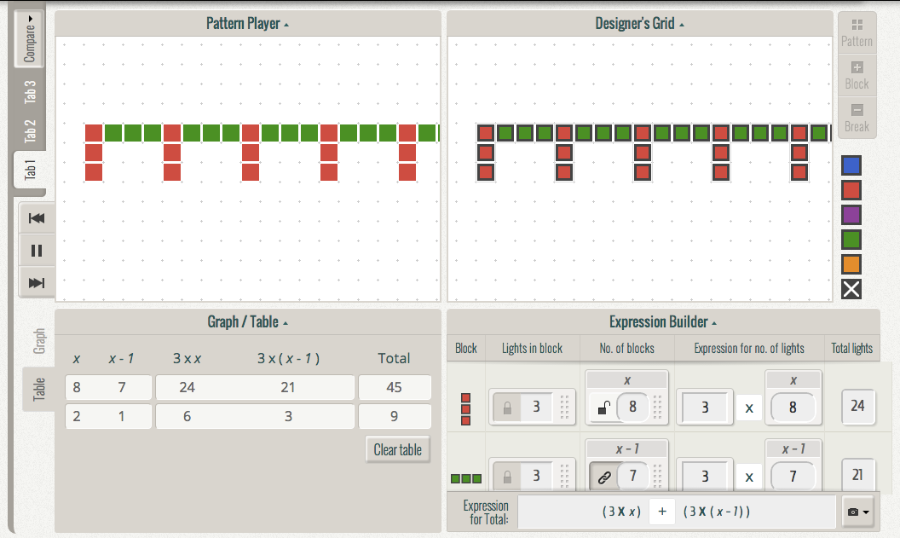
Technology enhanced units of work
Professional development
‘hard to teach’ topics
6
Notes:
02/20/12
6

Slide 7
Unit 1 – linear functions
Unit 2 – geometric similarity
Unit 3 – patterns and expressions
Unit 4 – ratio and proportion (in development)

Slide 8
PD Task 1: What is a linear function?
Write your personal response first…
If you finish before others, resist the temptation to discuss yet…
Instead, be thinking about how you introduce the concept to pupils during key stage 3 at your school…

Slide 9
PD Task 1: What is a linear function?
Share your descriptions with colleagues….
Listen for…
mathematical language?
references to different mathematical representations?
references to different mathematical notation?
mathematical rigour?
completeness?

Slide 10
PD Task 2: Hands on with the software
Open the Cornerstone Maths software
Select the Linear functions curriculum unit
Select Activity 3.3
Work in pairs on PD Task 2…
Notes:
Open Unit 1 software - Activity 3.3 now…..
In most schools you will do this by opening the LGfL web page:
https://www.lgfl.net/learning-resources/summary-page/cornerstone-maths
Choose any teacher code and any pupil codes.

Slide 11
PD Task 2: Hands on with the software
The race has not yet been created, – you’re going to edit the graph first to fit the given journey.
Click or tap on Edit – NOTICE what changes on the screen.
Click or tap on the car icons to toggle between the two cars
Click or tap on Edit to then test the simulation.
Notes:
There is no undo – if you need to refresh, use the browser refresh or the half moon.
Notes:
Open Unit 1 software - Activity 3.3 now…..
In most schools you will do this by opening the LGfL web page:
https://www.lgfl.net/learning-resources/summary-page/cornerstone-maths
Choose any teacher code and any pupil codes.

Slide 12
Things to think about/discuss…
What do each of the graph hotspots do (mathematically)?
Which hotspots can uniquely affect?
The speed?
The overall journey time?
The start position?
The overall distance travelled?

Slide 13
Things to think about/discuss…
Check that you can:
Hide and Show the graph, table and equation representations.
Edit and fully control the simulation using the graph.
Edit the simulation using the equation (speed and start position only, not the overall journey time).
Edit and control the simulation using the using the animation (start position only).
Key points about the software:
Hotspots are mathematically constrained to allow one variant property to be changed at a time – this is important as pupils need to see the mathematical effects.
The rate (speed in this context) is visible in the graph, table and equation – a big idea to build on…
Tables contain the dependent variables – they are determined by the function therefore cannot be edited.

Slide 14
PD Task 3: Reading and interpreting multiple representations
Use the above screenshot to complete PD Task 3 (Software not needed…)

Slide 15
PD Task 3: Reading and interpreting multiple representations
Share your different strategies…
Which ones did you use?
How many (there are at least 5!)
What mathematical knowledge did each strategy demand?

Slide 16
Big picture of the linear functions unit
“Let’s work on a game with robots.
We need to set up the mathematics to make our robots move at different
speeds.”
Context: Developing games for mobile phones: using mathematics to analyse and create simulated motion games.
Design principles:
dynamic simulation and linking between representations
drive the simulation from the graph or the function
show/hide representations, as appropriate
Big mathematical ideas
Coordinating algebraic, graphical, and tabular representations
Speed as a context to introduce rates of change
y= mx+c as a model of constant velocity motion – the meaning of m and c in the motion context
Piece-wise linear functions
Velocity as speed with direction and average velocity [in Part 2]
Simulation
Table of values
Graph
Equation

Slide 17
Research-informed approaches
Use of dynamic linked mathematical representations develops conceptual understanding.
Links with ‘variation theory’ – technology lets you explore conceptual variation by experience. The software will only let you change one mathematical variable at a time! (i.e. speed, starting point or total journey time).

Slide 18
Mathematical progression (part 1)
-Motion can be represented on a graph of time versus distance.
-Idealised motion on a time-distance graph appears as a straight line (constant rate).
-Motion can be represented on a graph of time versus distance.
-Idealised motion on a time-distance graph appears as a straight line (constant rate).
-Graphs are mathematical representations of relationships such as motion.
-Graphs of motion show characters’ start position, speed (relative) and places and times where characters meet.
-For graphs of motion, that is, time versus distance: the steeper the line, the faster the motion.
-Speed can be determined from different parts of graph and simulation.
-Equations, also known as algebraic expressions, are a form of mathematical representation. Graphs and tables are other forms.
-Equations can be written based on tables or graphs.
-You can “translate” between graphs, tables and equations.
-Time, distance and speed are represented differently in these three representations.
-For equations of the form y = mx, in motion contexts, m is the speed of a moving object.
-You can “translate” between graphs, tables and algebraic expressions.
-Introduction to non-proportional linear functions (not passing through the origin).
-Pupils explore two ways to derive the equations of non-proportional linear functions: using
differences of position and time in a table; using the y-intercept and speed/gradient of a graph.
-For equations of the form y = mx + c, in motion contexts, c is typically the starting point and m is the speed of a moving object.
-In a position-time graph, multi-segment graphs can represent characters moving at different speeds.
-Graphs tell a story. Stories can be represented in the form of graphs. In this activity, pupils will learn to write stories from graphs and make graphs for stories.
-“Flat” or horizontal lines represent standing still.

Slide 19
Get to know the Teacher’s guide!
It includes guidance on:
National Curriculum mapping (p. vii and viii)
Classroom organisation (p. ix – xi)
The CM Pedagogy: Predict-Check- Explain
Mathematical progression and key technology experiences
Context for the module (pages 1-2)
Outline ideas to support lesson planning - key ideas, question and guidance in relation to the task, plenary, pupil difficulties.
Pages from Pupil’s workbook with suggested answers

Slide 20
Get to know the early investigations
Using the pupil workbook, work through Investigations 1 to 4…
As you do so, think about:
The progression in the mathematical ideas, and how you’ll ensure that all pupils understand the developing concepts.
How you’ll support your pupils through the tasks – your introductions, key ideas, questions and potential pupil difficulties (The Teacher Guide offers support for this).

Slide 21
Planning for the landmark activity
The landmark activity for the linear functions unit is Investigation 4, ‘Shakey the robot’
This is the first activity where pupils meet linear functions expressed with algebra.
The emphasis is on pupils being able to understand the different representations, with a focus on the value and role of ‘m’.
We offer a planning proforma to support a more detailed lesson plan for this activity.
Many other teachers’ plans for the landmark activity are available in the NCETM Project Community.

Slide 22
The Lesson Study cycle
Use the Lesson Study Guide to support the planning, teaching and reflection cycle
Notes:
Link is http://www.ucl.ac.uk/ioe/research/projects/cornerstone-maths/pdf/2_1_3_Linear_functions_Lesson_study_guide.pdf

Slide 23
Planning Investigation 4
Do Investigation 4 for yourself – and establish your learning objectives.
Use the planning template to develop your lesson.
You may find it helpful to create a ppt/IWB presentation at the same time – with key instructions/prompts/questions etc.

Slide 24
Top tips for planning….
Think through when you should open the software from the front of the class first – and when to ask the pupils to open the software…
Give students time to make sense of the software – and how the editing works. Involve students in this – invite them to demonstrate from the front.
Encourage pupils to explain their thinking in words – by discussing first and then recording - they will want to rush through…
Inv 4 – Q 2 is a key question – think about how you will manage this phase.

Slide 25
Post lesson reflection discussion
Teaching:
What were the most effective prompts, questions and actions?
How was the software used and to what effect?
Learning:
What did pupils discuss?
How did pupils reason?
What did pupils record?
Mathematics:
How did the dynamic concept of a linear function develop during the lesson?
What mathematical surprises or challenges do you observe?

