Slide 1
Maternity hepatitis B virus (HBV) surveillance data from England

Slide 4
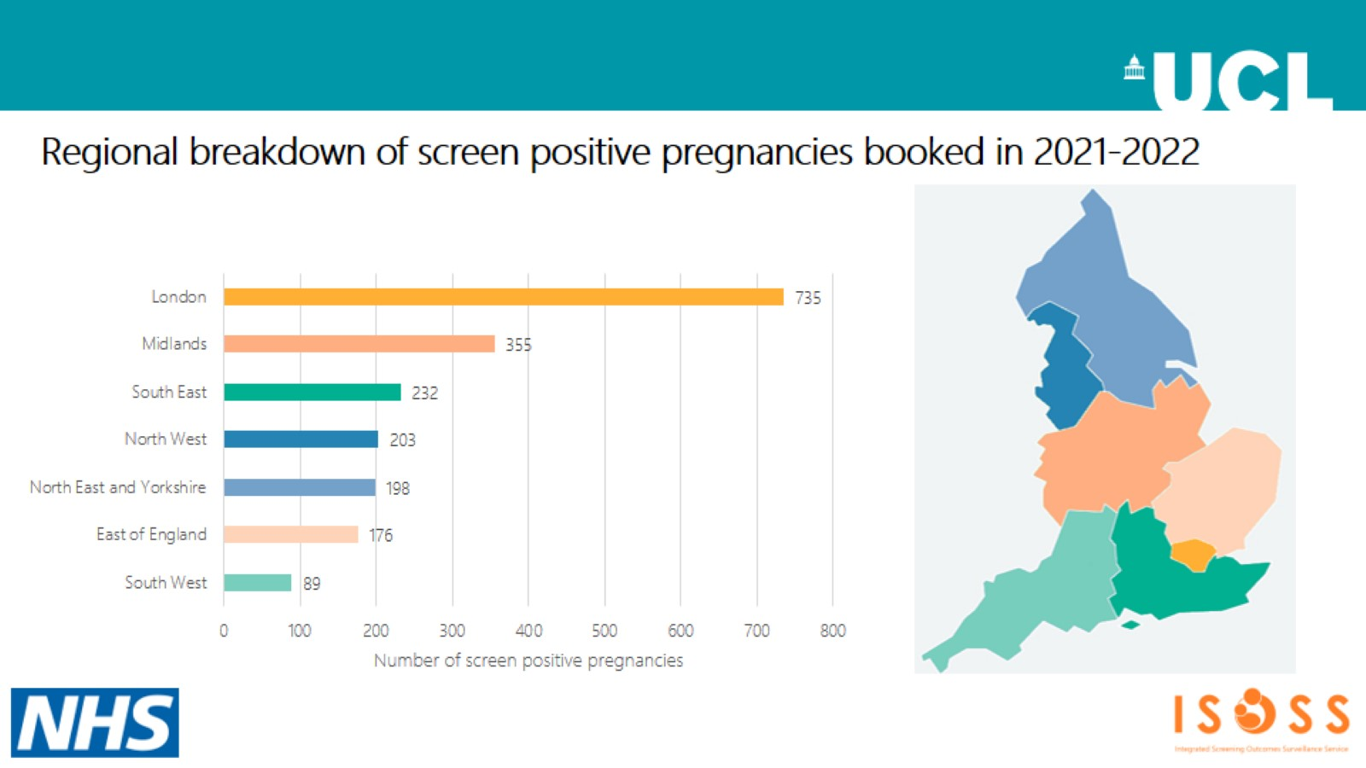

Slide 5
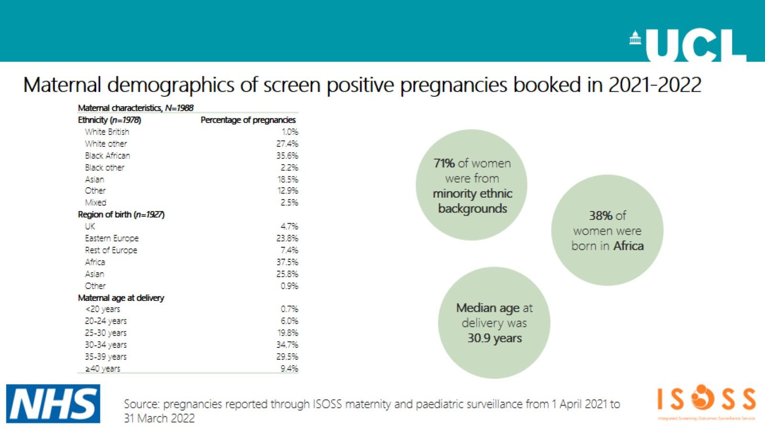

Slide 6
