Slide 1



Contouring Curation in Research Libraries:
Defining “Working” Data Units and Communities
Carole L. Palmer
Center for Informatics Research in Science & Scholarship
FOURTH BLOOMSBURY CONFERENCE ON E-PUBLISHING AND E-PUBLICATIONS
Valued Resources: Roles and Responsibilities of Digital Curators and Publishers
24-25 JUNE 2010

Slide 2
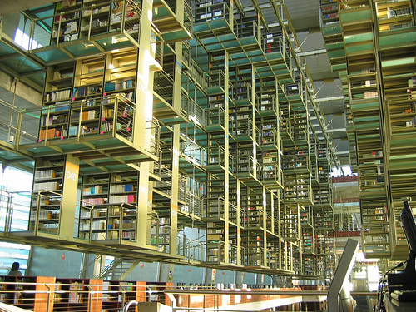
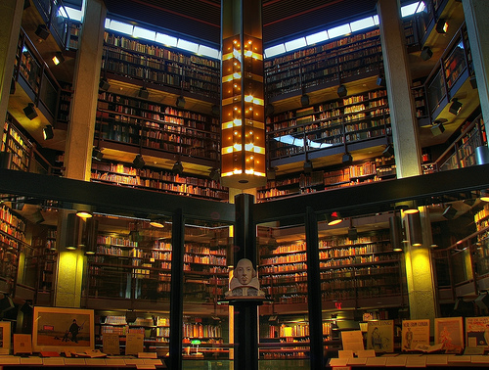
Data curation and the future of research libraries
Data assets vital for universities and research centers
- to produce competitive science and scholarship
- to be good stewards of the common good produced through research
Natural extension of research library mission
- to provide information resources to support current and future scholarship
The new stacks? (W. Tabb)
The new special collections? (S. Choudhury)
Flickr: stancia, rh creative commons
flickr.com/photos/001fj/2907653323/

Slide 3
Same “metascience” & specialist responsibilities
(Bates 1999)
  Provide access and promote sharing of broad landscape of information
    across institutions and disciplines
  in tradition union catalogs, bibliographies of bibliographies
    across generations
    long-term, just in case, collecting
But comprehensive and functioning infrastructure and services
envisioned for interdisciplinary & multi-scale science and scholarship,
requires information and data expertise
ON THE RESEARCH TEAM & IN THE LIBRARY

Slide 4
Research on range of organizational structures
Research libraries will provide direct support for some
  -- align with and connect to others
  local cross-departmental data – “faculty of the environment”
  geographic site cross-disciplinary data – unique research intensive location
  disciplinary “resource collections” – neuroscience case
  institutional repository services – individuals, across disciplines
  national research library initiative – Data Conservancy
Functionality will need to support “strategic reading” (Renear & Palmer, 2009)
not just of literature, but data sets as well.

Slide 5

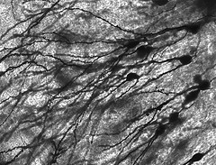

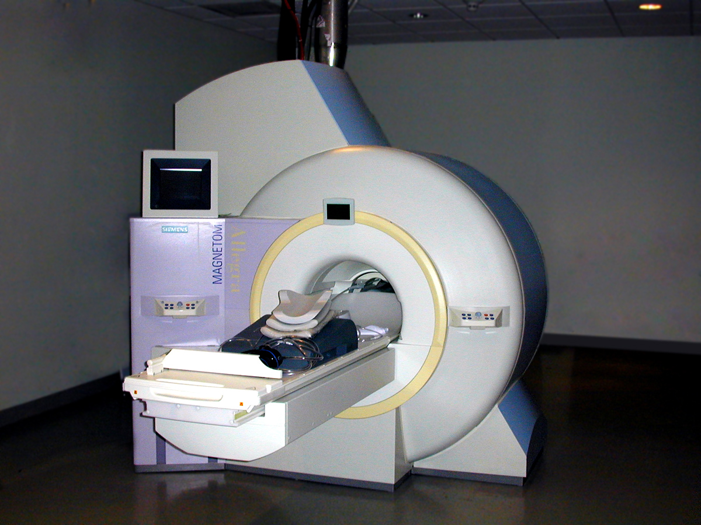
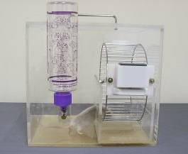
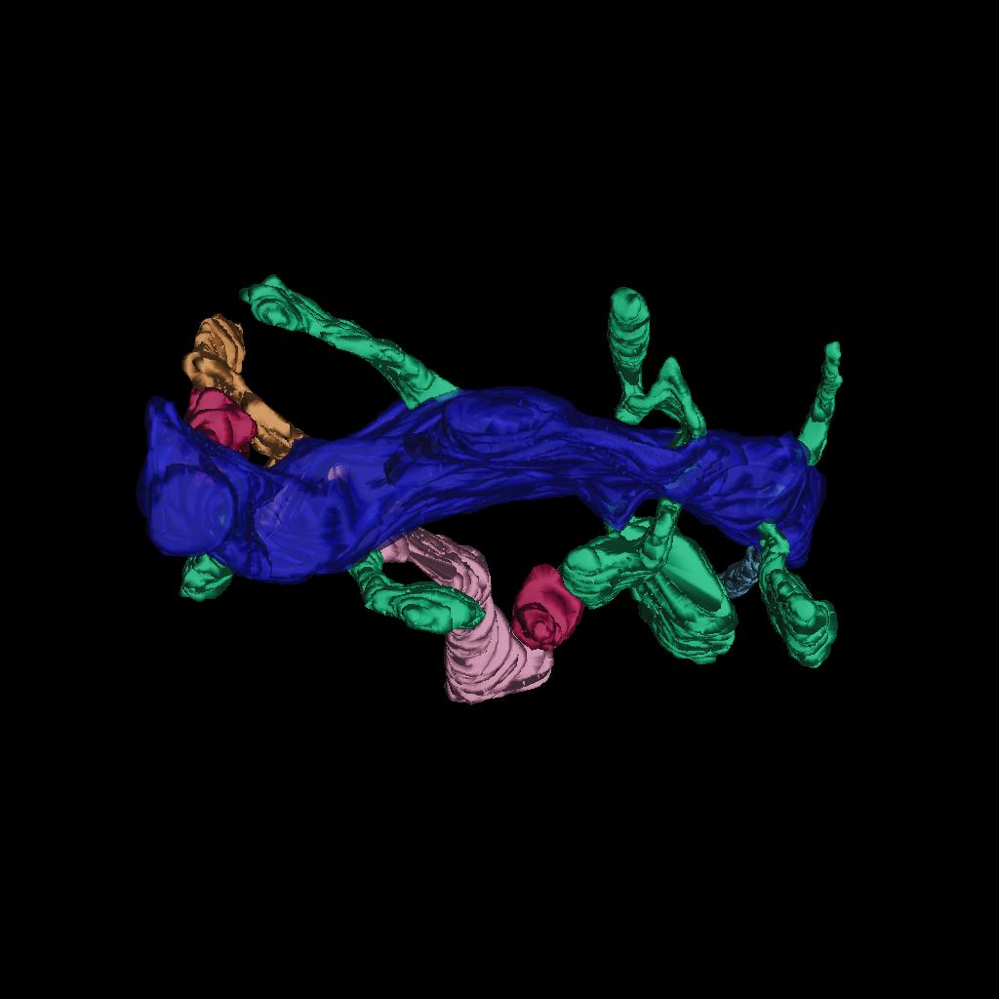
Discipline based repository
Information and Discovery in Neuroscience Project (NSF/CISE, 2002-2005)
Tensions managing data repository efforts & scientific research activities
  Depositor & user perspectives: 341 multi-scale, multi-format data sets
    cell biologists, microscopists, modelers
Important functions beyond archiving and access
  Registration, certification, awareness function (see Cragin, 2009 dissertation)
Implications for moving “research” collections to “resource” level repositories
Methods development - progressive, critical materials approach to data collection
from multiple information seeking, use, and management perspectives
Used with permission from NCMIR

Slide 6



Institutional repository
Data Curation Profiles Project (IMLS NLG 2007-2010)
Individual scientist’s data production workflows and perspectives on sharing
  Scott Brandt, PI; Collaborators: M. Witt & J. Carlson, (Purdue)
  Palmer, Cragin, & Shreeves (Illinois)
Biochemistry
Biology
Civil Engineering
Electrical Engineering
Food Sciences
Earth and Atmospheric Sciences
Soil Science
Anthropology
Geology
Plant Sciences
Kinesiology
Speech and Hearing
Earth and Atmospheric Sciences
Soil Science
derive requirements for managing data sets in IRs
develop policies for archiving and access
articulate librarian roles & skill sets for supporting archiving & sharing

Slide 7
Data collection and analysis
Interviews
- with scientists and data managers
Case Studies
- with selected research groups in
geology and civil engineering
Focus Groups
- with liaison librarians on their
work with academic researchers
related to data issues
Needs Analysis
- policy assertions for
preservation and access,
based on researchers as data producers, suppliers, and users
Curation Profiles
detailed disciplinary profiles
Instrument for curatorial practice

Slide 8
Nationally scoped research library repository
Data Conservancy - assertion and approach
Research libraries will be a core part of the emerging, distributed
network of data collections and services.
  Integrated and comprehensive data curation strategy
    to collect, organize, validate, and preserve data
    to address grand research challenges that face society
  Infrastructure builds on & connects existing exemplar projects and communities
    deep engagement with scientists
    extensive experience with large-scale, distributed system development.

Slide 9

Data Conservancy.org
PI, Sayeed Choudhury, Sheridan Libraries
  Network of domain and data scientists, information and computer scientists, enterprise experts, librarians, and engineers.
Co-PIs and Partners
Carl Lagoze | Cornell University
Mary Marlino | National Center for Atmospheric Research (NCAR)
Carole Palmer | CIRSS, GSLIS, University of Illinois at U-C
Paddy Patterson | Marine Biological Laboratory
Chris Borgman | University of California Los Angeles
Ruth Duerr | National Snow and Ice Data Center
Mark Evans | Tessella, Inc.
Eileen Fenton | Portico
Sandy Payette | DuraSpace / Fedora Commons

Slide 10
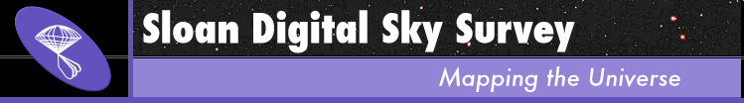

Astronomy as an exemplar community
Success in data standards, practices, documentation, and associated services
Ingest astronomy data into preservation archive,
connect data to existing services used by astronomers.
Demonstrate utility of hosting data in environment that supports
existing scientific capabilities in a sustainable manner.
Scope to include: life sciences
          earth sciences
          social sciences

Slide 11


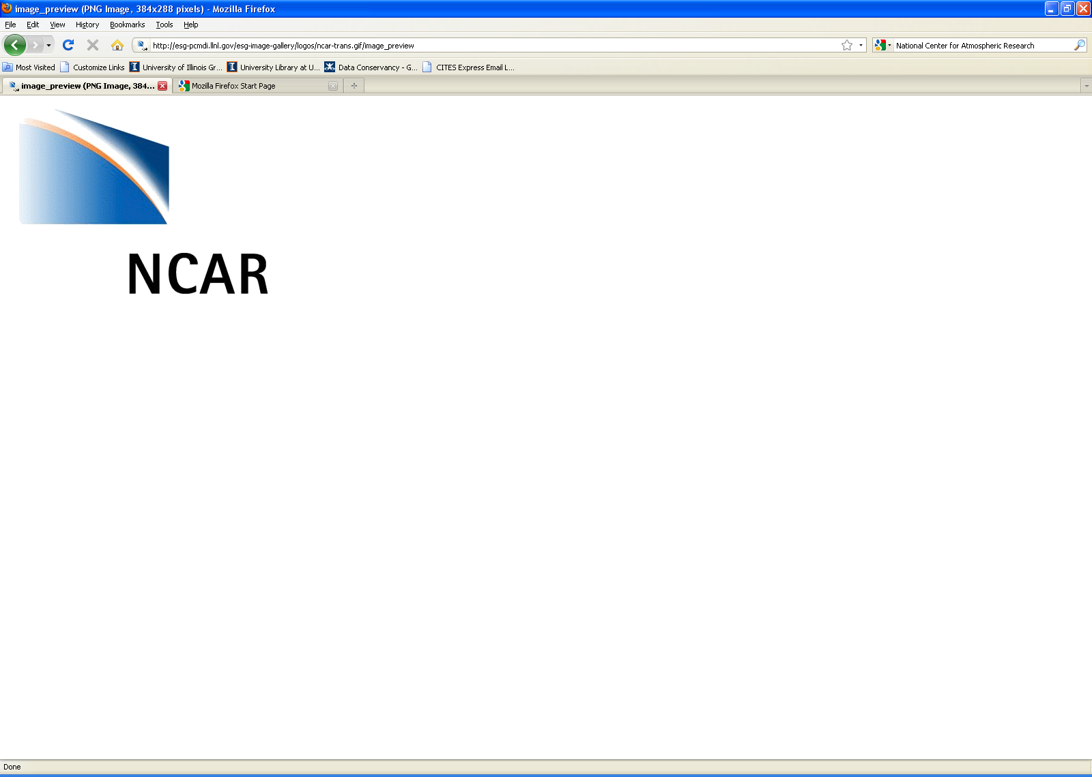

Science and library based hubs
Marine Biological Laboratory
  Encyclopedia of Life - taxonomic organization, ontology indexing
  species identification queries for climate change analyses
National Snow & Ice Data Center
  extensive sensor network, fieldwork, aircraft and satellite data
  access node on the DC network, test bed for distributed services
National Center for Atmospheric Research
  civic decision making and climate science in megacities
Cornell University Library
  DataStar - promotes archiving to disciplinary data centers
  arXiv eprints - OAI-ORE to link research data with publications
Notes:
Object reuse and exchange

Slide 12
Data framework
Start with a common conceptualization that applies across domains
-- scientific observation
Examine, adapt, and adopt existing models
  National Virtual Observatory
  Scientific Observations Network (Sonet)
Define fundamental concepts and identity conditions
  collections, data sets, version, etc.
(Data Concepts team at Illinois, lead by Allen Renear)
Accommodate range of disciplinary data and metadata standards
-- dozens in earth, atmospheric, soil science alone,
yet the “typical” scientist may know of none

Slide 13
User requirements and research
 | Astronomy | Life Sciences | Earth Sciences | Social Sciences
NCAR | Task-based design and usability testing ⇒ User cases, data requirements, system recommendations
UCLA | Ethnography, oral histories ⇒ Use cases, Data reqs. | SMALL SCIENCE - reuse potentials ⇒ Curation requirements framework relating data characteristics and stages (metadata & provenance) to community data practices |  |  | ILLINOIS

Slide 14
Applying quasi-profiling approach
Data kinds and stages - sharing targets, workflow/ provenance, context
Intellectual property - owner(s), stakeholders, terms of use, attribution
Ingest org /description – formal / local standards, documentation
Access - embargo, access control, mirror site
Preservation – targets, duration, migration
Tools - analytical, visualization, integration
Interoperability - needs, APIs, 3rd party data, etc.
Storage, integrity, security - audits, version control
Discovery – browse, search, external

Slide 15
Progressive data collection
Talking shop about data
  efficient exchange with the right scientists about the right things
Scientists leading research - IP, access, discovery, research context
      Pre-interview worksheets
      Semi-structured interviews
      follow up sessions with selected participants
  Scientists managing data - stages, versions, standards, tools
  (post docs, others from labs and research groups)
      Data deposit & sharing worksheet
      Data samples, related documentation

Slide 16
Units of analysis
  Data “sets”
    aligned with research group production and dissemination
    workflows and services
    policies on attribution, embargoing, etc.
  Data communities
    Aligned with current and future interactions around data
    representation, functionality, and use
    policies for selection, appraisal, retention, description

Slide 17
Data communities
What are the meaningful social units for organization and use
of data over the long term?
    Sub-discipline focused on particular kinds of data that
    produce specific measurements or analysis
    Specialized domain focused on a research problem,
    often interdisciplinary in nature
    Developers of shared community-level data collection
    (i.e., “Resource Collection”, NSB 2005)
    Core research challenge:
    Predict and design for communities of users,
    which will differ from producers, and change over time
Notes:
Urban vulnerability to climate and weather hazards

Slide 18
Systems oriented “small” science
 | Geobiology | Volcanology | Soil ecology
Analytical data unit | Site-specific time series: reduced spreadsheets: rock, water, microbial microscopy images annotated digital photographs | Rock profile: physical rock thin section chemical analysis photographs field notes | Database: multiple abiotic soil measurements associated metadata
User communities | Geology Chemistry Microbiology Genomics U.S. Park Service | Geology – igneous petrology Geophysics Geochemistry | Geology – bio geo chemistry Earthworm ecology Sensor network researchers
Sharing conventions | by request no repository mostly post-publication some unpublished | by request no repository | public resource collection
Individual data components required for reuse
At present, literature and conference-based sharing relationships

Slide 19
Research informing LIS education
Preparing information professionals for range of workforce demands:
MSLIS concentration in data curation
sciences, 2006 -
humanities, 2008 -
Masters in bioinformatics
2006 -
Curation
in the
Sciences
Curation
In the
Humanities
Biological
Information
Specialist
Summer
Institutes
In service professional
development
2008 -

Slide 20
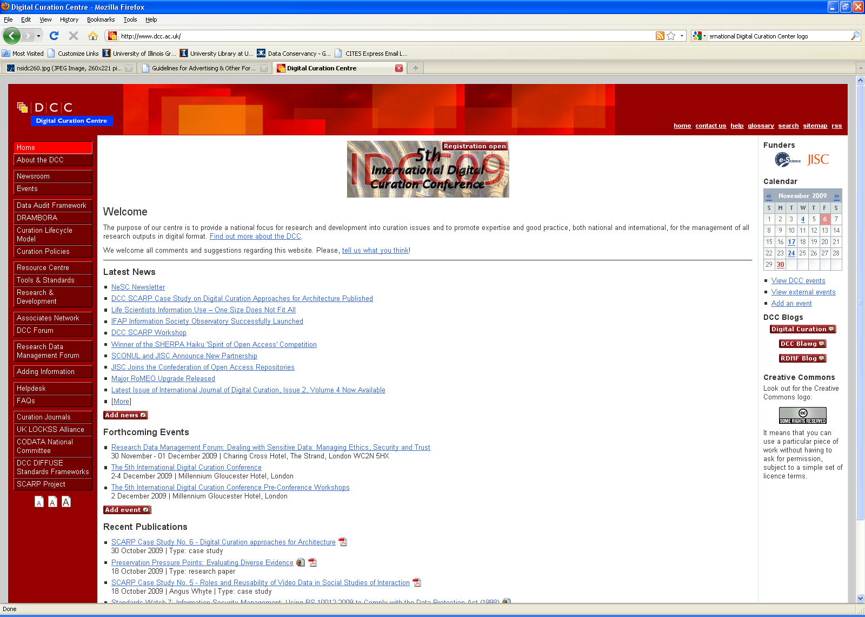
6th International Digital Curation Conference
Chicago, IL
Dec. 6-8, 2010
hosted by
CIRSS / GSLIS
in partnership with
Digital Curation Centre, UK
pre-conference DataNet Education Summit
post-conference LIS Research Summit

Slide 21
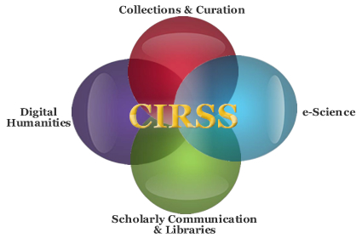
Questions & comments, please
Center for Informatics Research in Science and Scholarship
clpalmer@illinois.edu
http://cirss.lis.uiuc.edu/

Slide 23
Data curation is . . .
the active and on-going management of (research) data
through its lifecycle of interest and usefulness
to scholarship, science, and education.
Functions
enable discovery and retrieval
maintain data quality
add value
provide for re-use over time
archiving
preservation
Tasks
appraisal and selection
representation
authentication
data integrity
maintaining links
format conversions

