Slide 1
Problem Statement
Who is affected ?
What is it about ?
Where/When does it occur ?
Why ?
A problem statement is a concise description of the problem to be solved.
Notes:
Next we defined a Problem statement – It helps clearly identify the goals of the project and outline the scope of a project. It also helps guide the activities and decisions we make when working on the prototype.
this help shape focus and decisions based on a structure problem we all agreed to solve.
Who is affected by the problem ?
WHO is having a problem?
WHO will benefit from our solution?
What do we know/assume about them?
What is it about what is the problem?
Is it easy to explain?
Is it an actual/real problem?
Have we got any evidence?
Where/ when does it occur?
What is the context where the Persona is experiencing the problem?
Can we easily explain the context?
Have we got proof of the problem happening in a certain context or space?
Finally, why?
What is the most important value for the user?
What pain points would a solution help get rid of
Why is the problem important?

Slide 2
Problem Statement
Defined our problem statement
Who? - Looked after children 13-18 years old
What? - may not have the tools, experience, or opportunity to express themselves
Where/When? - and explain what they're feeling, what's happening to them, and what's important to them.
Why? - This is important to children looked after (13-18) because it gives them autonomy and control over their life story and enables them to talk for themselves.
Notes:
Next we defined the Problem statement in a collaborate workshop with UCL and OLM coming together, looking at who, what, where and why? We agreed together ….

Slide 3
Brainstorming and design
OLM UX Team worked internal
Personas of user
Average day mapping
Product ideas and features
Designed and built a prototype
Notes:
Next steps were to have details persona of the user
Bio of Sam age 14 in long term care
Creating details of his motivations, wants/needs and Pain points/Frustrations
Then we mapping out Sam’s digital touch points
Followed by product ideas aligned the overall problem statement
autonomy
control
Own voice

Slide 4
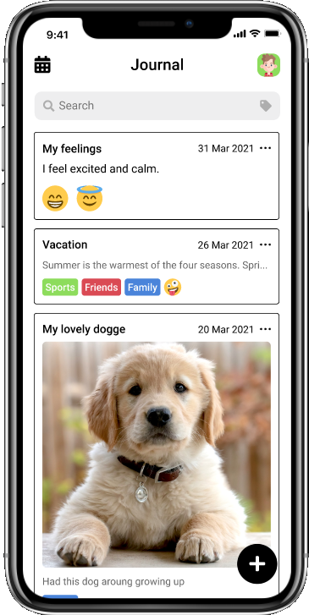
The protype

Slide 5
Testing and feedback
Usability testing has to be with participants that match the profile of the application user criteria
Insights were great and feedback was good
Co-researcher reviewed and with UCL
Feedback all included in feasibility documentation
Notes:
General the app was well received and easy to use.
Positives
No gender in the profile
Future thoughts for the app
Linkage to an adult/carer prompts to suggest postings
These would need further research and development but be clear to steer away form social worker home work approach. And be more nurture.
Question on image use – regards to photos of minors and others.
Overall, more testing would be required to analyse the suitability for older users.

