Slide 1
UCL Gender and Ethnicity pay report 2021/22

Slide 2
Foreword
This year both the mean and median gender pay gaps are likely to again to be amongst the lowest in the Russell Group. However we are disappointed that progress on reducing the gender gap has stalled. This will be explored in more detail later but the lack of reduction of the gender pay gap does hide some wider positive news. Importantly, we can see that the proportion of female staff at each of the grades above the median UCL earnings (Grades 8-10) is increasing. The static mean gap and marginal rise in median gap is driven by an increase of female staff at grades below the median, specifically at Grade 6.
Disappointingly we have again not made progress on the ethnicity pay gap, despite having conducted an equal pay audit. Here there is a similar trend to gender, with the proportion of BAME staff above the UCL median is also increasing (which is a positive development). However, this is offset by an increasing proportion of BAME staff compared to white staff at Grade 6. This year we have also seen a significant jump in the number of staff with ‘unknown’ ethnicity which has affected the ability to be able to draw reliable conclusions.
Nevertheless, we remain committed to addressing gender and ethnicity pay gaps over the coming years. We will continue to embed a series of targeted initiatives to tackle this issue and help promote UCL as an inclusive employer of choice. In particular we will continue to support the career development of women and BAME staff to increase their representation at our highest grades. We reported last year that we had launched our innovative new positive action secondment scheme ‘Accelerate to Leadership’ in our professional services areas to broaden the pool of BAME candidates for future Grade 9 and 10 roles and we have begun to see people promoted via this route. We wish to expand this scheme to Grade 8 roles. We would expect to see positive results from that in subsequent years and we hope that this will also help us to increase the proportion of BAME staff paid above the UCL median. It is important to note that this report focuses on data taken as at 31st March 2021, in the middle of the Covid- 19 pandemic. We are pleased to have taken action in reward processes, such as continuing academic promotions, which aim to ensure there is no unintended negative gendered effect from the pandemic on the pay of staff. It will be important to maintain this and monitor outcomes as we move forward.
Matthew Blain
Chief People Officer

Slide 3
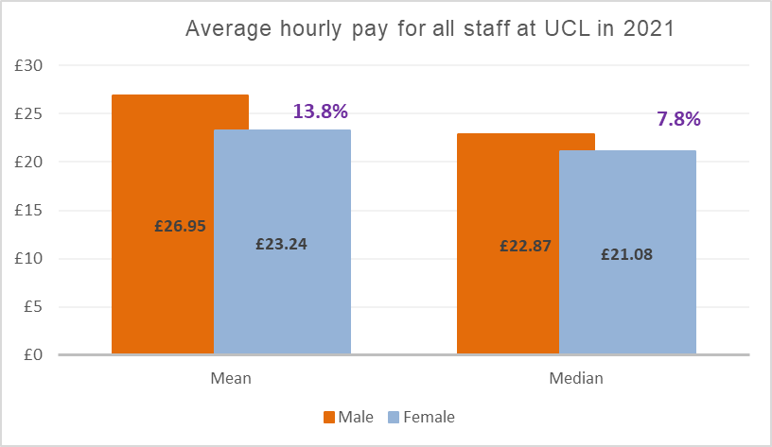
Gender pay gap analysis
Gender pay focuses on the differential between the average (median and mean*) salary of all women and men at UCL. The mean gap at UCL now stands at 13.8% and the median at 7.8%. This remains significantly below averages in wider society. As a reference point the ONS reported 2021 median gap for all staff in the UK is 15.4%, nearly double the UCL median.
Comparing these figures with 2020 reports would mean that UCL has the second lowest median and mean gap amongst the Russell group.
*The mean is calculated by adding up all of the wages of employees and dividing that figure by the number of employees. The median is the number that falls in the middle of a range when everyone’s wages are lined up from smallest to largest

Slide 4
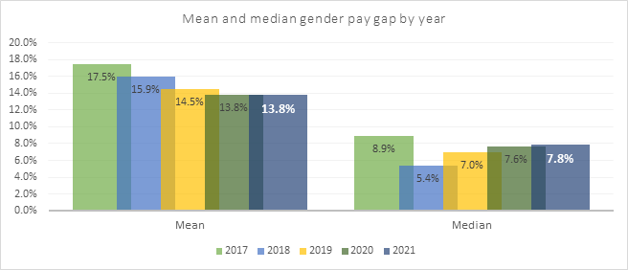
Gender pay gap analysis
UCL’s mean and median gaps have remained largely the same as last year. The proportion of female staff has increased at all levels of UCL including in each of G8,9 and 10. The increase at G9-10 is largely as a result of the senior academic promotions process which continues to deliver better diversity outcomes.
However, these positive aspects have been outweighed by the proportion and number of female staff paid below the median UCL salary also increasing. Specifically the number of G6 staff who are female has increased, meaning that the overall pay gap has remained static.

Slide 5
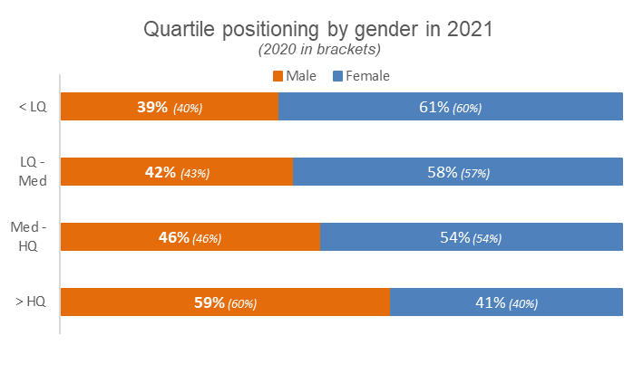
Gender pay gap analysis
The proportion of female staff has increased by 1% in all quartiles aside from the median to high quartile, which stayed the same. Female staff continue to be well represented in the UCL workforce.

Slide 6
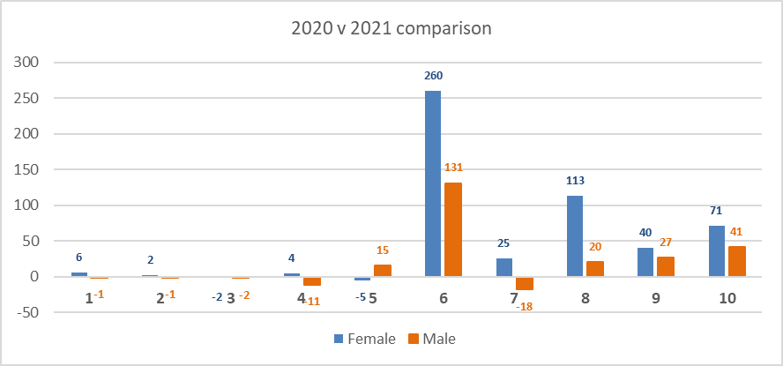
Gender pay gap analysis
We can see that at each of G8, 9 and 10 (above median) there has been a higher increase in the number of female staff in each grade. This reflects the positive action that UCL has taken at this level.
However, at G6 (below median) the number of females has increased by 260 compared to males increasing by 131. The effect of this has been to lower the female median salary more than the males.
The main reason for the increase in numbers at this grade is that more Postgraduate Teaching Assistants (PGTAs) have been employed via the payroll (reducing casualisation). The number of female staff in this cohort has increased dramatically.
At G7 (again below median) we can also see an increase in female staff (25) and a decrease in male staff (18) which would also have lowered the female median vs the male.

Slide 7
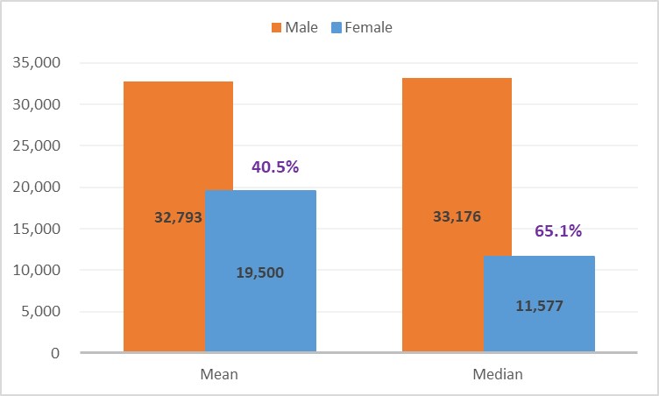
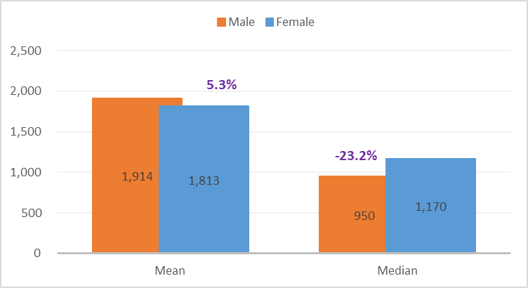
Gender pay – bonus reporting
As in previous years the proportion of staff who receive a bonus at UCL is very low. The majority of bonuses are NHS Clinical Excellence Awards (CEAs), the same as the position last year.
Only 0.6% of female staff received a bonus and 1.3% of male staff received a bonus. This is lower than previous years. The reason for the differential is that there is a far higher proportion of men who receive CEAs. When taking out CEAs the proportion of bonuses paid is equal for females and males.
The CEAs are much higher than typical payments, ranging up to £77,320 for the highest level award- platinum. These awards are agreed and mandated by the NHS but paid via UCL’s payroll.
If the CEAs were taken out of the reporting, women receive higher median (23.2%) but marginally lower mean (5.3%) bonuses than men.
Pay gap in bonuses paid
Pay gap in bonuses paid excluding Clinical Excellence Awards (CEAs)

Slide 8
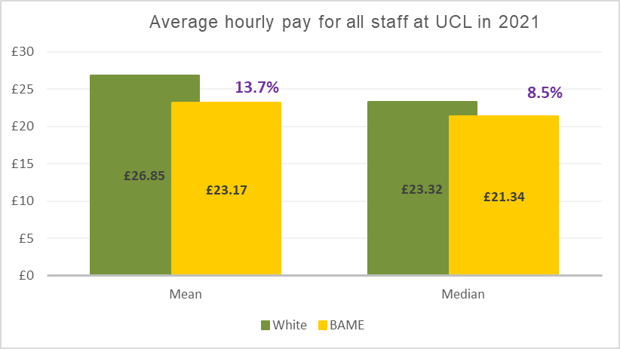
Ethnicity pay gap analysis
As with gender, BAME staff are underrepresented at senior levels which continues to be the overwhelming reason for the ethnicity pay gaps.
Last year UCL checked starting salary and salary position within grade by ethnicity as part of an equal pay audit. This has shown that, as with gender, UCL does not have a fairness issue in terms of equal pay for work of equal value. This is not therefore driving the overall ethnicity gap.

Slide 9
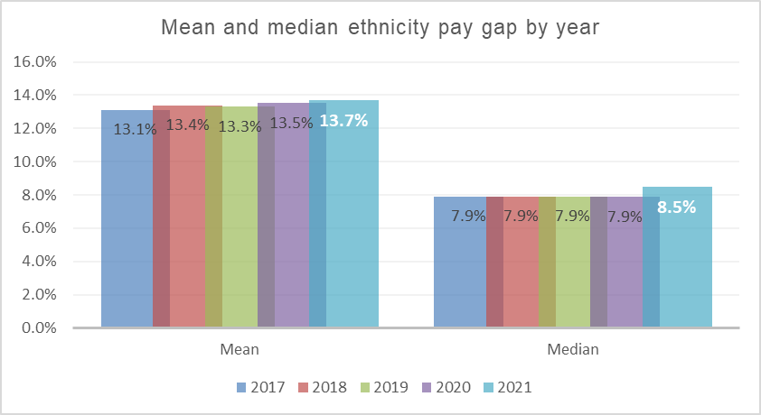
Ethnicity pay gap analysis
The results this year have again been almost static. The mean gap has increased marginally by 0.2% and is now 13.7% and the median gap has increased to 8.5%.
The proportion of BAME and White staff between the grades and the quartiles remains very similar to previous years.
The proportion of staff with unknown ethnicity has risen to 23% across UCL (which was 17% in 2020). Within specific grades the figure has risen even more- for example there is a 64% increase in the number of unknown staff within G6. We are concerned at the level of staff whose ethnicity is unknown and we will work to address this.
%

Slide 10
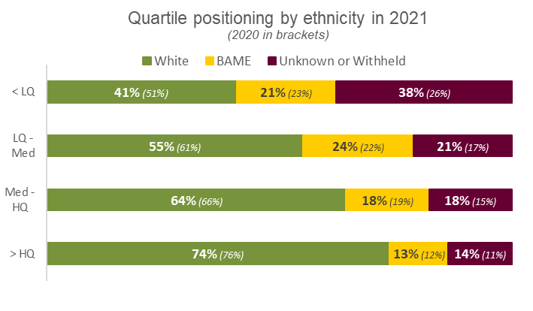
Ethnicity pay gap analysis
In terms of the quartile positioning the main differential between 2020 and 2021 is a 2% increase in the proportion of BAME staff paid between the lower quartile and median. This is the reason that the pay gaps have not reduced .
Across UCL the proportion of BAME staff is above UK averages but lower than the averages in London. We will continue to try and address this through our positive action schemes.
The proportion of BAME staff in the high quartile has increased by 1%, conversely the proportion of BAME staff in the median to high quartile has decreased by 1%. This may signify that more BAME staff are moving from G8 to G9, via various initiatives.

Slide 11
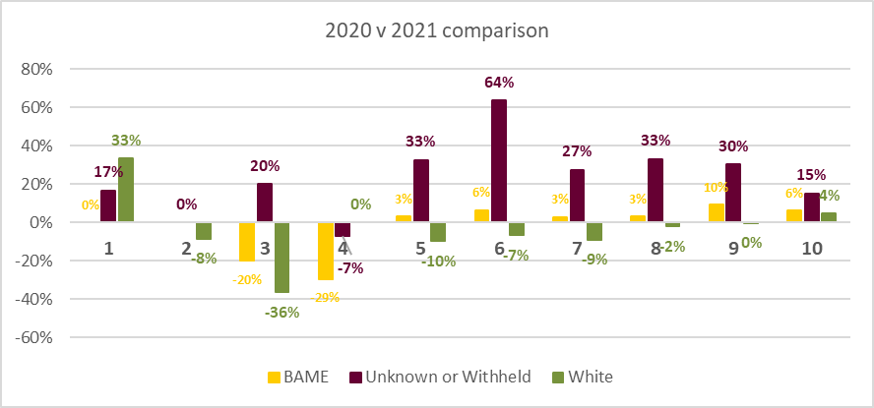
Ethnicity pay gap analysis % increase/decrease in population by grade
The table shows the change in proportion of staff at each grade.
Encouragingly we can see the population of BAME staff within grades above median (G8-G10) has increased more than the proportion of white staff in the same grades.
However below the median at G7 the population of BAME has increased while the proportion white staff has decreased.
At G6 this is more pronounced with the population of BAME staff increasing by 6% but the population of white staff in the same grade reducing by 7%.
The ethnicity pay gap is calculated by considering the differences between the pay of BAME and white staff only. However, this year the proportion of staff with an ‘unknown’ ethnicity has increased dramatically and this has caused issues with data reliability. Depending on the proportion of unknown staff who are white or BAME the gap would shrink or widen.

Slide 12
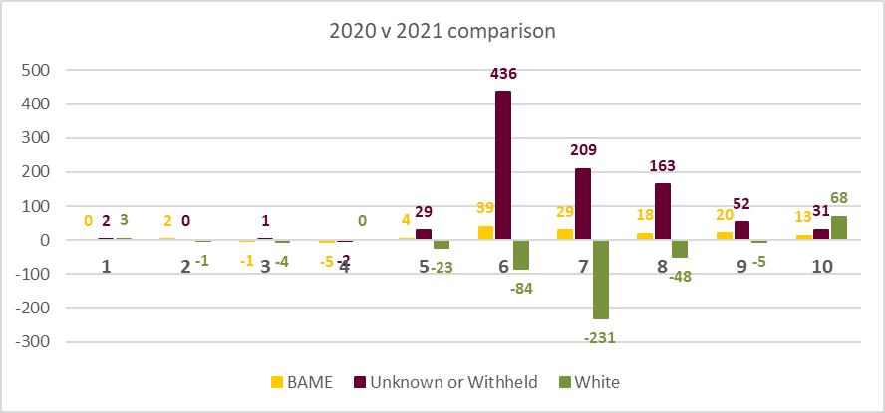
Ethnicity pay gap number increase/decrease in population by grade
The graph replicate the last one but focused on numbers rather than percentages. There is a substantial decrease in white staff at G6 (84) and G7 (231) who are paid below the median which has resulted in the median salary for white staff rising.
There is a large increase in unknown staff who are not included in the ethnicity pay calculation- which is focused on the salary average of BAME staff vs white staff.
It is positive that both the proportion and number of BAME staff has increased at all the grades above median salary (G8-10). In isolation this would have narrowed both the mean and median pay gaps. However, the marginal rise in numbers of BAME staff at G6 and G7 in conjunction with the substantial reduction in white staff at the same grades more than offsets this increased diversity at G8 upwards and results in the overall gap. As with gender the majority of these roles at G6 are PGTAs.
Aside from these changes we are seeing larger proportions of female and/or BAME researchers at G6 and G7. Ensuring early career promotion is undertaken systematically is important to the development and progression of our researchers.

Slide 13
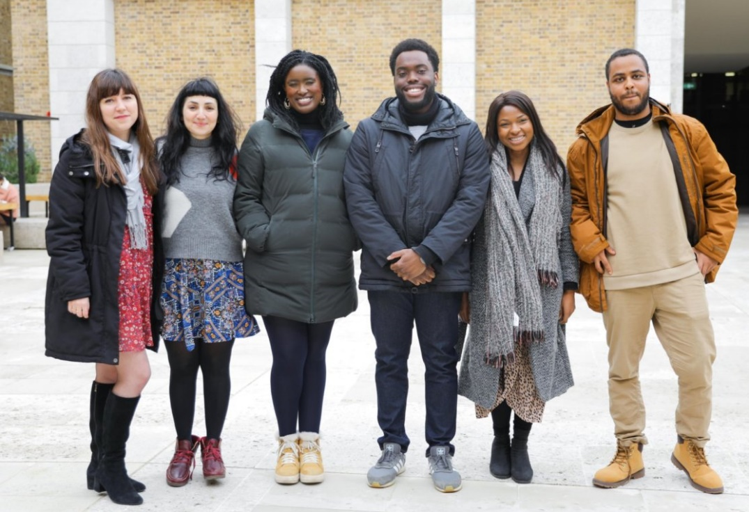
Actions
Expand the ‘Accelerate to Leadership’ positive action secondment scheme to G8 which will have the most significant effect on UCL’s median pay gap- as this would move BAME staff from G7 (below median) to G8 (above median).
Reduce the number of employee records where ethnicity is unknown as soon as possible. If an employee wishes to withhold this data they should be marked ‘withheld’. In addition staff will be able to update their equalities details using an app, which will make the process more straightforward and should drive increased returns. This may result in a marked (positive or negative) difference in UCL’s ethnicity pay gap.
Continue to embed the revised senior academic promotions framework which has increased the proportion of female staff in G9 and G10 on a year on year basis. Continue to supply Deans with information on the gender and ethnicity of promotion applicants prior to committee meetings. We also plan to review the promotions process from a disability inclusion perspective.
Ensure early career researchers are supported and developed so that they have the opportunity to be considered for promotion from G6 (Research Assistant) to G7 (Research Fellow) and from G7 to G8 (Senior Research Fellow). HR to provide Faculties with data of researchers at these two grades (including EDI statistics) and ensure all are considered for promotion on merit.
Produce Faculty splits of the data in this report to compare year on year trends in Faculty from the baseline Faculty reports of 2020 data. Work with Faculty leadership teams on action plans to reduce any gaps within the areas.
Continue to ensure that the pandemic is taken into account when making decisions about rewards, such as the adaptation already made to the academic promotions process to counter any gendered impact from covid 19 crisis.
Additional specific initiatives to address the gaps are included in the Athena SWAN and Race Equality Charter and also the Race Equality Implementation Group action plans.

